Slide 1
Integrative physiology
Hemodynamics
Volume balance
osmotic balance
Oxygen transport
ionic balance
Acid-Base homeostasis

Slide 2
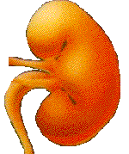
External environment of organism
CO₂
H⁺
GIT
Lungs
„exchangers“
Kidney
plasma
blood cells
intravascular
Lymph
(part of ICF)
fluid
Circulation
capillaries
extracellular fluid -ECF
„mixing“
interstitial fluid - ISF
transcellular fluid
intracellular fluid - ICF
ACID-BASE
BALANCE
Metabolism
https://bodylight.physiome.cz/Bodylight-Scenarios/bloodgases-p1/#bloodymaryO2CO2.md

Slide 3

Practically complete reabsorbtion of HCO₃⁻
Acid-Base Balance
H⁺ excretion
60 mmol/24 h
CO₂
HCO₃⁻
H₂CO₃
TA+NH₄⁺
H₂O
H⁺
A⁻
20 000 mmol/24 hod
60 mmol/24 hod
Metabolic production of CO₂
Metabolic production od strong acids

Slide 4
Buffering systems of the blood
CO₂
+
H₂O
H₂CO₃
H⁺
+
HCO₃⁻
H⁺
+
Buf⁻
HBuf
H⁺
+
Hb⁻
HHb
H⁺
+
Alb⁻
HAlb
H⁺
+
HPO₄²⁻
H₂PO₄⁻
non-bicarbonate buffers
Buf = Hb + Alb + PO₄⁻

Slide 5
Buffering reactions
CO₂
HCO₃⁻
H₂CO₃
H₂O
H⁺
HBuf
Buf⁻

Slide 6
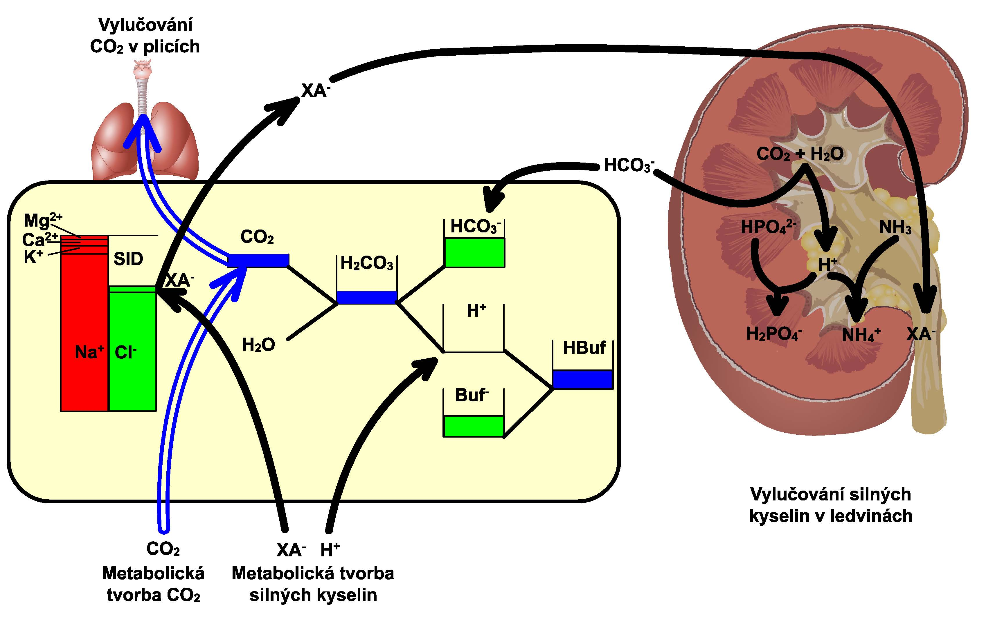

Slide 7
Acid-Base Balance
Acid Balance
Base Balance
Production of H⁺
Production of HCO₃⁻
Diet -> 2H⁺+SO₄²⁻
Diet ->H⁺ + HPO₄⁻
Diet -> 3K⁺+ 3 HCO₃⁻
Removal of H⁺
Removal of HCO₃⁻
2H⁺+2HCO₃⁻ -> 2CO₂+2H₂O
Glucose -> 3H⁺+Citrate⁻
Add „new“ HCO₃⁻
Excrete organic anions
2NH₄⁺+SO₄⁻
H₂PO₄²⁻
3K⁺+Citrate⁻
Urine

Slide 8
H⁺ formation/removal
Reactions that yields H⁺ (more negative charge in products than in substrates)
Glucose -> Lactate⁻ + H⁺
C₁₆ fatty acids -> 4 ketoacids anions⁻ + 4 H⁺
Cysteine -> urea + CO₂+H₂O+SO₄²⁻ + 2 H⁺
Lysine⁺ -> urea + CO₂ + H⁺
Reactions that removes H⁺ (more net positive charge in products than in substrates)
Lactate⁻ + H⁺ -> Glucose
Glutamate⁻ + H⁺ -> urea + CO₂+H₂O
Citrate⁻ + 3 H⁺ -> CO₂+H₂O
H⁺ are neither produced nor removed (neutrals to neutrals)
Glucose -> Glycogen or + CO₂+H₂O
Triglyceride -> CO₂+H₂O
Alanine -> urea + glucose or CO₂+H₂O

Slide 9
Diet
ECF
2 H⁺
2CO₂+2H₂O
Sulfur-AA
2 HCO₃⁻
SO₄²⁻
urine
Glutamine
SO₄²⁻
2NH₄⁺
2NH₄⁺
kidney
Diet
ECF
H⁺
CO₂+H₂O
HCO₃⁻
RNA-P⁻
HPO₄²⁻
urine
CO₂+H₂O
HPO₄⁻
H⁺
kidney

Slide 10
liver
Diet
OA utilisation
Glucose
OA⁻
H⁺
HCO₃⁻
H⁺
OA⁻
ECF
K⁺
CO₂+H₂O
CO₂+H₂O
K⁺
OA⁻
OA⁻
kidney
urine

Slide 11
Acid-base regulation
CO₂
-
HCO₃
TA + NH₄⁺
H₂CO₃
CO₂ balance
H₂O
H⁺
Buffer systems (msec)
Respiration control (12 hours)
Kidney control (3-5 days)
H⁺ balance
HBuf
Buf ⁻
Exchange H⁺/K⁺ H⁺/Na⁺ between cells and ECF
Role of liver in AB regulation

Slide 12
Acid-base disturbances:
CO₂
-
HCO₃
TA + NH₄⁺
H₂CO₃
CO₂ balance
H₂O
H⁺
H⁺ balance
HBuf
Buffer system acid-base disturbances
Balance acid-base disturbances:
Buf ⁻
- metabolic acidosis/alkalosis
- respiration acidosis/alkalosis

Slide 13
CO₂
-
HCO₃
TA + NH₄⁺
H₂CO₃
CO₂ balance
H₂O
H⁺
H⁺ balance
HBuf
Buffers system acid-base disturbances:
  Dilutional acidemia
  Contractional alkalemia
  Hypoproteinemic alkalemia
Buf ⁻

Slide 14
Integrative physiology
Hemodynamics
Volume balance
osmotic balance
Oxygen transport
ionic balance
Acid-Base homeostasis

Slide 15
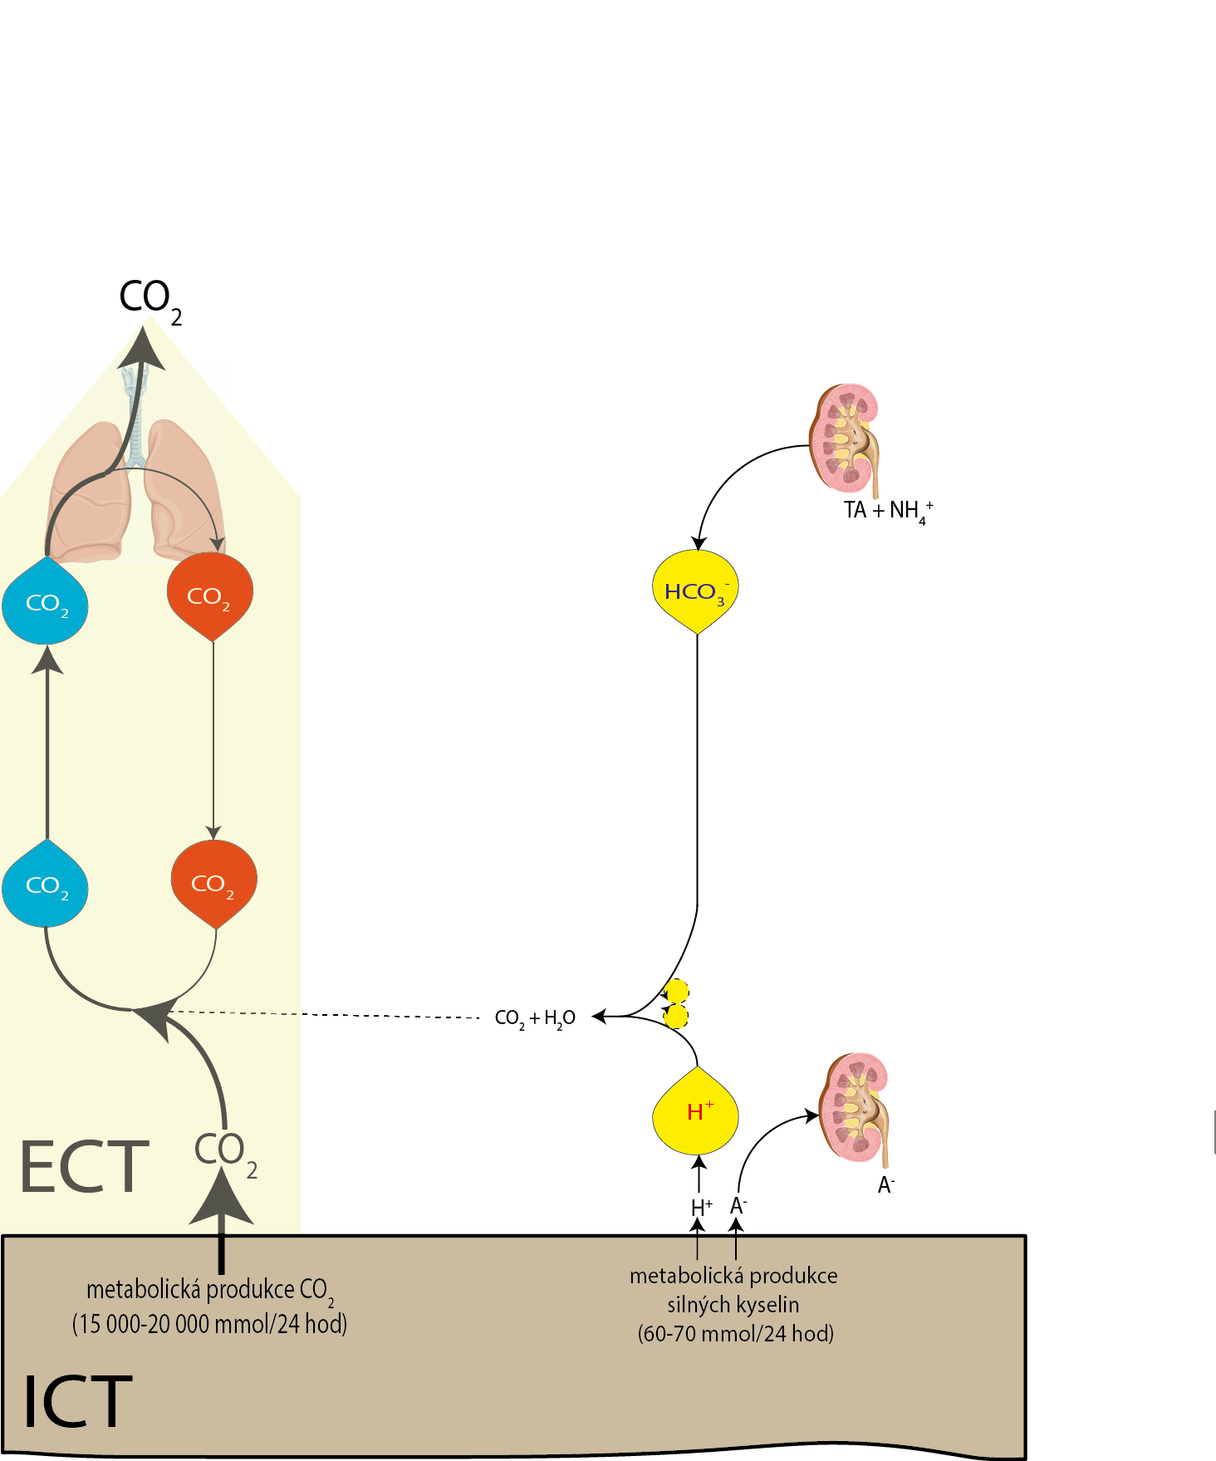
Alveolar ventilaton
Alveolar ventilaton
paCO2
CvCO2 = CaCO2+VCO2/Q
CaCO2
Perfusion - Q
(Cardiac output)
By Fick law:
VCO2 = Q (CvCO2 - CaCO2)
VCO2 - CO₂ metabolic production
(15 000-20 000 mmol/24 h
Strong acids metabolic production
(60-70 mmol/24 h

Slide 16
Alveolar ventilaton
Hypercapnic acidosis in tissues – pCO2
CvCO2 = CaCO2+VCO2/Q
Hypoperfusion – Q
Perfusion - Q
(Cardiac output)
By Fick law:
VCO2 = Q (CvCO2 - CaCO2)

Slide 17
Integrative physiology
Hemodynamics
Volume balance
osmotic balance
Oxygen transport
ionic balance
Acid-Base homeostasis

Slide 18
Dilution
CO₂
-
HCO₃
TA + NH₄⁺
H₂CO₃
CO₂ balance
H₂O
H⁺
H⁺ balance
HBuf
Buffers system acid-base disturbances:
  Dilutional acidemia
Buf ⁻

Slide 19
Dilution
CO₂
equilibrium shift
-
HCO₃
TA + NH₄⁺
H₂CO₃
CO₂ balance
H₂O
H⁺
H⁺ balance
HBuf
Buffers system acid-base disturbances:
  Dilutional acidemia
Buf ⁻

Slide 20
Hemoconcentration
CO₂
-
HCO₃
TA + NH₄⁺
H₂CO₃
CO₂ balance
H₂O
H⁺
H⁺ balance
HBuf
Buffers system acid-base disturbances:
  Contractional alkalemia
Buf ⁻

Slide 21
Hemoconcentration
CO₂
-
HCO₃
TA + NH₄⁺
H₂CO₃
CO₂ balance
H₂O
H⁺
H⁺ balance
HBuf
Buffers system acid-base disturbances:
  Contractional alkalemia
Buf ⁻

Slide 22
Hemoconcentration
CO₂
-
HCO₃
equilibrium shift
TA + NH₄⁺
H₂CO₃
CO₂ balance
H₂O
H⁺
H⁺ balance
HBuf
Buffers system acid-base disturbances:
  Contractional alkalemia
Buf ⁻

Slide 23
Integrative physiology
Hemodynamics
Volume balance
osmotic balance
Oxygen transport
ionic balance
Acid-Base homeostasis

Slide 24
Acute hypoproteinemia
CO₂
-
HCO₃
TA + NH₄⁺
H₂CO₃
CO₂ balance
H₂O
H⁺
H⁺ balance
HBuf
Buffers system acid-base disturbances:
Hypoproteinemic alkalemia
Buf ⁻

Slide 25
Patogenesis of acute hypoproteinemic alkalosis
Liver – albumine production
Alb ⁻
H⁺
Endotel, liver – albumine degradation

Slide 26
Patogenesis of acute hypoproteinemic alkalosis
Liver – albumine production
H₂O +
CO₂
Alb ⁻
H⁺
HCO₃⁻
HCO₃⁻
-d[Alb⁻] = d[HCO₃⁻]
Endotel, liver – albumine degradation
no changed value of SID

Slide 27
production
Acute hypoproteinemia
CO₂
+H₂O
Alb ⁻
H⁺
HCO₃⁻
CO₂
-
HCO₃
degradation
TA + NH₄⁺
H₂CO₃
CO₂ balance
H₂O
H⁺
-d[Alb⁻] = d[HCO₃⁻]
no changed value of SID
H⁺ balance
HBuf
Balance disorders:
Hypoproteinemic alkalosis
Buf ⁻

Slide 28
Integrative physiology
Hemodynamics
Volume balance
osmotic balance
Oxygen transport
ionic balance
Acid-Base homeostasis

Slide 29
Acid-base disturbances:
CO₂
-
HCO₃
TA + NH₄⁺
H₂CO₃
CO₂ balance
H₂O
H⁺
H⁺ balance
HBuf
Buffer system acid-base disturbances
Balance acid-base disturbances:
Buf ⁻
- metabolic acidosis/alkalosis
- respiration acidosis/alkalosis

Slide 30
PCO₂ torr
90
pH=7,1
pH=7,2
pH=7,3
pH=7,37
pH=7,43
80
pH=7,5
Sustained respiratory acidosis
70
Acute respiratory acidosis
pH=7,6
60
Sustained metabolic alkalosis
50
40
Acute metabolic acidosis
Akute metabolic alkalosis
30
Sustained metabolic acidosis
Acute
respiratory acidosi
Sustained respiratory alkalosis
20
10
-25
-20
-15
-10
-5
0
5
10
15
20
25
30
Base Excess mmol/l

Slide 31
Bicarbonate reabsorbtion
(2) Disorder of H⁺ excretion
(4) diarhoea
H⁺excretion
CO₂
HCO₃⁻
(3) losses of
HCO₃⁻
H₂CO₃
TA+NH₄
⁺
H⁺ retention
H⁺ depletion
H₂O
H⁺
HBuf
A⁻
Buf ⁻
(1) Increased metabolic production of strong acids

Slide 32
Metabolic acidosis with:
increased anion gap
normal anion gap
Gastrointestinal losses of bicarbonate
NH₃
A⁻
HCO₃⁻
H⁺
Cl⁻
H⁺
Accumulation of anions of strong acids
(laktate acidosis
ketoacidosis
uremic acidosis)
Cl⁻
NH₄⁺
Cl⁻
Urea
Overdosis of NH₄Cl
K⁺
Anion gap
Normal anion
gap
Na⁺
Na⁺
Na⁺
Increased
anion
gap
Na⁺
In urine:
[K⁺]+[Na⁺]-[Cl⁻] < 0
HCO₃⁻
HCO₃⁻
HCO₃⁻
Cl⁻
Relative accumulation of chlorides
Cl⁻
Cl⁻
Cl⁻
NH₃
HCO₃⁻
HCO₃⁻
H⁺
Decreased acidification
(tubular acidosis, hypoaldosteronisms,
decreases glomer. filtration)
HCO₃⁻
Cl⁻
NH₄⁺
K⁺
Cl⁻
Na⁺
in urine:
[K⁺]+[Na⁺]-[Cl⁻] >= 0

Slide 33
Diarrhoea

Slide 34
Cl⁻
Na⁺
H⁺
H₂0 + CO₂
HCO₃⁻
H₂O
H₂O
NHE
AE
Colon
H⁺
Na⁺
Cl⁻
HCO₃⁻
H₂0 + CO₂
HCO₃⁻
Na⁺
Cl⁻
HCO₃⁻
H₂O

Slide 35
Cl⁻
H⁺
H₂0 + CO₂
HCO₃⁻
HCO₃⁻
Na⁺
Na⁺
H₂O
H₂O
H₂O
AE
NHE
Colon
H⁺
Na⁺
Cl⁻
HCO₃⁻
H₂0 + CO₂
HCO₃⁻
Hypotonic fluid loss
Na⁺
Cl⁻
HCO₃⁻
H₂O
Cl⁻
Hypertonic dehydratation
Alkalic diarrhoea
HCO₃⁻
Hyperchloremic acidosis

Slide 36
Cl⁻
Cl⁻
H⁺
H₂0 + CO₂
HCO₃⁻
HCO₃⁻
Na⁺
Na⁺
H₂O
H₂O
H₂O
AE
NHE
Colon
K⁺
Potassium loss
H⁺
Na⁺
Cl⁻
HCO₃⁻
H₂0 + CO₂
HCO₃⁻
Hypotonic fluid loss
Na⁺
Cl⁻
HCO₃⁻
H₂O
Cl⁻
Hypertonic dehydratation
Severe alkalic diarrhoea
HCO₃⁻
Hyperchloremic acidosis

Slide 37
Histidine
Cl⁻
H.Histidine⁺
Cl⁻
H⁺
H₂0 + CO₂
HCO₃⁻
Na⁺
Na⁺
H₂O
H₂O
H₂O
NHE
Colon
AE
H⁺
Na⁺
Cl⁻
HCO₃⁻
H₂0 + CO₂
HCO₃⁻
Hypotonic fluid loss
Na⁺
Cl⁻
HCO₃⁻
H₂O
HCO₃⁻
Hypertonic dehydratation
Acidic diarrhoea in DRA, down-regulated adenoma
Cl⁻
Hypochloremic alkalosis

Slide 38
Anion gap
Cl⁻
Na⁺
HCO₃⁻
HCO₃⁻
Complete reabsorbtion
norm
H⁺
Cl⁻
norm
Normal acidification
proximal tubular renal acidosis
Cl⁻
NH₄⁺
Rate of bicarbonate reabsorbtion
NH₄⁺
Cl⁻
c
b
a
K⁺
Normal urine
anion
gap
Na⁺
In urine:
[K⁺]+[Na⁺]-[Cl⁻] < 0
10
15
20
25
Plasma level of HCO₃⁻
Cl⁻
NH₃
Hyperchloremic acidosis with normal anion gap
Cl⁻
HCO₃⁻
HCO₃⁻
normal
anion gap
H⁺
Na⁺
HCO₃⁻
Cl⁻
Decreased acidification
(tubular acidosis, hypoaldosteronisms,
decreases glomer. filtration)
HCO₃⁻
Cl⁻
NH₄⁺
K⁺
Positive urine
anion
gap
Cl⁻
c
b
a
norm
Na⁺
In urine:
[K⁺]+[Na⁺]-[Cl⁻] > 0
pH=5,5
pH=6,5
pH=7,8
pH=5,5

Slide 39
Metabolic alkalosis
Bicarbonate reabsorbtion
Overdosis HCO₃⁻ infusion
H⁺excretion
CO₂
HCO₃⁻
H₂CO₃
TA+NH₄
⁺
Retence H⁺
Retence H
H₂O
H⁺
HBuf
A⁻
hyperaldosteronism
katabolism
Buf ⁻
(7) K⁺
depletion
(6) vomiting
H⁺
K⁺

Slide 40
PCO₂ torr
90
pH=7,1
pH=7,2
pH=7,3
pH=7,37
pH=7,43
80
pH=7,5
Sustained respiratory acidosis
70
Acute respiratory acidosis
pH=7,6
60
Sustained metabolic alkalosis
50
40
Acute metabolic acidosis
Akute metabolic alkalosis
30
Sustained metabolic acidosis
Acute
respiratory acidosi
Sustained respiratory alkalosis
20
10
-25
-20
-15
-10
-5
0
5
10
15
20
25
30
Base Excess mmol/l

Slide 41
Vomiting

Slide 42
Normal state
HCO₃⁻
Stomach
CO₂
H⁺
Cl⁻
Balanced
CO₂
H₂O
H₂O
Cl⁻
No acid-base changes
H⁺
Cl⁻
HCO₃⁻
H⁺
CO₂
H₂O
Duodenum and pancreas

Slide 43
Chloride loss
H⁺
loss
Hypertonic dehydratation
Vomitoing
Cl⁻
H⁺
Hypotonic fluid loss
HCO₃⁻
retention
HCO₃⁻
HCO₃⁻
Stomach
CO₂
H⁺
Cl⁻
Unbalanced
CO₂
H₂O
H₂O
Cl⁻
Hypochloremic alkalosis
H⁺
Cl⁻
HCO₃⁻
H⁺
CO₂
H₂O
Duodenum and pancreas

Slide 44
Glomerular filtraton (norm)
Primary cause: Losses of Cl⁻ a H⁺ by vomiting
Na⁺
Glomerulal filtration (hypochloremic alkalosis)
Na⁺
Cl⁻
Depletion of chlorides
Cl⁻
Cl⁻
Readsorbtion of sodium and chlorides
H⁺
Na+/Cl- reabsorbtion is diminished
Metabolic alkalosis
Na⁺
Na⁺
H⁺
H⁺
Cl⁻
Cl⁻
K⁺
K⁺
Remnant of sodium is exchanged with and H⁺
Increased exchange Na+ with K+ and Na+ with H+
Intracellular fluid
K⁺
Potassium depletion
K⁺
Na⁺
Na⁺
H⁺
H⁺
Excretion of potassium increases,
acidification of urine regardless of alkalosis
K⁺
K⁺
H⁺
H⁺
K⁺
Paradoxal urine acidification
Increases lossse ofn
H⁺
NH₄⁺
Notes:
obr. 13.42 Patogeneze vzniku paradoxní acidifikace moči a deplece draslíku po ztrátách chloridů při těžkém zvracení.

Slide 45
PCO₂ torr
90
pH=7,1
pH=7,2
pH=7,3
pH=7,37
pH=7,43
80
pH=7,5
Sustained respiratory acidosis
70
Acute respiratory acidosis
pH=7,6
60
Sustained metabolic alkalosis
50
40
Acute metabolic acidosis
Akute metabolic alkalosis
30
Sustained metabolic acidosis
Acute
respiratory acidosi
Sustained respiratory alkalosis
20
10
-25
-20
-15
-10
-5
0
5
10
15
20
25
30
Base Excess mmol/l

Slide 46
PCO₂ torr
90
pH=7,1
pH=7,2
pH=7,3
pH=7,37
pH=7,43
80
pH=7,5
Sustained respiratory acidosis
70
Acute respiratory acidosis
pH=7,6
60
Sustained metabolic alkalosis
50
40
Acute metabolic acidosis
Akute metabolic alkalosis
30
Sustained metabolic acidosis
Acute
respiratory acidosi
Sustained respiratory alkalosis
20
10
-25
-20
-15
-10
-5
0
5
10
15
20
25
30
Base Excess mmol/l

Slide 47
Arterial blood at pH=7,4
Concentration of O₂
Oxygen released
due drop
PO₂
Oxygen released due
to shift
of dissotiacion curve
(Bohr effect)
Venose blood at pH=7,2
PO₂
PvO₂
PaO₂
Notes:
obr. 13.35 Význam Bohrova efektu pro uvolňování kyslíku z krve do tkání. Na tkáňovém konci kapilár vlivem přesunu oxidu uhličitého z tkání do krve klesá pH. Disociační křivka hemoglobinu se posouvá doprava. To umožňuje při stejné tenzi kyslíku uvolnit z krve do tkání další množství kyslíku.

Slide 48
Arterial blood at pH=7,4
(normal conditions)
Arterial blood
at pH=7,6
(alkalemia)
Release of oxygen
at respiratory alkalosis
Concentration of O₂
Release of oxygen
at normal condition
Venous blood
at pH=7,36
(alkalemia)
Venous blood at pH=7,2
(normal conditions)
Decrease of
oxygen delivery
to tissues at
acute
respiratory alkalosis
PO₂
PvO₂
normal PaO₂
High PaO₂ during hyperventilation at respiratory alkalosis

Slide 49
Mixed acid-base disturbances - examples
PCO₂ torr
90
pH=7,1
pH=7,2
pH=7,3
pH=7,37
pH=7,43
80
pH=7,5
Sustained respiratory acidosis
70
Acute respiratory acidosis
pH=7,6
Metabolic acidosis
+ respiratory acidosis
60
Sustained metabolic alkalosis
50
40
Acute metabolic acidosis
Akute metabolic alkalosis
30
Sustained metabolic acidosis
Acute
respiratory acidosi
Sustained respiratory alkalosis
20
Diarrhoea -> metabolic acidosis
+ vomiting -> metabolic alkalosis
+ catabolism, ->lactate metabolic acidosis
10
Metabolic acidosis
+ respiratory alkalosis
-25
-20
-15
-10
-5
0
5
10
15
20
25
30
Base Excess mmol/l

Slide 50
Potassium, Acid-Base and volume

Slide 51
K⁺mmol/l
8
7
H⁺
H⁺
6
K⁺
Normal kalemia range
B
K⁺
5
4
A
C
3
2
D
1
A: Norm
6,9
7,0
7,1
7,2
7,3
7,4
7,5
7,6
7,7
7,8
pH
H⁺
H⁺
H⁺
H⁺
H⁺
H⁺
K⁺
K⁺
K⁺
K⁺
K⁺
K⁺
D:
Rapid alkalinization - H⁺/K⁺ - dangerous hypokalemia
K⁺
K⁺
B: Acidemia - exchange K⁺ / H⁺
C: long lasting acidemia - K⁺ depletion
K⁺

Slide 52
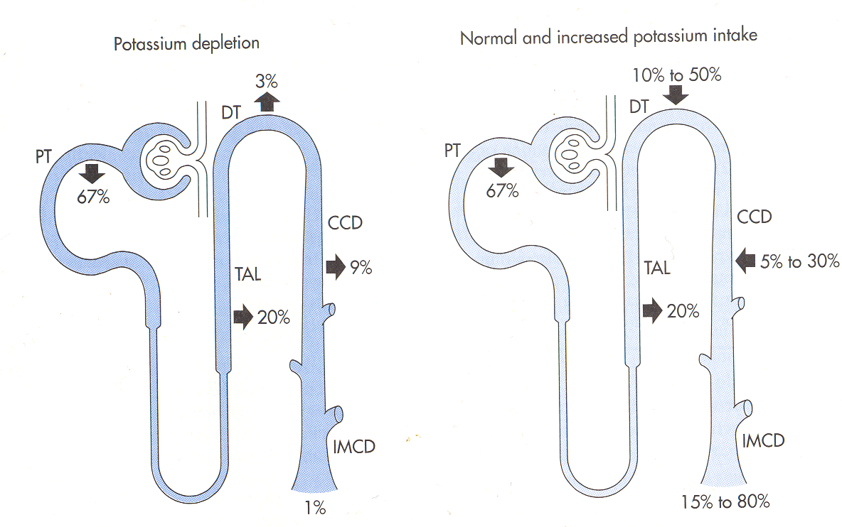
K⁺
Normal or increased intake of potassium
Potassium depletion
From 10% to 50%
from 5% to 30%

Slide 53
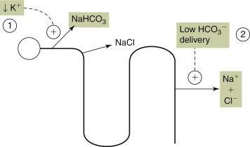
Intracellular acidosis in proximal tubule
Effect of hypokalemia on ECF volume
K⁺
H⁺
H⁺
Enhanced resorption HCO₃⁻
Enhanced resorption Cl⁻
Enhanced resorption Cl⁻

Slide 54
Potassium depletion
Large delivery of sodium in CCD
(e.g. in osmotic diuresis)
Low chloride in CCS
Catabolism
Long lasting acidemia
Hypealdosteronism
Diuretics (Furosemid)
K⁺
K⁺

Slide 55
Potassium retention
Oliguric phase of acute renal failure
Tubular damage
(e.g. interstitial nephritis, diabetic nephropathy)
Hypoaldosteronism
(m. Addisoni)
K⁺
K⁺

Slide 56

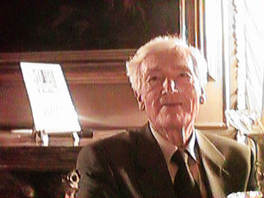
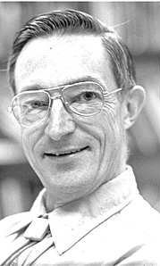
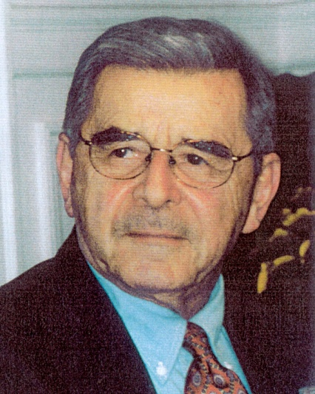
ACID-BASE BALANCE
Danish School of acid-base balance
?
"Modern" approach to acid-base balance by Stewart and Fencl
Notes:
Siggaard-Andersen contra Stewart-Fencl

Slide 57
Classical approach of "Danish School"
Problem:
How to measure PCO₂?

Slide 58
Measurement of Acid-Base parameters
pH, pCO2, [HCO₃⁻]
CO₂
HCO₃⁻
H₂CO₃
H₂O
H⁺
HBuf
Buf⁻

Slide 59
Measurement of Acid-Base parameters
pH, pCO2, [HCO₃⁻]
CO₂
HCO₃⁻
H₂CO₃
H₂O
H⁺
HBuf
Buf⁻

Slide 60
Measurement of Acid-Base parameters
pH, pCO2, [HCO₃⁻]
Alkaline reserve
CO₂
HCO₃⁻
H₂CO₃
H₂O
H⁺
HBuf
Buf⁻

Slide 61
Measurement of Acid-Base parameters
P. Astrup 1956
pH, pCO2, [HCO₃⁻]
CO₂
HCO₃⁻
H₂CO₃
H₂O
H⁺
HBuf
Buf⁻

Slide 62
Equilibration method for pCO2 measurement by Astrup
log PCO
2
High level
pCO
2
in mixture
O
2
/CO
2
pCO2
in measered sample
Titration curve
Low level
pCO
2
In mixture
O
2
/CO
2
pH
pH after equilibration
pH
In blood sample
pH after equilibration
with high pCO
(before equilibration
2
í
with low pCO
2

Slide 63
Buffer Base (BB)
BB = [HCO₃⁻ ]+ [Buf ⁻ ]
CO₂
-
HCO₃
depends on cHb
H₂CO₃
H₂O
H⁺
Normal buffer base:
NBB=41.7+0.42*cHB [g/100ml]
HBuf
Buf ⁻
Base Excess:
BE=BB-NBB

Slide 64
CO₂
-
HCO₃
+ 1 mmol H⁺ added to 1 litre
of blood
H₂CO₃
H₂O
H⁺
HBuf
Buf ⁻

Slide 65
CO₂
-
HCO₃
+ 1 mmol H⁺ added to 1 litre
of blood
H₂CO₃
H₂O
H⁺
HBuf
1 mmol/l drop of [HCO₃⁻] + [Buf⁻]
Buf ⁻
BE=-1mmol/l

Slide 66
CO₂
-
HCO₃
+ 1 mmol OH⁻ added to 1 litre
of blood
H₂CO₃
H₂O
H⁺
HBuf
Buf ⁻

Slide 67
CO₂
-
HCO₃
+ 1 mmol OH⁻ added to 1 litre
of blood
H₂CO₃
H₂O
H⁺
HBuf
1 mmol/l increase of [HCO₃⁻] + [Buf⁻]
Buf ⁻
BE= 1mmol/l

Slide 68
log pCO2
Plasma and blood with different hematocrit
BE
curve
BE=0
40 torr
BE=-5
BE=5
BE=-10
7.4
pH

Slide 69
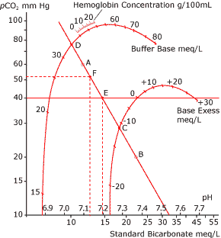
NBB=41,7 + 0,42 * cHB
Odečet BB
reading of BE

Slide 70
Buffer reactions
CO₂
+
H₂O
H₂CO₃
H⁺
+
HCO₃⁻
H⁺
+
Buf⁻
HBuf
H⁺
+
Hb⁻
HHb
H⁺
+
Alb⁻
HAlb
H⁺
+
HPO₄²⁻
H₂PO₄⁻

Slide 71
Buffer reactions
CO₂
+
H₂O
H₂CO₃
H⁺
+
HCO₃⁻
H⁺
+
Buf⁻
HBuf
H⁺
+
Hb⁻
HHb
H⁺
+
Alb⁻
HAlb
H⁺
+
HPO₄²⁻
H₂PO₄⁻
Nebikarbonátové pufry
Buf = Hb + Alb + PO₄⁻

Slide 72
Buffer reactions
CO₂
HCO₃⁻
H₂CO₃
H₂O
H⁺
HBuf
Buf⁻

Slide 73
Siggaard-Andersen
BB=[HCO₃⁻] +[Buf⁻] = const
CO₂
HCO₃⁻
H₂CO₃
Siggaard-Andersen
H₂O
H⁺
HBuf
Buf⁻

Slide 74
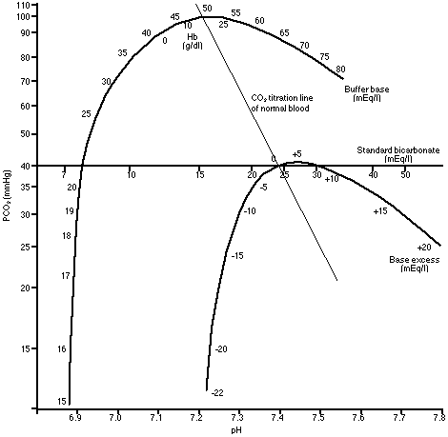
BE=0 mEq/l
BE=-15 mEq/l

Slide 75
Siggaard-Andersen (1960-1962)
Definition (for blood in vitro)
- Buffer Base: [BB]=[HCO₃⁻]+[Buf⁻] (independent on pCO₂)
Normal Buffer Base: [NBB]
[BB] při pH=7.4 při pCO=40 torr at givenHb
(SA nomogram - at normal albumins, phophates)
Base Excess: [BE]=[BB]-[NBB]
Definition only for standard conditions
not included hypo/hyperalbuminemia
hyper/hypophosphatemia
SA nomogram initialy was defined at 38°C

Slide 76
Siggaard-Andersen (1974-1995)
Definition (for blood in vitro)
- Buffer Base: [BB]=[HCO₃⁻]+[Buf⁻] (independent on pCO₂)
Normal Buffer Base: [NBB]
[BB] při pH=7.4 při pCO=40 torr at givenHb
(SA nomogram - at normal albumins, phophates)
Base Excess: [BE]=[BB]-[NBB]
Definition NBB dependent on Hb, albumin and phosphates
Notes:
76

Slide 77
Problems of Danish school
Problems: In patients with acute disturbances of nonbikarbonate buffers :
e.g. altered plasma concentrations
( if the original SA nomogram is used)

Slide 78
Stewart theory (1983)
Ca⁺ Mg⁺
K⁺
[H⁺] [OH⁻] = K'_{w}
[Buf⁻]+[HBuf] = [Buf_{TOT}]
[Buf⁻] [H⁺] = K_{Buf} [HBuf]
[H⁺] [HCO₃⁻] = M × pCO₂
[H⁺] [CO₃²⁻] = N × [HCO₃⁻]
SID+ [H⁺]– [HCO3⁻] –
[Buf⁻]– [CO₃²⁻]– [OH⁻] = 0
HCO₃⁻
Peter Stewart
SID
Buf⁻
Na⁺
XA⁻
Cl⁻

Slide 79
Stewart theory – solution of equations
[H⁺]⁴ + (SID + K_{BUF}) [H⁺]³ +
+(K_{BUF} (SID - [Buf_{TOT}])- K'_{w}-M×pCO₂)[H⁺]²
- (K_{BUF}(K'_{w}² + M × pCO₂)-N×M×pCO₂)[H⁺]
- K'_{w}×N×M×pCO₂ = 0
pH = f (pCO2, SID, Buf_{TOT})

Slide 80
Mathematical wizardry
Vladimír Fencl
dependency of variables = causality
pH = f (pCO2, SID, Buf_{TOT})

Slide 81
Stewart‘s „modern approach
Lungs
Ventilation
Perfusion
KREV
Independent variables
PCO₂
SID
[Buf_{TOT}]
Dependent variables
[HCO₃⁻]
[Buf⁻]
[CO₃²⁻]
[OH⁻]
[H⁺] (pH)
CO₂
Tissues
Perfusion
Metabolism
Transport
CO₂
STRONG IONS
KIDNEYS
Filtration
Resorption
Secretion
LIVER
Synthesis
Degradation
GIT
Absorbtion
Secretion
STRONG IONS
PROTEINS
STRONG IONS
Notes:
81

Slide 82
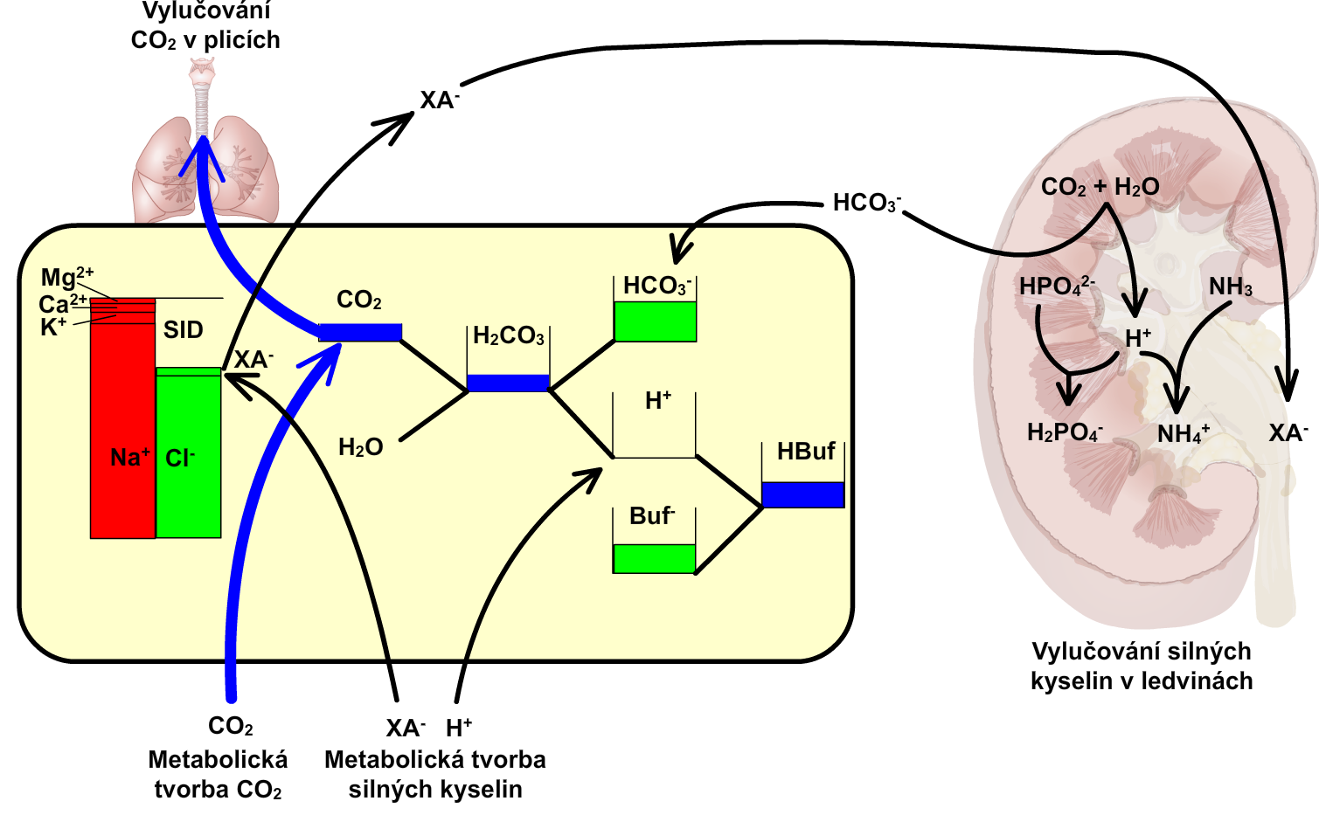
BALANCE THEORY
Excretion of CO₂ in the lungs
The excretion of strong acids in the kidney
CO₂ production
Metabolic production of strong acids

Slide 83
Integrative physiology
Hemodynamics
Volume balance
osmotic balance
Oxygen transport
ionic balance
Acid-Base homeostasis

Slide 84
Cardiac Output
Frank-Starling law
The heart is a pump driven by its inflow (or pressure on its input)
End diastolic pressere

Slide 85
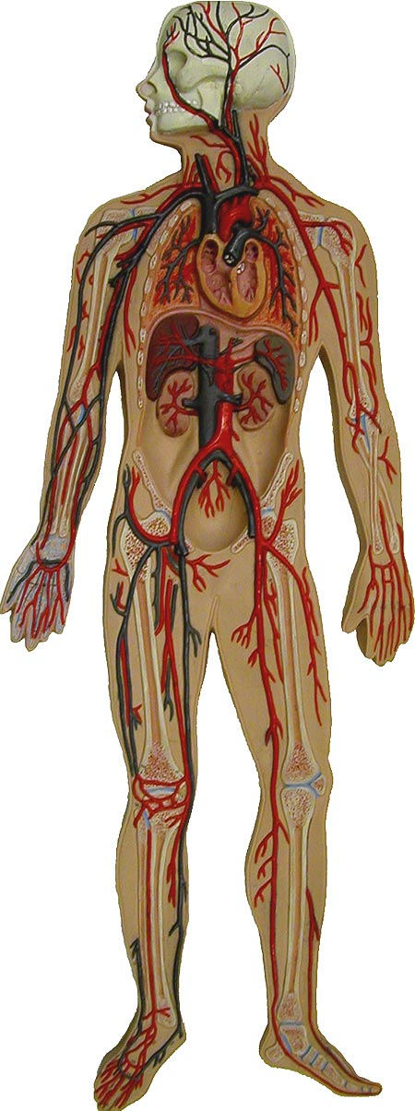
Basic properties of blood vessels

Slide 86
Inlet pressure
Flow
The heart is a pump driven by its inflow (or pressure on its input)

Slide 87
Elastic arteries
Inlet pressure
Flow
Elastic veins
The heart is a pump driven by its inflow (or pressure on its input)
Capillary and arteriolar resistances

Slide 88
Elastic arteries
Inlet pressure
Flow
Elastic veins
The heart is a pump driven by its inflow (or pressure on its input)
pressure
Capillary and arteriolar resistances
volume

Slide 89
Elastic arteries
Inlet pressure
Flow
Elastic veins
The heart is a pump driven by its inflow (or pressure on its input)
pressure
Capillary and arteriolar resistances
volume

Slide 90
Elastic arteries
Inlet pressure
Flow
Elastic veins
The heart is a pump driven by its inflow (or pressure on its input)
pressure
Capillary and arteriolar resistances
volume

Slide 91
Elastic arteries
Inlet pressure
Flow
Elastic veins
The heart is a pump driven by its inflow (or pressure on its input)
pressure
Capillary and arteriolar resistances
volume

Slide 92
Elastic arteries
Inlet pressure
Flow
Elastic veins
The heart is a pump driven by its inflow (or pressure on its input)
pressure
Capillary and arteriolar resistances
volume

Slide 93
Elastic arteries
Inlet pressure
Flow
Elastic veins
The heart is a pump driven by its inflow (or pressure on its input)
pressure
P
Capillary and arteriolar resistances
V
V₀
volume
compliance C=dV/dP

Slide 94
Elastic arteries
Inlet pressure
Flow
Elastic veins
The heart is a pump driven by its inflow (or pressure on its input)
pressure
P
Capillary and arteriolar resistances
V
V₀
V₀
volume
compliance C=dV/dP

Slide 95
Elastic arteries
Inlet pressure
Flow
Elastic veins
The heart is a pump driven by its inflow (or pressure on its input)
pressure
P
Capillary and arteriolar resistances
V
V₀
volume
compliance C=dV/dP

Slide 96
Elastic arteries
Inlet pressure
Flow
Elastic veins
The heart is a pump driven by its inflow (or pressure on its input
pressure
P
Capillary and arteriolar resistances
V
V₀
volume
compliance C=dV/dP

Slide 97
Elastic arteries
Inlet pressure
Flow
Elastic veins
The heart is a pump driven by its inflow (or pressure on its input)
pressure
P
Capillary and arteriolar resistances
V
V₀
volume
compliance C=dV/dP

Slide 98
Elastic arteries
Inlet pressure
Flow
Elastic veins
The heart is a pump driven by its inflow (or pressure on its input
pressure
P
C₁
Capillary and arteriolar resistances
C₂
V
V₀
volume
compliance C=dV/dP

Slide 99
Elastic arteries
Inlet pressure
Flow
Elastic veins
The heart is a pump driven by its inflow (or pressure on its input
pressure
P
C₁
<
Capillary and arteriolar resistances
C₂
dV₁
dV₂
dP
V
V₀
volume
dV₁/dP< dV₂/dP
compliance C=dV/dP

Slide 100
Elastic arteries
Inlet pressure
Flow
Elastic veins
The heart is a pump driven by its inflow (or pressure on its input
pressure
P
C₁
<
Capillary and arteriolar resistances
C₂
V
V₀
volume
dV₁/dP< dV₂/dP
compliance C=dV/dP

Slide 101
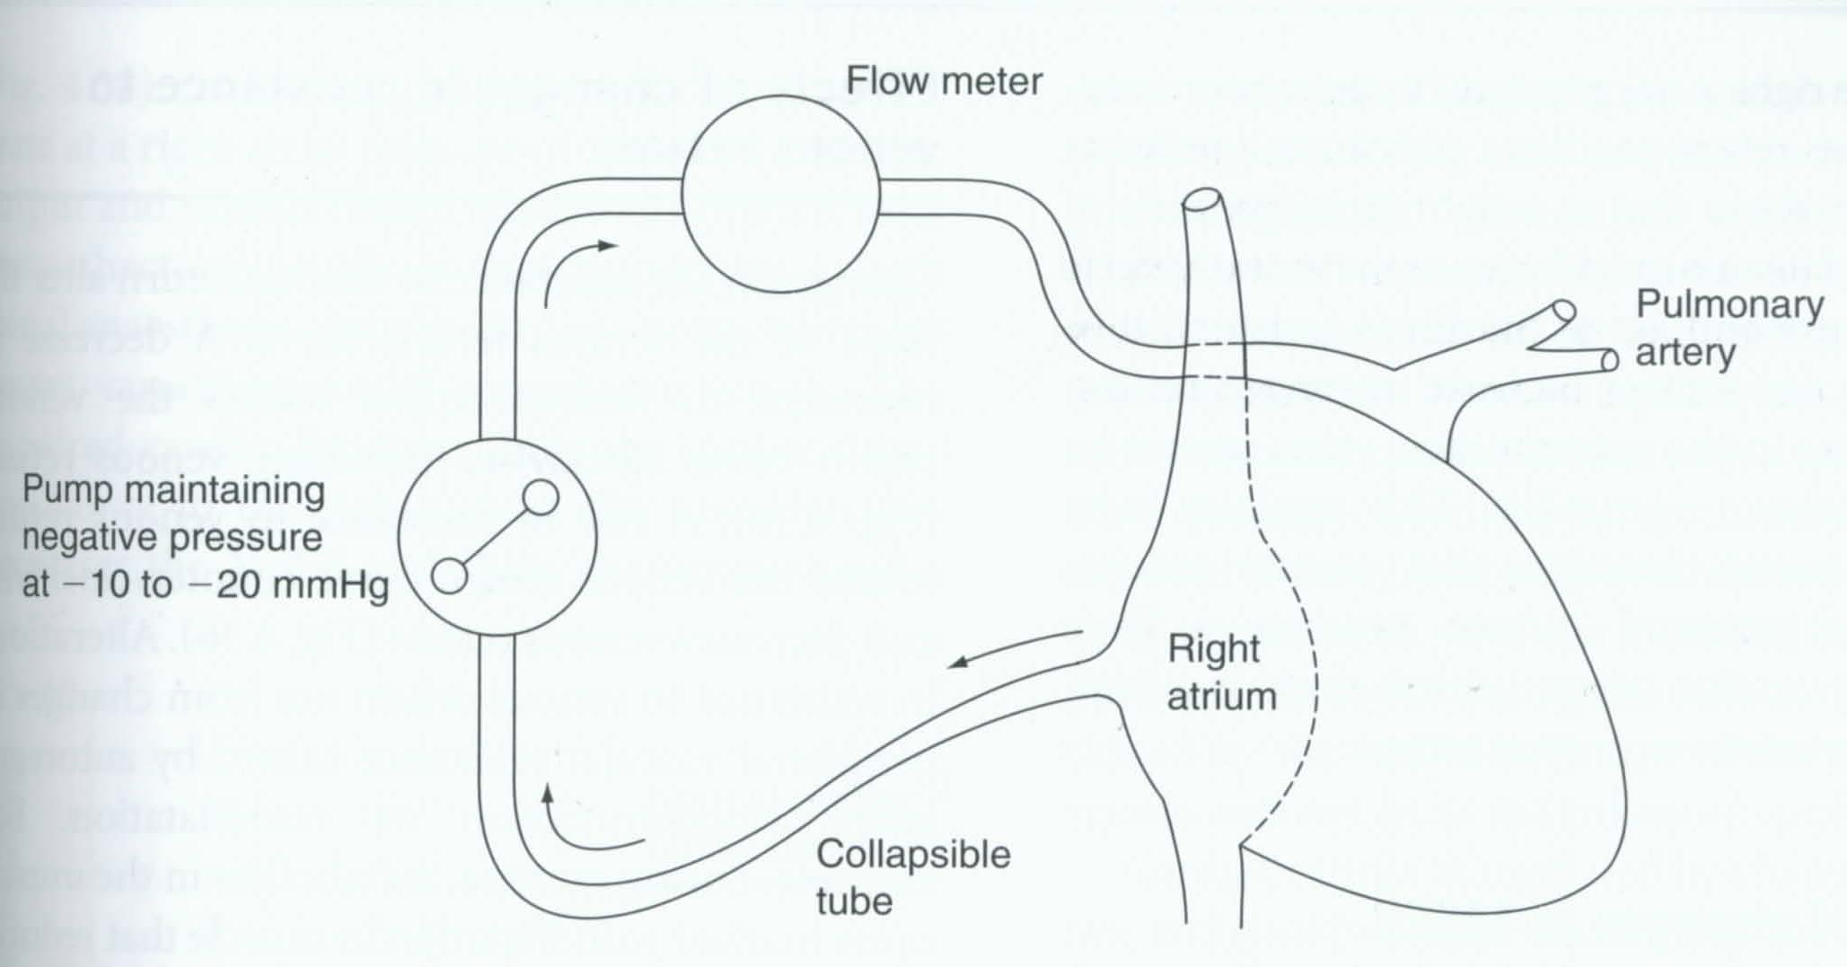
Guyton experiments
http://patf-biokyb.lf1.cuni.cz/~tribula/cirkulaceen/

Slide 102
Flow
Q
Elastic arteries
Elastic veins
P_{a}
The heart is a pump driven by its inflow (or pressure on its input
P_{v}
Capillary and arteriolar resistances

Slide 103
Flow
Q=0
Elastic arteries
Elastic veins
P_{a}
The heart is a pump driven by its inflow (or pressure on its input
P_{v}
Capillary and arteriolar resistances

Slide 104
Flow
Q=0
Elastic arteries
Elastic veins
P_{a}
The heart is a pump driven by its inflow (or pressure on its input
P_{v}
Capillary and arteriolar resistances

Slide 105
Flow
Q=0
Elastic arteries
Elastic veins
P_{a}
The heart is a pump driven by its inflow (or pressure on its input
P_{v}
Capillary and arteriolar resistances

Slide 106
Flow
Q=0
Elastic arteries
Elastic veins
P_{a} = Pm
P_{v}
P_{v} = P_{a} = P_{m}
Q
Capillary and arteriolar resistances
P_{m}
P_{m} – „mean circulatory pressure“
P_{v}

Slide 107
Flow
Q
Elastic arteries
Elastic veins
P_{a}
P_{v}
Q
Capillary and arteriolar resistances
P_{m}
P_{v}

Slide 108
Flow
Q
Elastic arteries
Elastic veins
P_{a}
P_{v}
Q
Capillary and arteriolar resistances
P_{m}
P_{v}

Slide 109
Flow
Q
Elastic arteries
Elastic veins
P_{a}
P_{v}
Q
Capillary and arteriolar resistances
P_{m}
P_{v}

Slide 110
Flow
Q
Elastic arteries
Elastic veins
P_{a}
P_{v}
P_{v}=0
Q
Capillary and arteriolar resistances
P_{m}
P_{v}

Slide 111
Flow
Q cannot rise
Elastic arteries
Elastic veins
P_{v}< 0
P_{a}
Elastic veins collapses
P_{v}
P_{v}<0
Q
Capillary and arteriolar resistances
P_{m}
P_{v}

Slide 112
Flow
Q=0
Elastic arteries
Elastic veins
P_{a} = Pm
P_{v}
P_{v}= P_{m}
Q
Capillary and arteriolar resistances
P_{m}
P_{v}

Slide 113
Flow
Q
Elastic arteries
Elastic veins
P_{a}
P_{v}
Q
Capillary and arteriolar resistances
P_{m}
P_{v}

Slide 114
Flow
Q
Flow
Elastic arteries
Elastic veins
P_{a}
P_{v}
Q
Capillary and arteriolar resistances
P_{m}
P_{v}

Slide 115
Flow
Q
Elastic arteries
Elastic veins
P_{a}
P_{v}
Q
Capillary and arteriolar resistances
P_{m}
P_{v}

Slide 116
Flow
Q
Elastic arteries
Elastic veins
P_{a}
P_{v}
Q
Capillary and arteriolar resistances
P_{m}
P_{v}

Slide 117
Flow
Q
Elastic arteries
Elastic veins
P_{a}
P_{v}
P_{v}=0
Q
Capillary and arteriolar resistances
P_{m}
P_{v}

Slide 118
Flow
Q cannot rise
Elastic arteries
Elastic veins
P_{a}
Elastic veins collapes
P_{v}
P_{v}<0
Q
Capillary and arteriolar resistances
P_{m}
P_{v}

Slide 119
Flow
Q=0
Elastic arteries
Elastic veins
P_{a} = Pm
P_{v}
P_{v}= P_{m}
Q
Capillary and arteriolar resistances
P_{m}
P_{v}

Slide 120
Flow
Q=0
Elastic arteries
Elastic veins
P_{a} = Pm
P_{v}
P_{v}= P_{m}
Q
Capillary and arteriolar resistances
P_{m}
P_{v}

Slide 121
Flow
Q
Elastic arteries
Elastic veins
P_{a}
P_{v}
Q
Capillary and arteriolar resistances
P_{m}
P_{v}

Slide 122
Flow
Q
Flow
Elastic arteries
Elastic veins
P_{a}
P_{v}
Q
Capillary and arteriolar resistances
P_{m}
P_{v}

Slide 123
Flow
Q
Elastic arteries
Elastic veins
P_{a}
P_{v}
Q
Capillary and arteriolar resistances
P_{m}
P_{v}

Slide 124
Flow
Q
Elastic arteries
Elastic veins
P_{a}
P_{v}
Q
Capillary and arteriolar resistances
P_{m}
P_{v}

Slide 125
Flow
Q
Elastic arteries
Elastic veins
P_{a}
P_{v}
P_{v}=0
Q
Capillary and arteriolar resistances
P_{m}
P_{v}

Slide 126
Flow
Q cannot rise
Elastic arteries
Elastic veins
P_{a}
Elastic veins collapes
P_{v}
P_{v}<0
Q
Capillary and arteriolar resistances
P_{m}
P_{v}

Slide 127
Flow
Q=0
Elastic arteries
Elastic veins
P_{a} = Pm
P_{v}
P_{v}= P_{m}
Q
Capillary and arteriolar resistances
P_{m}
P_{v}

Slide 128
Flow
Q=0
Elastic arteries
Elastic veins
P_{a} = Pm
Venotonus
P_{v}
P_{v}= P_{m}
Q
Capillary and arteriolar resistances
P_{m}
P_{m}
P_{v}

Slide 129
Flow
Q=0
Elastic arteries
Elastic veins
P_{a} = Pm
Venotonus
P_{v}
P_{v}= P_{m}
Blood Volume
Q
Capillary and arteriolar resistances
P_{m}
P_{m}
P_{v}

Slide 130
Flow
Q=0
Elastic arteries
Elastic veins
P_{a} = Pm
Venotonus
P_{v}
P_{v}= P_{m}
Blood Volume
Q
Capillary and arteriolar resistances
P_{m}
P_{m}
P_{v}

Slide 131
Flow
Q
Elastic arteries
Elastic veins
P_{a}
Venotonus
P_{v}
Blood Volume
Q
Capillary and arteriolar resistances
P_{m}
P_{m}
P_{v}

Slide 132
Flow
Q
Flow
Elastic arteries
Elastic veins
P_{a}
Venotonus
P_{v}
Blood Volume
Q
Capillary and arteriolar resistances
P_{m}
P_{m}
P_{v}

Slide 133
Flow
Q
Elastic arteries
Elastic veins
P_{a}
Venotonus
P_{v}
Blood Volume
Q
Capillary and arteriolar resistances
P_{m}
P_{m}
P_{v}

Slide 134
Flow
Q
Elastic arteries
Elastic veins
P_{a}
Venotonus
P_{v}
Blood Volume
Q
Capillary and arteriolar resistances
P_{m}
P_{m}
P_{v}

Slide 135
Flow
Q
Elastic arteries
Elastic veins
P_{a}
Venotonus
P_{v}
P_{v}=0
Blood Volume
Q
Capillary and arteriolar resistances
P_{m}
P_{m}
P_{v}

Slide 136
Flow
Q cannot rise
Elastic arteries
Elastic veins
P_{a}
Elastic veins collapes
Venotonus
P_{v}
P_{v}<0
Blood Volume
Q
Capillary and arteriolar resistances
P_{m}
P_{m}
P_{v}

Slide 137
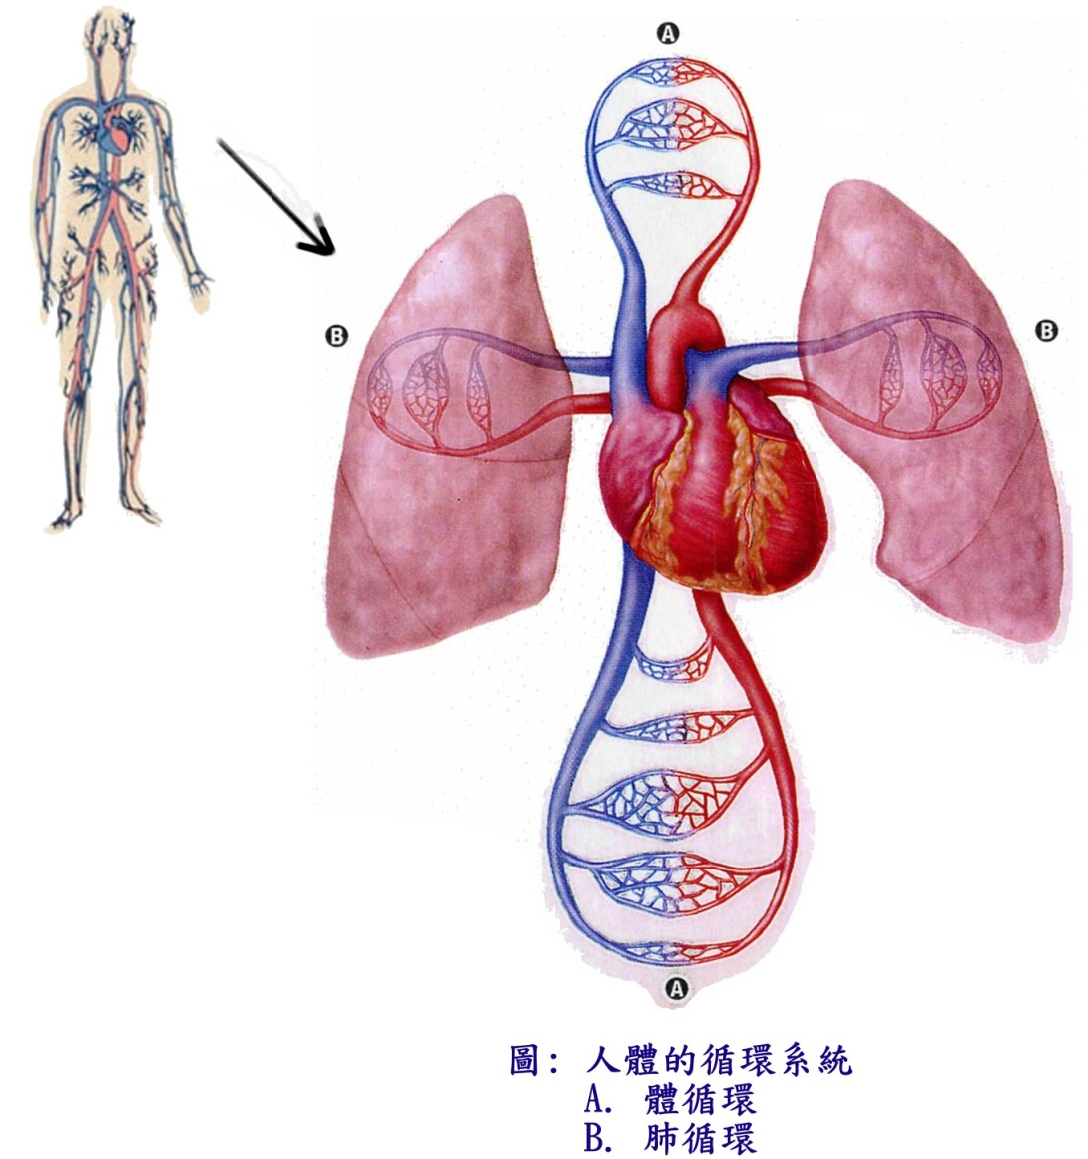
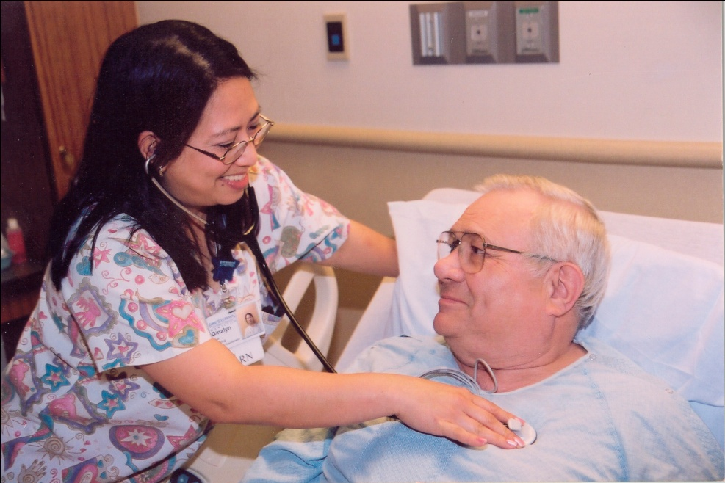
Heart + Vessels
http://patf-biokyb.lf1.cuni.cz/~tribula/cirkulaceen/

Slide 138
Cardiac output
0
End diastolic pressure

Slide 139
Cardiac output
Increase of peripheral resistance
0
End diastolic pressure

Slide 140
Cardiac output
Decrease of peripheral resistance
Increase of peripheral resistance
0
End diastolic pressure

Slide 141
Cardiac output
Increase blood volume
or (increase of venotone)
Decrease of peripheral resistance
Increase of peripheral resistance
0
End diastolic pressure

Slide 142
Cardiac output
Increase blood volume
or (increase of venotone)
Decrease of peripheral resistance
Decrease blood volume
or (decrease of venotone)
Increase of peripheral resistance
0
End diastolic pressure

Slide 143
Cardiac output
Frank-Starling curve
Venous return curve
End diastolic pressure

Slide 144
Cardiac output
Frank-Starling curve
Venous return curve
End diastolic pressure

Slide 145
Cardiac output
Frank-Starling curve
Venous return curve
End diastolic pressure

Slide 146
Cardiac output
Frank-Starling curve
Venous return curve
End diastolic pressure

Slide 147
Cardiac output
Frank-Starling curve
Venous return curve
End diastolic pressure

Slide 148
Cardiac output
Frank-Starling curve
Venous return curve
End diastolic pressure

Slide 149
Cardiac output
Frank-Starling curve
Venous return curve
End diastolic pressure

Slide 150
Cardiac output
diuretics
kardiotonics
Increasing the volume of circulating blood venokonstriction,
insufficiency
vasoconstriction
End diastolic pressure increase
! pulmonary edema, swelling
End diastolic pressure

Slide 151
Starling curve and venous return curve
Cardiac
output
Starling curve
Venous return curve
preload
Normal circulation
Notes:
151

Slide 152
Starling curve and venous return curve
inotropy,
heart rate
Cardiac
output
Cardiac
output
Starling curve
inotropy,
heart rate
Venous return curve
preload
preload
Normal circulation
Starling curve changes
Notes:
152

Slide 153
Starling curve and venous return curve
inotropy,
heart rate
Cardiac
output
Cardiac
output
Starling curve
inotropy,
heart rate
Venous return curve
preload
preload
Normal circulation
Starling curve changes
Cardiac
output
resistance
resistance
preload
Venous return curve changes
Notes:
153

Slide 154
Starling curve and venous return curve
inotropy,
heart rate
Cardiac
output
Cardiac
output
Starling curve
inotropy,
heart rate
Venous return curve
preload
preload
Normal circulation
Starling curve changes
Cardiac
output
resistance
Cardiac
output
venotonus,
blood volume
resistance
venotonus,
blood volume
preload
preload
Venous return curve changes
Venous return curve changes
Notes:
154

Slide 155
Starling curve and venous return curve
inotropy,
heart rate
Cardiac
output
Cardiac
output
Starling curve
inotropy,
heart rate
Venous return curve
preload
preload
Normal circulation
Starling curve changes
Cardiac
output
resistance
Cardiac
output
venotonus,
blood volume
resistance
venotonus,
blood volume
preload
preload
Venous return curve changes
Venous return curve changes
Notes:
155

Slide 156
Basic Priciples of Hemodynamics in Shock
Cardiac
output
Starling curve
Venous return curve
preload
Normal circulation
Notes:
156

Slide 157
Cardiac output
Cardiac insufficiency
Retention volume
The increase in venous tone
Vasoconstriction
End diastolic pressure
Cardiogenic shock
preload
Notes:
157

Slide 158
Basic Priciples of Hemodynamics in Shock
Cardiac
output
Cardiac
output
Starling curve
inotropy
resistance
venotonus
Venous return curve
preload
preload
Normal circulation
Cardiogenic shock
Notes:
158

Slide 159
Cardiac output
Increased heart rate and inotropy
Loss of volume
Vasoconstriction
Compensation - an increase of venous tone
Hypovolemic shock
preload
Notes:
159

Slide 160
Basic Priciples of Hemodynamics in Shock
Cardiac
output
Cardiac
output
Starling curve
inotropy
resistance
venotonus
Venous return curve
preload
preload
Normal circulation
Cardiogenic shock
blood volume
resistance
heart rate
inotropy
preload
Hypovolemic shock
Notes:
160

Slide 161
Cardiac output
Increased heart rate and inotropy
cardiodepression
vasodilatation
Loss of volume – transsudation to ISF
Distributive shock
preload
Notes:
161

Slide 162
Basic Priciples of Hemodynamics in Shock
Cardiac
output
Cardiac
output
Starling curve
inotropy
resistance
venotonus
Venous return curve
preload
preload
Normal circulation
Cardiogenic shock
blood volume
resistance
resistance
heart rate
blood volume
inotropy
heart rate
inotropy
inotropy
preload
preload
Hypovolemic shock
Distributive shock
Notes:
162

Slide 163
Basic Priciples of Hemodynamics in Shock
Cardiac
output
Cardiac
output
Starling curve
inotropy
resistance
venotonus
Venous return curve
preload
preload
Normal circulation
Cardiogenic shock
Notes:
163

Slide 164
Basic Priciples of Hemodynamics in Shock
Cardiac
output
Cardiac
output
Starling curve
inotropy
resistance
venotonus
Venous return curve
preload
preload
Normal circulation
Cardiogenic shock
blood volume
resistance
heart rate
inotropy
preload
Hypovolemic shock
Notes:
164

Slide 165
Basic Priciples of Hemodynamics in Shock
Cardiac
output
Cardiac
output
Starling curve
inotropy
resistance
venotonus
Venous return curve
preload
preload
Normal circulation
Cardiogenic shock
blood volume
resistance
resistance
heart rate
blood volume
inotropy
heart rate
inotropy
inotropy
preload
preload
Hypovolemic shock
Distributive shock
Notes:
165

Slide 166
Basic Priciples of Hemodynamics in Shock
Cardiac
output
Cardiac
output
Starling curve
inotropy
resistance
venotonus
Venous return curve
preload
preload
Normal circulation
Cardiogenic shock
blood volume
resistance
resistance
heart rate
blood volume
inotropy
heart rate
inotropy
inotropy
preload
preload
Hypovolemic shock
Distributive shock
Notes:
166

Slide 167
Integrative physiology
Hemodynamics
Volume balance
osmotic balance
Oxygen transport
ionic balance
Acid-Base homeostasis

Slide 168
Oxygen delivery
Circulation
PiO2
PaO2
Hb
SaO2
Ventilation
CaO2*Q

Slide 169
Oxygen delivery
Circulation
PiO2
PaO2
Hb
SaO2
Ventilation
CaO2*Q
ATP/ADP ratio etc.
Metabolic requirement
VO2
Cells
Oxygen comsumption

Slide 170
Oxygen delivery
Circulation
PvO2
PaO2
Hb
SaO2
Ventilation
CaO2*Q
CvO2
PaO2
Diffusion
ATP/ADP ratio etc.
PistO2
Metabolic requirement
VO2
Cells
Oxygen comsumption

Slide 171
Oxygen delivery
Circulation
PiO2
PaO2
Hb
SaO2
Ventilation
CaO2*Q
CvO2
PaO2
Diffusion
ATP/ADP ratio etc.
PistO2
Metabolic requirement
VO2
criticalDO2
VO2
Cells
Oxygen comsumption
Oxygen delivery - DO2

Slide 172
Integrative physiology
Hemodynamics
Volume balance
osmotic balance
Oxygen transport
ionic balance
Acid-Base homeostasis

Slide 173
Blood Volume
Extracellular fluid volume
Arterial Pressure

Slide 174
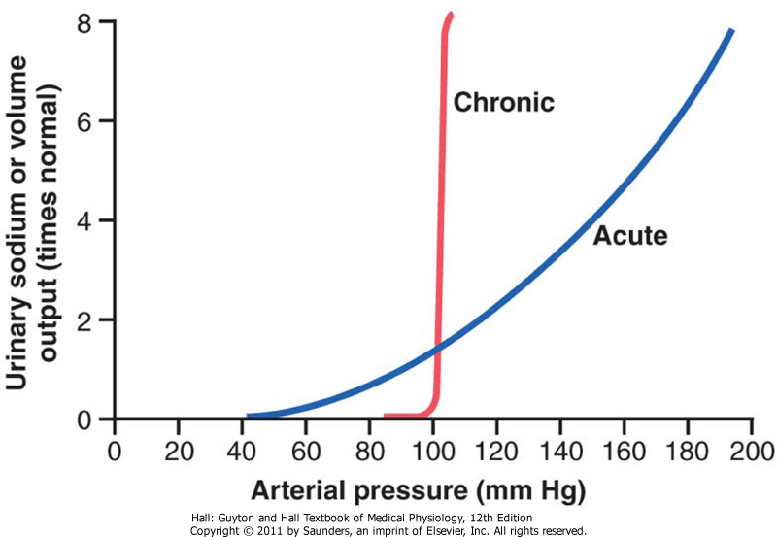

Slide 175
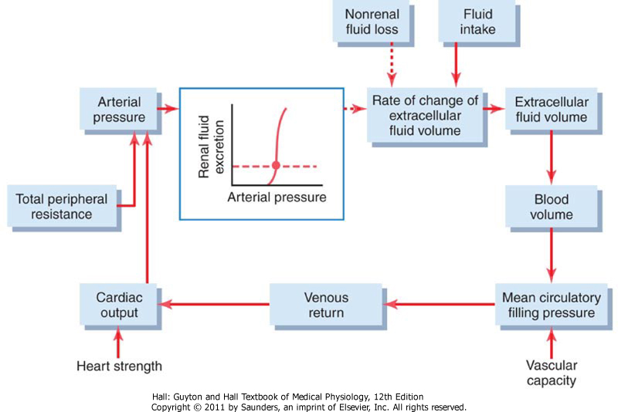
return

Slide 176
Starling curve and venous return curve

Slide 177
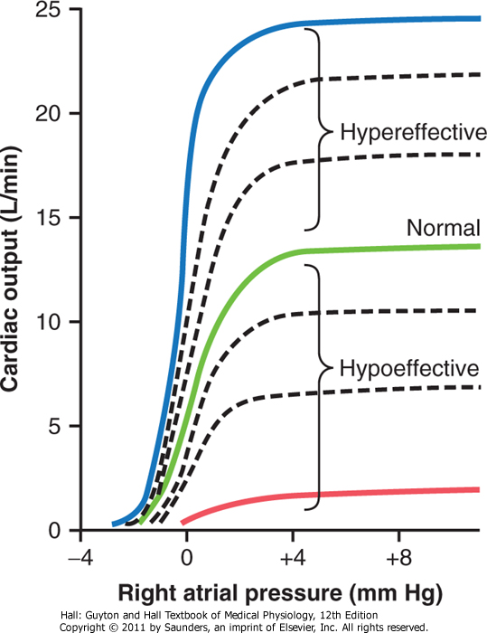

Slide 178
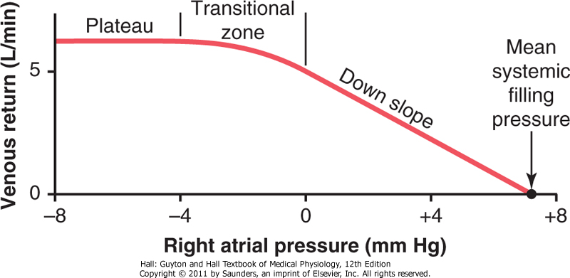

Slide 179
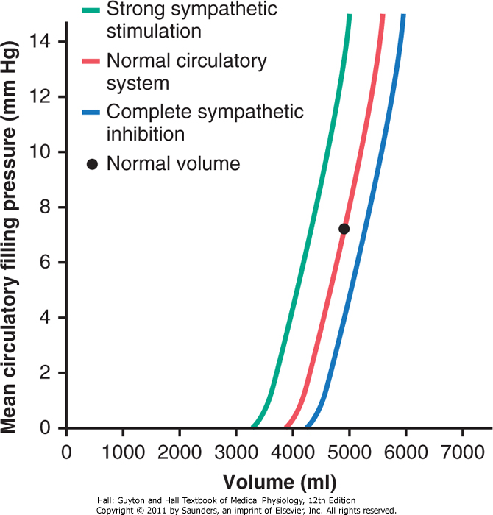

Slide 180
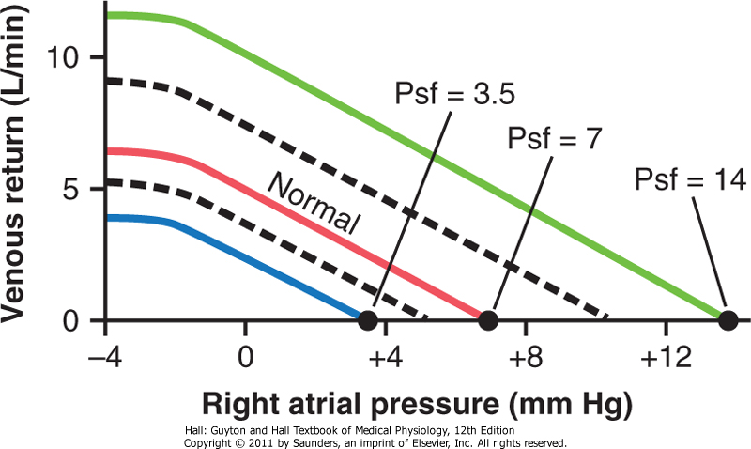

Slide 181
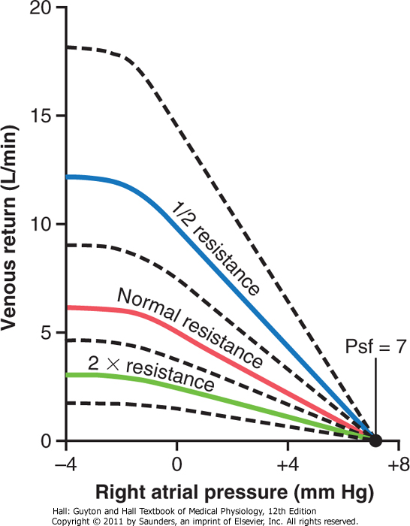

Slide 182
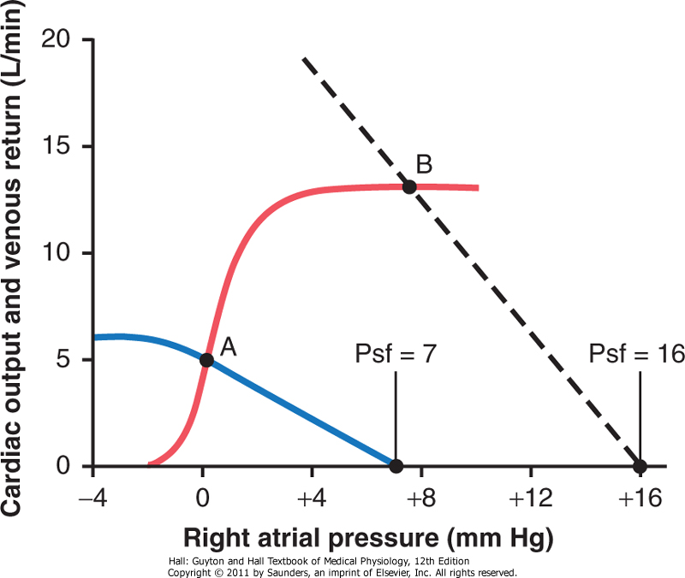

Slide 183
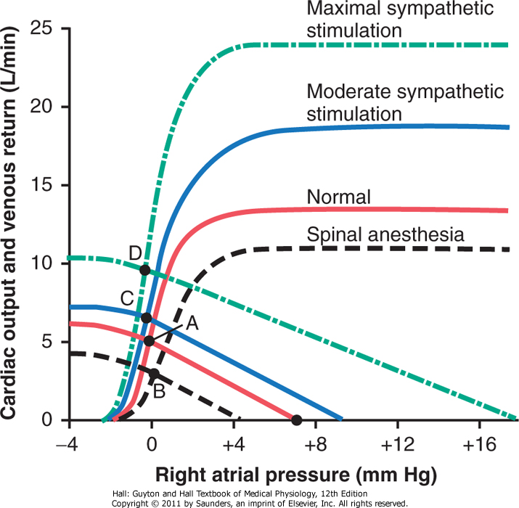

Slide 184
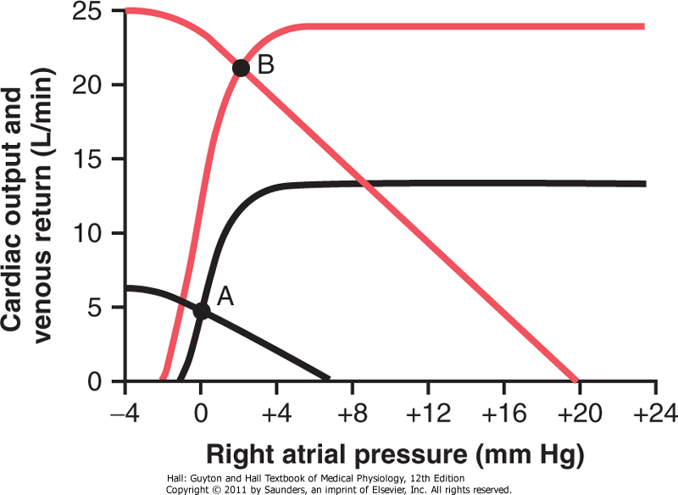
Strenous excercise
Rest

Slide 185
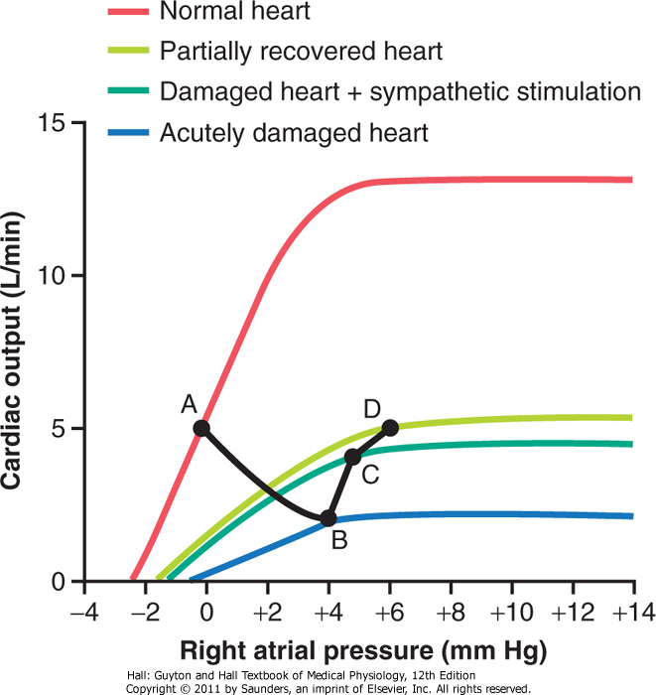

Slide 186
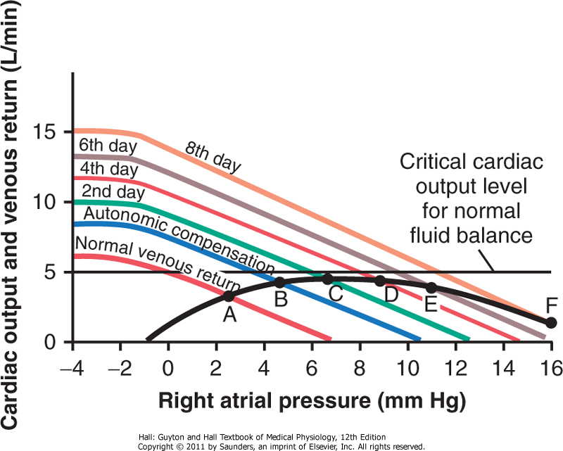
Decompensated cardiac failure

Slide 187
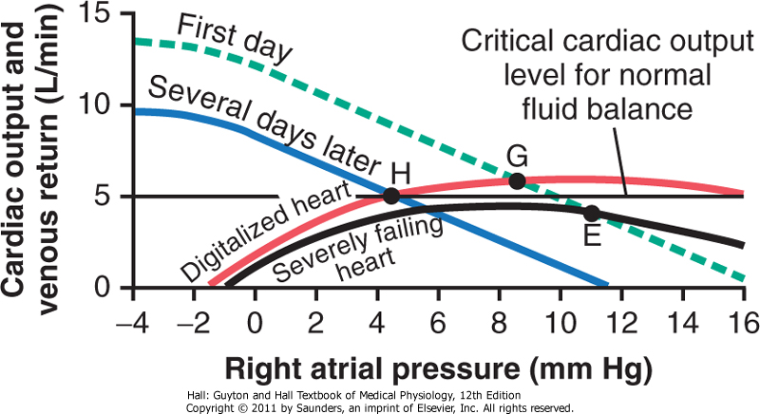
Treatment od decompensated cardiac failure

Slide 188
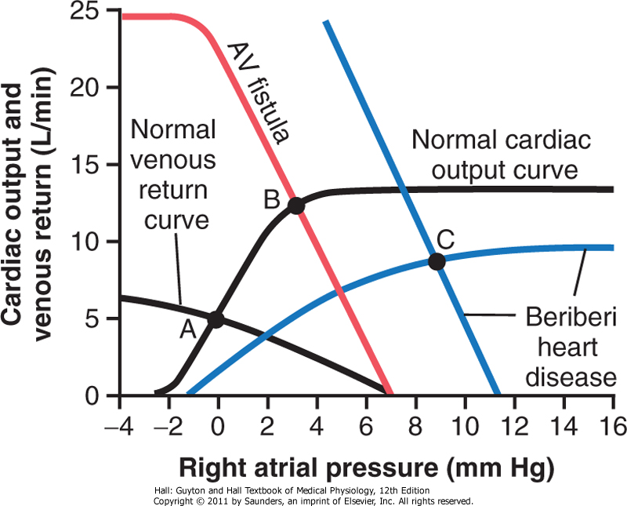
High-output cardiac failure
return

