Slide 1

Kuhtz-Buschbeck et al., 2018

Slide 2
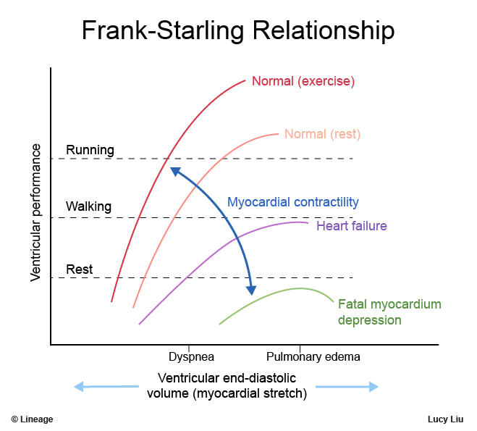
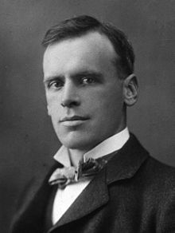
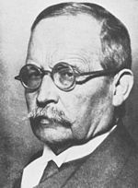
Otto Frank (1865-1944)
Ernest Starling (1866-1924)

Slide 3
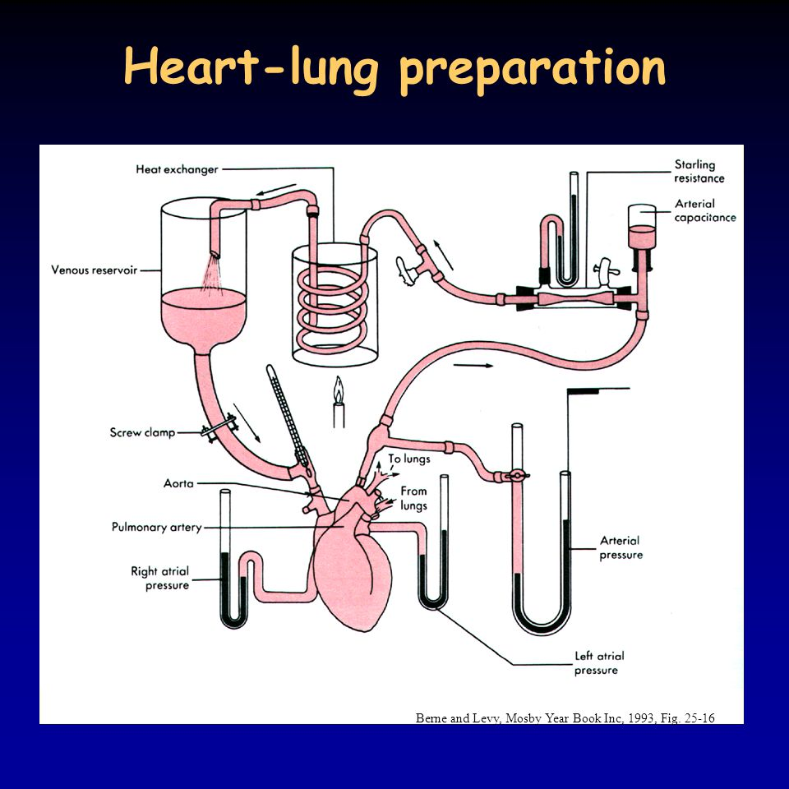

Slide 4
PRESSURE
VOLUME

Slide 5
PRESSURE
constant pressure
Isobaric maxima curve
VOLUME

Slide 6
PRESSURE
Isovolumic maxima curve
D
Isobaric maxima curve
VOLUME

Slide 7
PRESSURE
Isovolumic maxima curve
Isobaric maxima curve
žabí srdce: O. Frank 1898
VOLUME

Slide 8
PRESSURE
Isovolumic maxima curve
Curve of the maxima of afterloaded contractions
Isobaric maxima curve
VOLUME

Slide 9
PRESSURE
Isovolumic maxima curve
Curve of the maxima of afterloaded contractions
Isobaric maxima curve
VOLUME

Slide 10
PRESSURE
Isovolumic maxima curve
Curve of the maxima of afterloaded contractions
Isobaric maxima curve
VOLUME

Slide 11
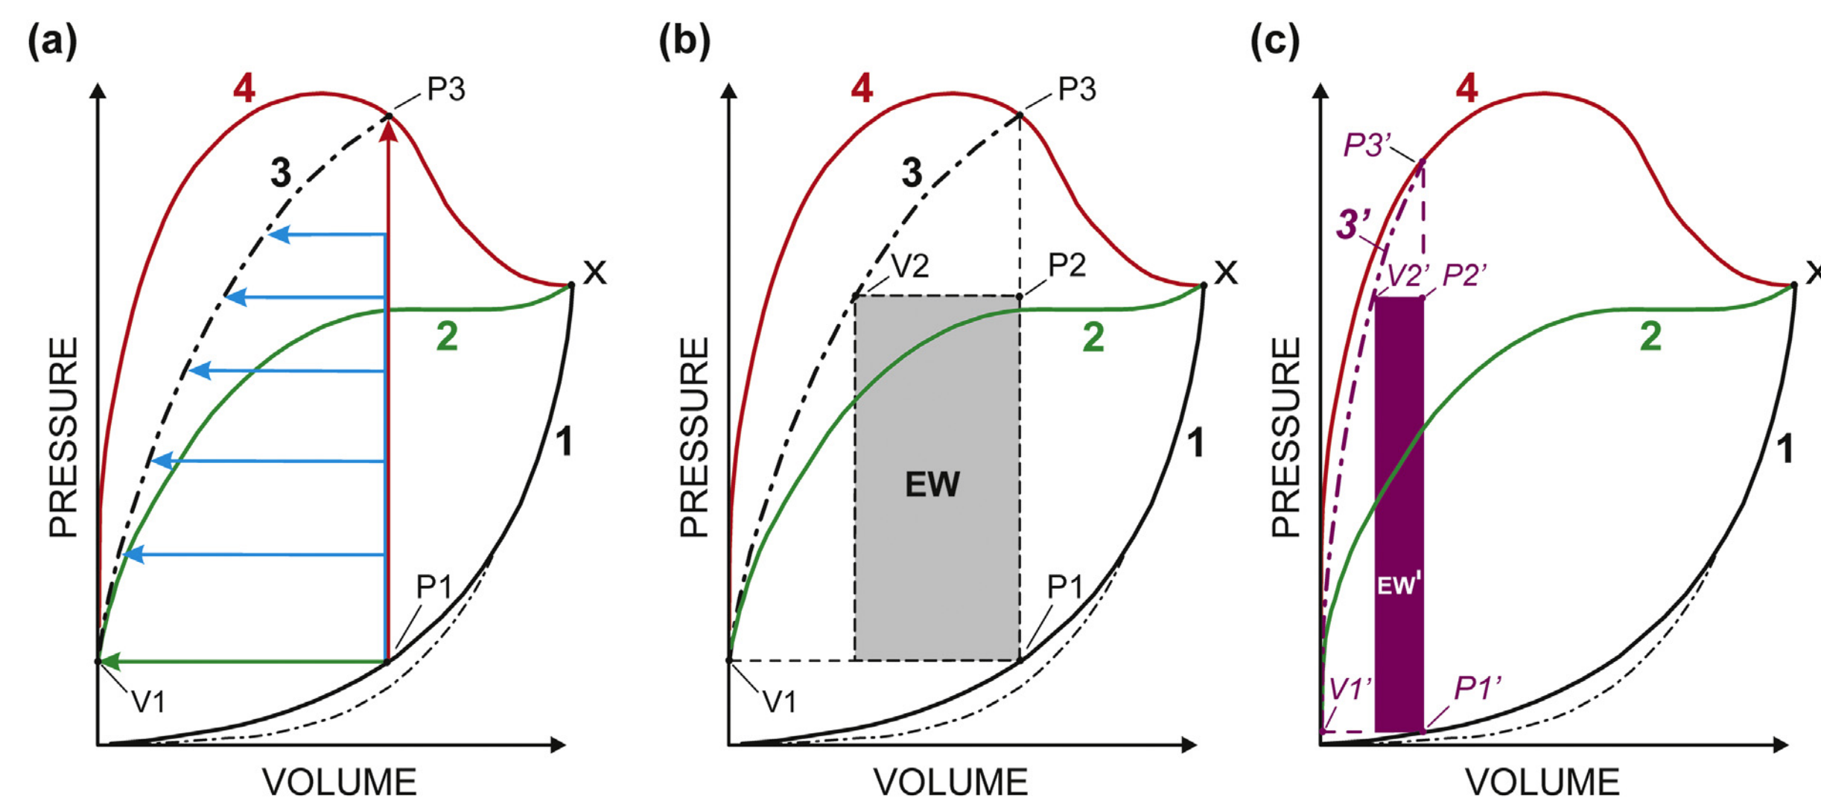

Slide 12
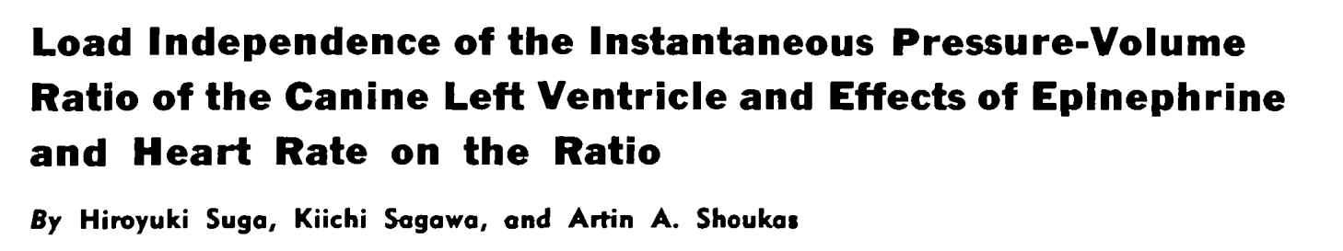
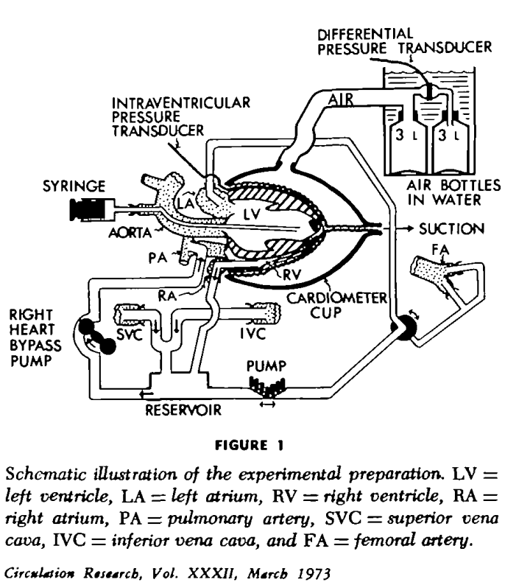
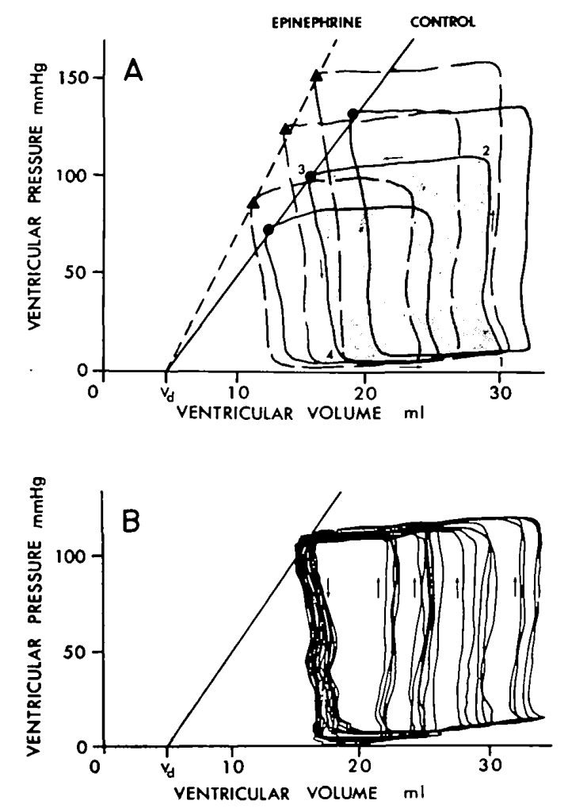
Suga, Sagawa, et al. 1973
Různý afterload
1973
Různý preload,
konstantní afterload

Slide 13
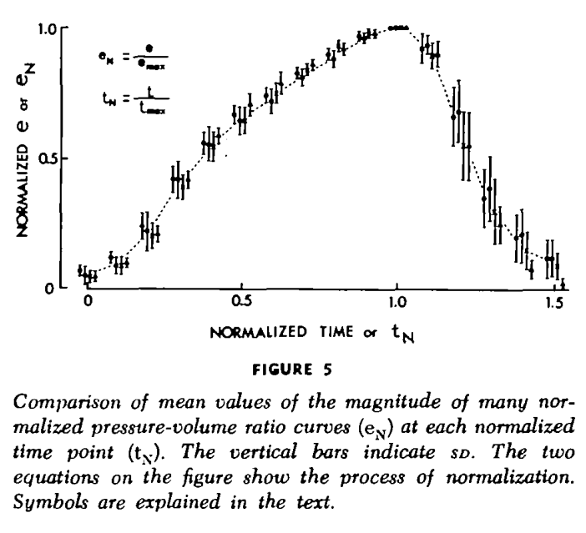

Slide 14
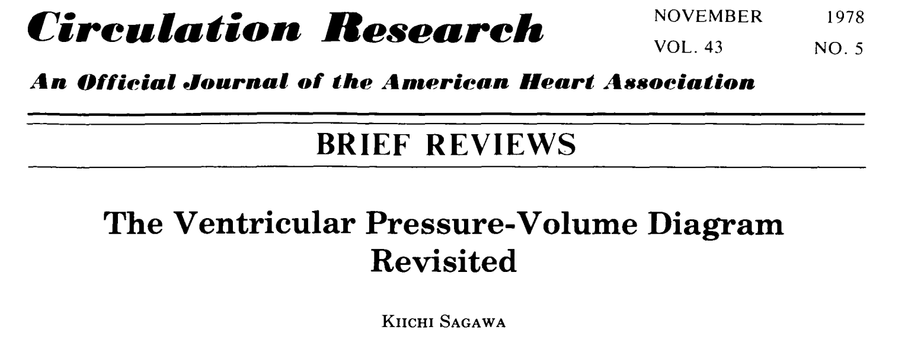
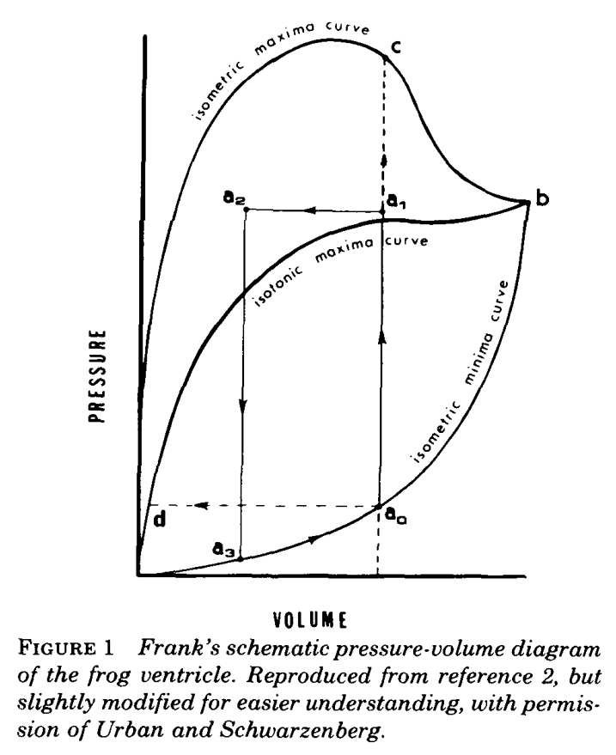
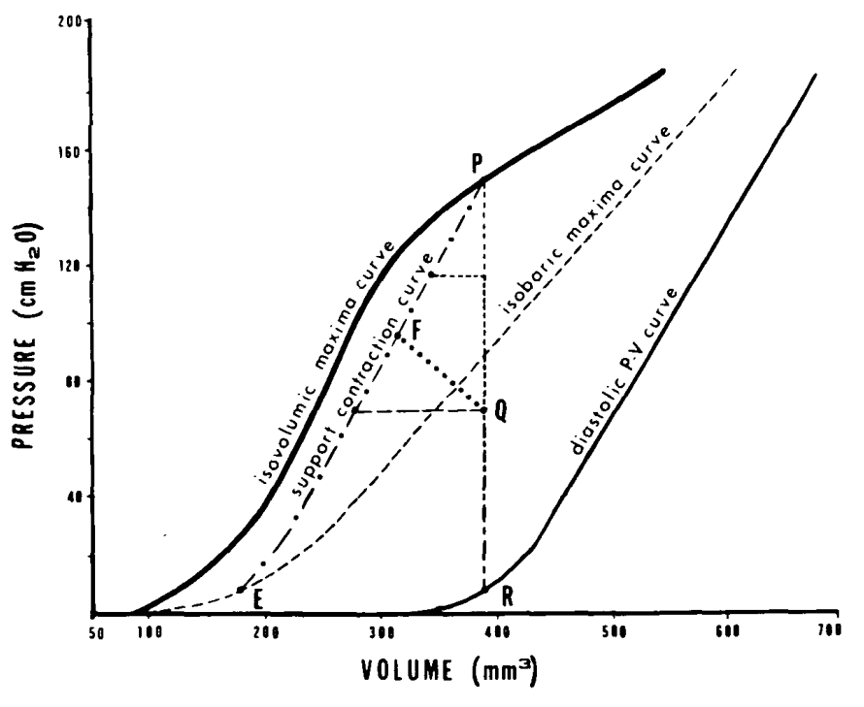
Sagawa 1978

Slide 15
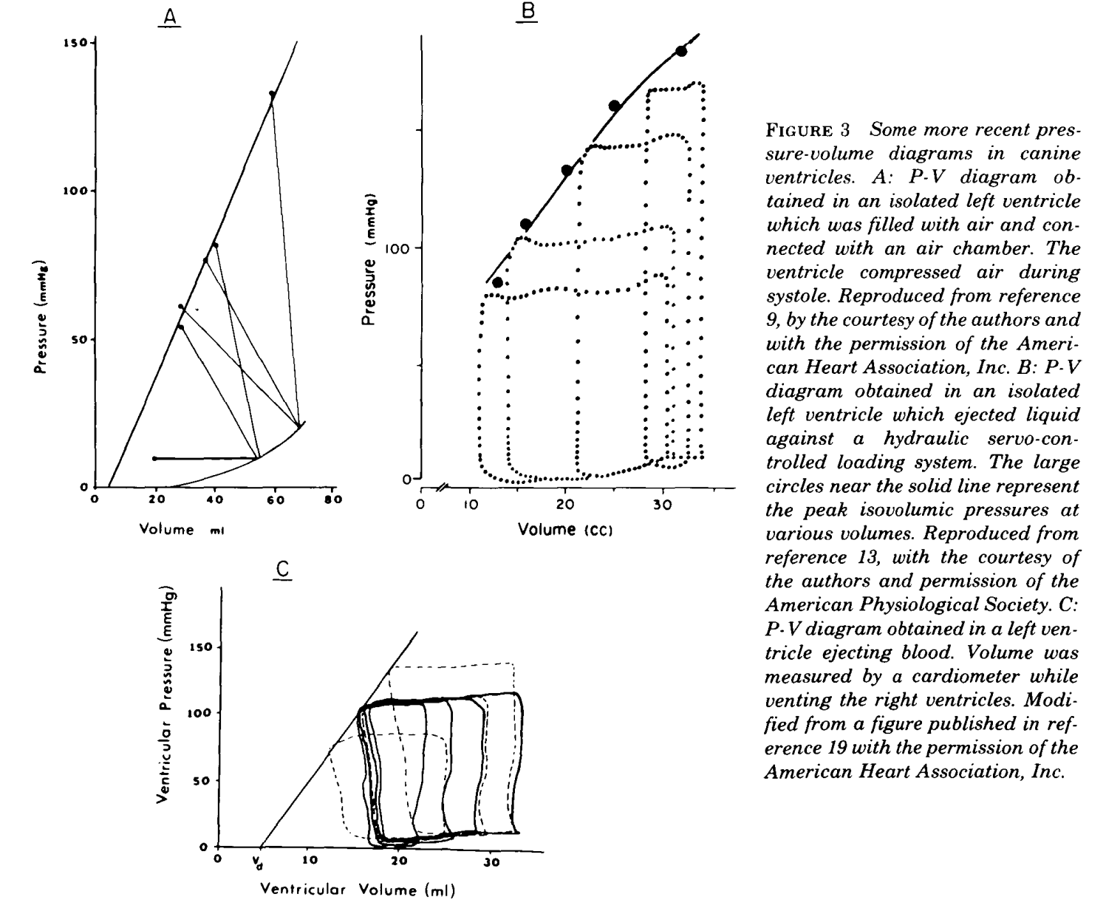
Různý preload,
různý afterload
Různý preload,
různý afterload
Různý preload,
konstantní afterload

Slide 16
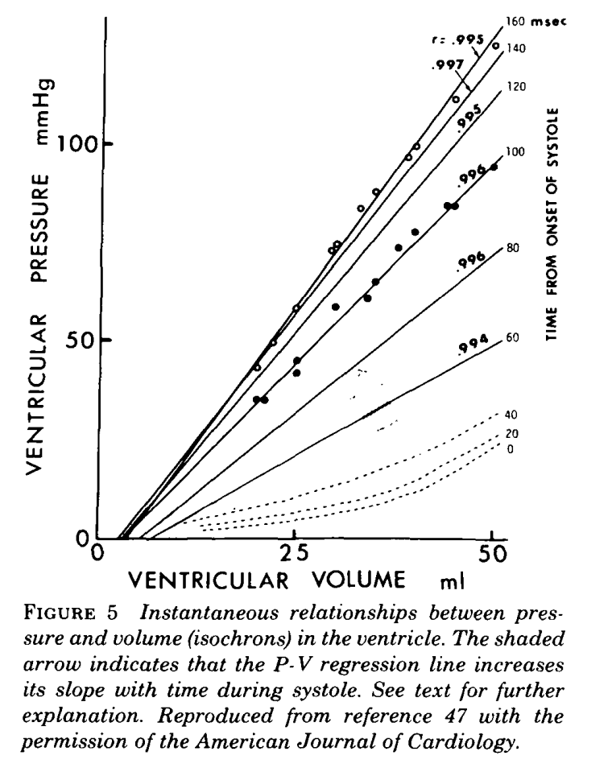

Slide 17
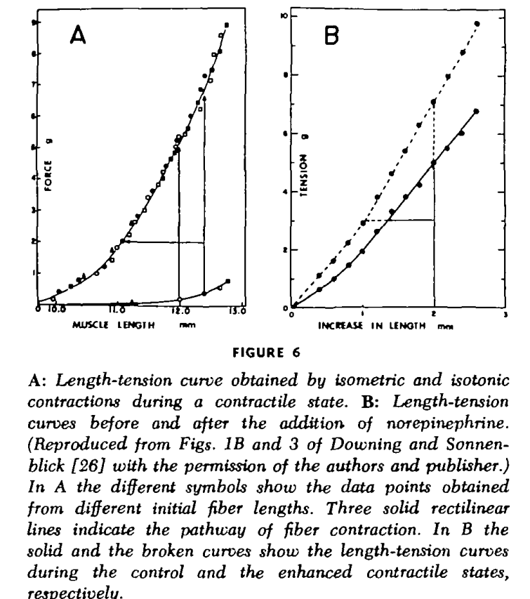

Slide 18
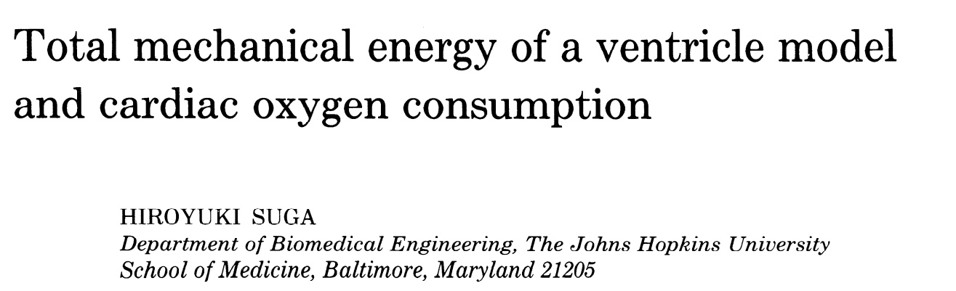
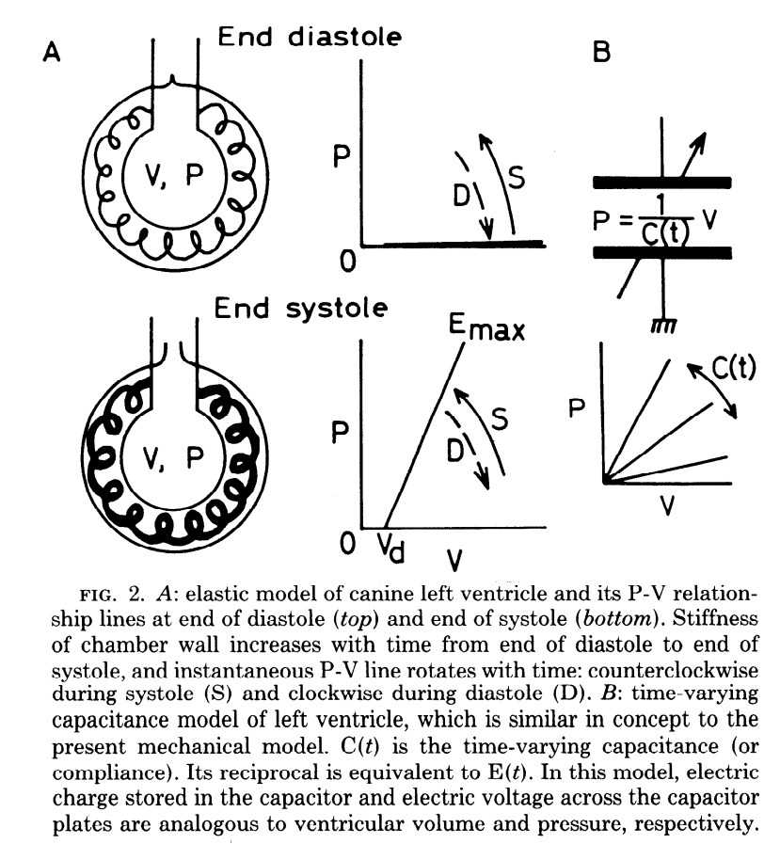
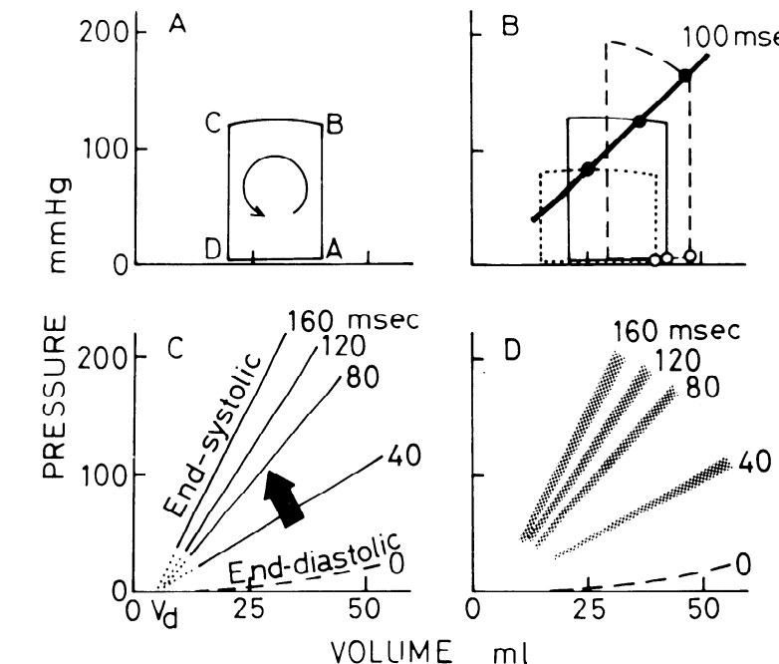
Suga, 1979
1979

Slide 19
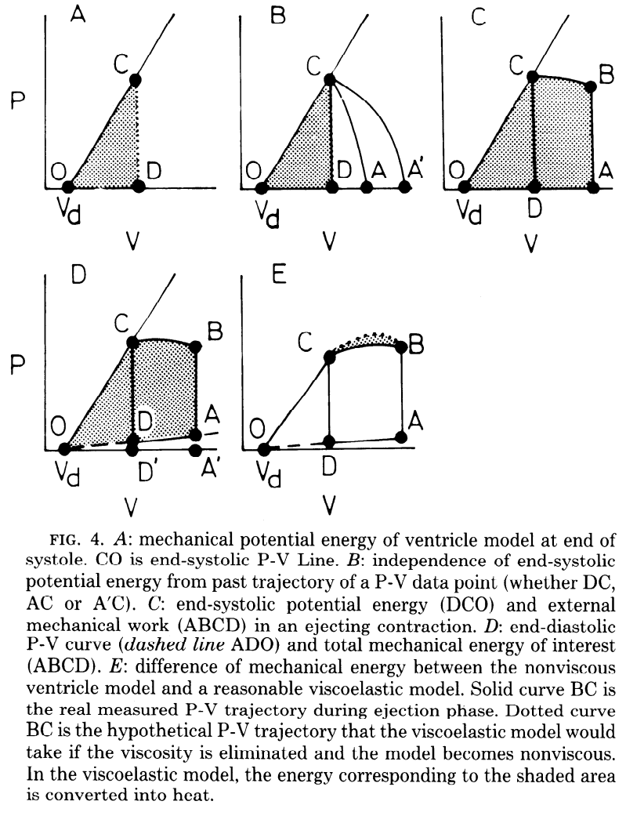
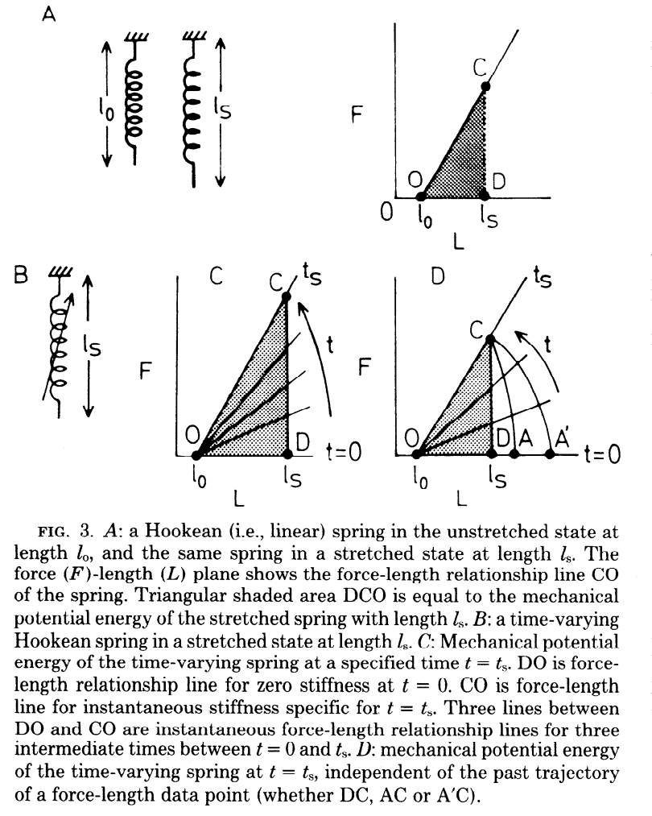

Slide 20
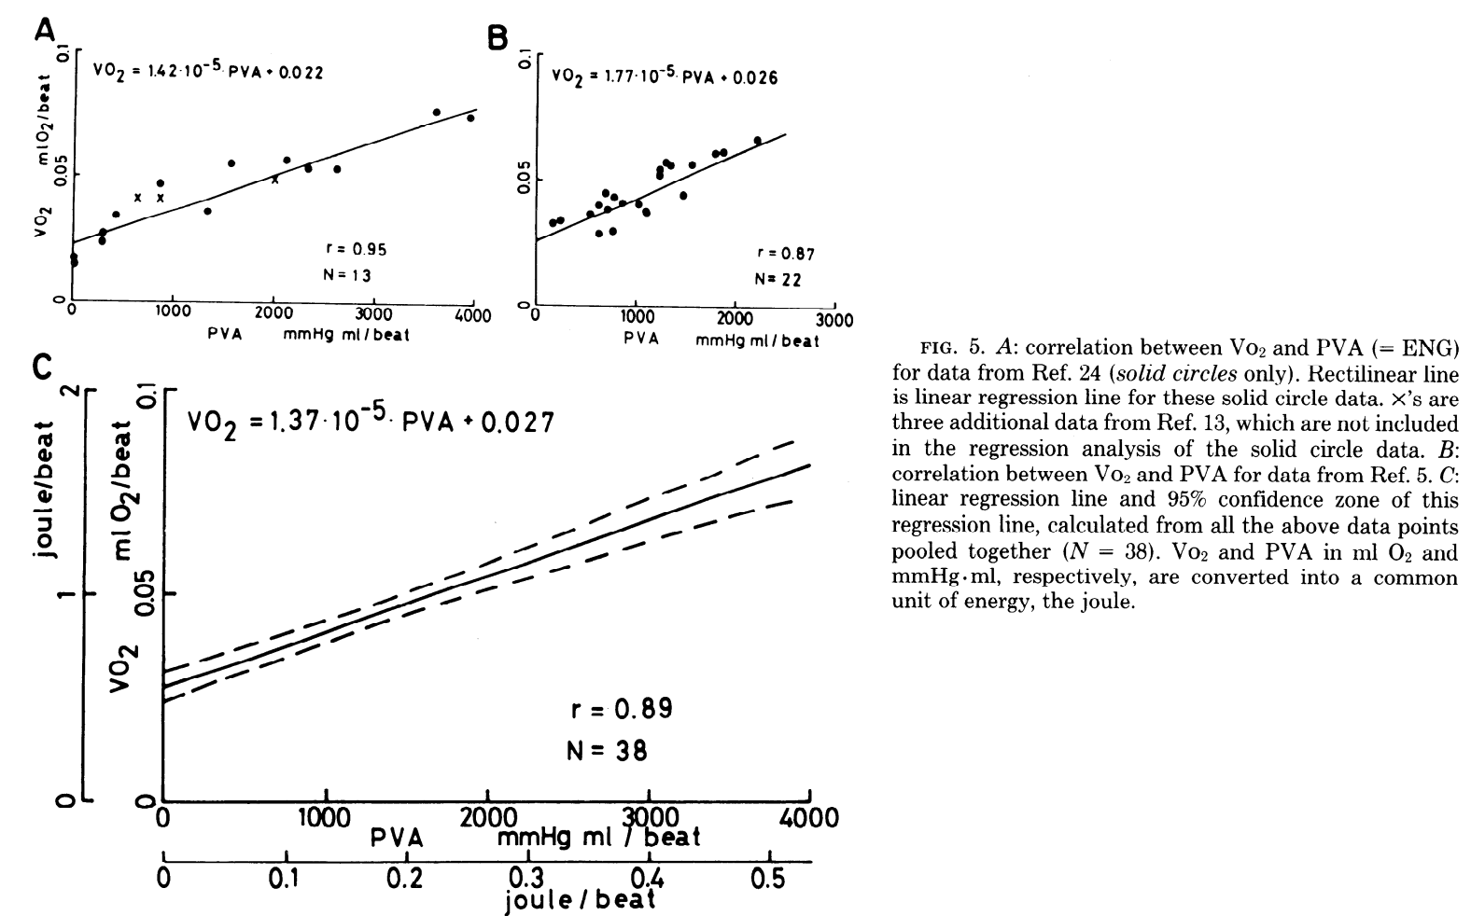


Slide 21
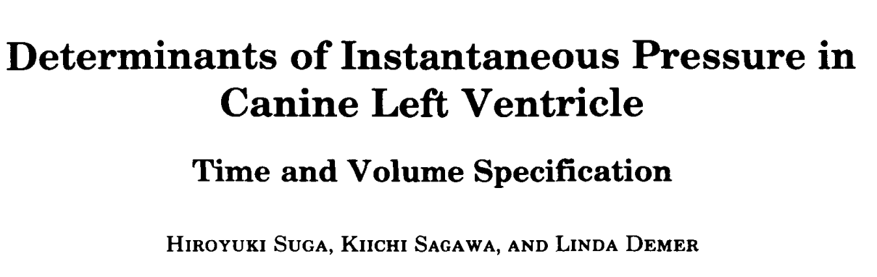
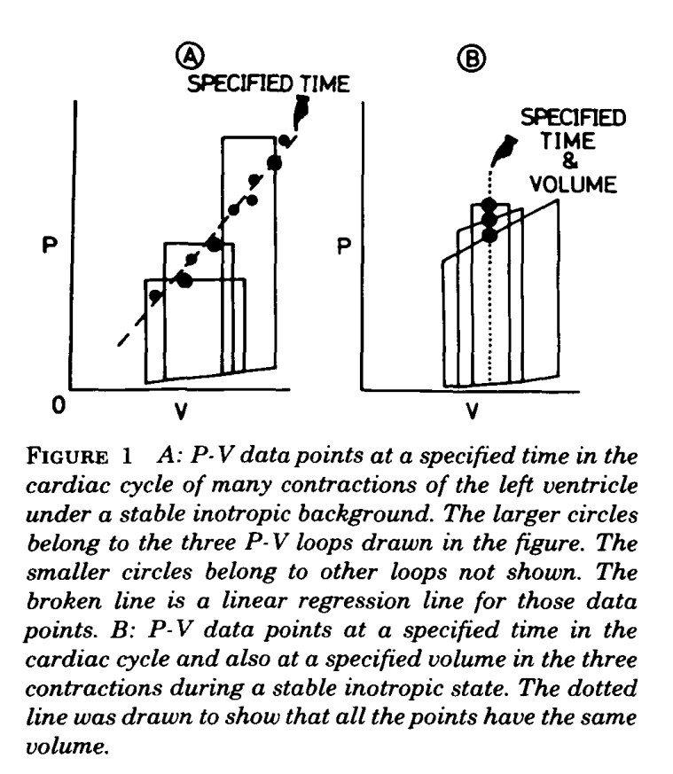
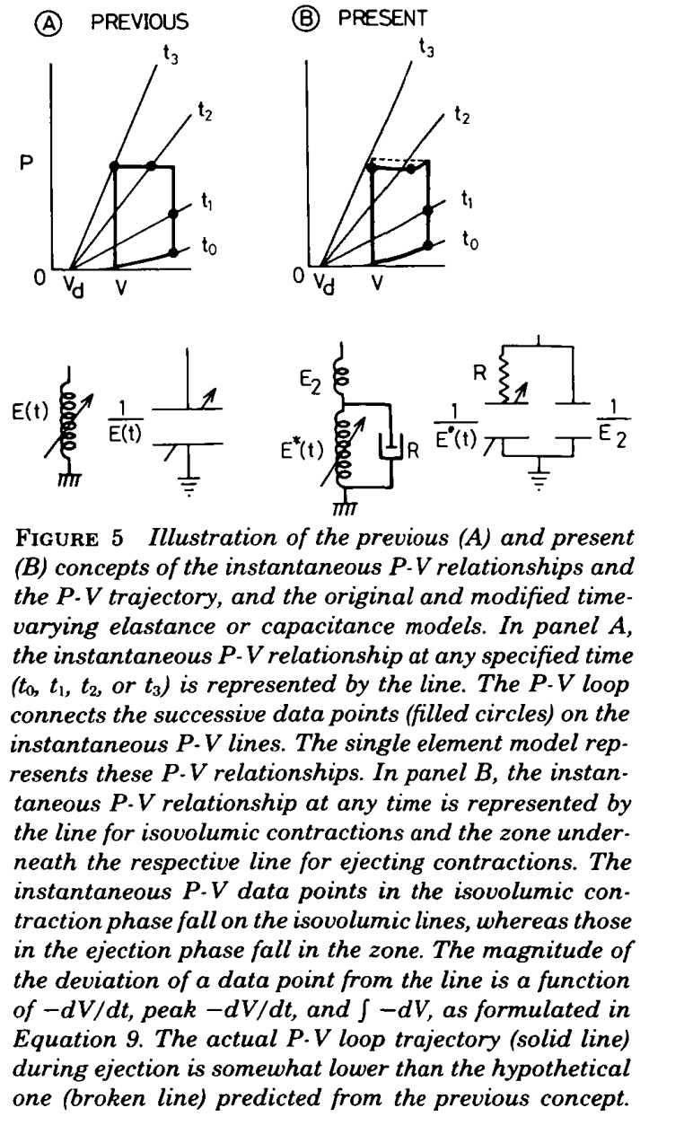
Suga, Sagawa, Demer, 1980

Slide 22
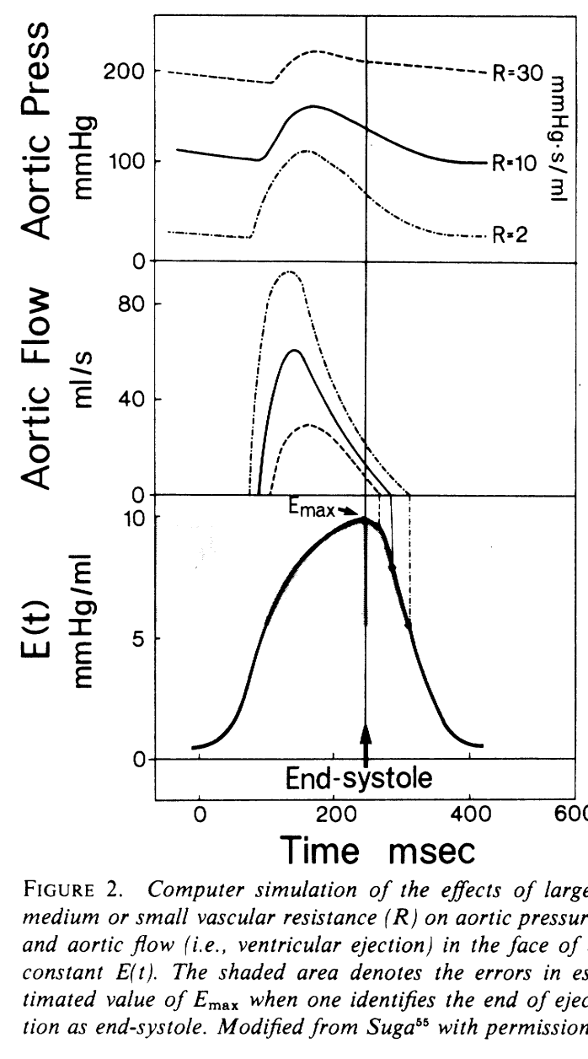
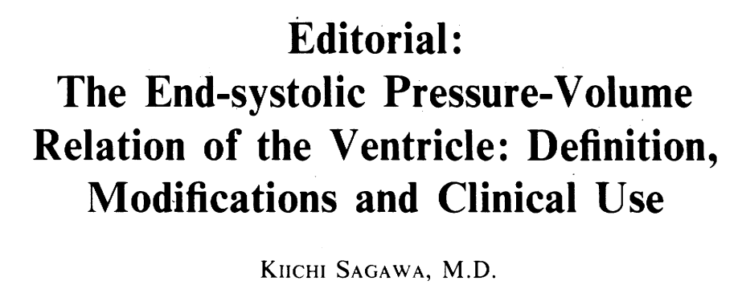
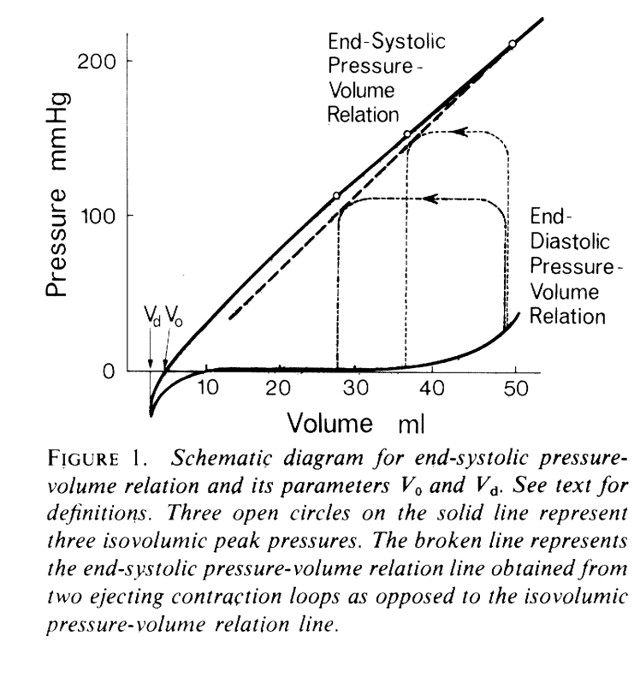
Sagawa, 1981
1980

Slide 23
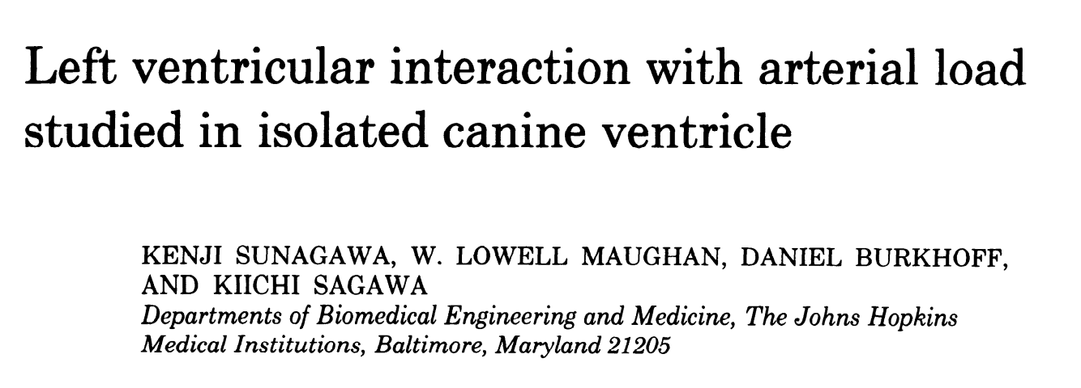
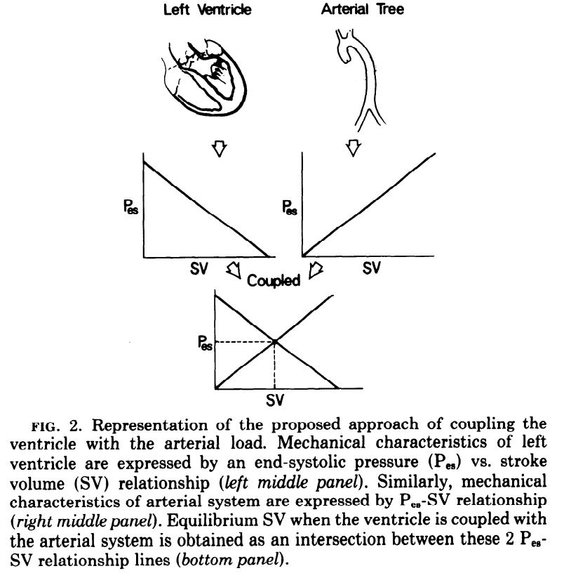
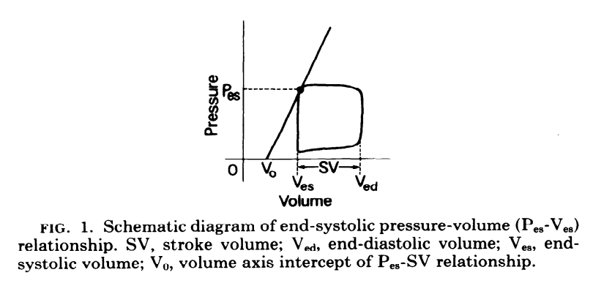
Sunagawa, Maughan, Butkhoff, Sagawa, 1983

Slide 24
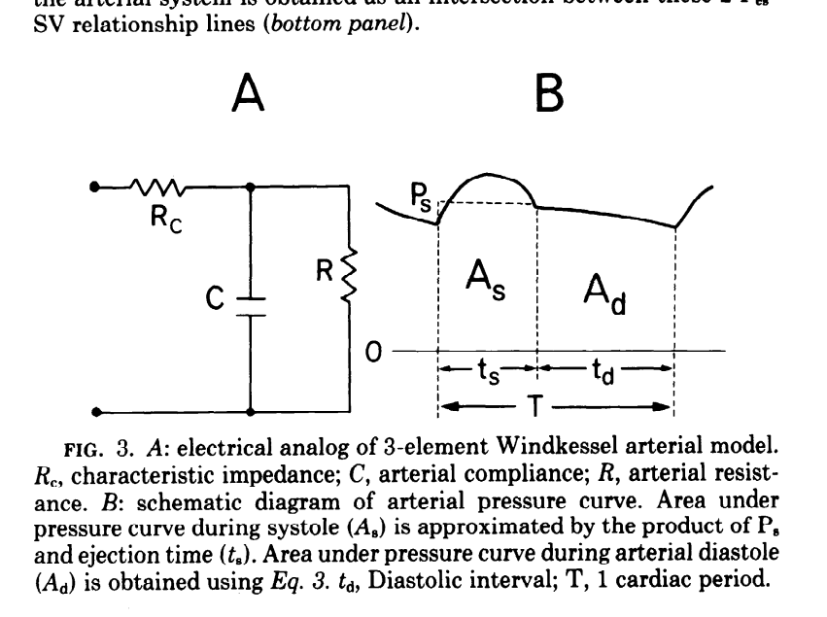
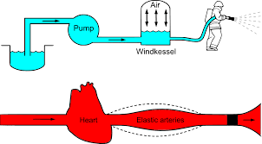

Slide 25
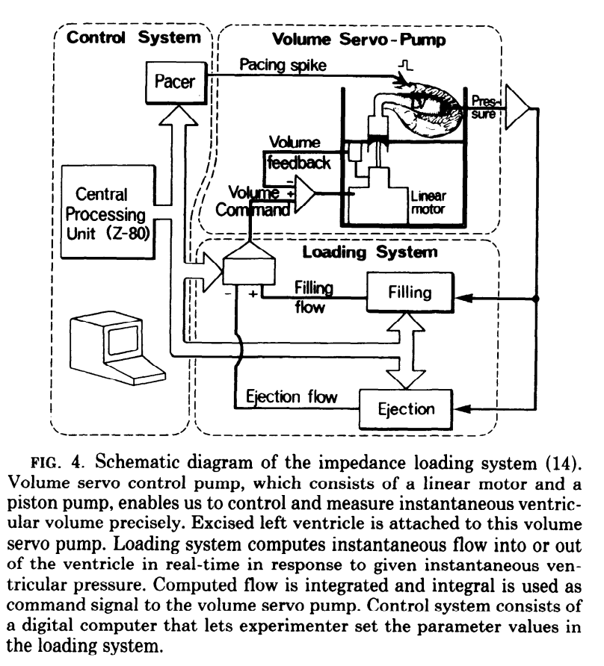
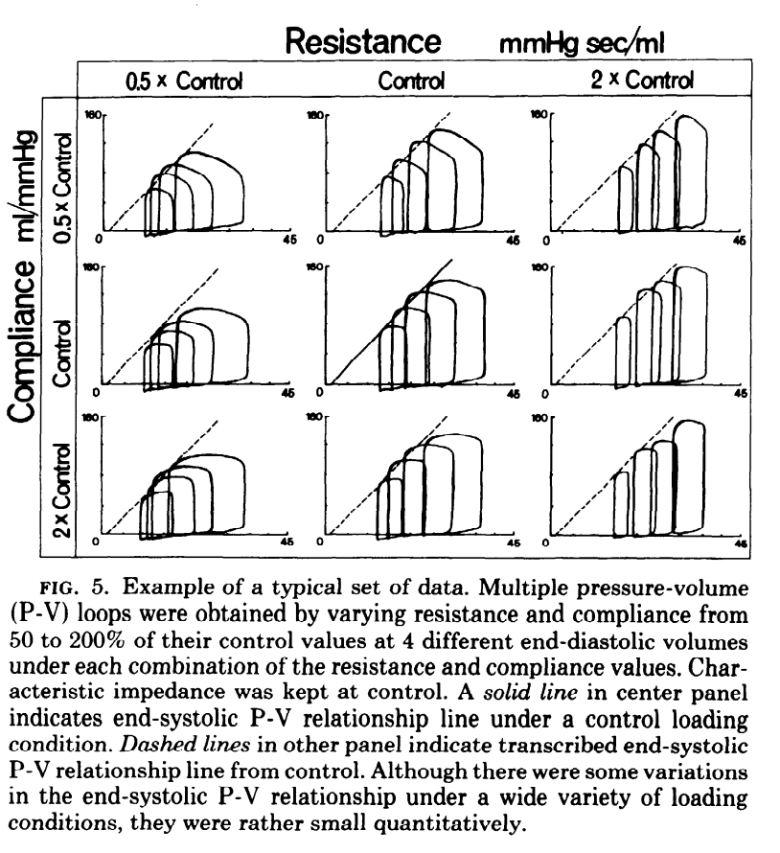

Slide 26
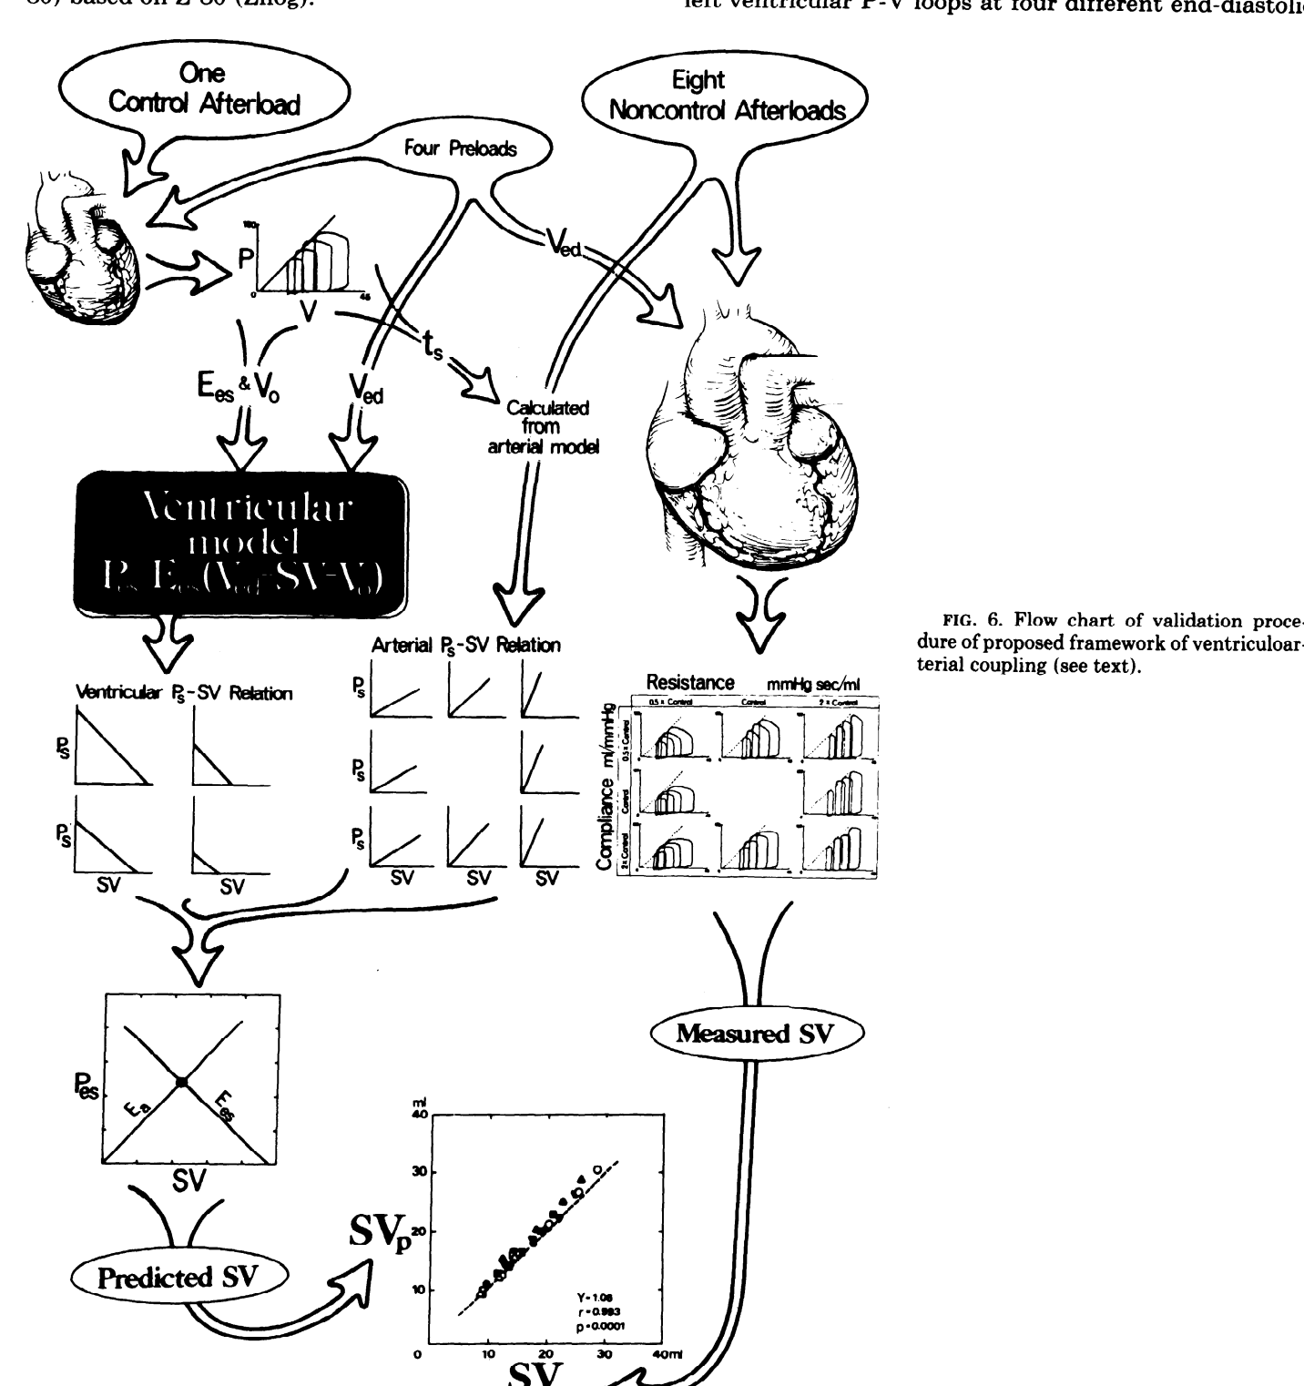

Slide 27
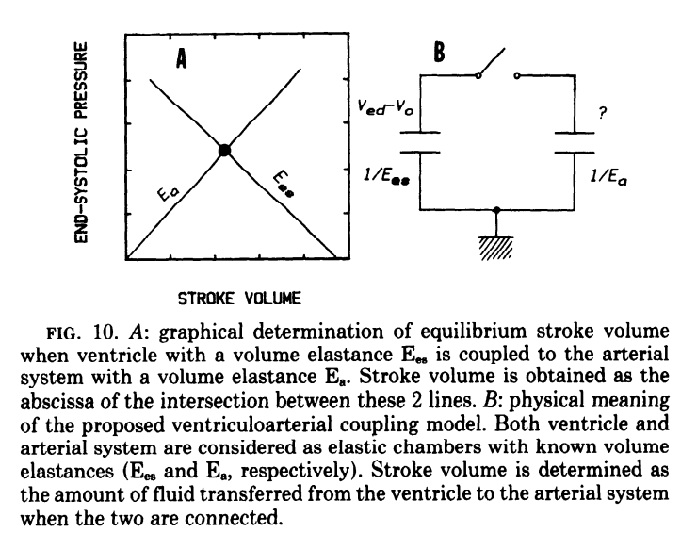
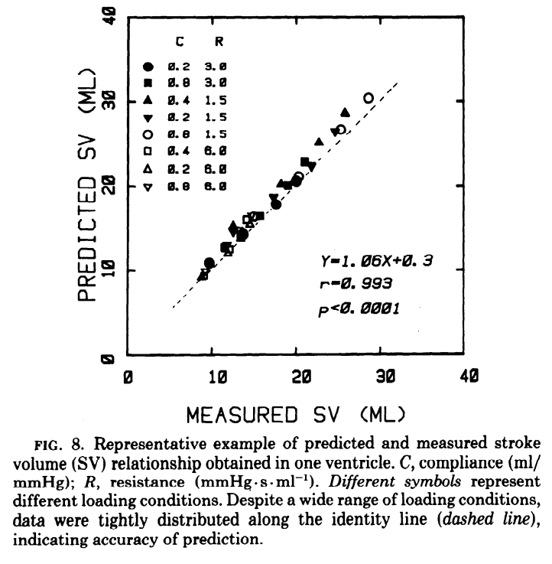

Slide 28
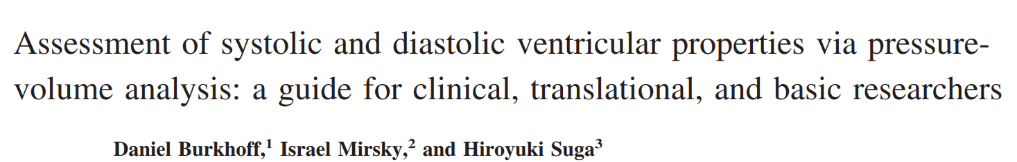
2005

Slide 29
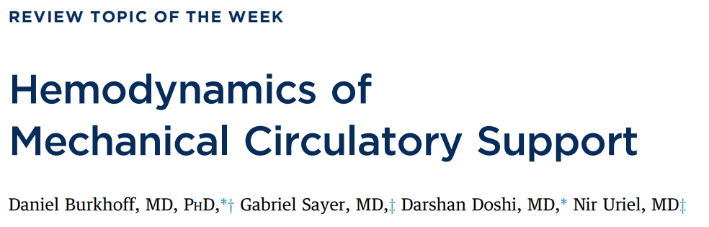
2015

Slide 30
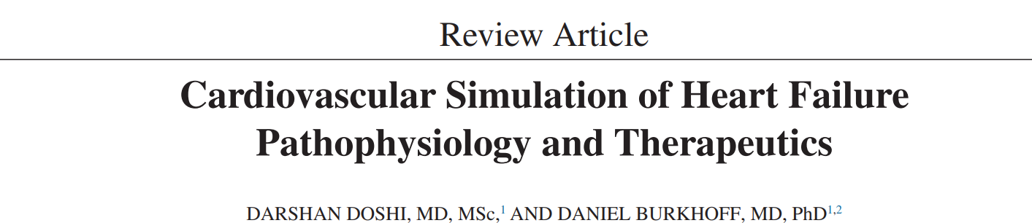
2016

Slide 31
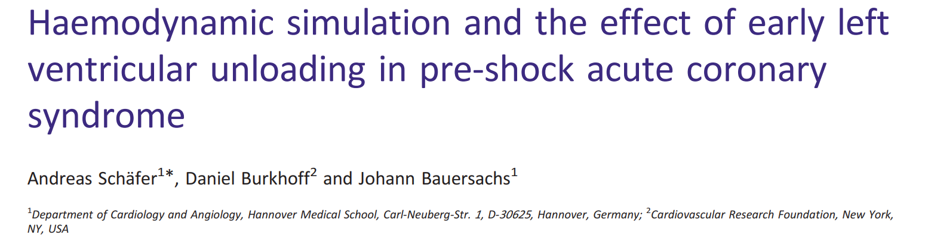
2019

Slide 32
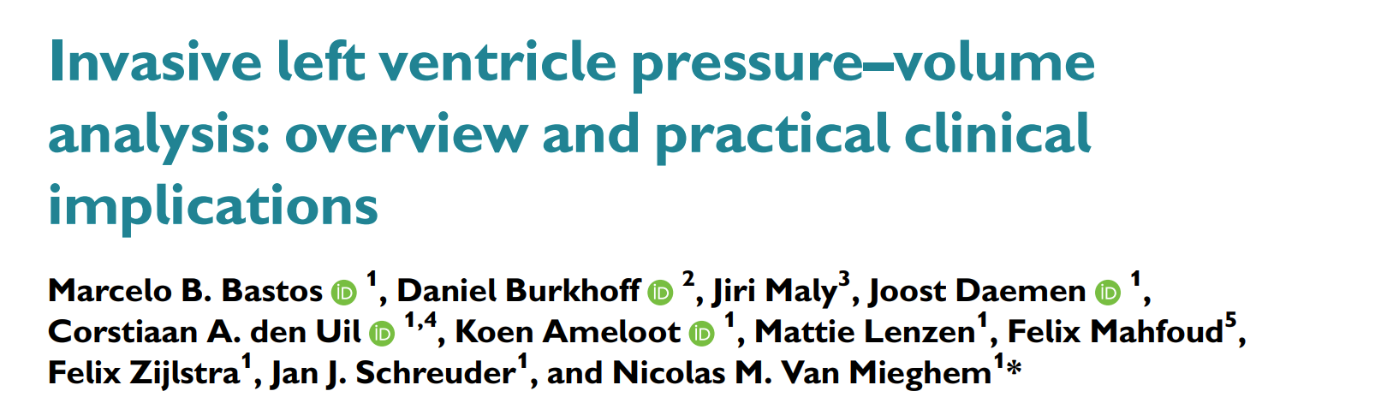
2020

Slide 33
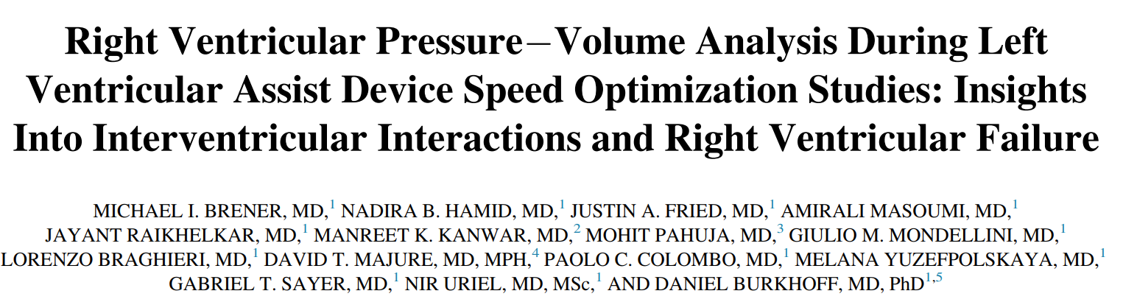
2019

