Slide 1

Three players for O₂ and CO₂ transfer

Slide 2

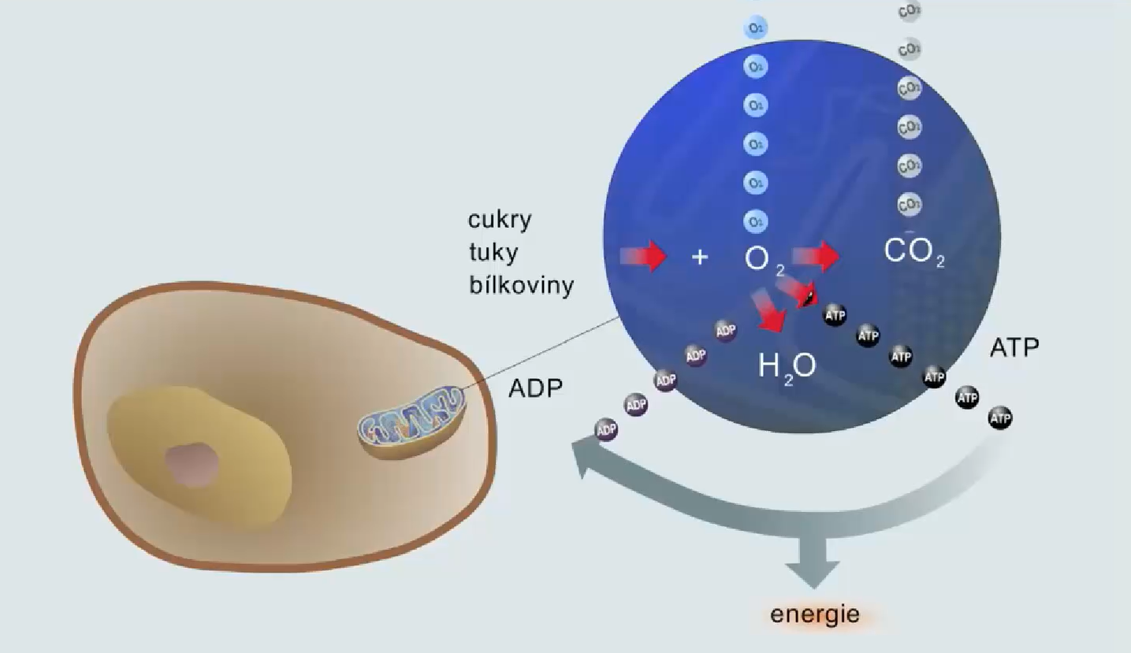
CO₂
O₂
O₂
CO₂

Slide 3
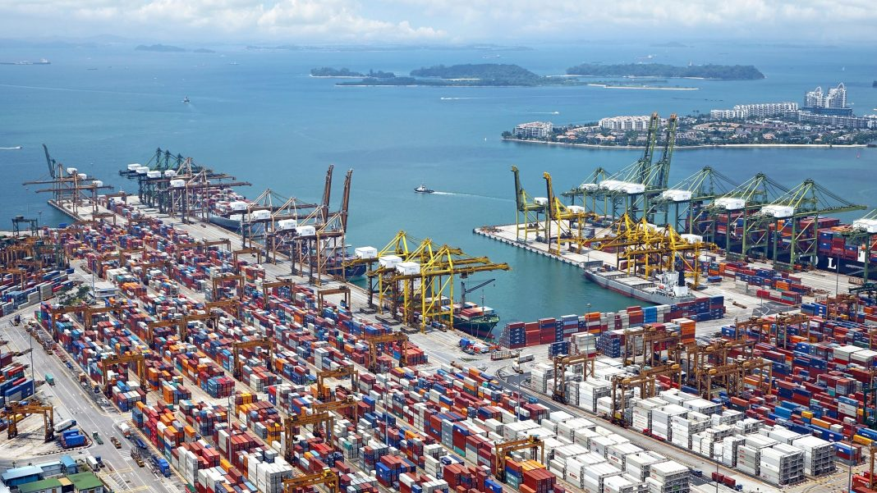
CO₂
O₂
O₂
CO₂

Slide 4
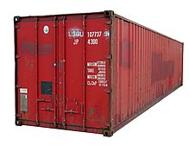
CO₂
O₂
CO₂
O₂
O₂
CO₂
CO₂
O₂

Slide 5
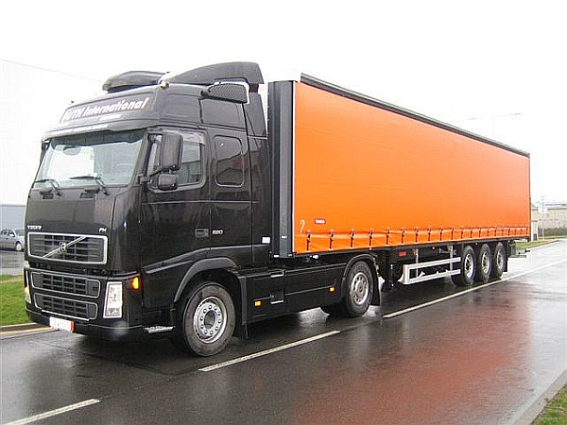
CO₂
O₂
CO₂
O₂
O₂
CO₂
CO₂
O₂

Slide 6
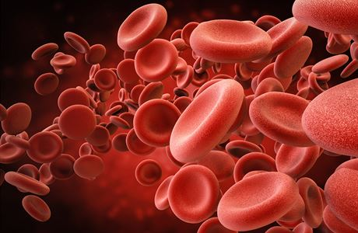
CO₂
O₂
O₂
CO₂
O₂
CO₂
O₂
CO₂

Slide 7
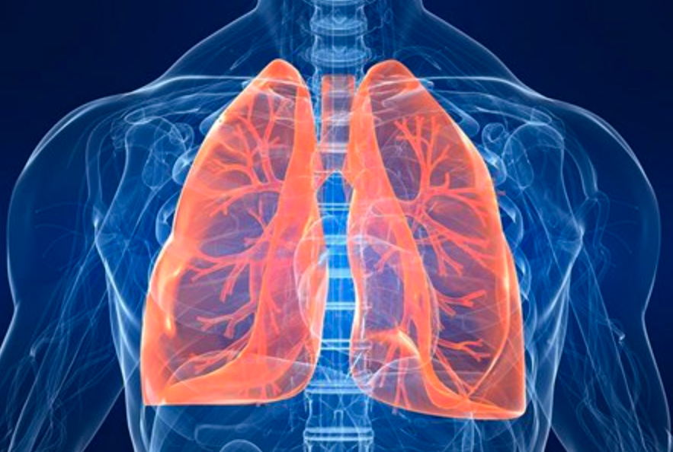
O₂
CO₂
CO₂
O₂
O₂
CO₂
O₂
CO₂

Slide 8
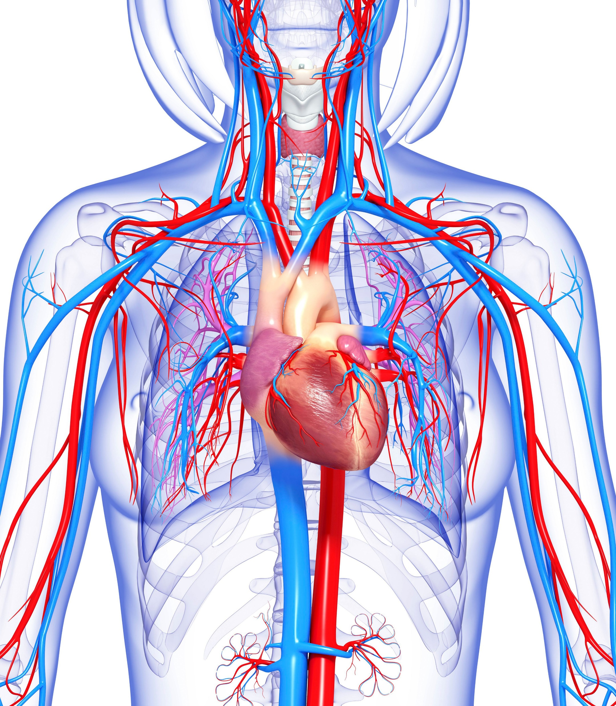
O₂
CO₂
CO₂
O₂
O₂
CO₂
O₂
CO₂

Slide 9
Respiration
O₂
CO₂
Hemopoiesis
Circulation

Slide 10
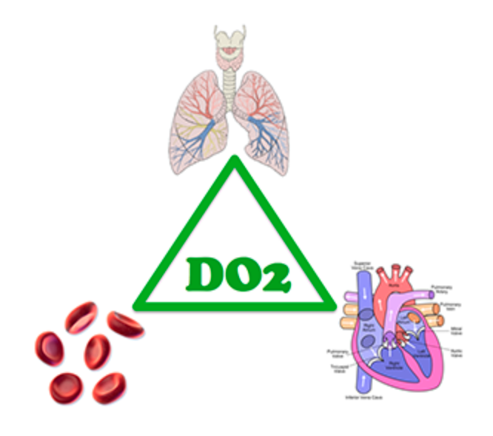
Three players for oxygen delivery to tissues (and CO₂ removal from the body)

Slide 11
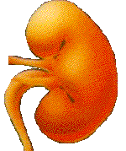

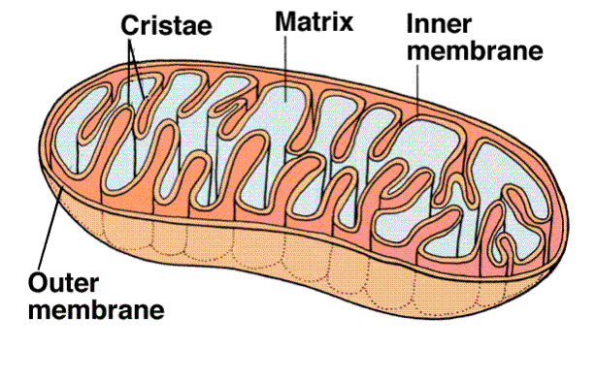
High Altitude Hypoxia
O₂
CO₂
Bone marrow
erythropoesis
erythropoetin
Respiratory Hypoxia
pO2
Circulatory Hypoxia (ischemic)
kidneys
Hypoxia from Anemia
Histotoxic Hypoxia
Saccharides
Fats
Proteins
+ O₂ CO₂
H₂O
mitochondrion
cell
mitochondrion

Slide 12
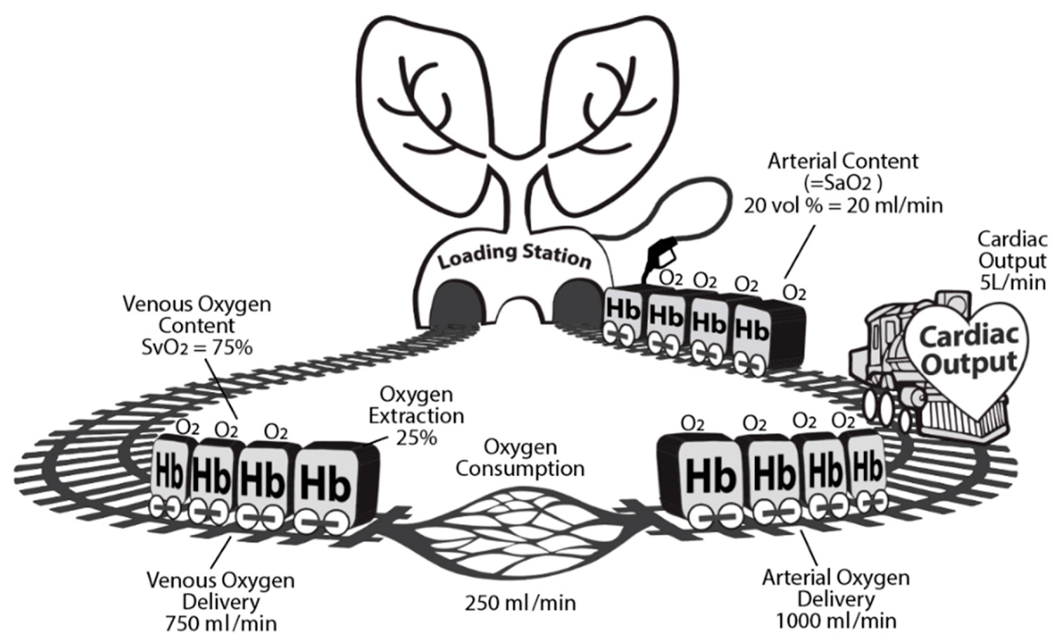

Slide 13
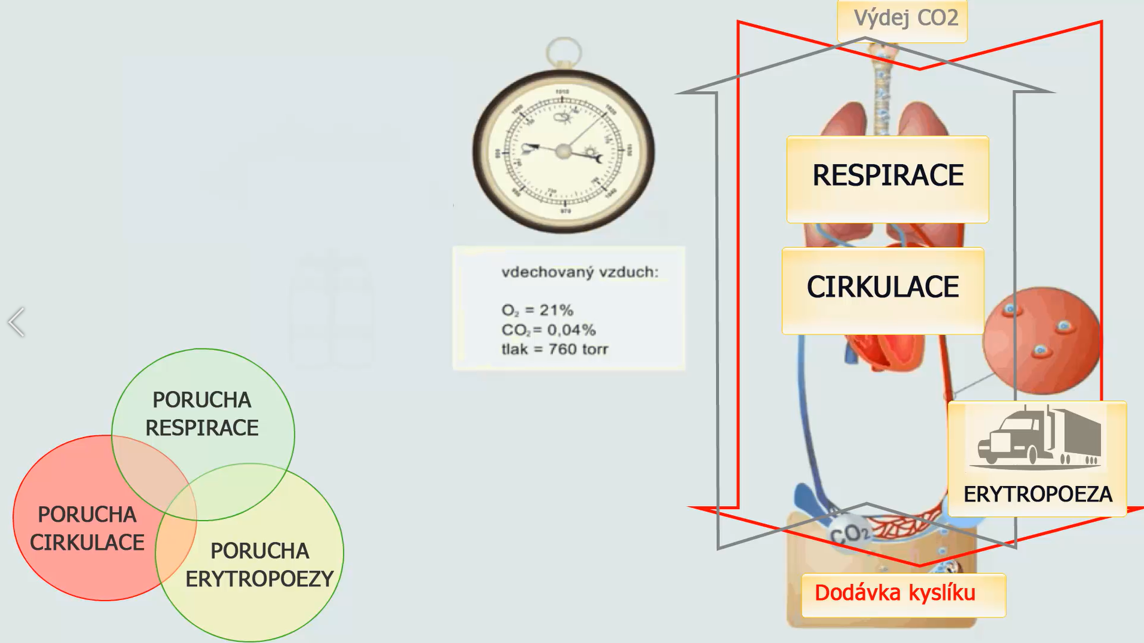
CO2 removal
Oxygen delivery
Respiration
Oxygen consumption
Inspired air
Circulation
Respiration
disorder
Erythropoiesis
Circulation
disorder
Erythropoiesis
disorder
Oxygen delivery

Slide 14
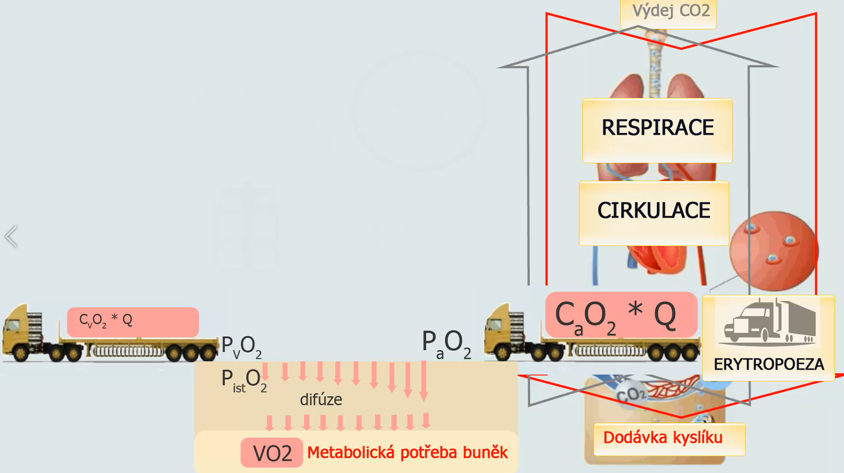
CO2 removal
Oxygen delivery
Respiration
Oxygen consumption
Circulation
Erythropoiesis
difusion
Oxygen delivery
Oxygen consumption

Slide 15
CO2 removal
What does the delivery depend on?
Respiration
Circulation
Oxygen delivery
What does consumption depend on?
Erythropoiesis
difusion
Oxygen delivery
Oxygen consumption

Slide 16
Oxygen delivery
Circulation
P_{i}O₂
P_{a}O₂
Hb
Ventilation
S_{a}O₂
C_{a}O₂*Q

Slide 17
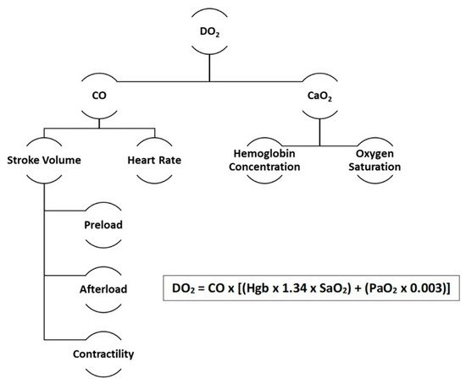
Notes:
Oxygen supply can be calculated from hemoglobin concentration, oxygen partial pressure and hemoglobin saturation in arterial blood

Slide 18
Oxygen delivery
Circulation
P_{i}O₂
P_{a}O₂
Hb
Ventilation
S_{a}O₂
C_{a}O₂*Q
ATP/ADP relation
Metabolic requirements
VO2
Cells
Oxygen consumption

Slide 19
Oxygen delivery
Circulation
P_{i}O₂
P_{a}O₂
Hb
Ventilation
S_{a}O₂
C_{a}O₂*Q
P_{v}O₂
C_{v}O₂
P_{a}O₂
Diffusion
ATP/ADP relation
P_{ist}O₂
Metabolic requirements
VO2
Cells
Oxygen consumption

Slide 20
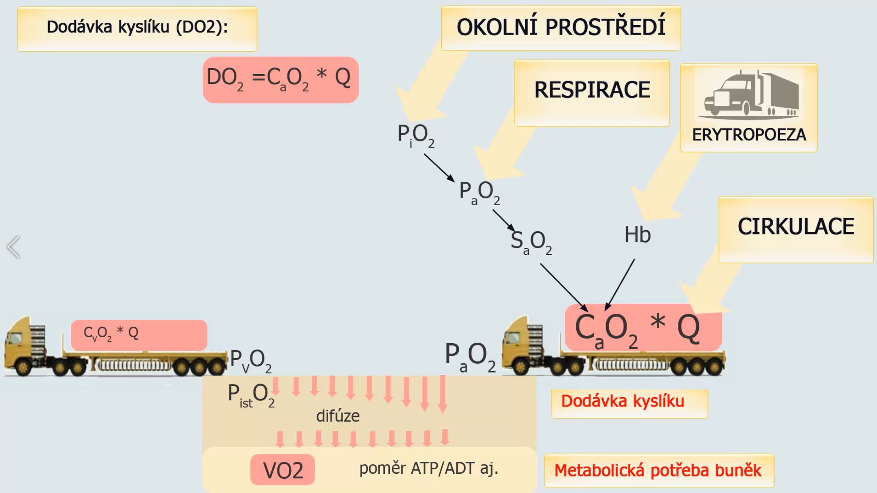
Oxygen delivery (DO2):
Environment
Respiration
Erythropoiesis
Circulation
Oxygen delivery
difusion
ADT/ATP ratio
Metabolic needs of cells

Slide 21
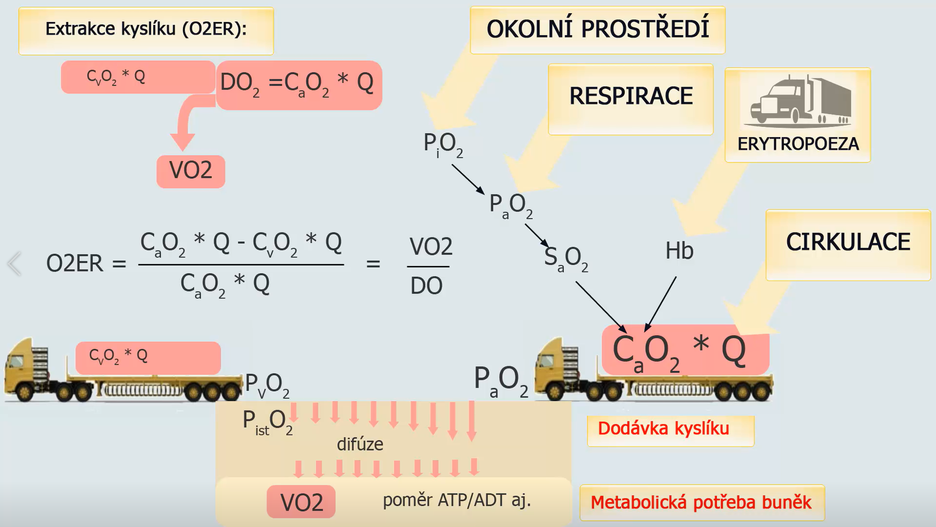
Oxygen Extraction Ratio O2ER
Environment
Respiration
Erythropoiesis
Circulation
2
difusion
Oxygen delivery
ADT/ATP ratio
Metabolic needs of cells

Slide 22
Oxygen delivery
Circulation
P_{i}O₂
P_{a}O₂
Hb
Ventilation
S_{a}O₂
C_{a}O₂*Q
P_{v}O₂
C_{v}O₂
P_{a}O₂
Diffusion
ATP/ADP relation
P_{ist}O₂
Metabolic requirements
Oxygen
consumption
- VO₂
critical DO₂
VO2
Cells
Oxygen consumption
Oxygen delivery - DO₂
Notes:
Oxygen consumption does not depend on the supply - the tissues take as much oxygen flow from the blood as needed. The result is a decrease in PO2 in the tissues and the venous blood. The oxygen extraction fraction rises.
In reducing oxygen supply, for various reasons, we eventually reach the point where, given a given oxygen consumption and a given oxygen supply, the oxygen concentration around the mitochondria will be critically low, and the cells will switch to anaerobic metabolism. Let's not talk about the critical value of oxygen supply (for a given oxygen consumption).

Slide 23
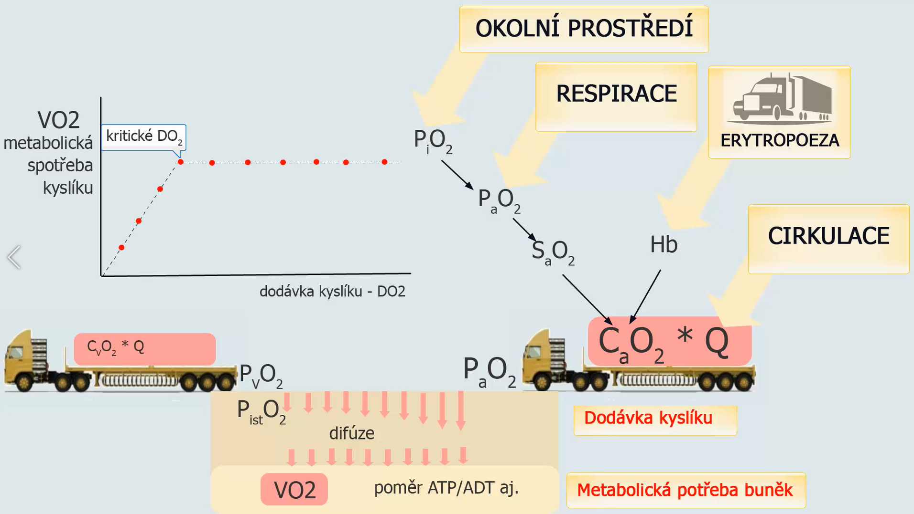
Environment
Respiration
Critical DO2
Erythropoiesis
Metabolic oxygen consumption
Critical DO2
Circulation
Oxygen delivery DO2
difusion
Oxygen delivery
ADT/ATP ratio
Metabolic needs of cells

Slide 24
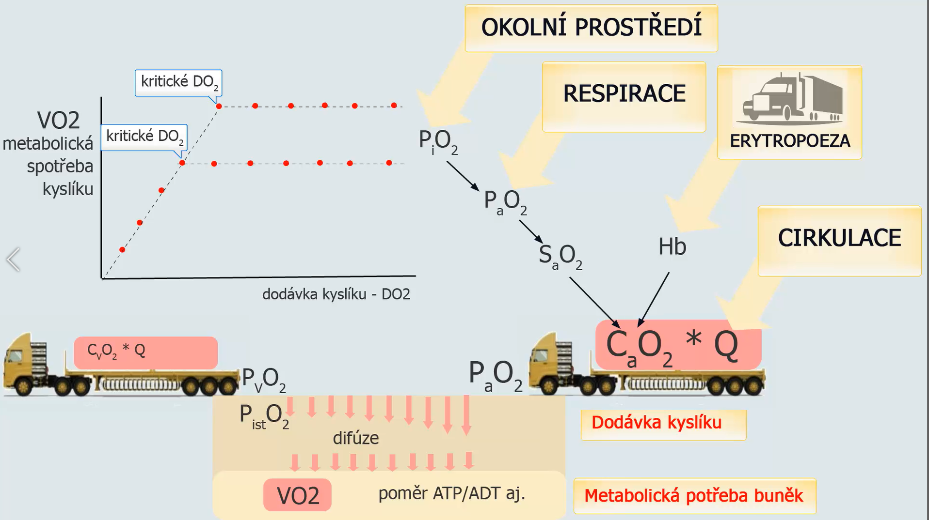
Environment
Critical DO2
Respiration
Critical DO2
Erythropoiesis
Metabolic oxygen consumption
Circulation
Oxygen delivery DO2
Oxygen delivery
difusion
ADT/ATP ratio
Metabolic needs of cells

Slide 25
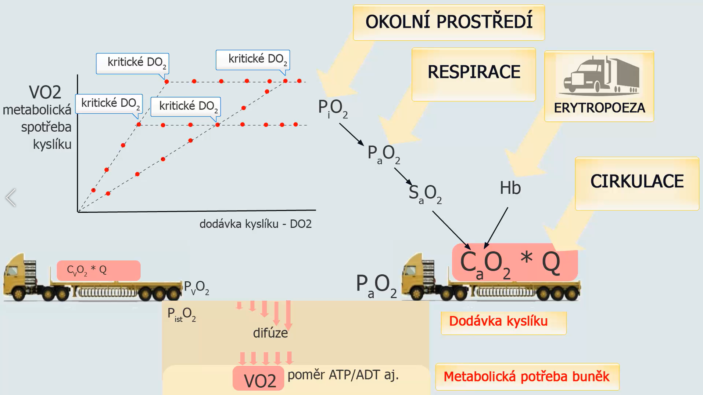
Environment
Critical DO2
Critical DO2
Respiration
Critical DO2
Critical DO2
Erythropoiesis
Metabolic oxygen consumption
Circulation
Oxygen delivery DO2
Oxygen delivery
difusion
ADT/ATP ratio
Metabolic needs of cells

Slide 26
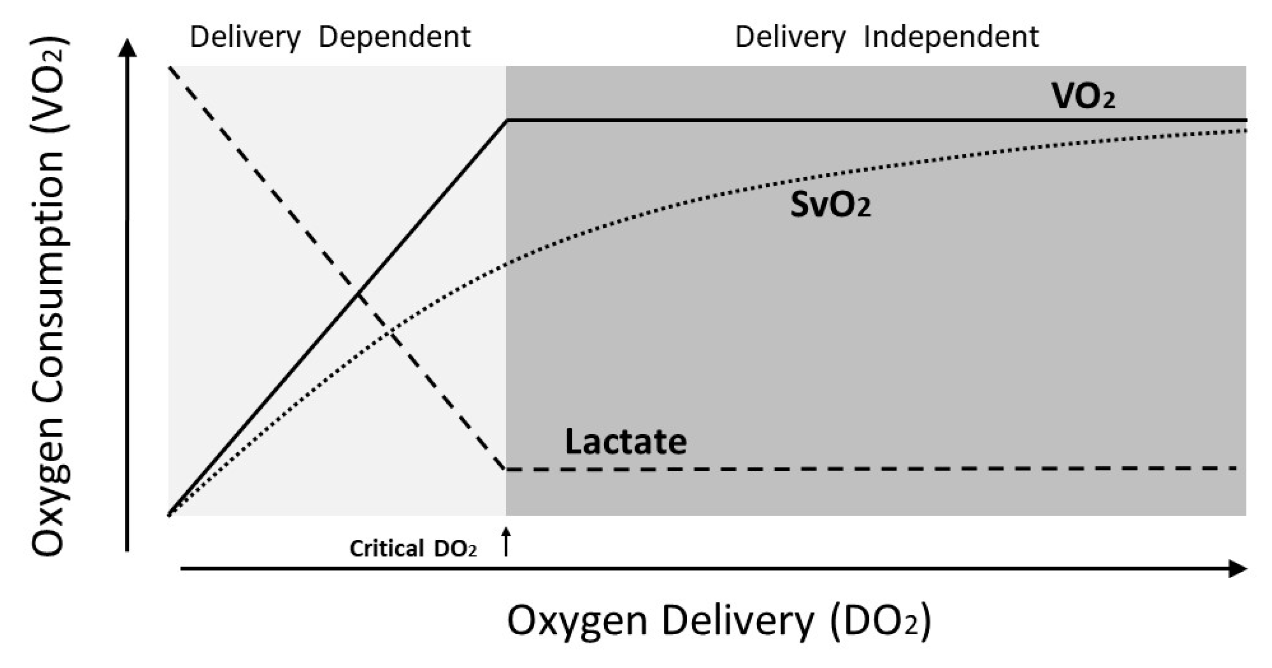
Notes:
Lactate levels rise, and as the oxygen supply further decreases, oxygen consumption decreases. Oxygen consumption is then dependent on supply - that's why we talk about delivery-dependent oxygen consumption

Slide 27

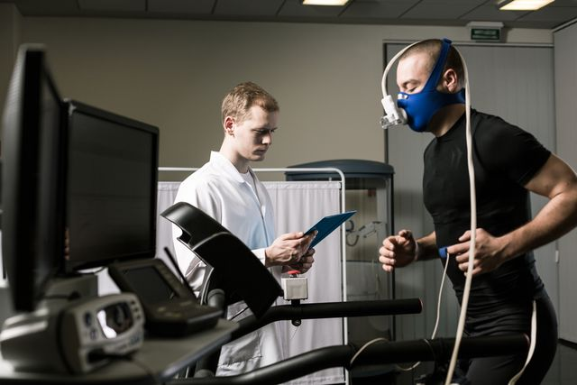
VO2 200 ml/min=>2000-3000 ml/min
Q 5 l/min=> 25 l/min
Notes:
The maximum oxygen consumption of athletes characterizes the top performance that an athlete can achieve.
Training can increase VO2 max.

Slide 28
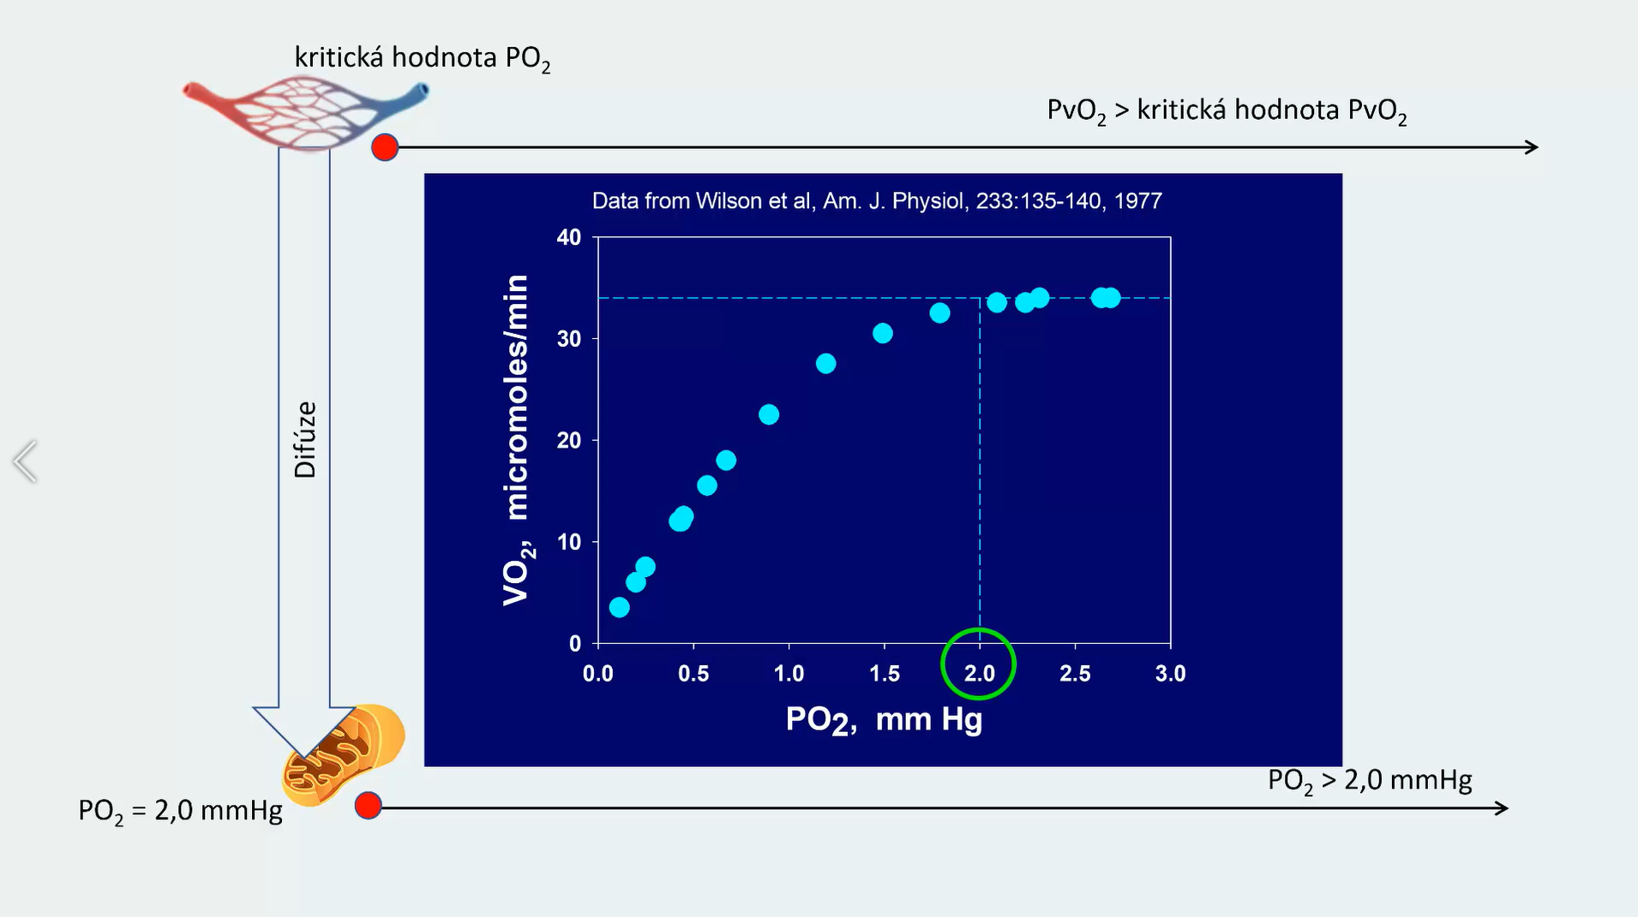
critical value PvO₂
critical value PvO₂

Slide 29
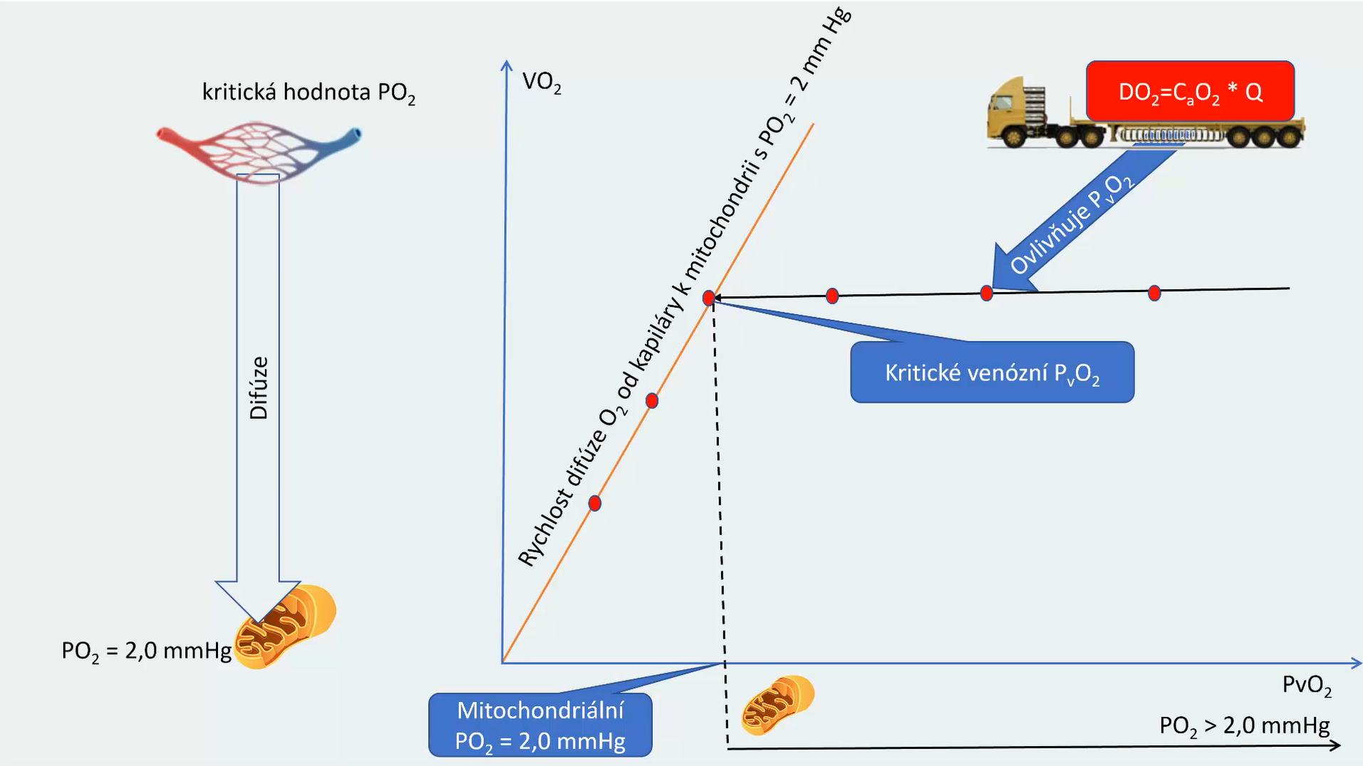
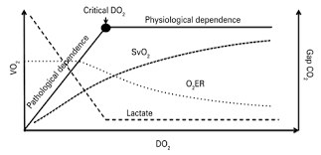
critical value PvO₂
It affects PvO₂
O₂ diffusion rate from capillary to mitochondria at P_{mit}O₂ = 2 mmHg
Diffusion
Critical venous O₂
Mitochondrial PO₂=2 mmHg

Slide 30

Different diffusion area or diffusion distance
Different diffusion area or diffusion distance
Different diffusion area or diffusion distance
critical value PvO₂
critical value PvO₂
It affects PvO₂
O₂ diffusion rate from capillary to mitochondria at P_{mit}O₂ = 2 mmHg
Diffusion
Critical venous O₂
Mitochondrial PO₂=2 mmHg

Slide 31
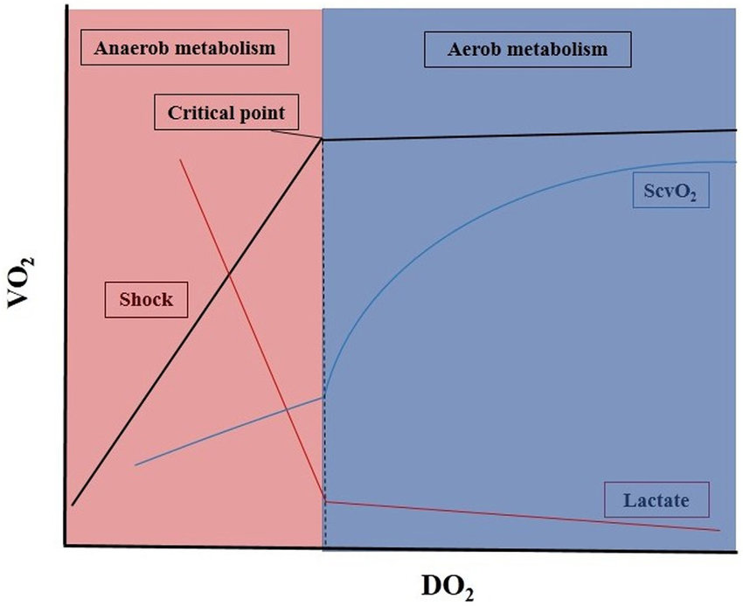

Slide 33
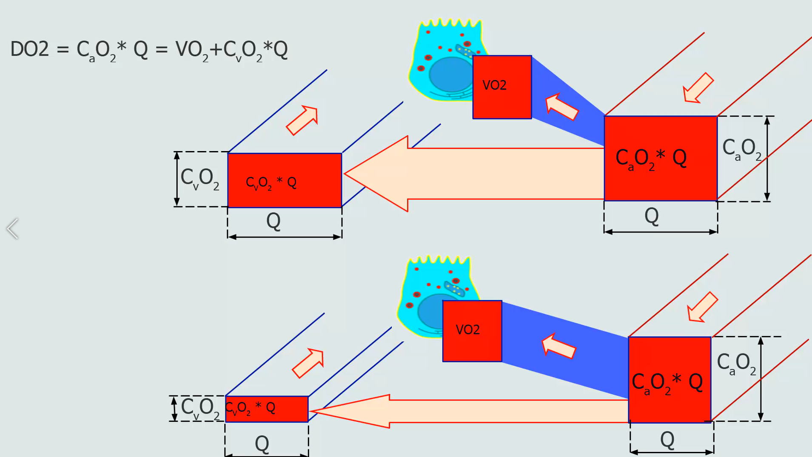
Decrease
Hb or PaO2
Perfusion decrease

Slide 34
decrease in perfusion

Slide 35
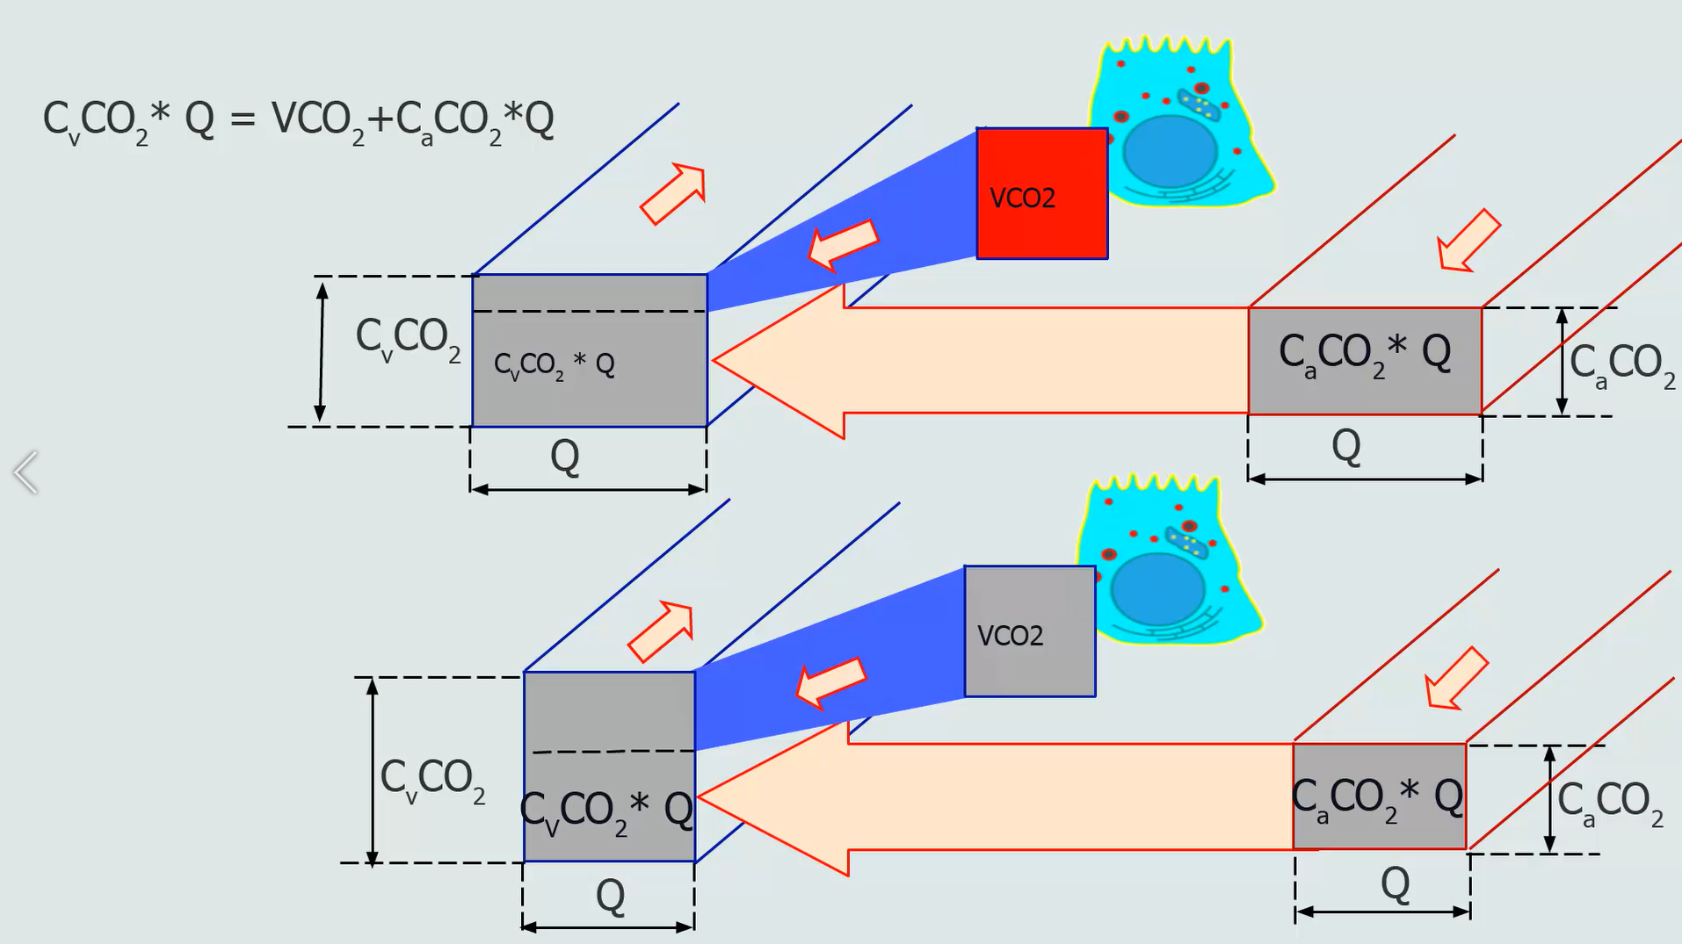

Slide 36
decrease in perfusion

Slide 37
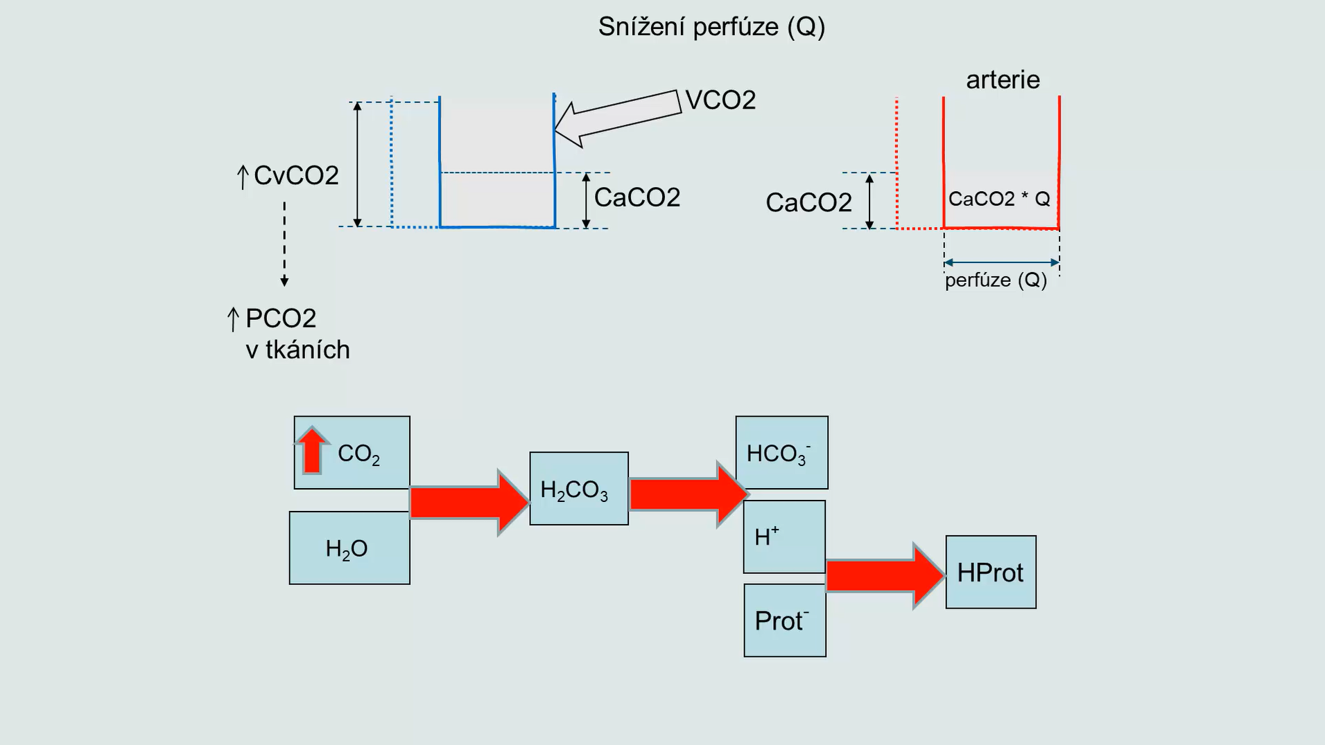

Slide 38
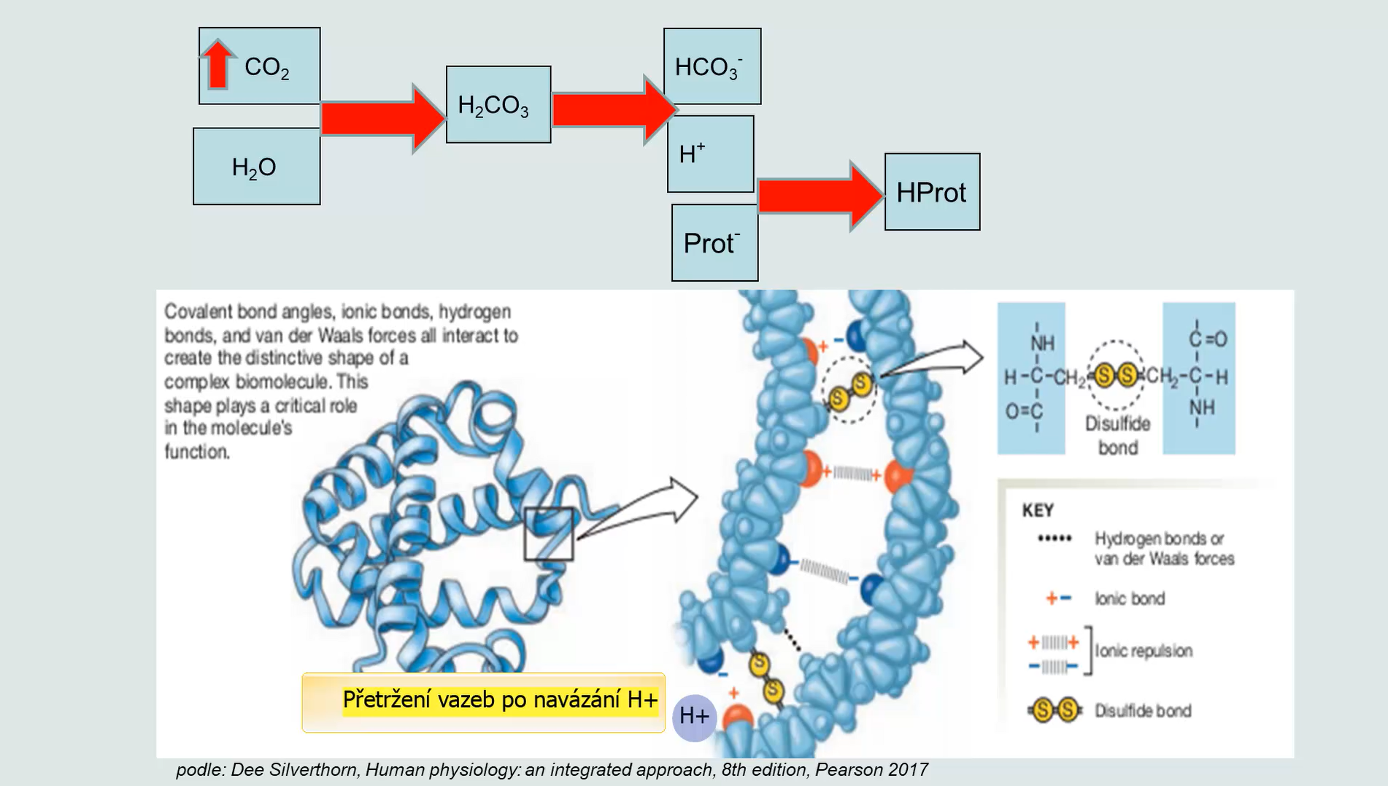

Slide 39
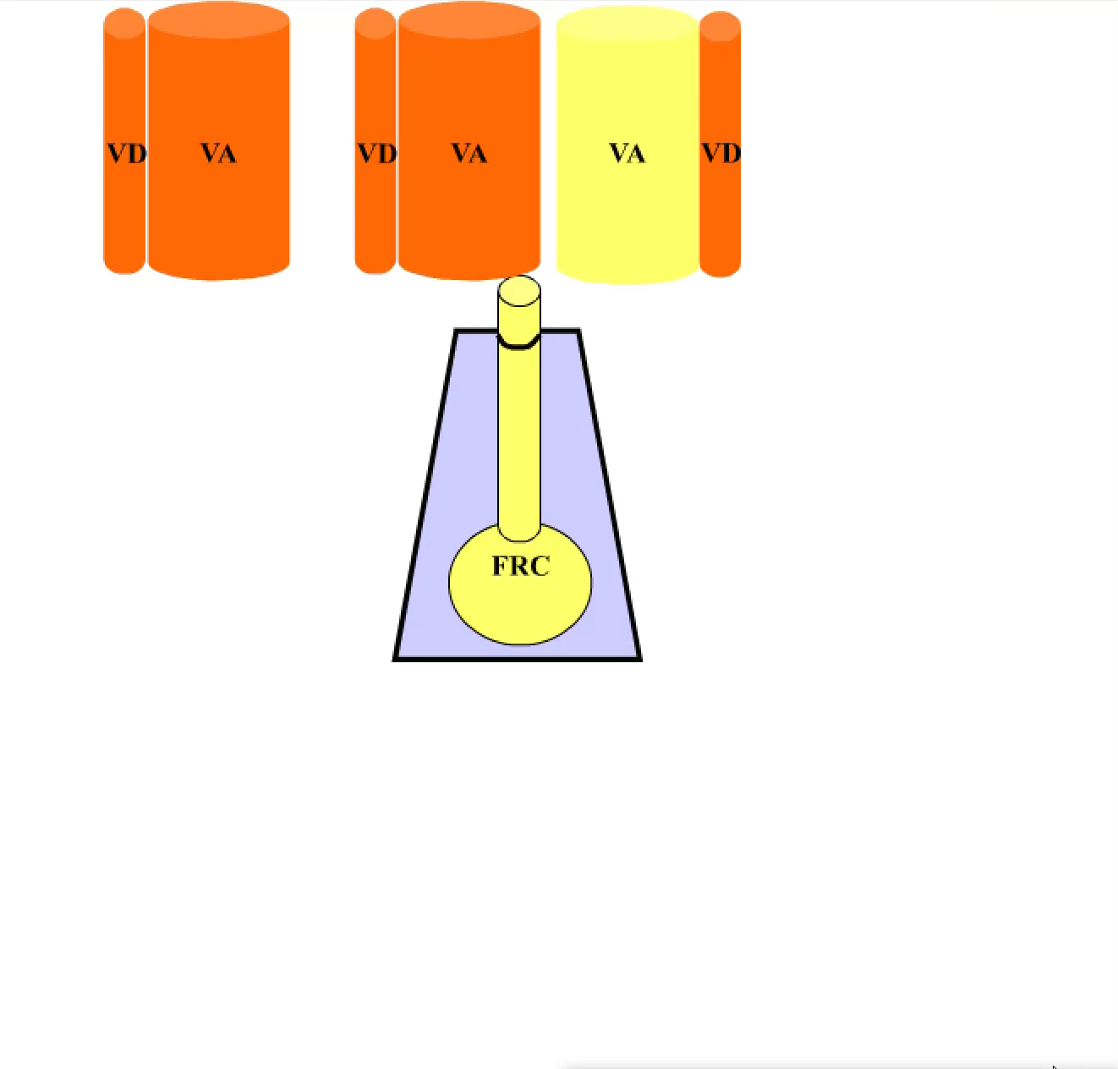
The concept of alveolar ventilation

Slide 40
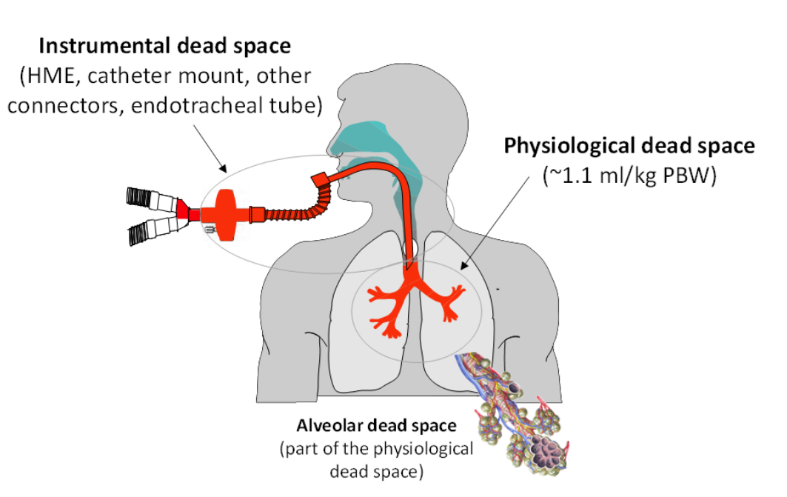
Lveolar ventiklation

Slide 41
Alveolar Ventilation Controls Rate of Breathing by Influencing pCO2 and pO2
VA
pO₂
VE=VD+VA
Respir. Centre
pCO₂
VA
Only when pO₂ is low
pCO₂
pO₂
pCO₂
pO₂

Slide 42
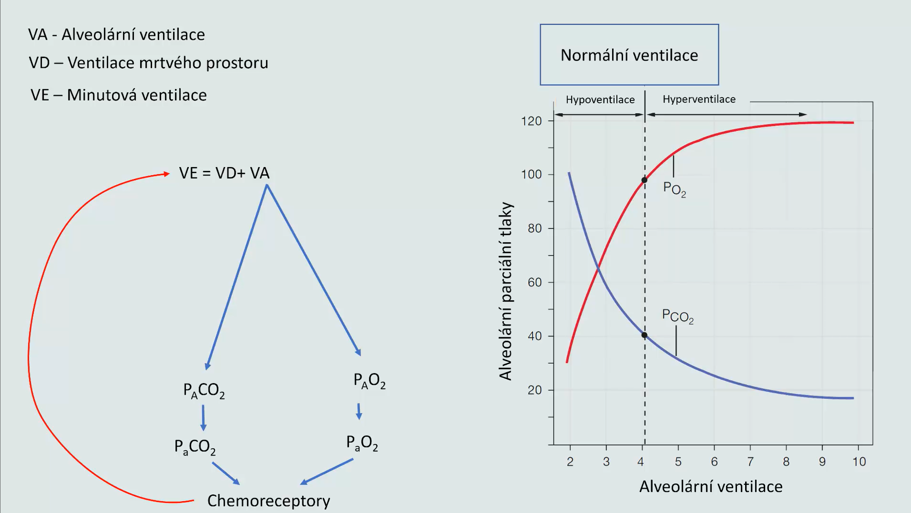
Alveolar ventilation
Dead space ventilation
Normal ventilation
Minute ventilation
Hypoventilation
Hyperventilation
Alveolar partial pressures
Alveolar ventilation
Chemoreceptors

Slide 43
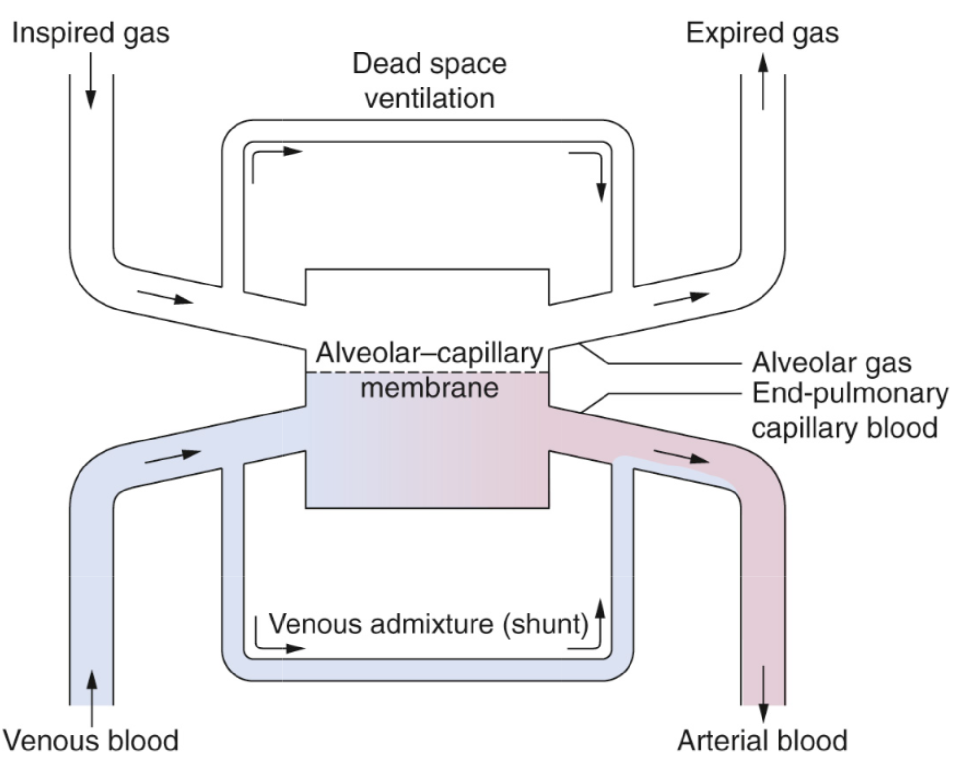
Alveolar ventilation
Alveolar capillary
perfusion

Slide 44
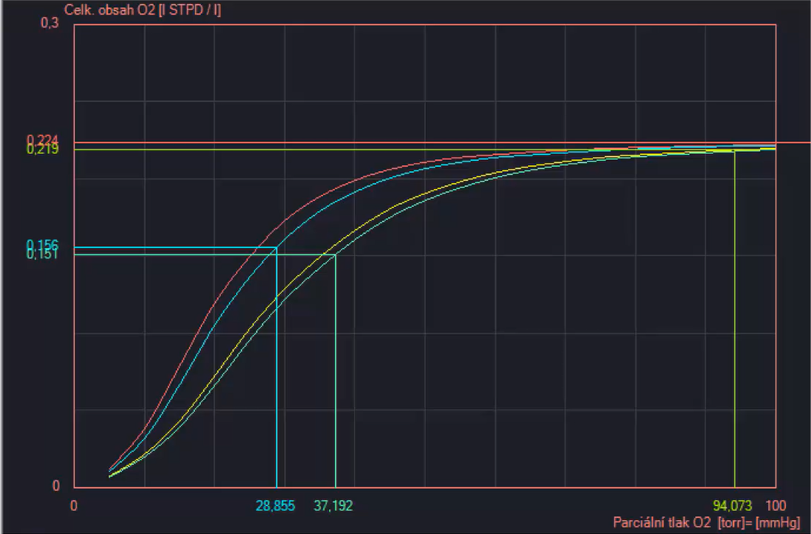
Inadequate hyperventilation
Shift of the oxygen dissociation curve to the left
A decrease in PO2
in the tissues
venous
arterial

Slide 45
Inadequate hyperventilation
Shift of the oxygen dissociation curve to the left
A decrease in PO2
in the tissues
Lactic acidification
(decrease in BE)
Shift of the oxygen dissociation curve back to the right
Return of PO2 back to normal
venous
arterial

Slide 46
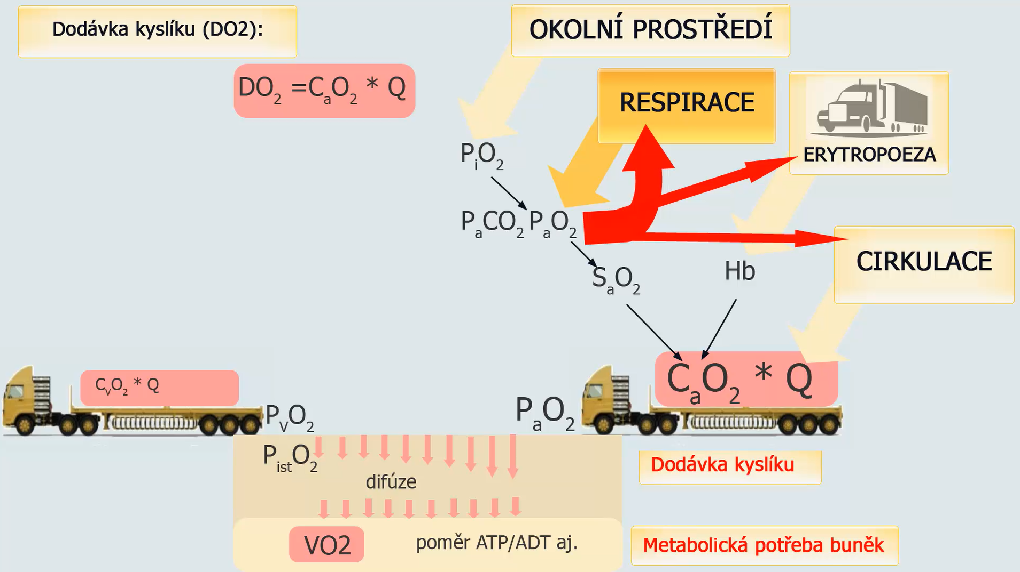
Oxygen delivery (DO2):
Environment
Respiration
Erythropoiesis
Circulation
difusion
Oxygen delivery
ADT/ATP ratio
Metabolic needs of cells

Slide 47
PO2 and circulation
It's different in the lungs!
Decreased PO2 in systemic tissues
Normalization of PO2
vasodilatation
Increase in oxygen supply

Slide 48
PO2 and circulation
It's different in the lungs!
Decreased PO2 in systemic tissues
Decrease alveolar ventilation
Normalization of PO2
Decreased PO2 in capillary blood in the alveoli
vasodilatation
Vasoconstriction in the afferent pulmonary arteriole
Increase in oxygen supply
Redirection of blood flow to adjacent unaffected alveoli

Slide 49
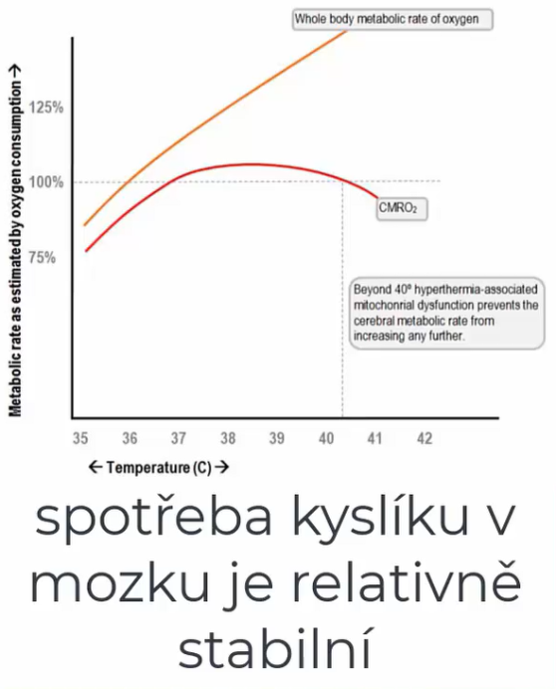
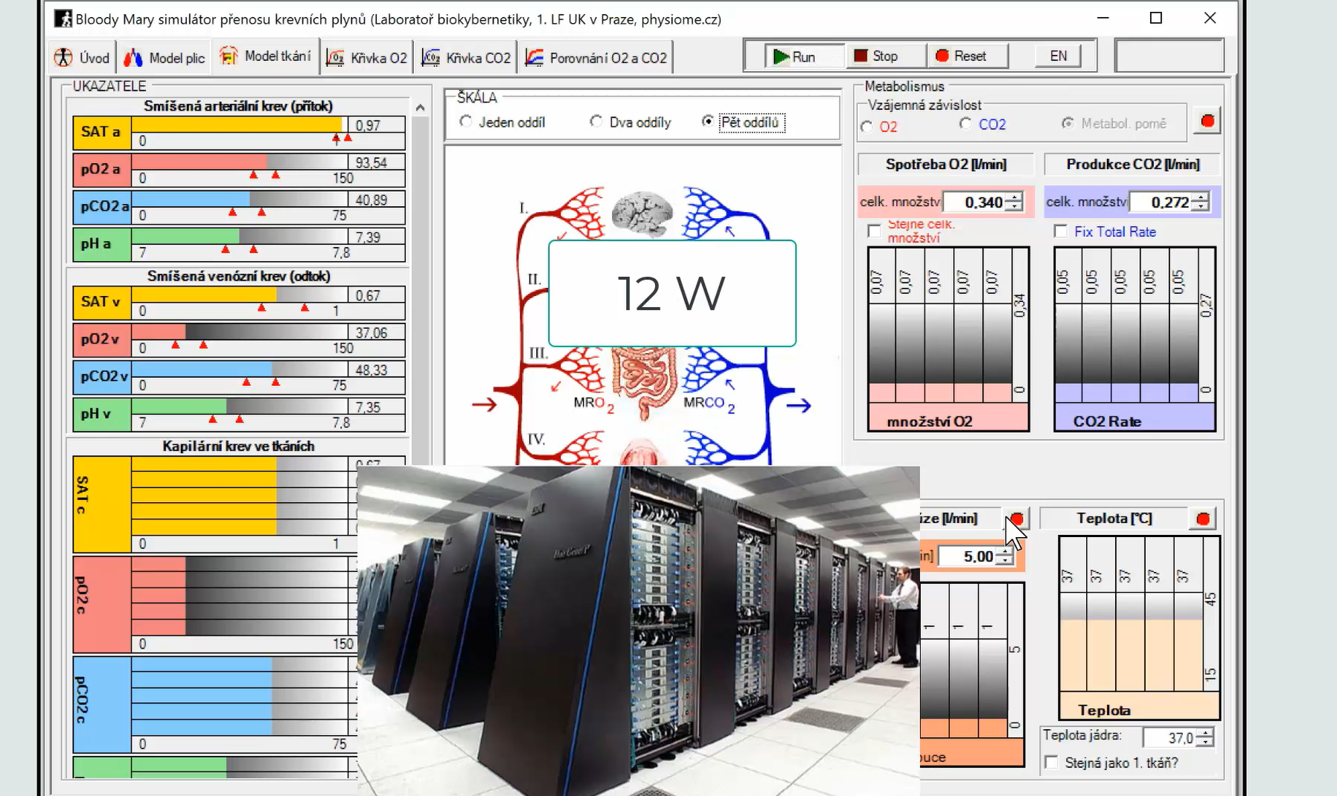

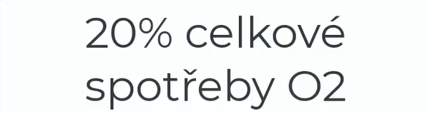
25% of glucose consumption
20% of total O2 consumption
Oxygen consumption is relatively stable

Slide 50
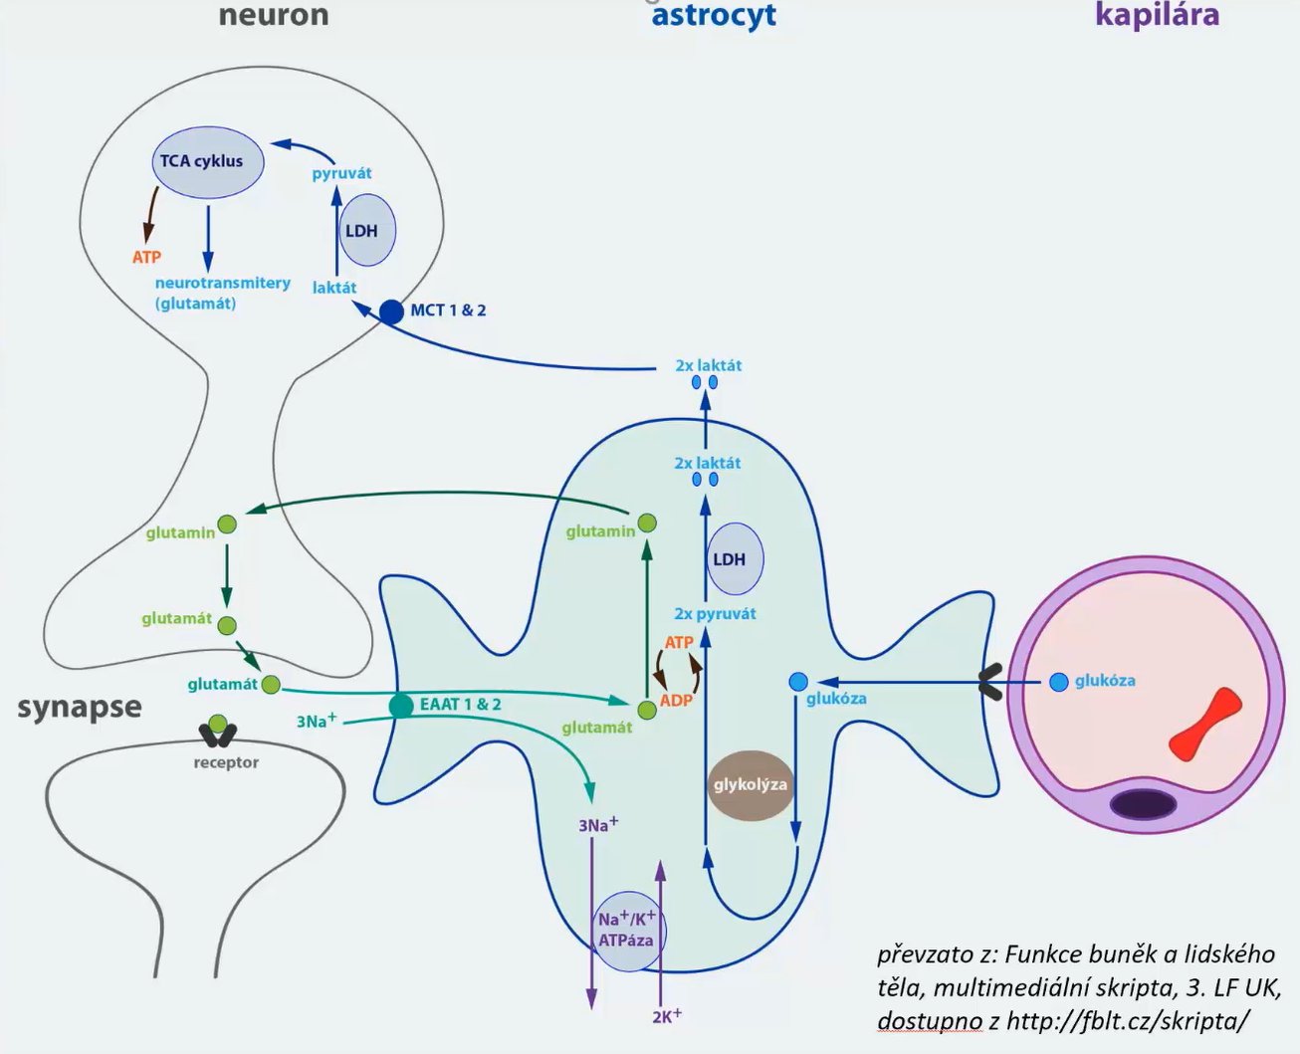
neuron
astrocyte
capillary
synapses

Slide 51
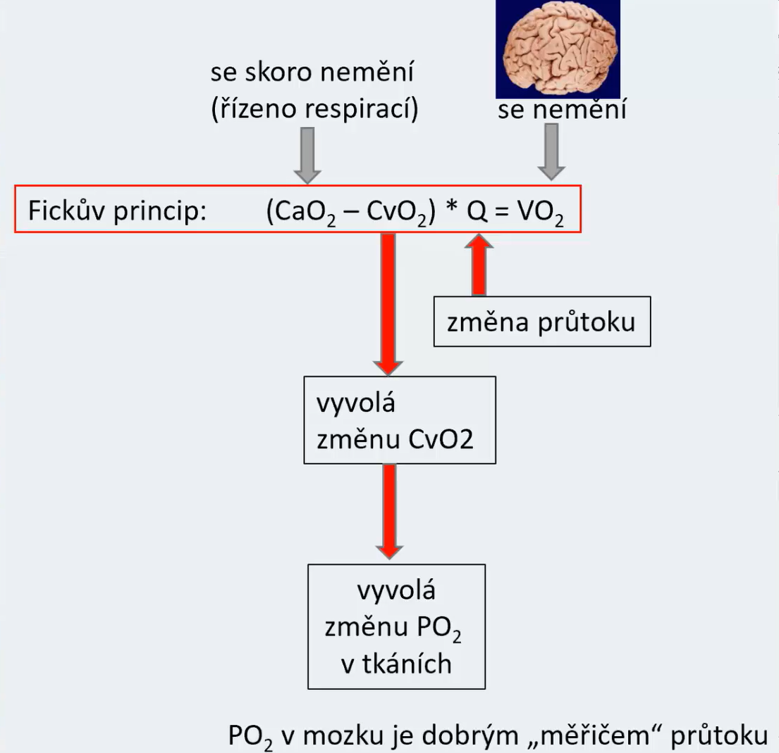
hardly changes
(controlled by respiration)
does not change
Fick's principle:
change in perfusion
induces a change in CvO₂
induces a change in PO₂ in the brain tissue
low PO₂ - vasodilatation of cerebral vessels
PO2 in the brain is a good sensor of blood flow

Slide 52

hardly changes
(controlled by respiration)
does not change
Fickův princip: (CvCO₂ – CaCO₂)*Q = VCO₂
Fick's principle:
On the edge of consciousness. How to heal the soul with holotropic breathing?
induces a change in CvCO₂
change in perfusion
Hyperventilation
induces a change in PCO₂ in the brain tissue
low PCO₂ – vasoconstriction of cerebral vessels
Low PaCO₂
Vasoconstriction of cerebral vessels
PCO2 in the brain is a good sensor of blood flow

Slide 53
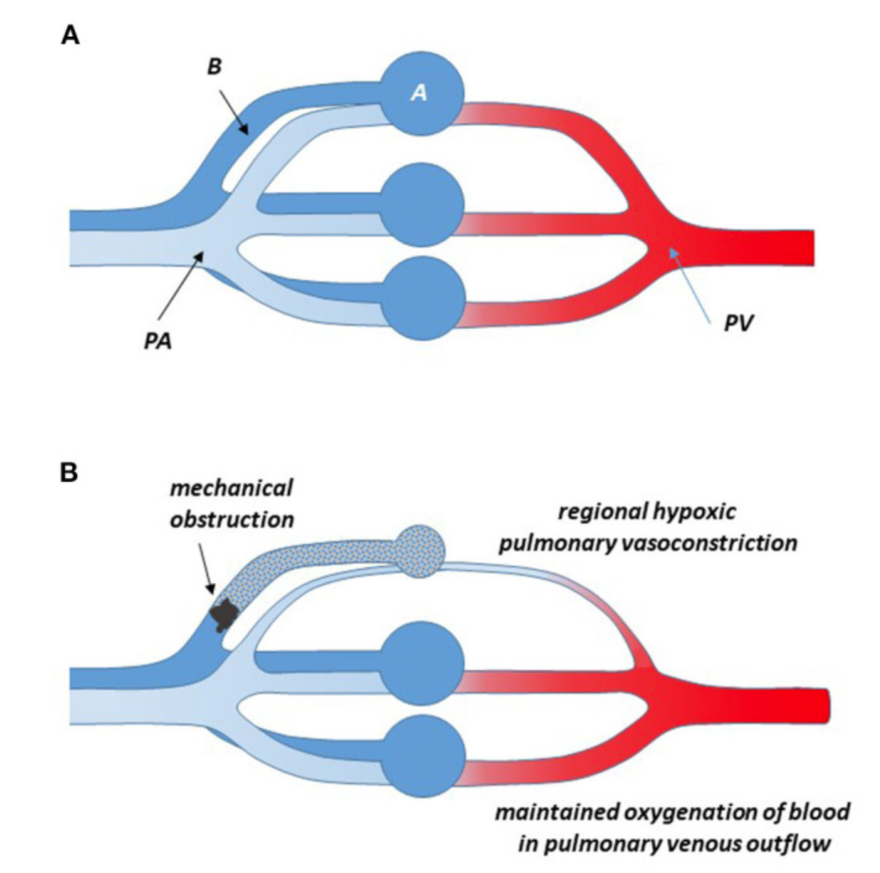
In lungs:

Slide 54
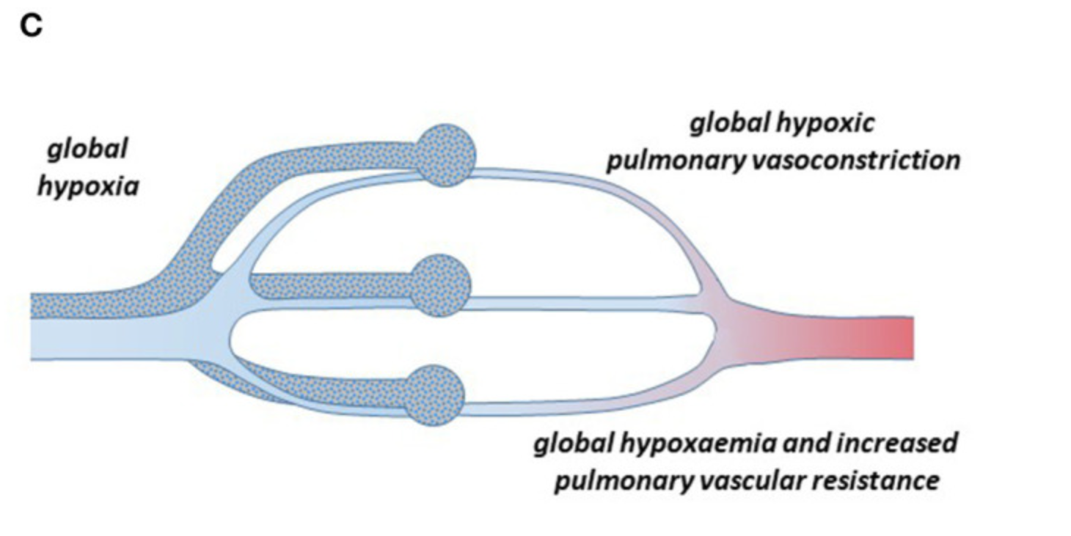
In lungs:

Slide 55
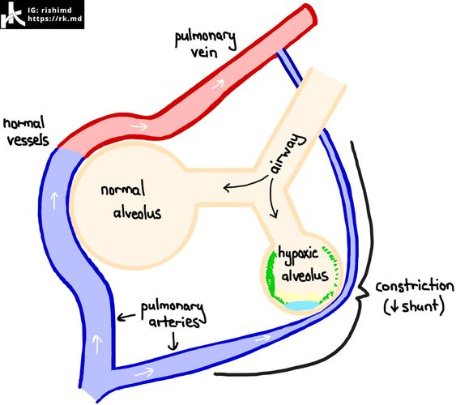
In lungs:
Decrease PO2

Slide 56
High Altitude Hypoxia
Climing
Barometric pressure drop
Decrease in barometric pressure with altitude

Slide 57
High Altitude Hypoxia
Climbing
Pokles barometrického tlaku
A drop in barometric pressure
PO2 in inspired air

Slide 58
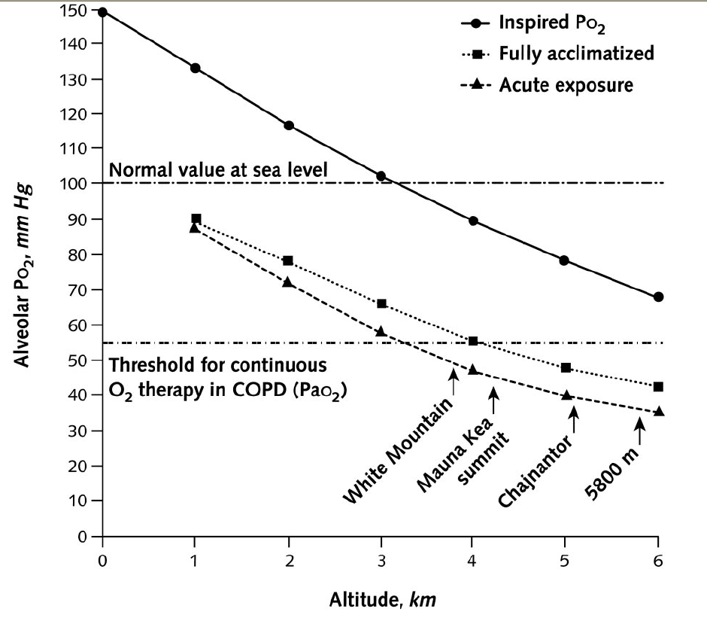
High Altitude Hypoxia
Climing
Drop in barometric pressure
Decrease in PO2 in inspired air
Decrease in alveolar PO2
PO2 v inspir. vzduchu
PAO2 - aklimatizovaní
Decrease in arterial PO2
PO2 in inspir. air
PAO2 – akutní expozice
PAO2 – fully acclimatized
PAO2 – acute altitude exposure

Slide 59
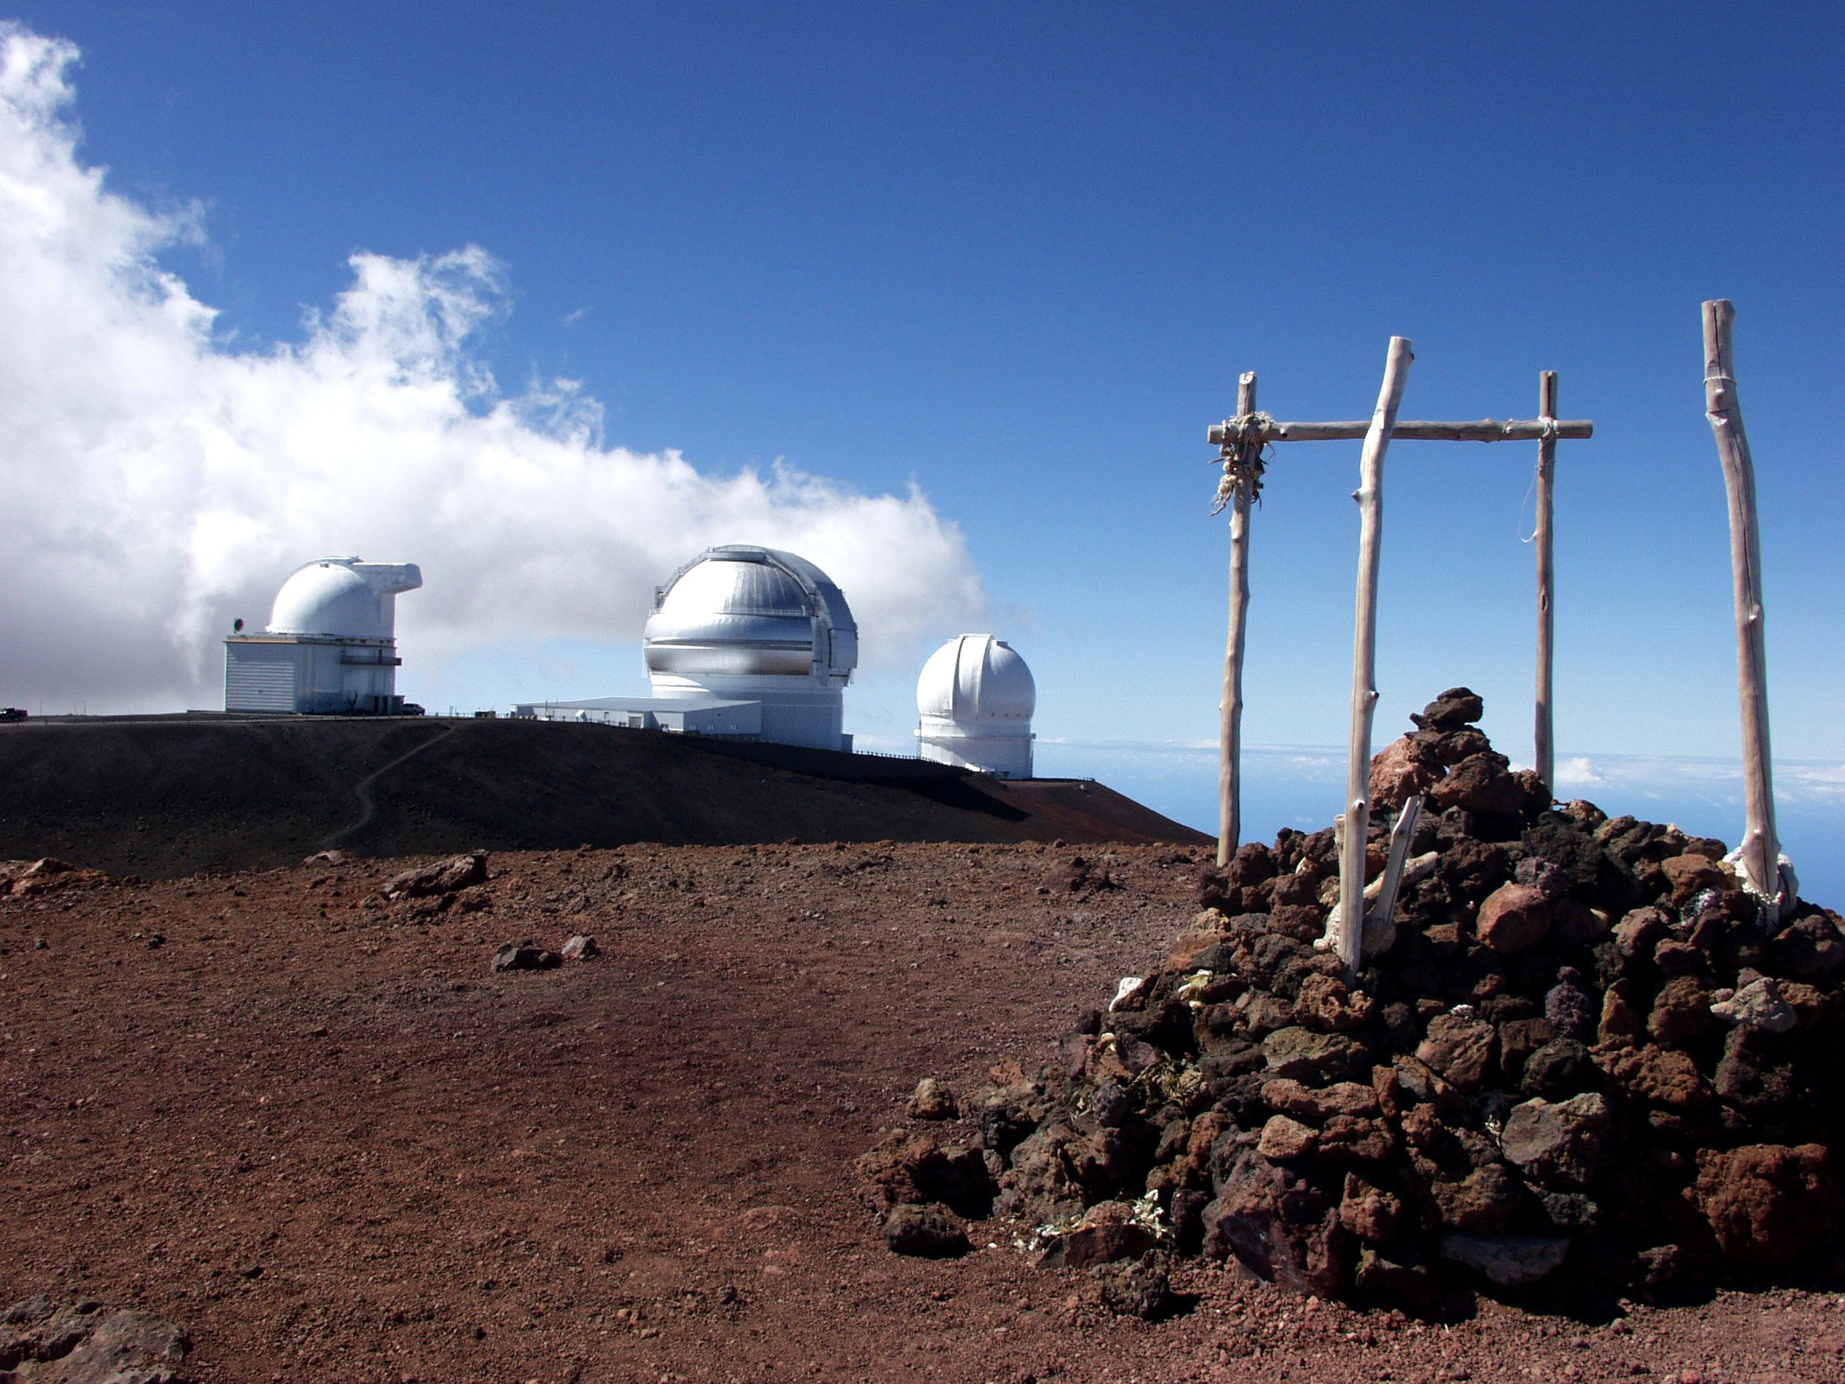

Slide 60
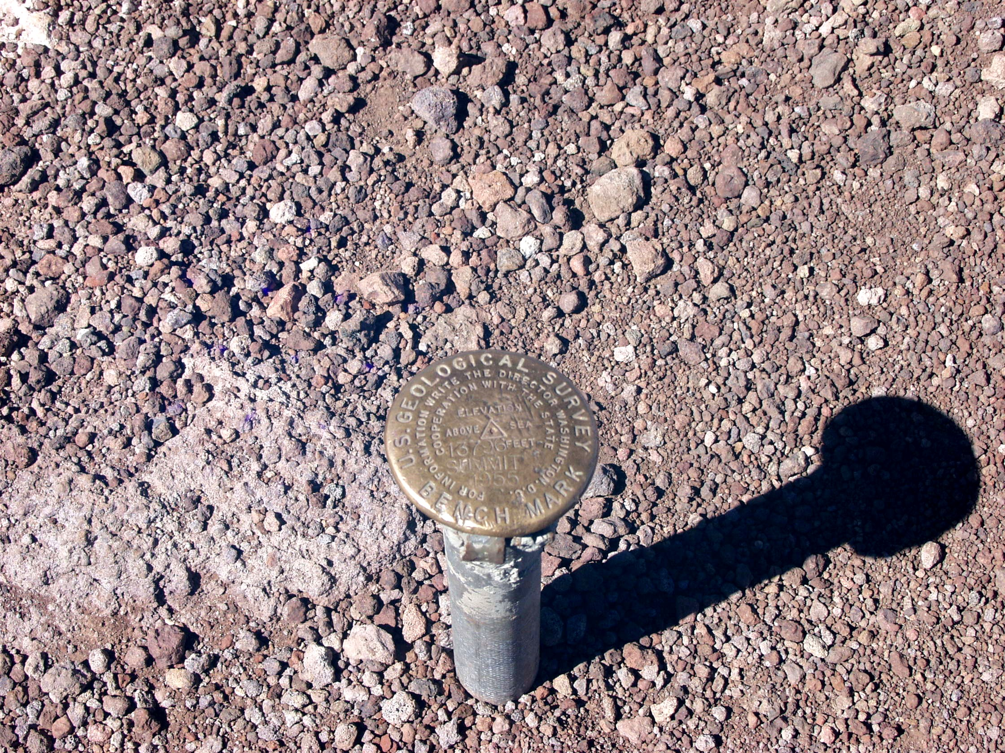

Slide 61
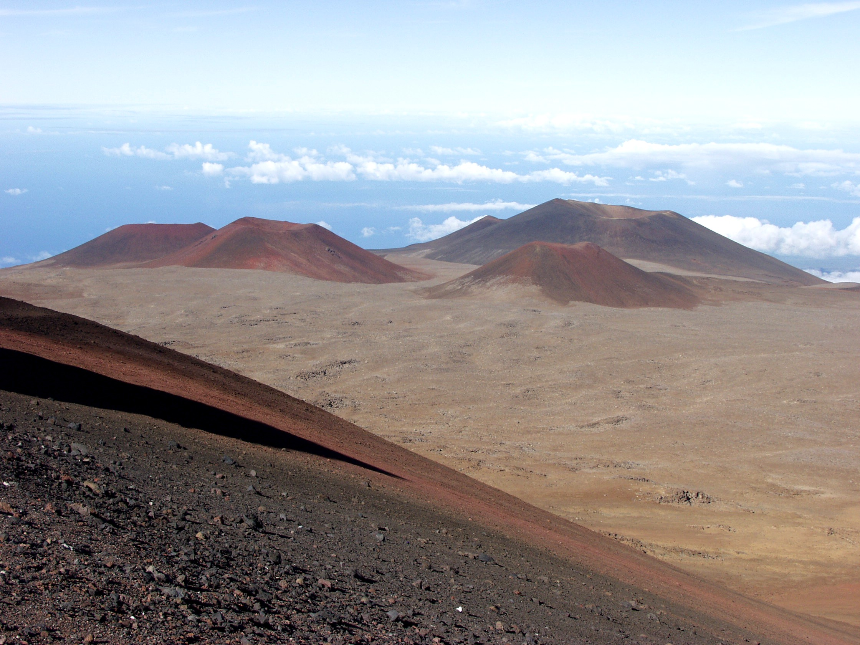

Slide 62
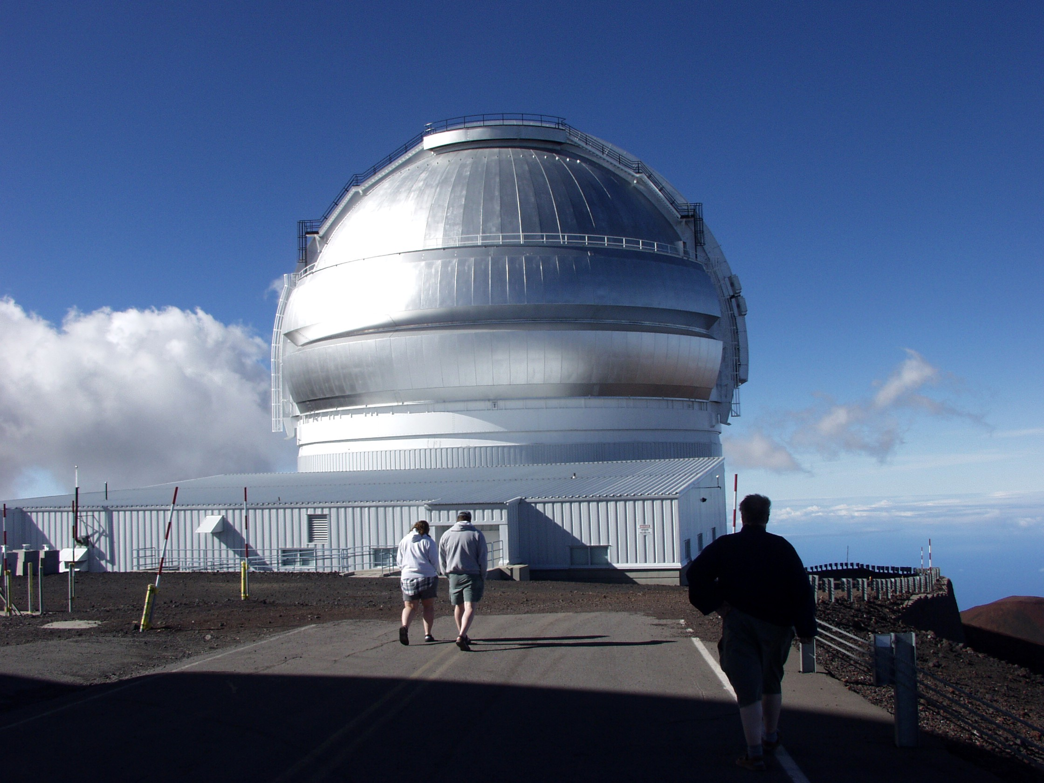

Slide 63
High Altitude Hypoxia
Climing
Improving the release of oxygen
Drop in barometric pressure
Pokles PO₂ v inspirovaném vzduchu
Improvement of hypoxia
Decrease in alveolar PO2
Shift of the oxygen dissociation curve to the right
ADAPTATION
Decrease in arterial PO2
SO2
Stimulation of the respiratory center
Blood acidification
O2 release
O2 release
Hyperventilation
Renal response to alkalemia: increased bicarbonate excretion
Hypocapnia
pO2
Alkalosis
Impairment of oxygen release in tissues
Shift of the oxygen dissociation curve to the left

Slide 64
High Altitude Hypoxia
Climing
Improving the release of oxygen
Drop in barometric pressure
Pokles PO₂ v inspirovaném vzduchu
Improvement of hypoxia
Decrease in alveolar PO2
Shift of the oxygen dissociation curve to the right
ADAPTATION
ADAPTATION
Decrease in arterial PO2
Increase in hematocrit
Increase in erythropoietin production
Stimulation of the respiratory center
Blood acidification
Stimulation of erythropoiesis
Hyperventilation
Hemoconcentration
Increased water loss through hyperventilation
Renal response to alkalemia: increased bicarbonate excretion
Hypocapnia
Dehydration
Alkalosis
Impairment of oxygen release in tissues
Shift of the oxygen dissociation curve to the left

Slide 65
High Altitude Hypoxia
Dangerous complications of high altitude sickness
PULMONARY EDEMA IN ALTITUDE SICKNESS
RIGHT SIDED CARDIAC FAILURE
CEREBRAL EDEMA IN ALTITUDE SICKNESS

Slide 66
High Altitude Hypoxia
Alveolar hypoxia

Slide 67
High Altitude Hypoxia
Alveolar hypoxia
vasoconstriction
Vasoconstriction in all pulmonary arterioles
Pressure rise

Slide 68
High Altitude Hypoxia
Alveolar hypoxia
Weaker
vasoconstriction
Edema
Nonuniform hypoxic vasoconstriction of pulmonary arterioles
Pressure rise
Pressure rise
Rise in pulmonary arterial pressure
An increase in pressure in those capillaries in front of which there is insufficient contraction of arterioles
Exudation
PULMONARY EDEMA IN ALTITUDE SICKNESS

Slide 69
High Altitude Hypoxia
Alveolar hypoxia
Weaker
vasoconstriction
Edema
Nonuniform hypoxic vasoconstriction of pulmonary arterioles
Pressure rise
Pressure rise
Rise in pulmonary arterial pressure
An increase in pressure in those capillaries in front of which there is insufficient contraction of arterioles
Exudation
Damage to the basement membrane
Neutrophil activation
Platelet activation
Release of inflammatory factors
Fibrin thrombi
PULMONARY EDEMA IN ALTITUDE SICKNESS

Slide 70
High Altitude Hypoxia
Alveolar hypoxia
Weaker
vasoconstriction
Nonuniform hypoxic vasoconstriction of pulmonary arterioles
Pressure rise
Rise in pulmonary arterial pressure
GRADUAL ADAPTATION OF LUNGS TO ALTITUDE

Slide 71
High Altitude Hypoxia
Alveolar hypoxia
Zvýšení
vasokonstrikce
Nonuniform hypoxic vasoconstriction of pulmonary arterioles
Pressure rise
Rise in pulmonary arterial pressure
Gradual muscle hypertrophy even in those capillaries where there was weaker vasoconstriction
Remodeling of the pulmonary basin – pulmonary vasoconstriction is unidirectional
All capillaries are protected from the transfer of high pressure from the pulmonary artery to the capillaries
GRADUAL ADAPTATION OF LUNGS TO ALTITUDE

Slide 72
High Altitude Hypoxia
Alveolar hypoxia
Zvýšení
vasokonstrikce
COMPLICATION:
RIGHT SIDED CARDIAC FAILURE
Nonuniform hypoxic vasoconstriction of pulmonary arterioles
Vzestup tlaku
Rise in pulmonary arterial pressure
Gradual muscle hypertrophy even in those capillaries where there was weaker vasoconstriction
Remodeling of the pulmonary basin – pulmonary vasoconstriction is unidirectional
All capillaries are protected from the transfer of high pressure from the pulmonary artery to the capillaries
GRADUAL ADAPTATION OF LUNGS TO ALTITUDE
RIGHT SIDED CARDIAC FAILURE

Slide 73
High Altitude Hypoxia
Hypocapnia
Hypoxia
Vasoconstrictive effect on cerebral vessels
Great stimulus for vasodilatation and hyperemia
HEADACHE, INSOMNIA, ANOREXIA, FATIGUE
The hypocapnic vasoconstrictive effect disappears after 2-3 days
Intracranial hypertension
Increase in brain flow
CEREBRAL EDEMA IN ALTITUDE SICKNESS

Slide 74


Slide 75
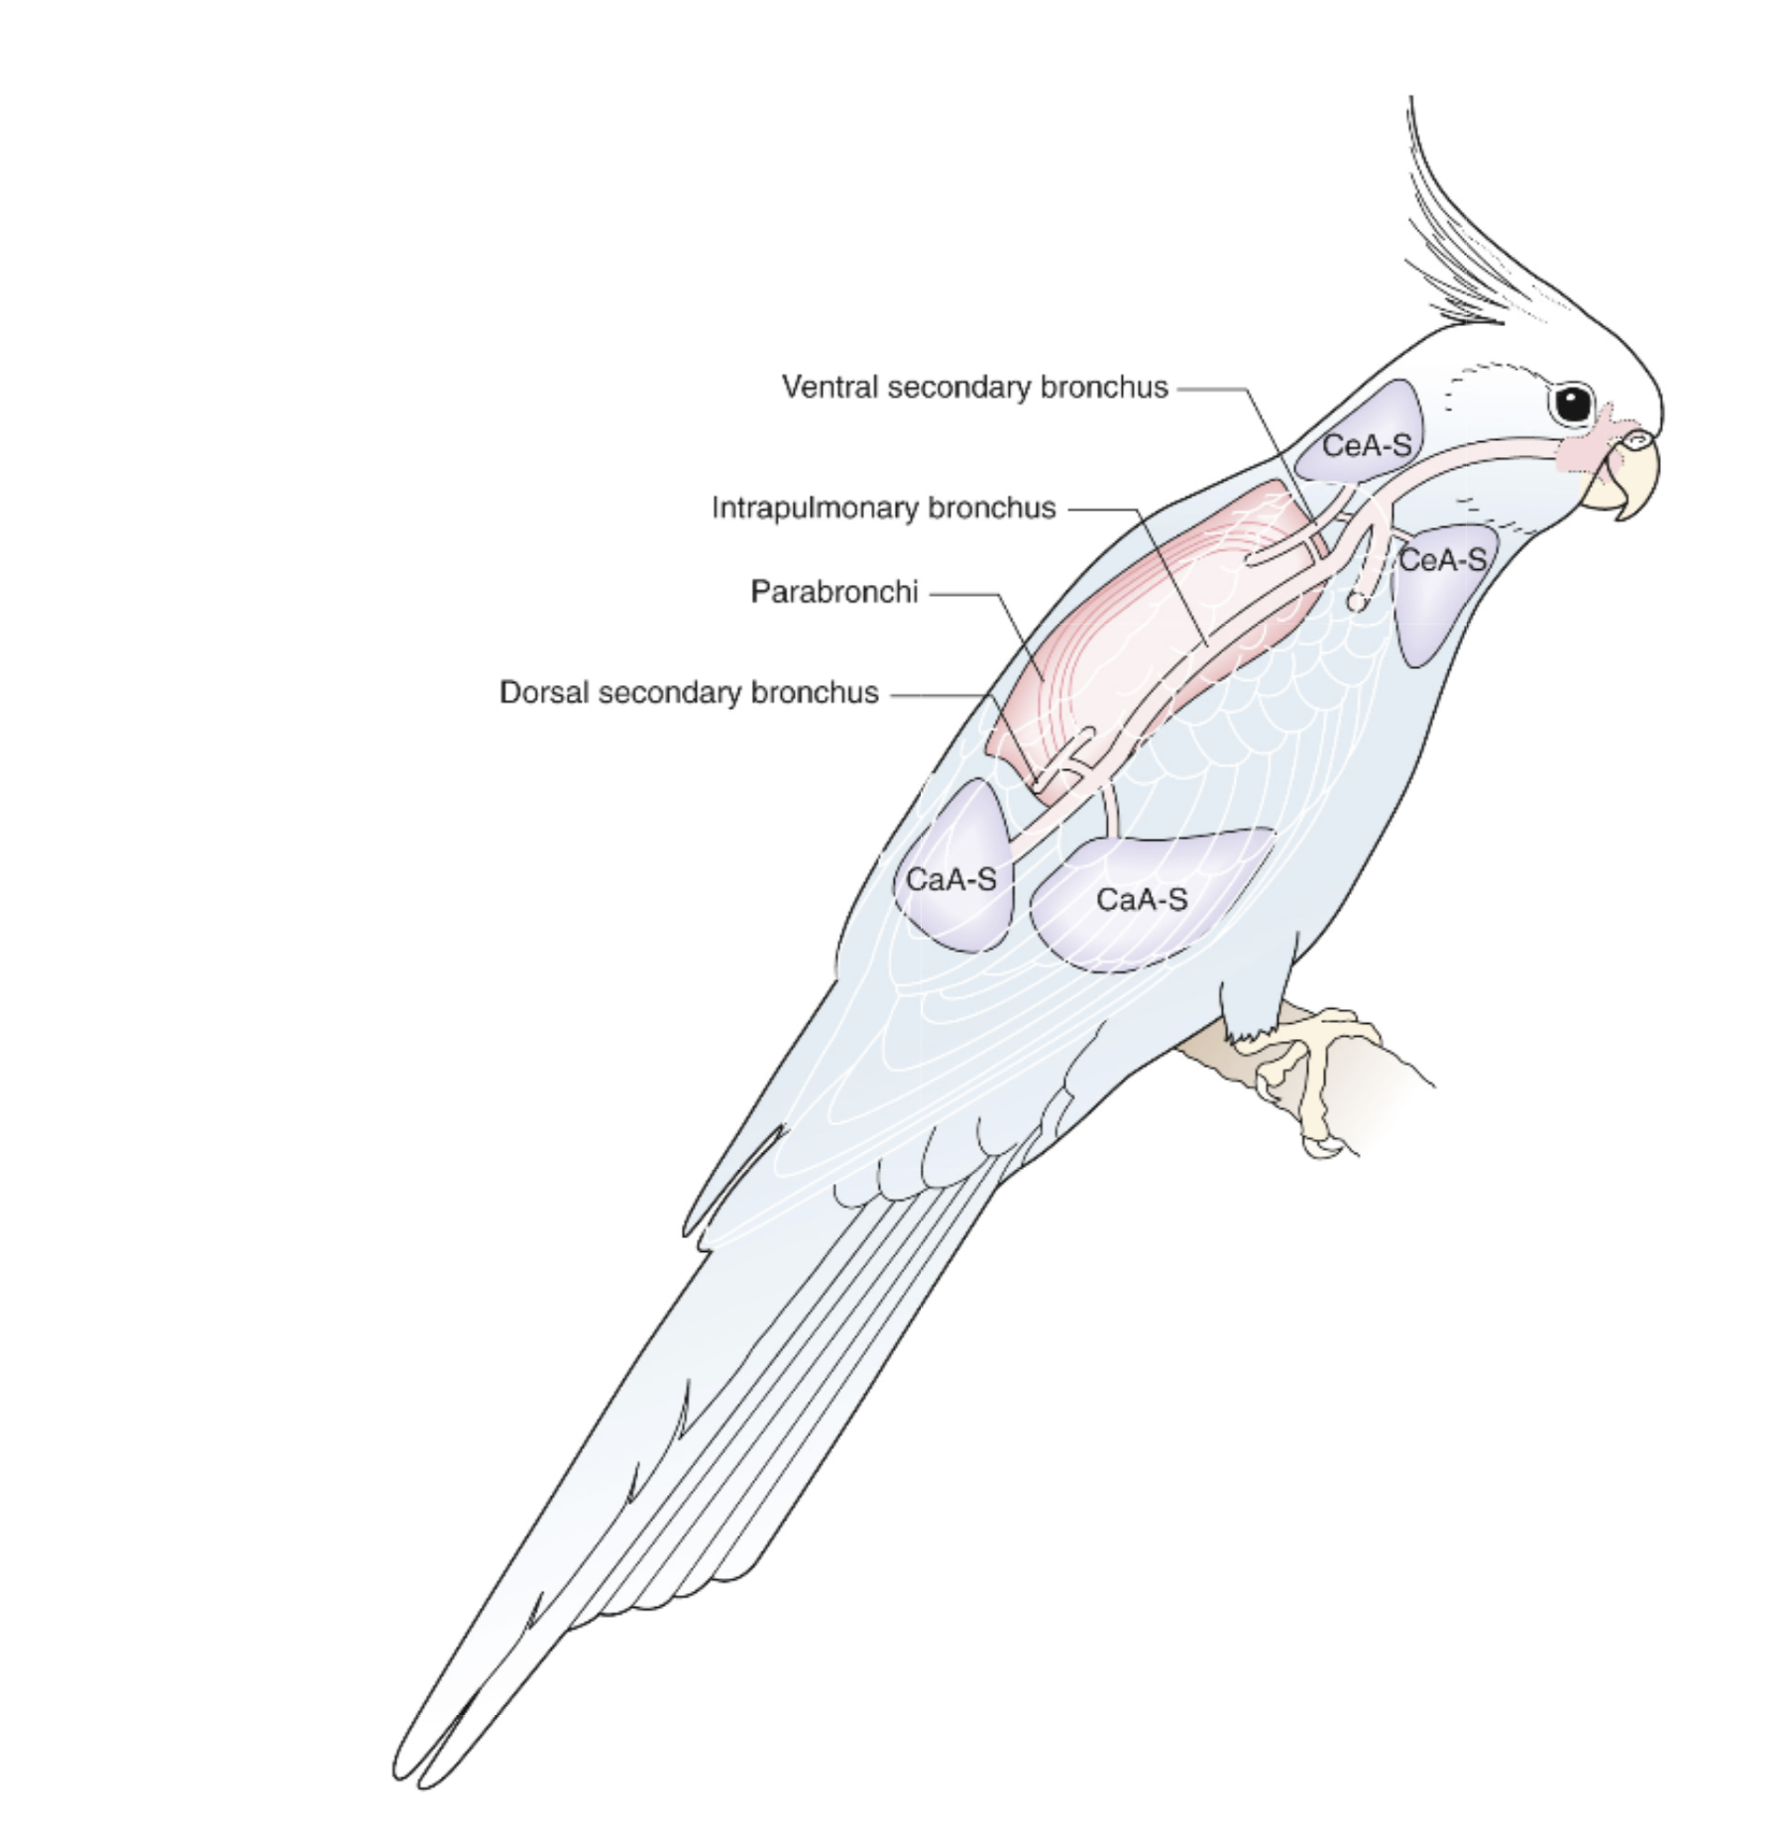
Blood
Air

Slide 76
Blood
Air

Slide 77
Blood
Air

