Slide 1
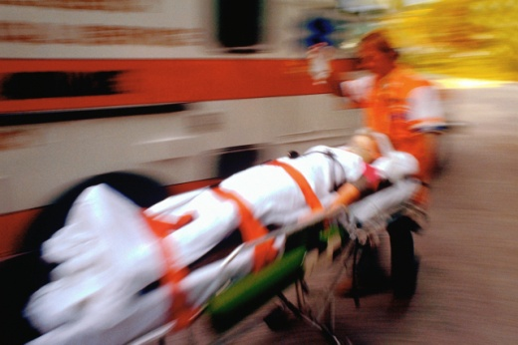
Integrative Physiology
O2/CO2 transport disorders
Circulation disorders
Respiratory disorders
Osmolarity disorders
Acid-Base disorders
Electrolyte disorders
Volume disorders
Gastrointestinal disorders
Kidney disorders

Slide 2
Integrative Physiology
O2/CO2 transport disorders
Circulation disorders
Respiratory disorders
Acid-Base disorders
Osmolarity disorders
Acid-Base disorders
Electrolyte disorders
Volume disorders
Gastrointestinal disorders
Kidney disorders

Slide 3
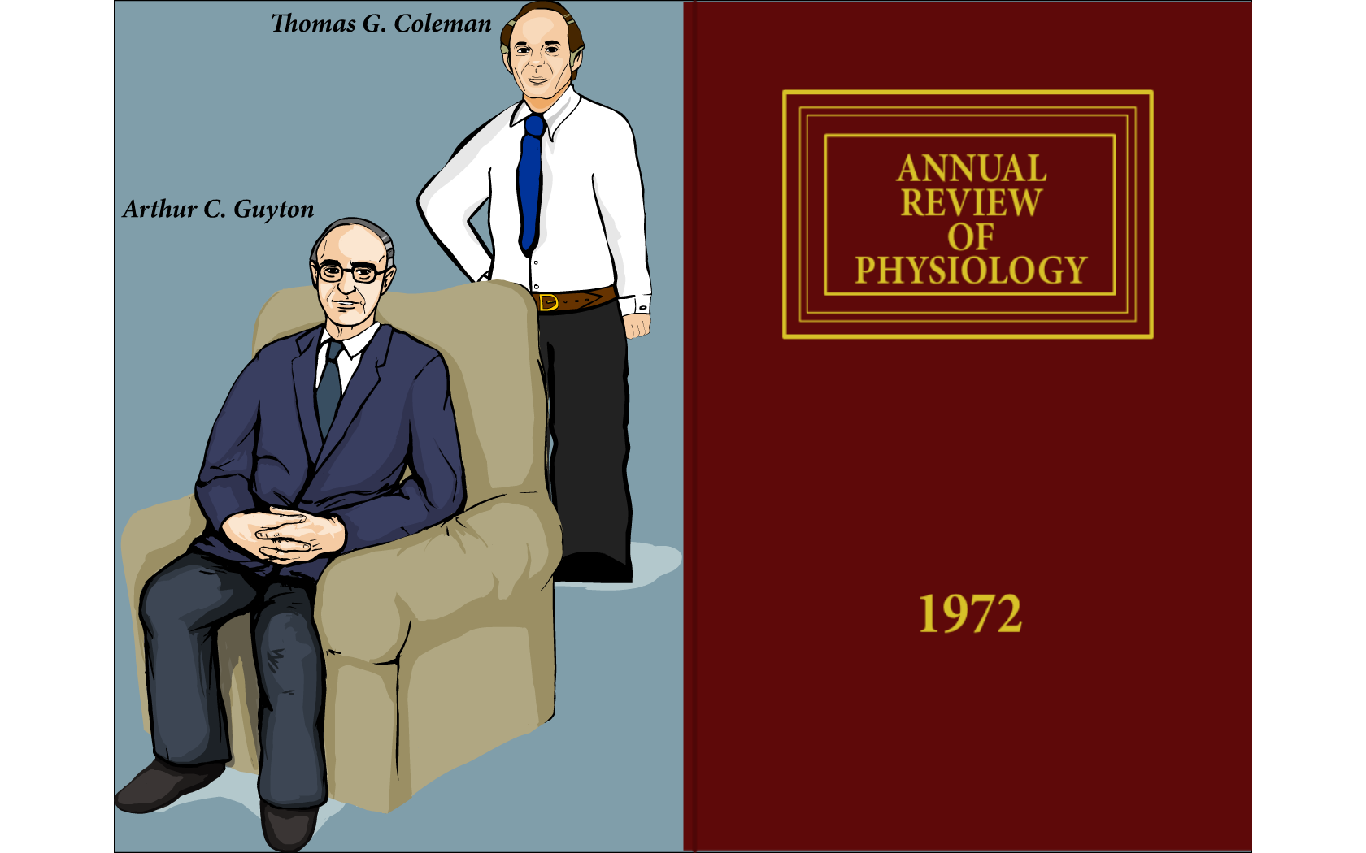

Slide 4
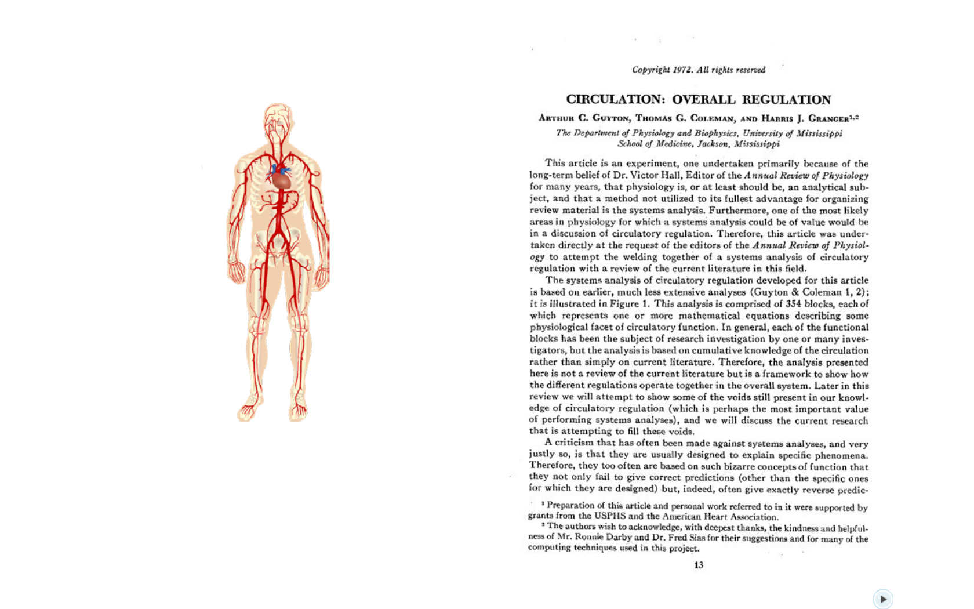

Slide 5
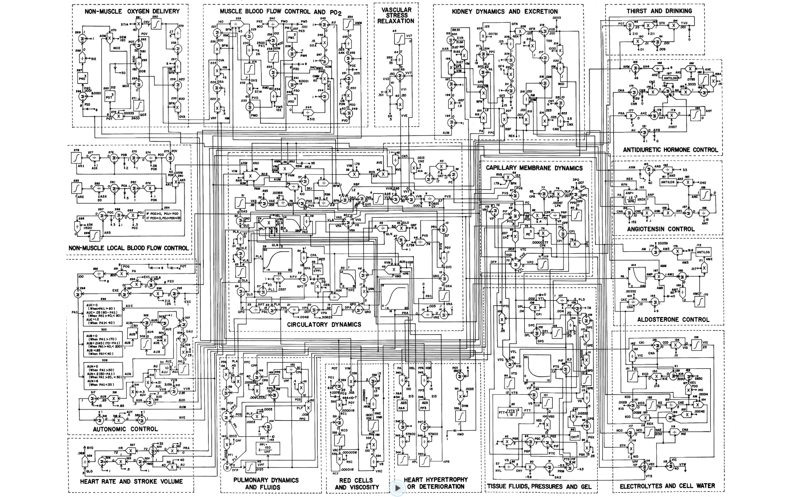

Slide 6
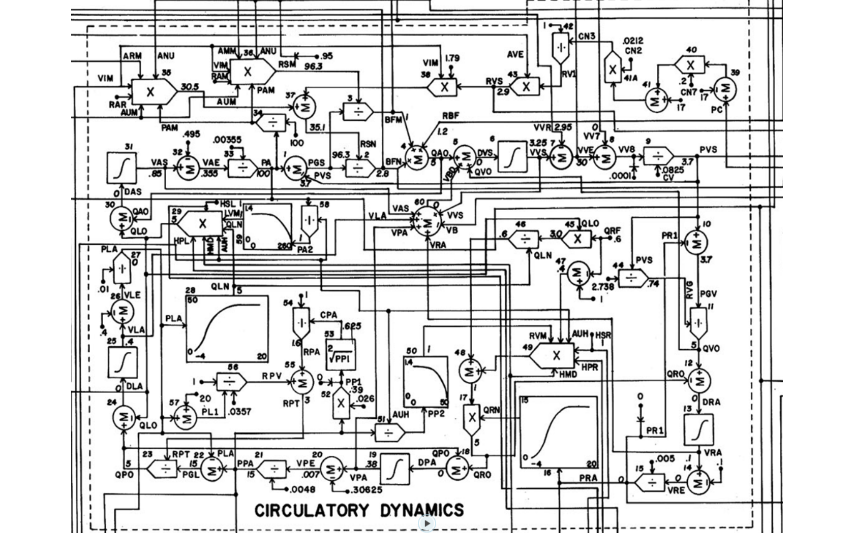

Slide 7
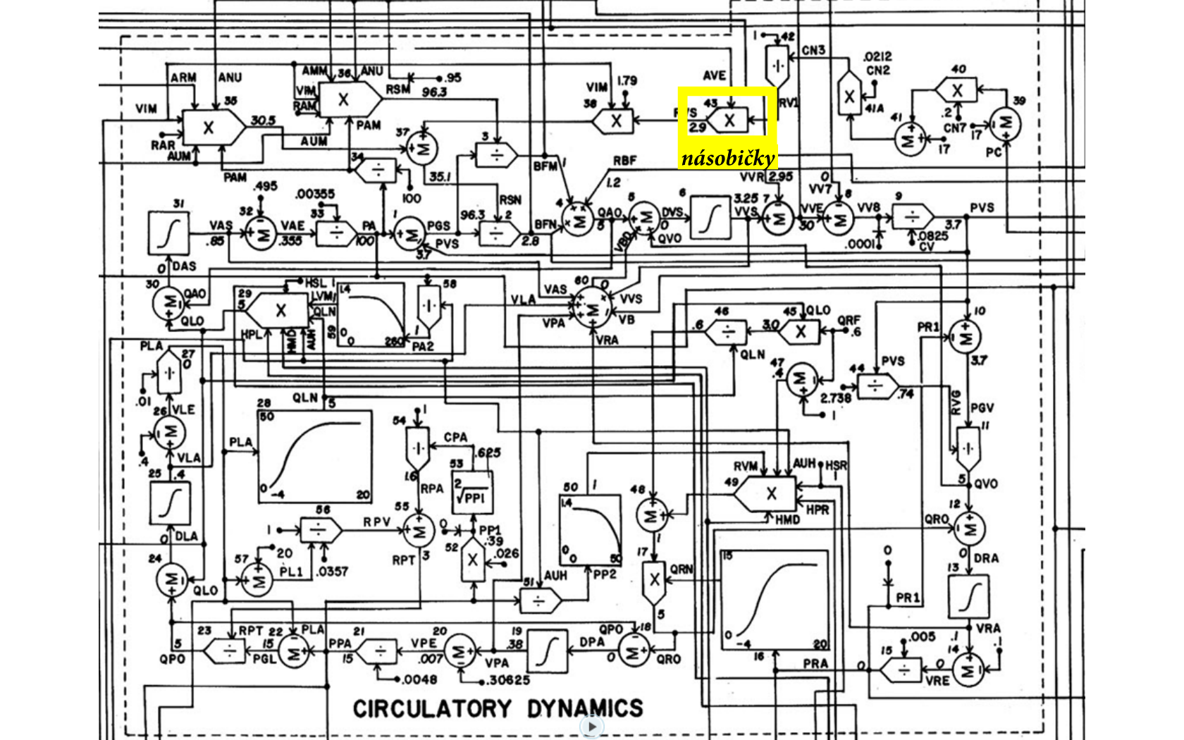
multiplier

Slide 8
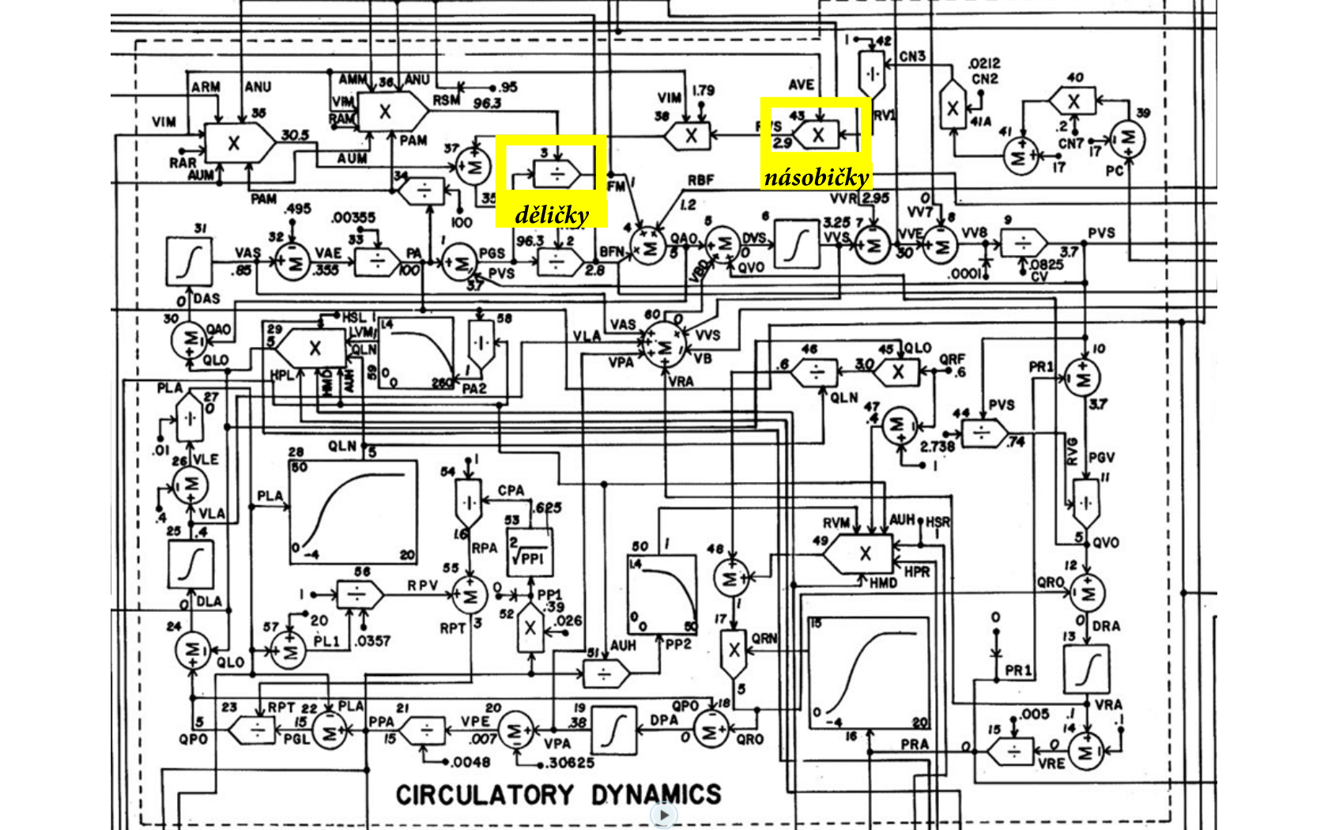
multiplier
divider

Slide 9
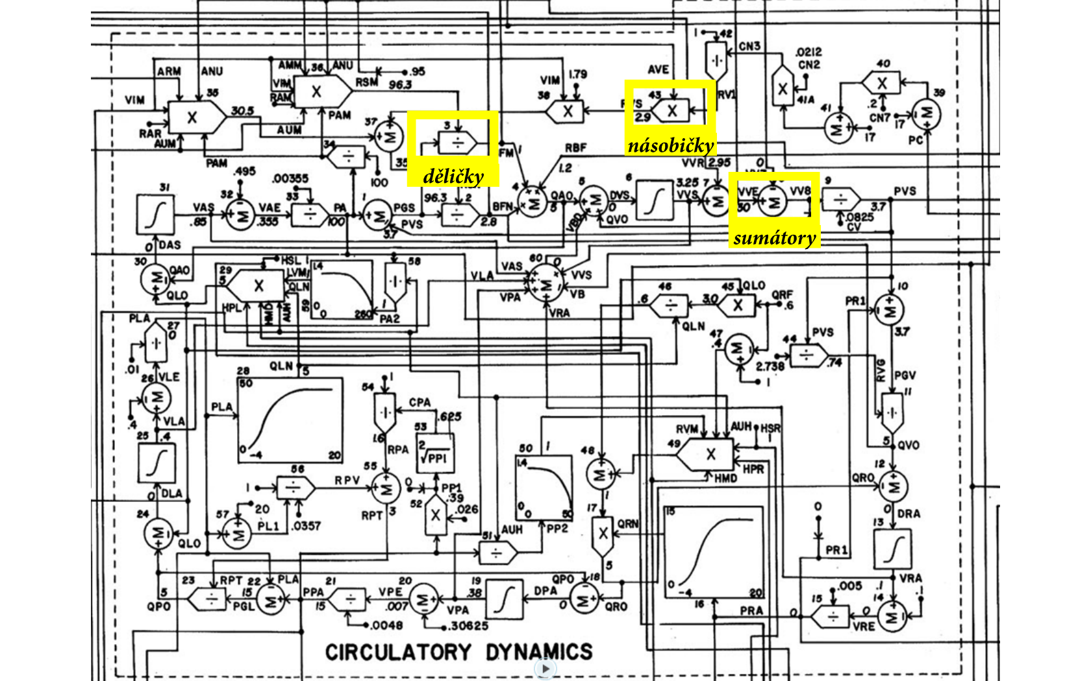
multiplier
divider
sumator

Slide 10
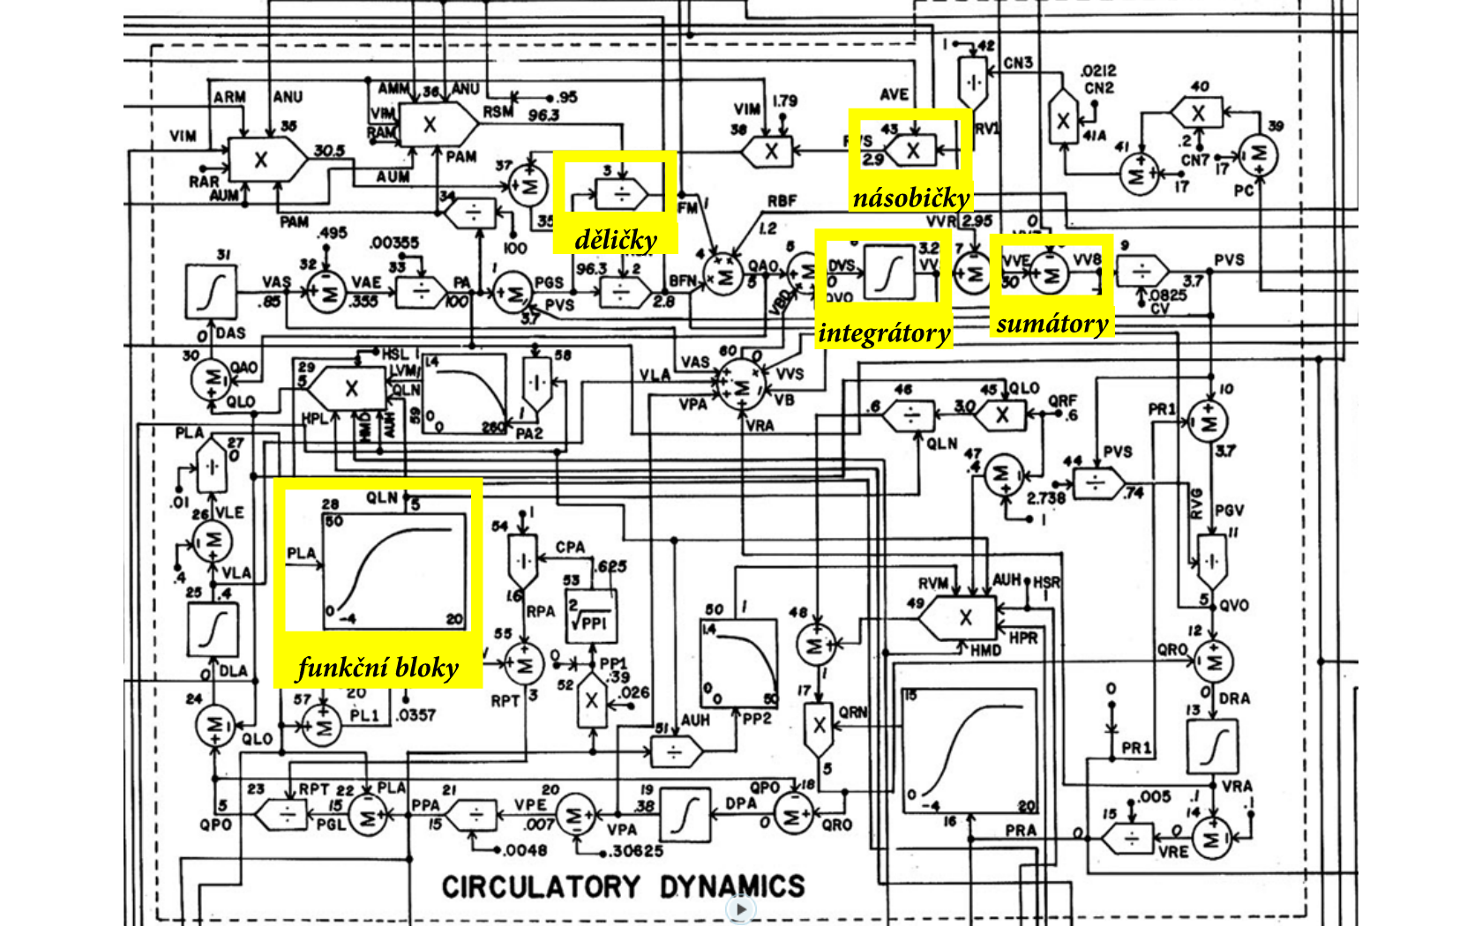
multiplier
divider
integrator
sumator
function block

Slide 11

multiplier
divider
integrator
sumator
function block

Slide 12
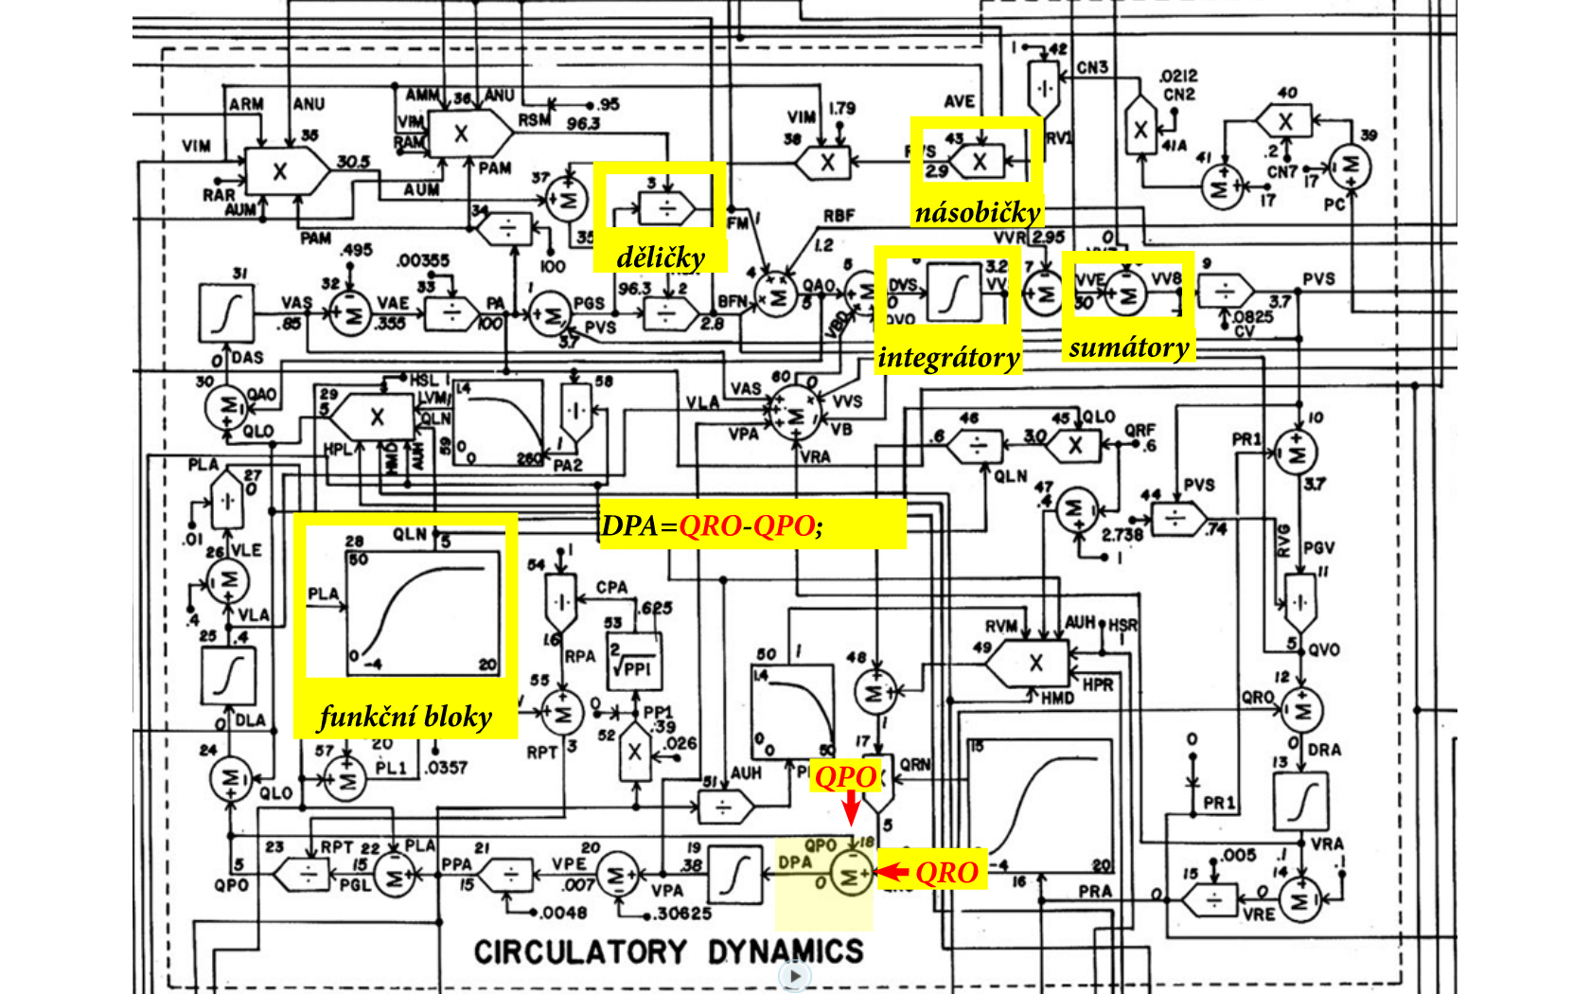
multiplier
divider
integrator
sumator
function block

Slide 13
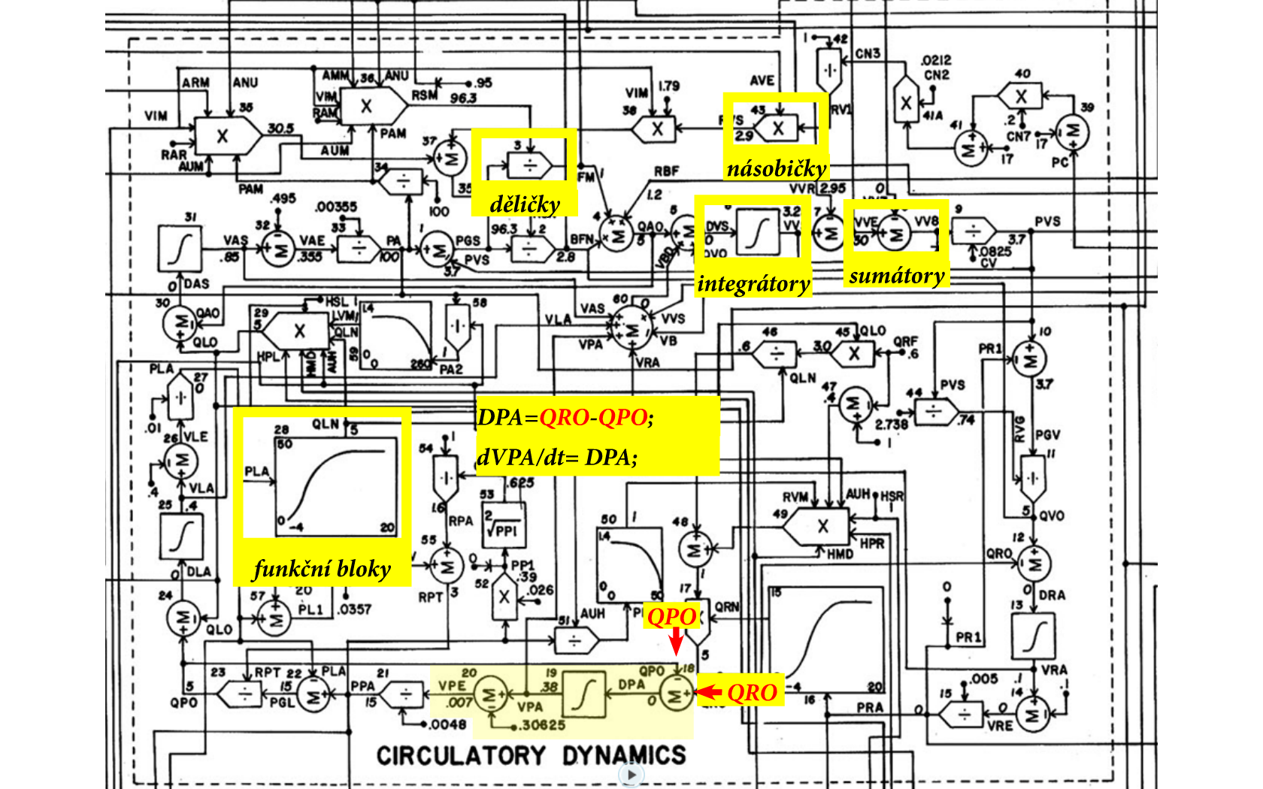
multiplier
divider
integrator
sumator
function block

Slide 14
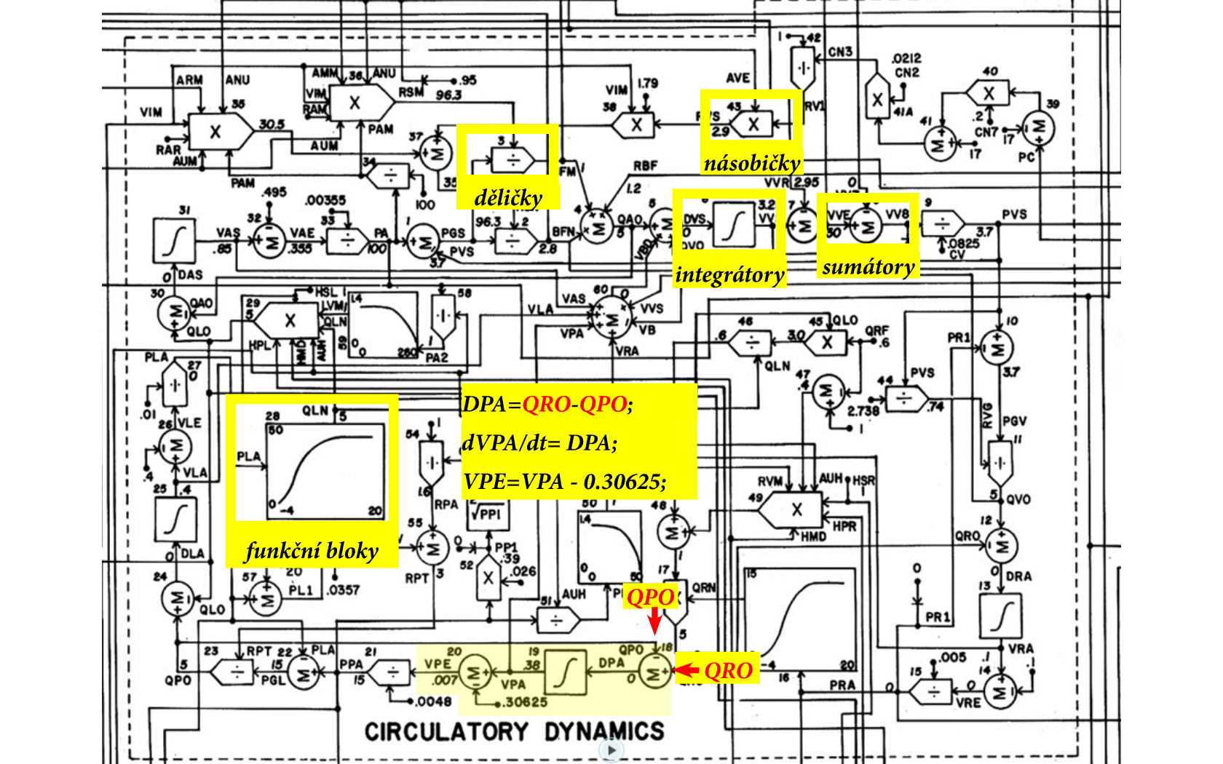
multiplier
divider
integrator
sumator
function block

Slide 15
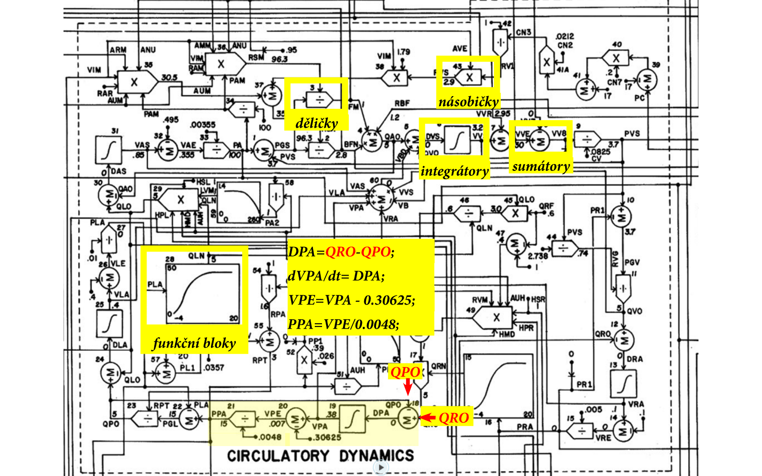
multiplier
divider
integrator
sumator
function block

Slide 16

multiplier
divider
integrator
sumator
function block

Slide 17

multiplier
divider
integrator
sumator
function block

Slide 18

multiplier
divider
integrator
sumator
function block

Slide 19

multiplier
divider
integrator
sumator
Set of equations:
function block

Slide 20
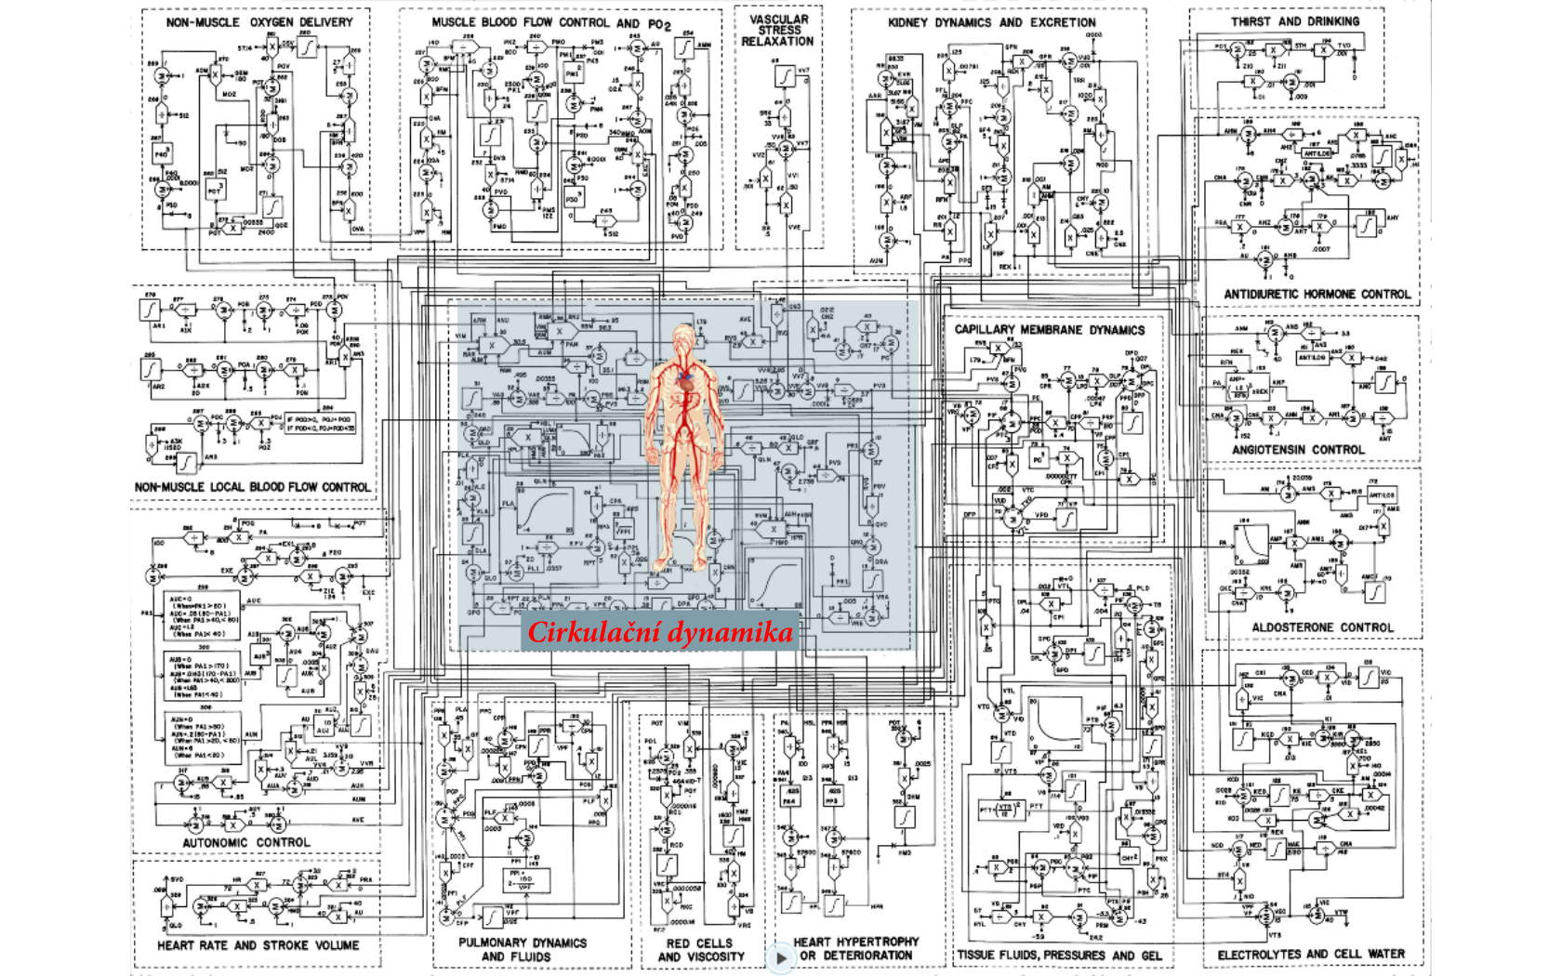
Circulation dynamics

Slide 21
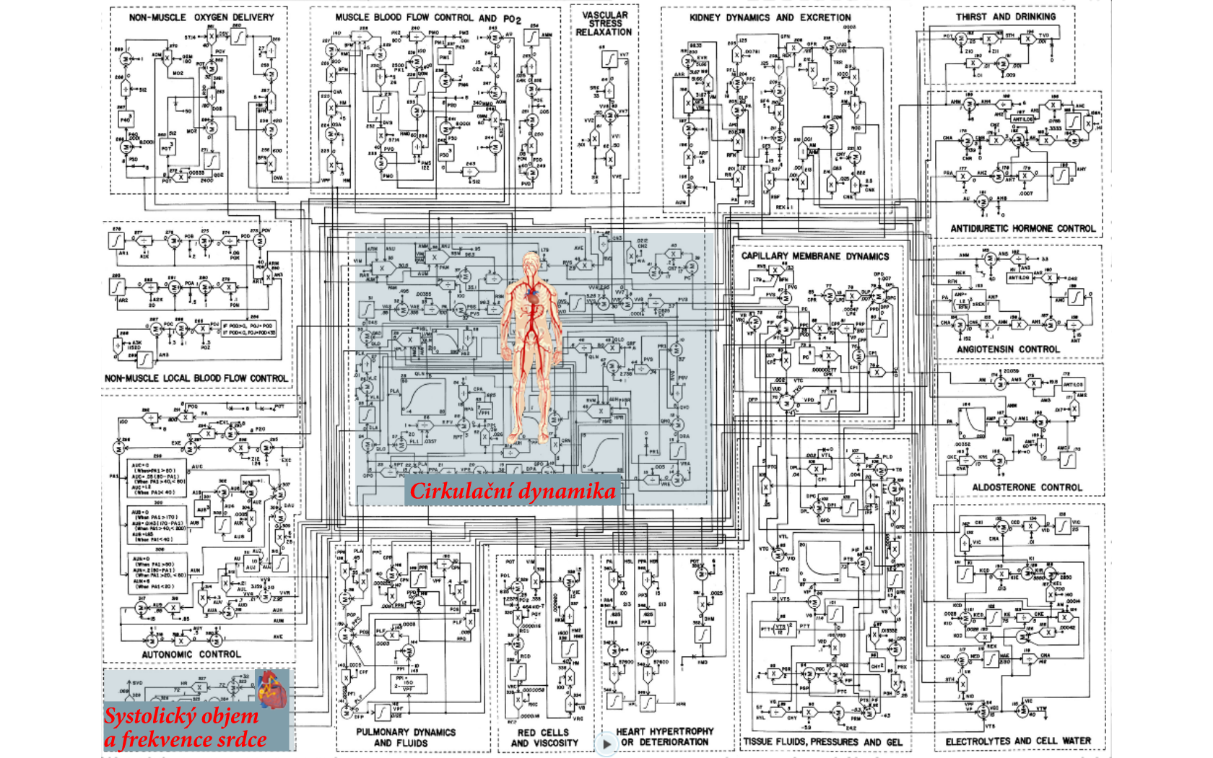
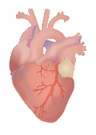
Circulation dynamics
Heart rate and stroke volume

Slide 22
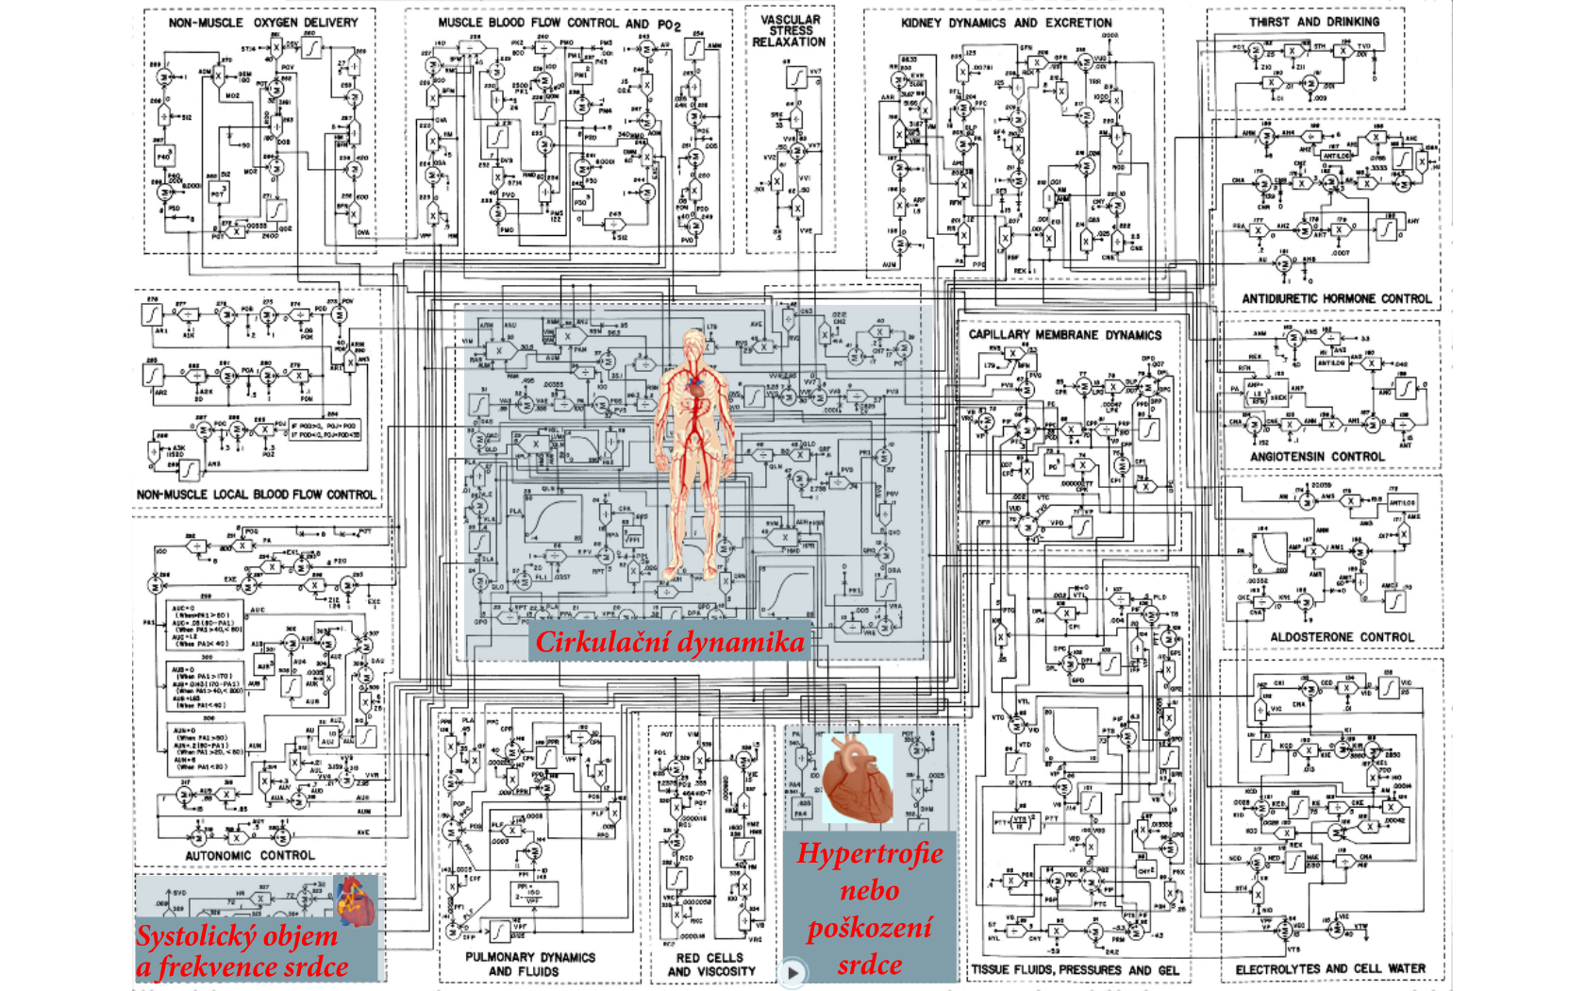
Circulation dynamics
Heart hypertrophy or deterioration
Heart rate and stroke volume

Slide 23
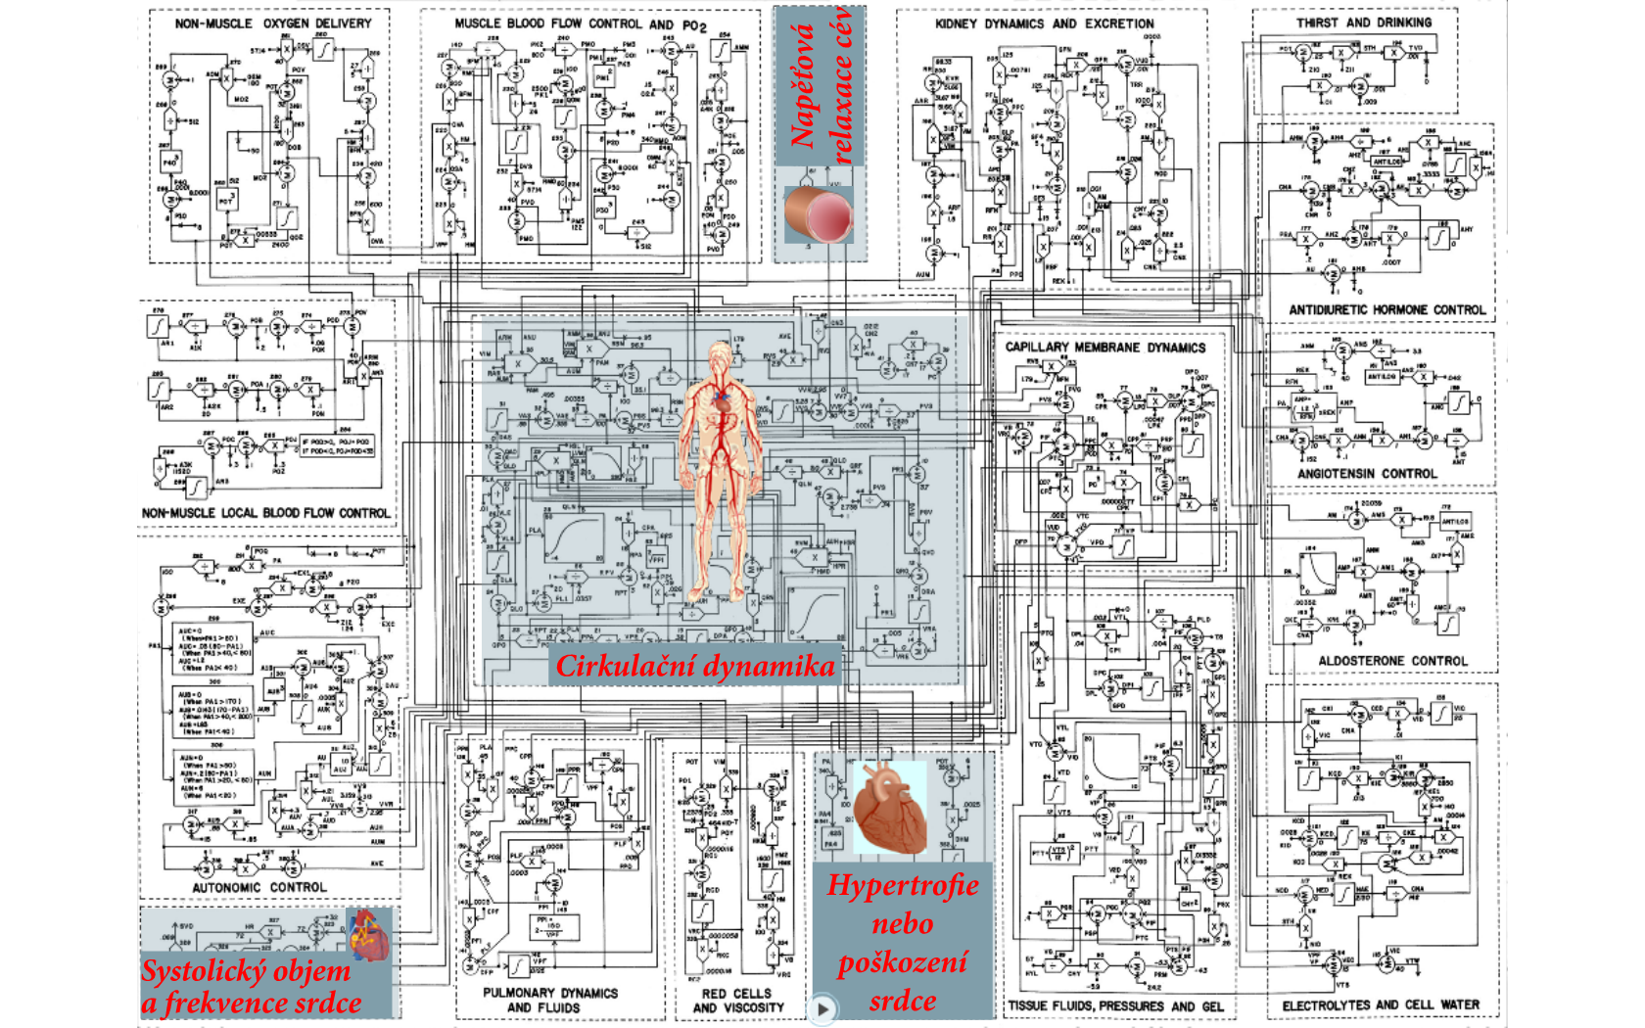
Vascular stress relaxation
Circulation dynamics
Heart hypertrophy or deterioration
Heart rate and stroke volume

Slide 24
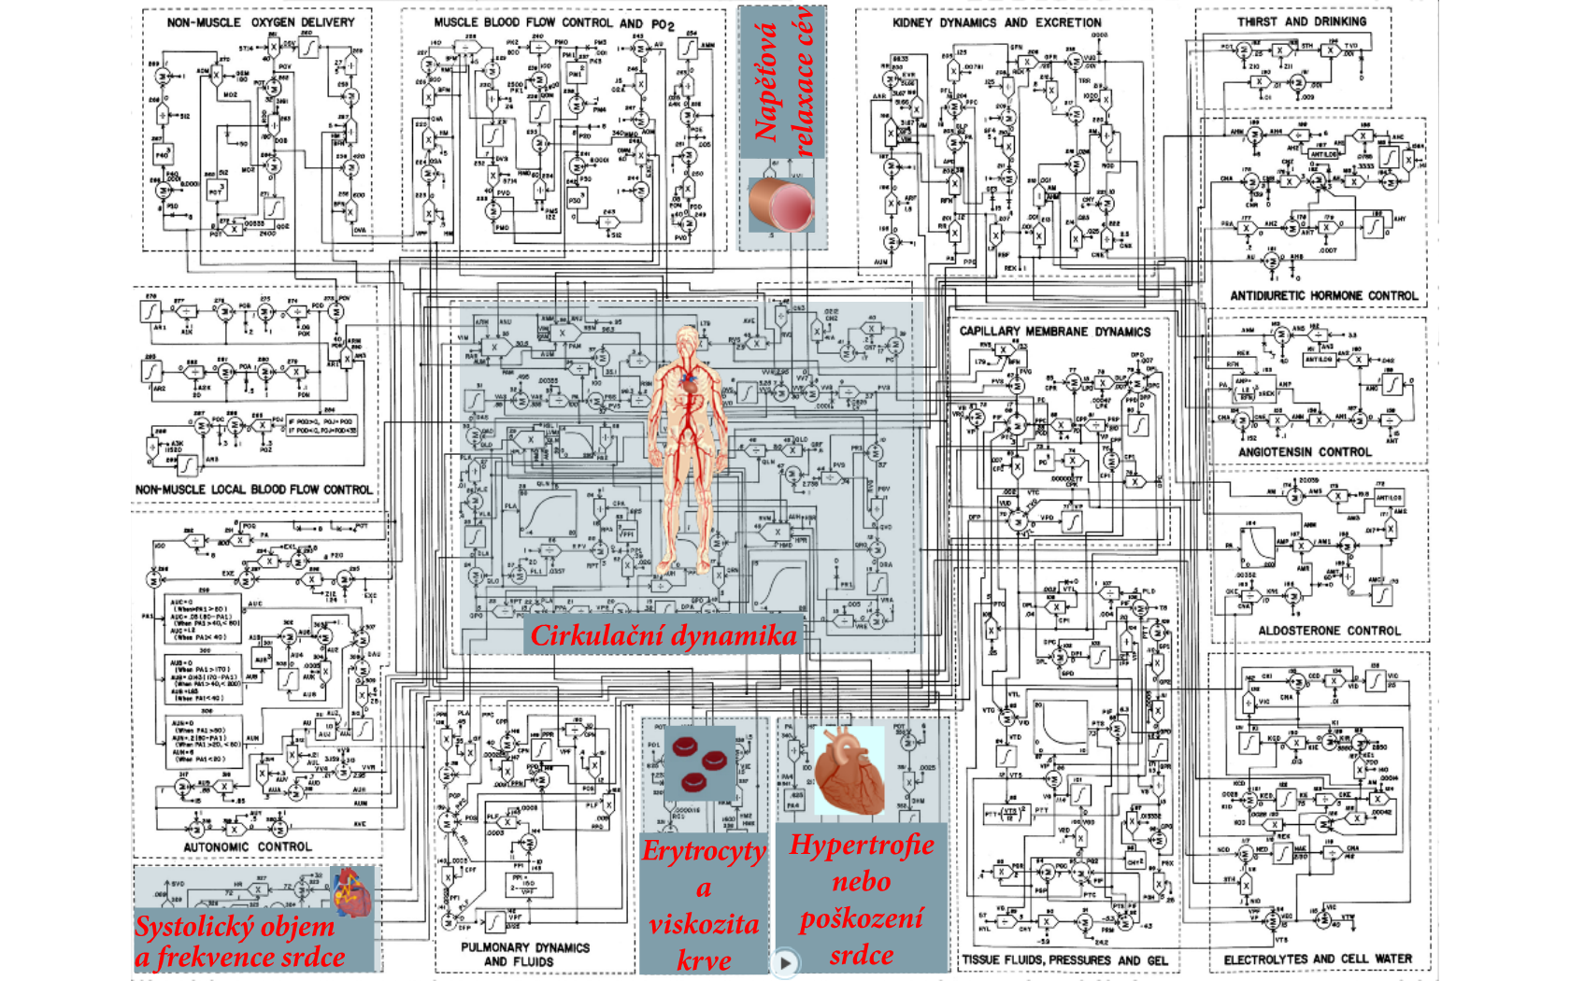
Vascular stress relaxation
Circulation dynamics
Red cells and viscosity
Heart hypertrophy or deterioration
Heart rate and stroke volume

Slide 25
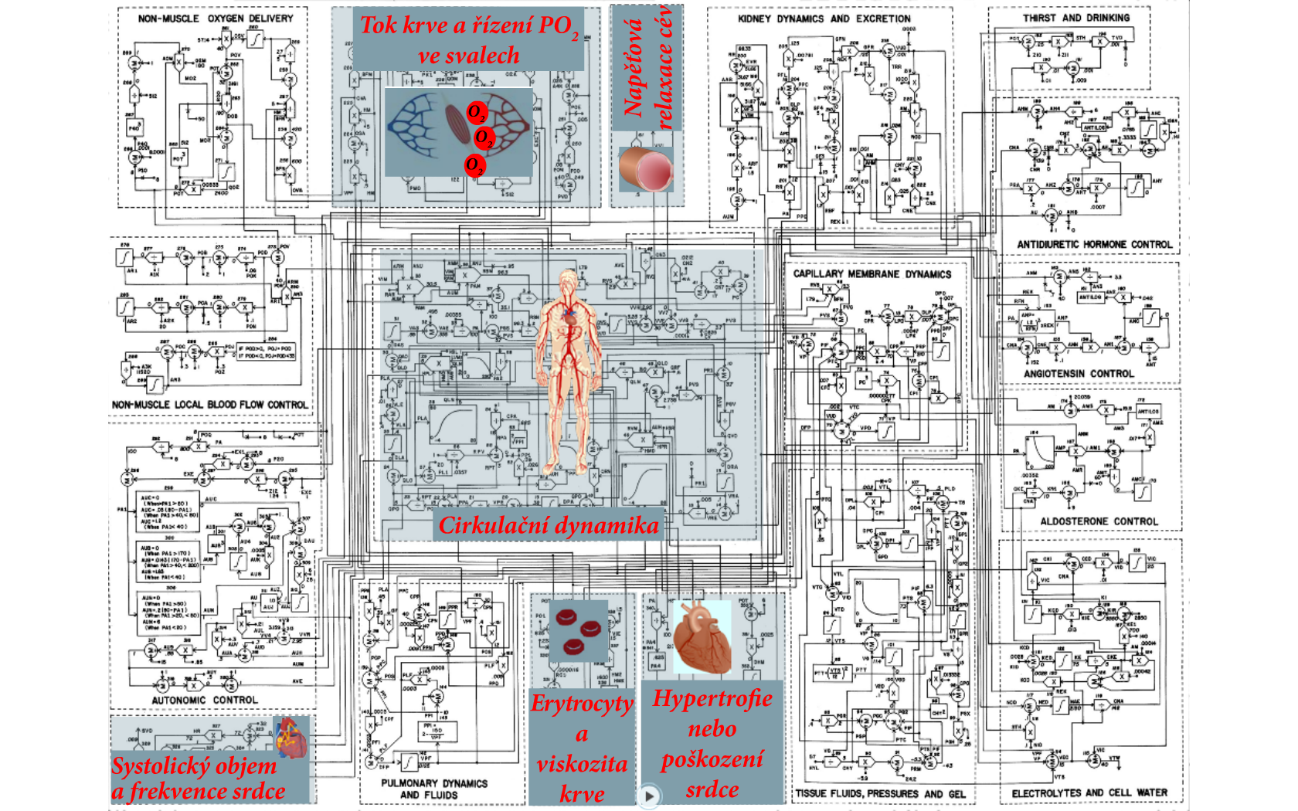
Muscle blood flow control and PO₂
Vascular stress relaxation
Circulation dynamics
Red cells and viscosity
Heart hypertrophy or deterioration
Heart rate and stroke volume

Slide 26
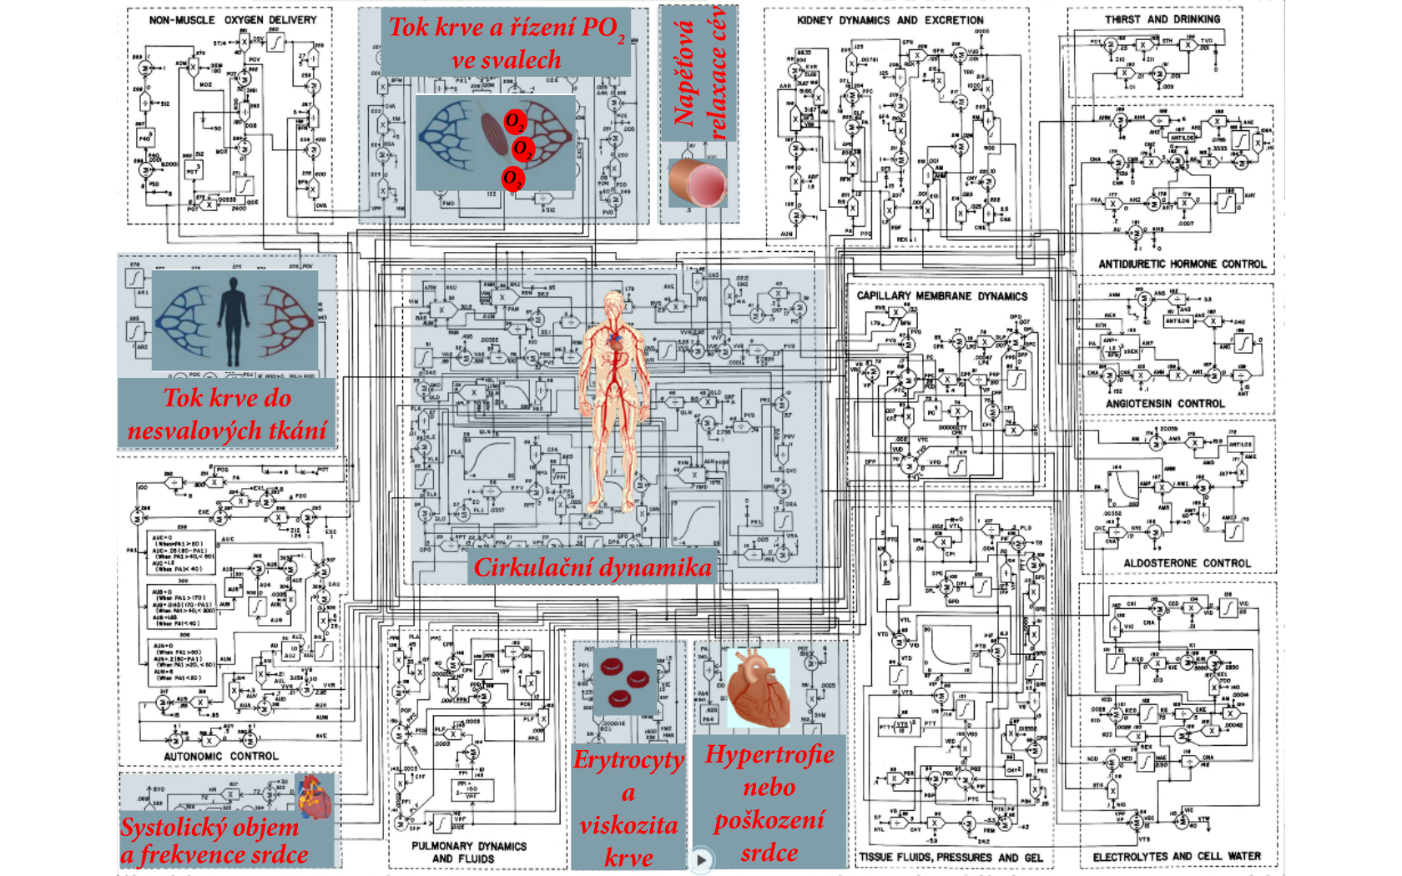
Muscle blood flow control and PO₂
Vascular stress relaxation
Non-muscle local blood flow control
Circulation dynamics
Red cells and viscosity
Heart hypertrophy or deterioration
Heart rate and stroke volume

Slide 27
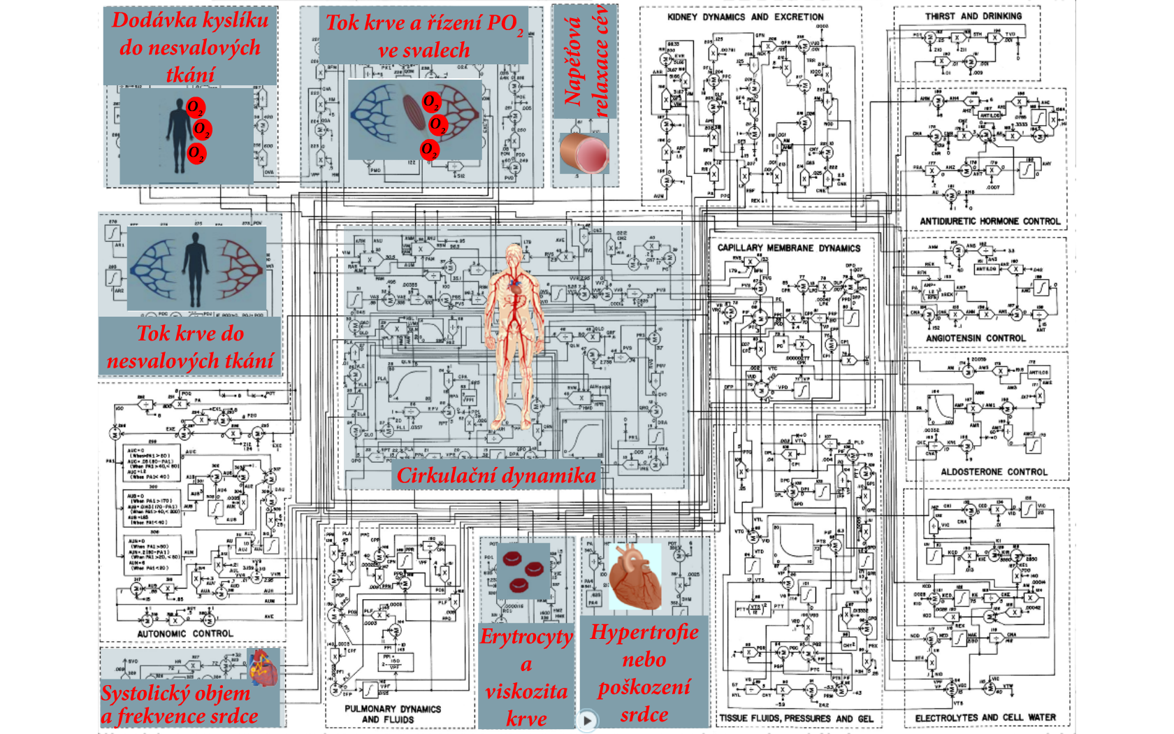
Non-muscle oxygen delivery
Muscle blood flow control and PO₂
Vascular stress relaxation
Non-muscle local blood flow control
Circulation dynamics
Red cells and viscosity
Heart hypertrophy or deterioration
Heart rate and stroke volume

Slide 28
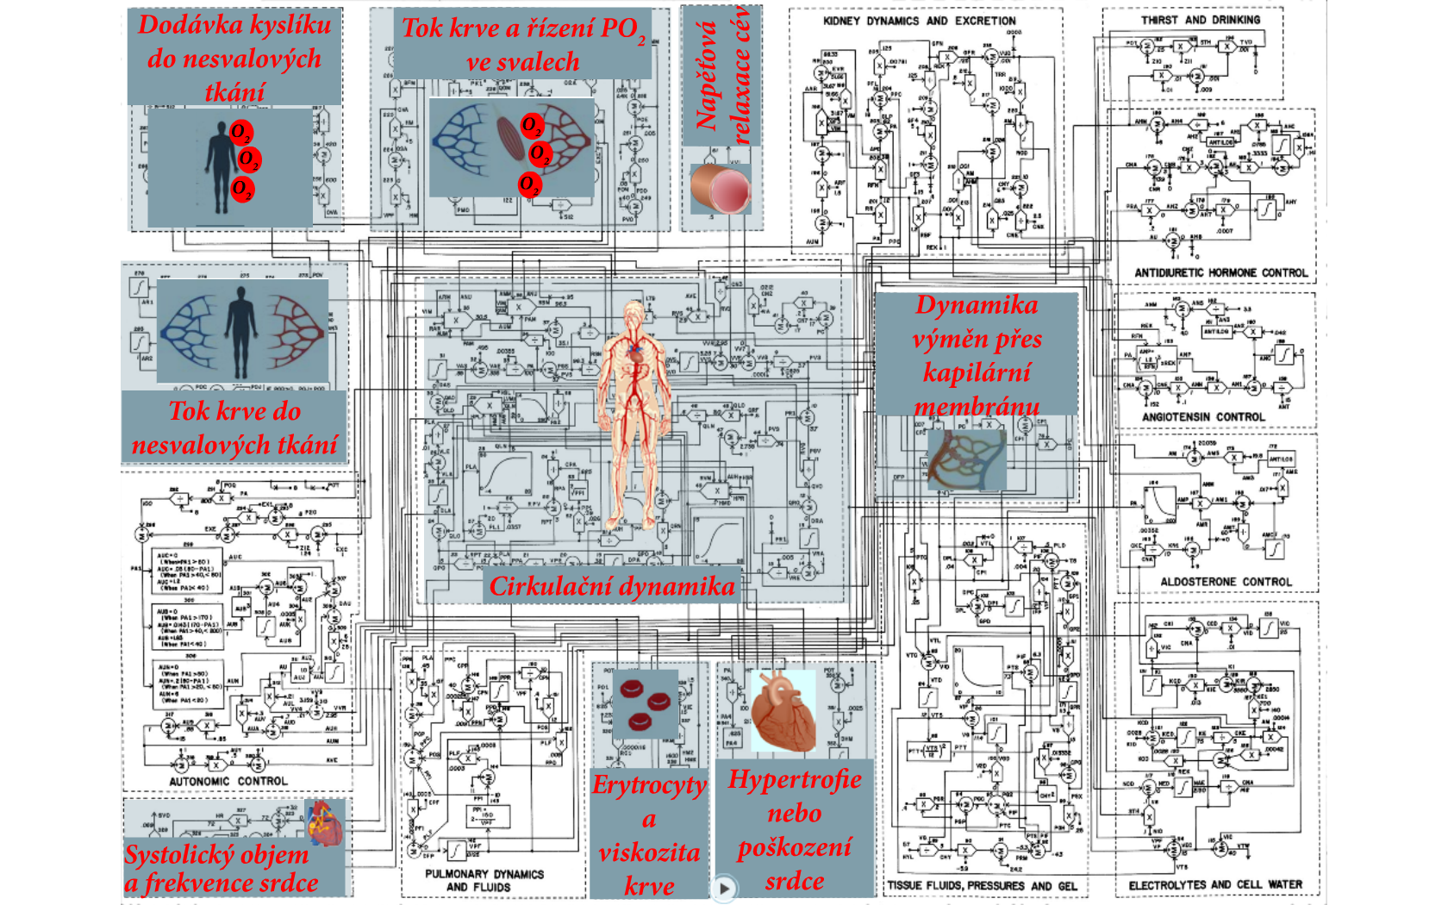
Non-muscle oxygen delivery
Muscle blood flow control and PO₂
Vascular stress relaxation
Capillary membrane dynamics
Non-muscle local blood flow control
Circulation dynamics
Red cells and viscosity
Heart hypertrophy or deterioration
Heart rate and stroke volume

Slide 29
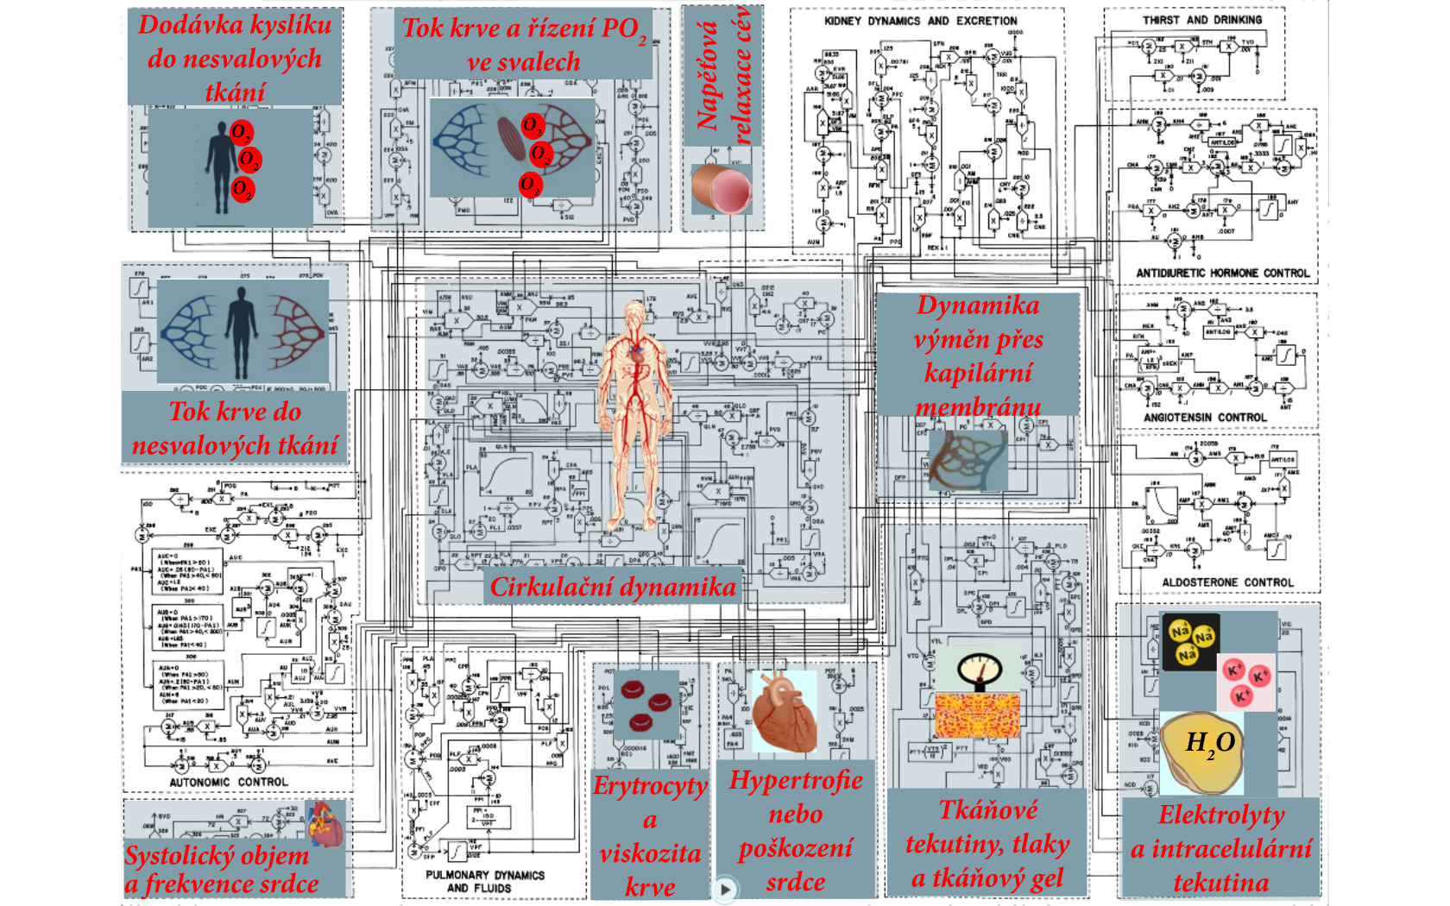
Non-muscle oxygen delivery
Muscle blood flow control and PO₂
Vascular stress relaxation
Capillary membrane dynamics
Non-muscle local blood flow control
Circulation dynamics
Red cells and viscosity
Heart hypertrophy or deterioration
Tissue fluids, pressures and gel
Electrolytes and cell water
Heart rate and stroke volume

Slide 30
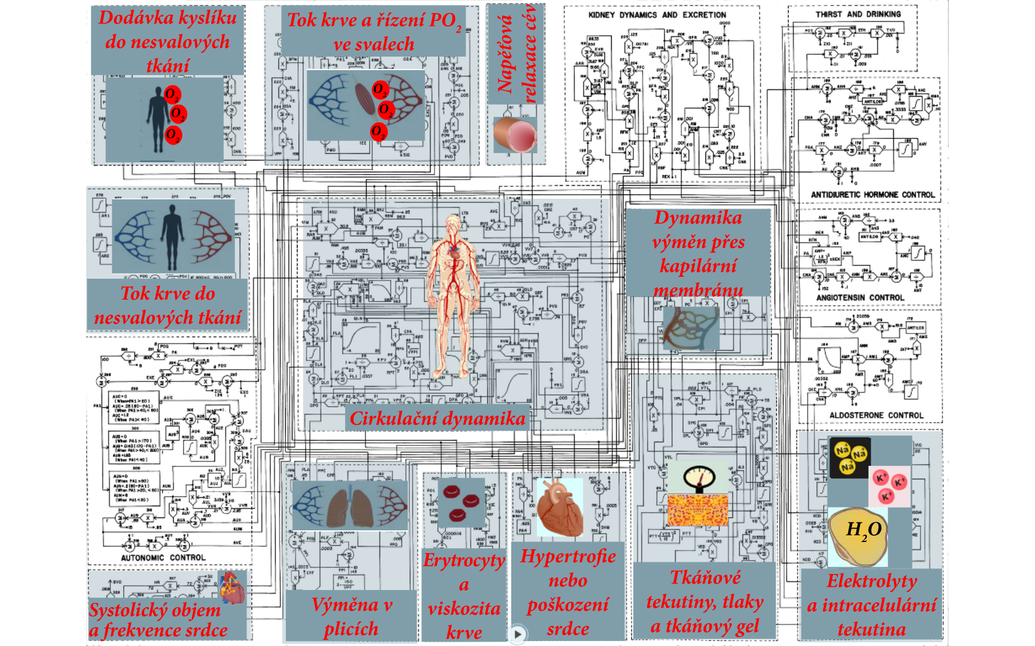
Non-muscle oxygen delivery
Muscle blood flow control and PO₂
Vascular stress relaxation
Capillary membrane dynamics
Non-muscle local blood flow control
Circulation dynamics
Red cells and viscosity
Heart hypertrophy or deterioration
Tissue fluids, pressures and gel
Electrolytes and cell water
Heart rate and stroke volume
Pulmonary dynamics and fluids

Slide 31
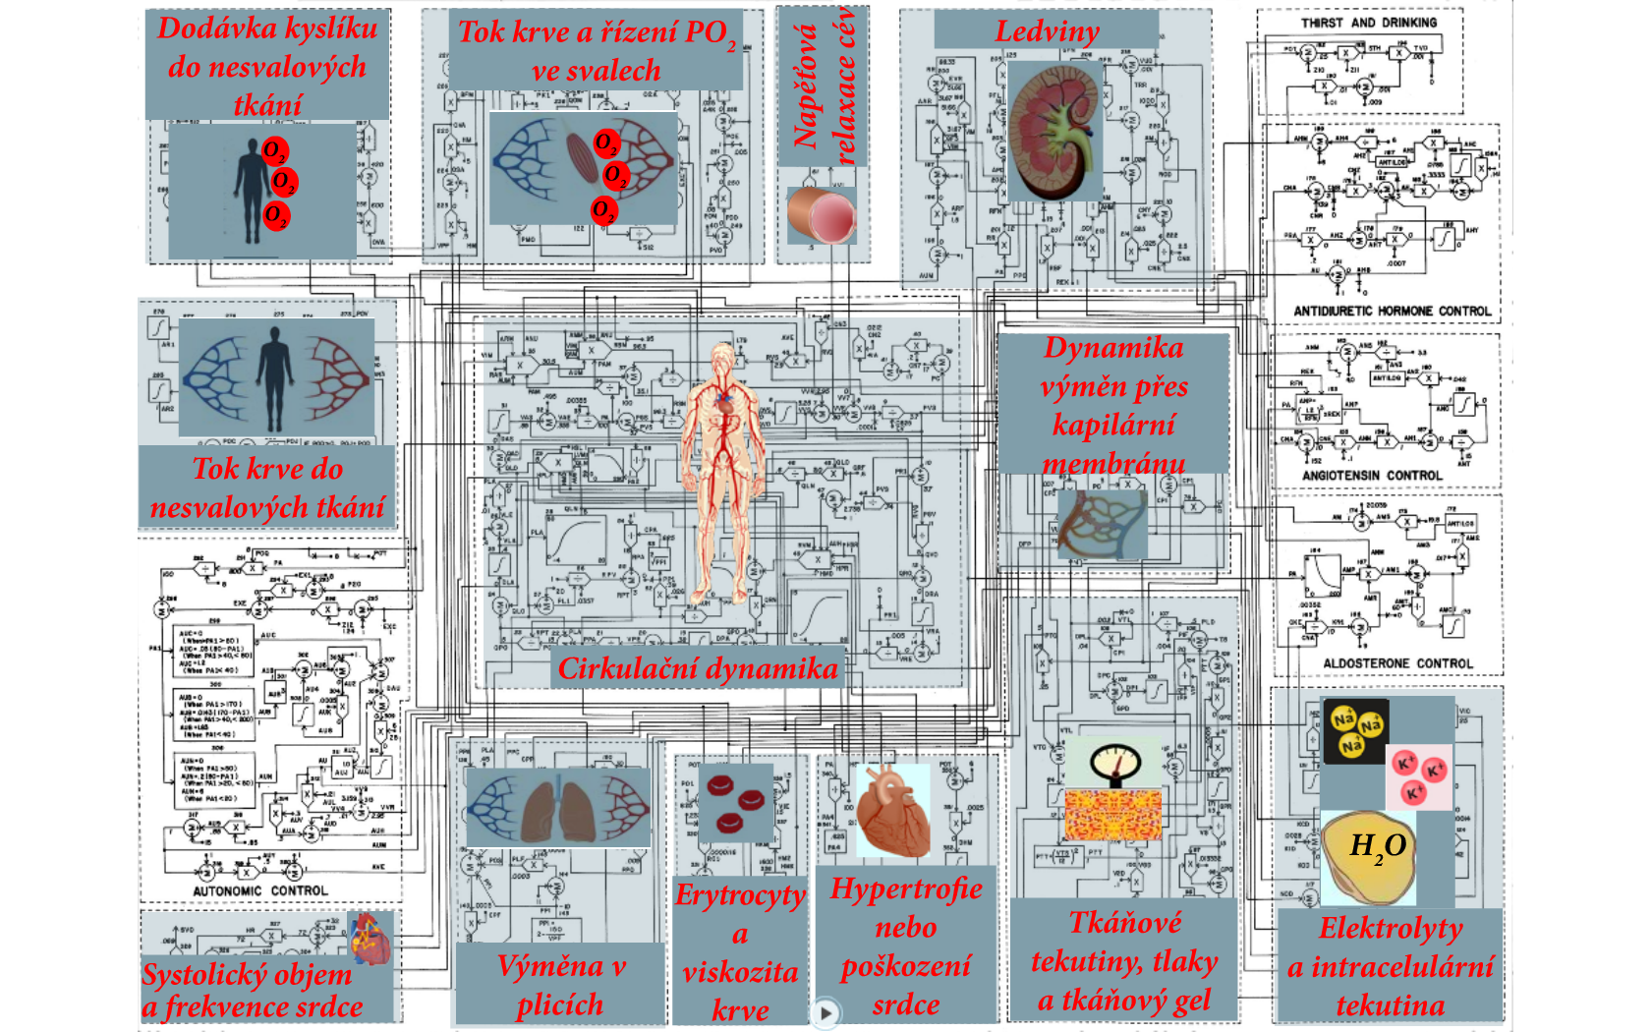
Non-muscle oxygen delivery
Muscle blood flow control and PO₂
Kidney dynamics and excretion
Vascular stress relaxation
Capillary membrane dynamics
Non-muscle local blood flow control
Circulation dynamics
Red cells and viscosity
Heart hypertrophy or deterioration
Tissue fluids, pressures and gel
Electrolytes and cell water
Heart rate and stroke volume
Pulmonary dynamics and fluids

Slide 32
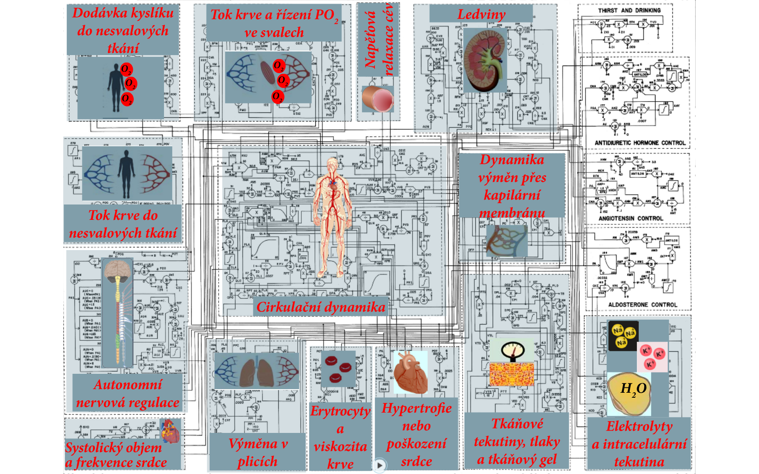
Non-muscle oxygen delivery
Muscle blood flow control and PO₂
Kidney dynamics and excretion
Vascular stress relaxation
Capillary membrane dynamics
Non-muscle local blood flow control
Circulation dynamics
Autonomic control
Red cells and viscosity
Heart hypertrophy or deterioration
Tissue fluids, pressures and gel
Electrolytes and cell water
Heart rate and stroke volume
Pulmonary dynamics and fluids

Slide 33
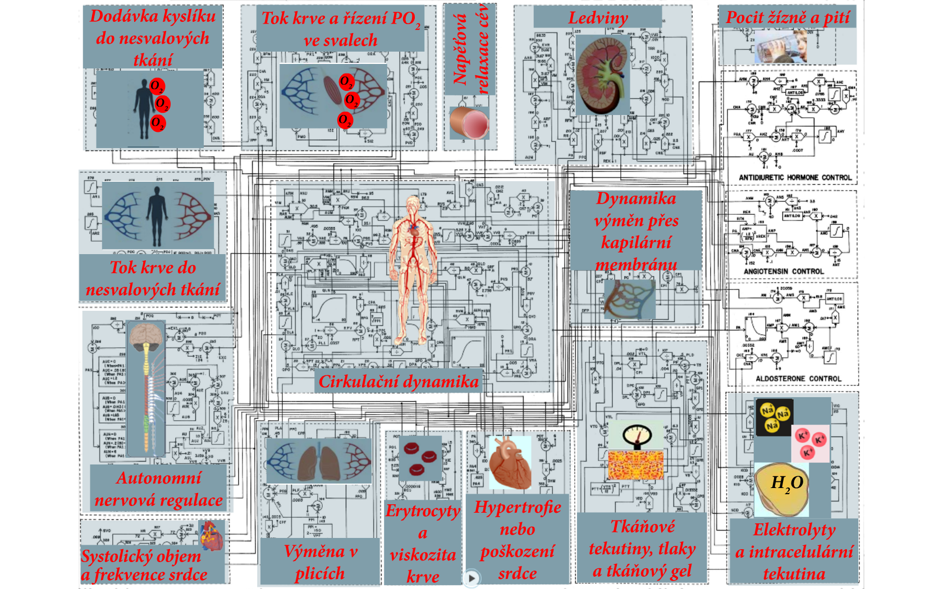
Non-muscle oxygen delivery
Muscle blood flow control and PO₂
Kidney dynamics and excretion
Thirts and drinking
Vascular stress relaxation
Capillary membrane dynamics
Non-muscle local blood flow control
Circulation dynamics
Autonomic control
Red cells and viscosity
Heart hypertrophy or deterioration
Tissue fluids, pressures and gel
Electrolytes and cell water
Heart rate and stroke volume
Pulmonary dynamics and fluids

Slide 34
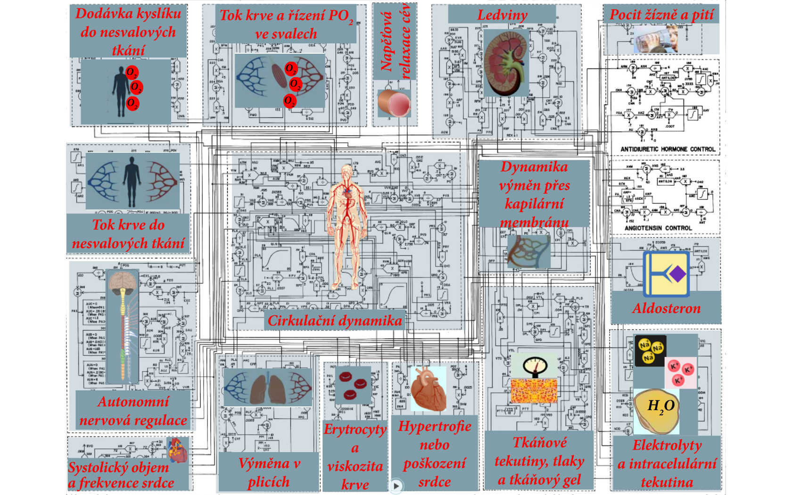
Non-muscle oxygen delivery
Muscle blood flow control and PO₂
Kidney dynamics and excretion
Thirts and drinking
Vascular stress relaxation
Capillary membrane dynamics
Non-muscle local blood flow control
Aldosterone control
Circulation dynamics
Autonomic control
Red cells and viscosity
Heart hypertrophy or deterioration
Tissue fluids, pressures and gel
Electrolytes and cell water
Heart rate and stroke volume
Pulmonary dynamics and fluids

Slide 35
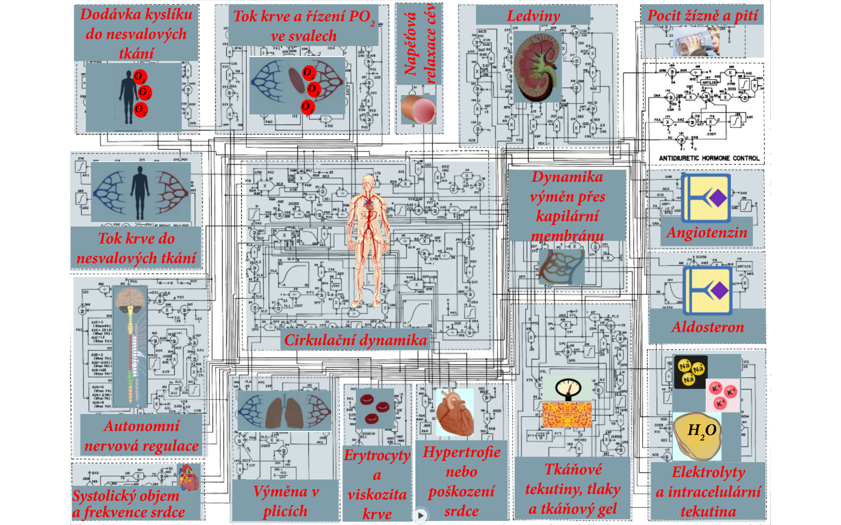
Non-muscle oxygen delivery
Muscle blood flow control and PO₂
Kidney dynamics and excretion
Thirts and drinking
Vascular stress relaxation
Capillary membrane dynamics
Angiotensin control
Non-muscle local blood flow control
Aldosterone control
Circulation dynamics
Autonomic control
Red cells and viscosity
Heart hypertrophy or deterioration
Tissue fluids, pressures and gel
Electrolytes and cell water
Heart rate and stroke volume
Pulmonary dynamics and fluids

Slide 36
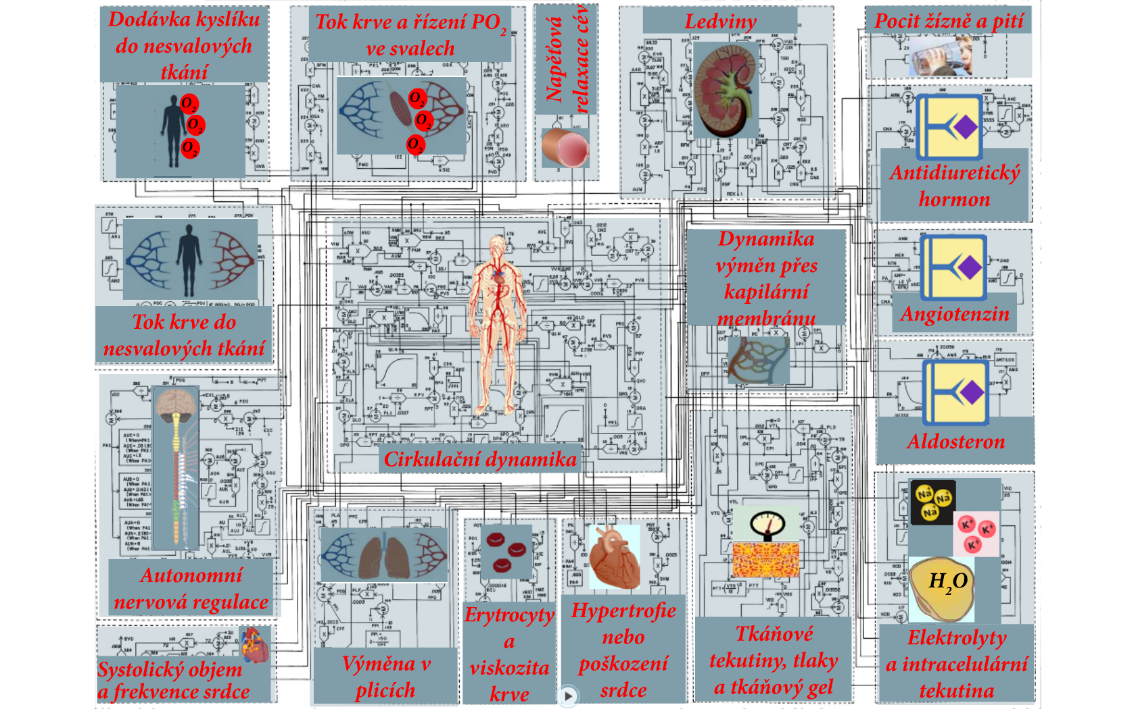
Non-muscle oxygen delivery
Muscle blood flow control and PO₂
Kidney dynamics and excretion
Thirts and drinking
Vascular stress relaxation
Antidiuretic hormone control
Capillary membrane dynamics
Angiotensin control
Non-muscle local blood flow control
Aldosterone control
Circulation dynamics
Autonomic control
Red cells and viscosity
Heart hypertrophy or deterioration
Tissue fluids, pressures and gel
Electrolytes and cell water
Heart rate and stroke volume
Pulmonary dynamics and fluids

Slide 37
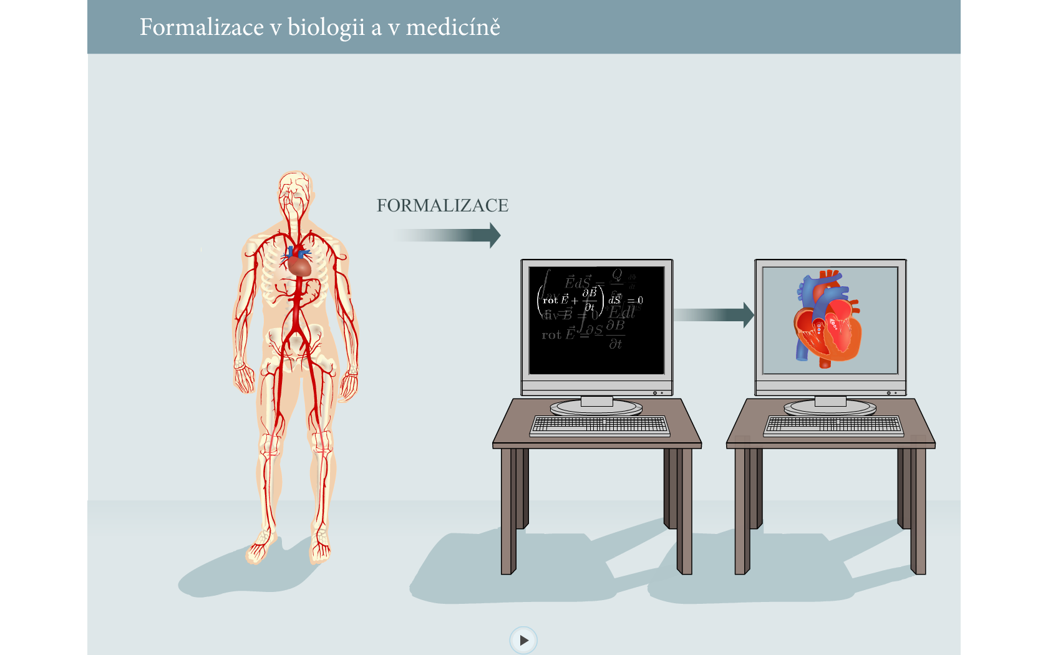
Formalisation in biology and medicine
FORMALISATION

Slide 38
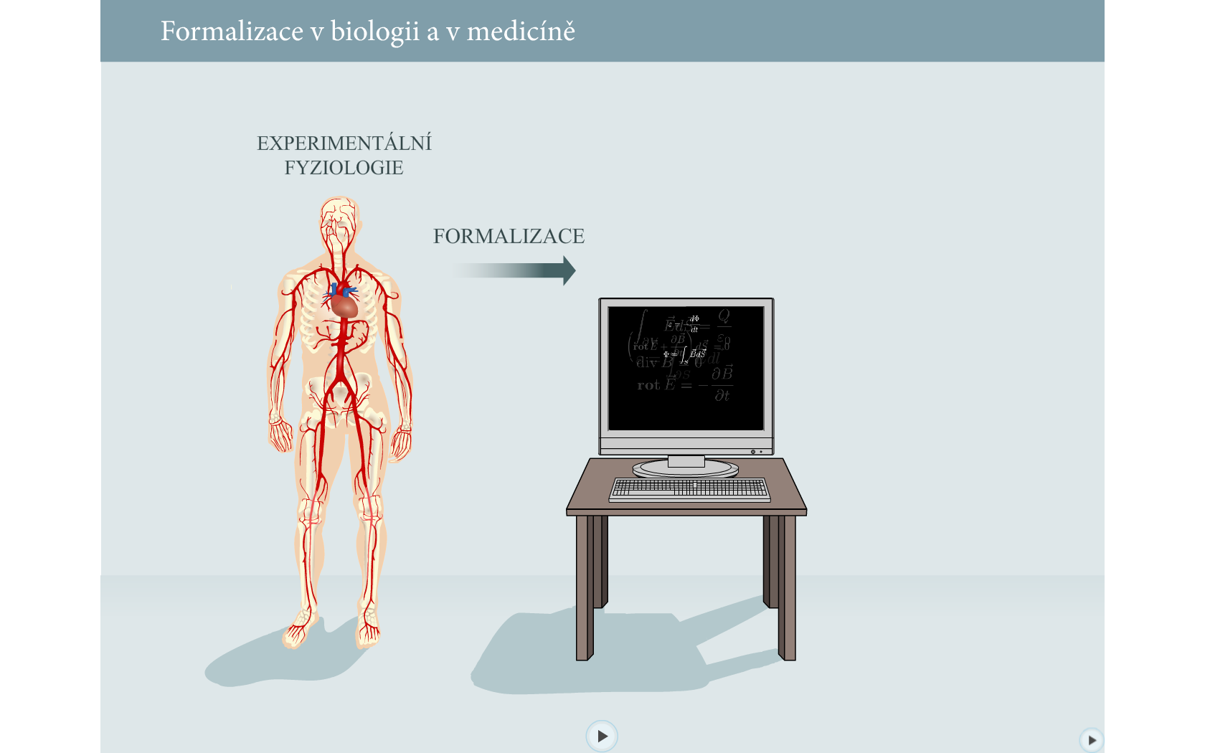
Formalisation in biology and medicine
EXPERIMENTAL PHYSIOLOGY
FORMALISATION

Slide 39
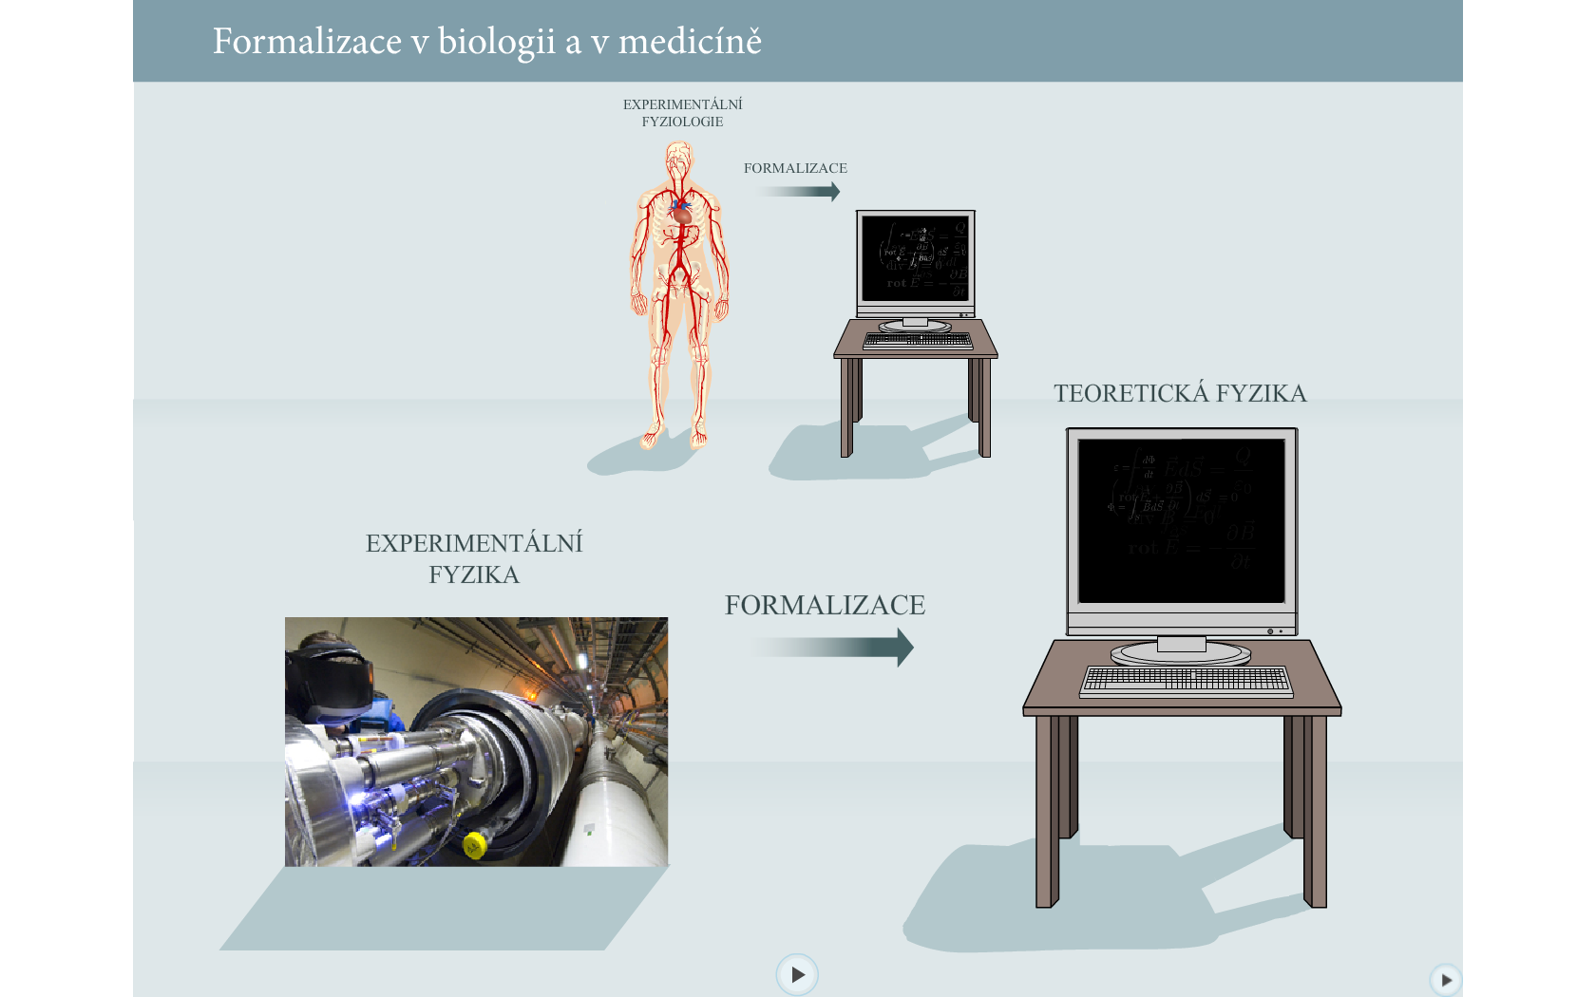
Formalisation in biology and medicine
EXPERIMENTAL PHYSIOLOGY
FORMALISATION
THEORETICAL PHYSICS
EXPERIMENTAL PHYSICS
FORMALISATION

Slide 40
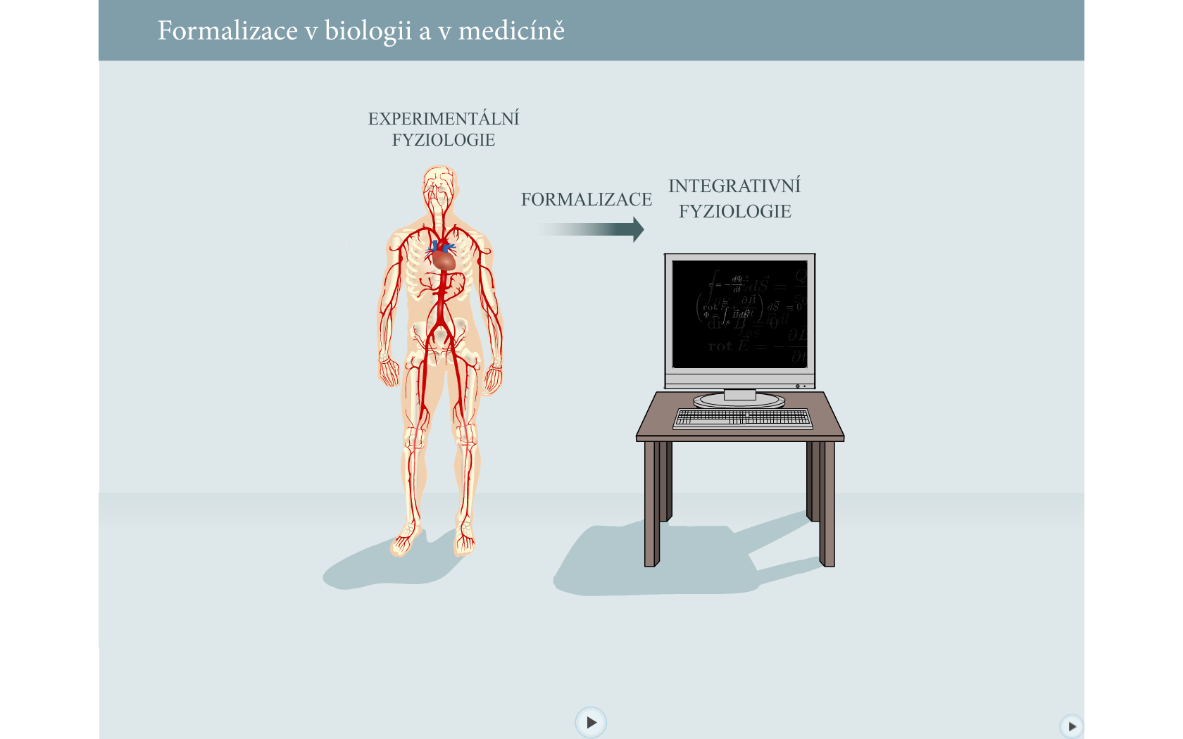
Formalisation in biology and medicine
EXPERIMENTAL PHYSIOLOGY
FORMALISATION
INTEGRATIVE PHYSIOLOGY

Slide 41
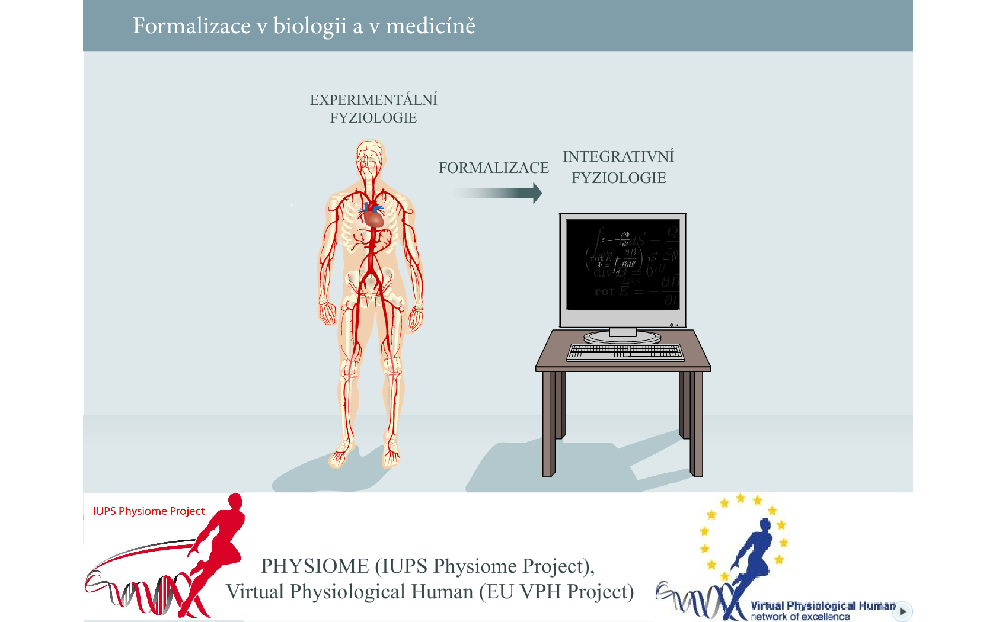
Formalisation in biology and medicine
EXPERIMENTAL PHYSIOLOGY
FORMALISATION
INTEGRATIVE PHYSIOLOGY

Slide 42
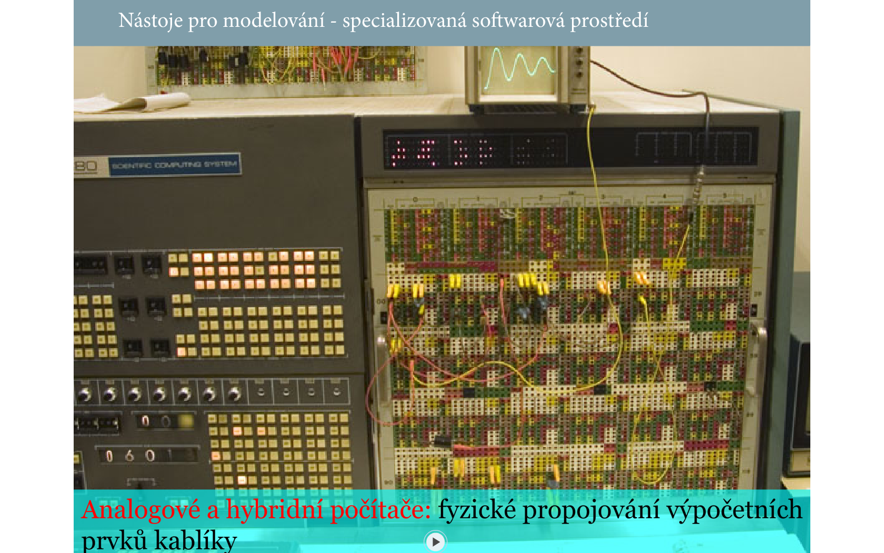
Modeling tools – Analog and Hybrid computers
Physical interconnection of computing elements by cables

Slide 43
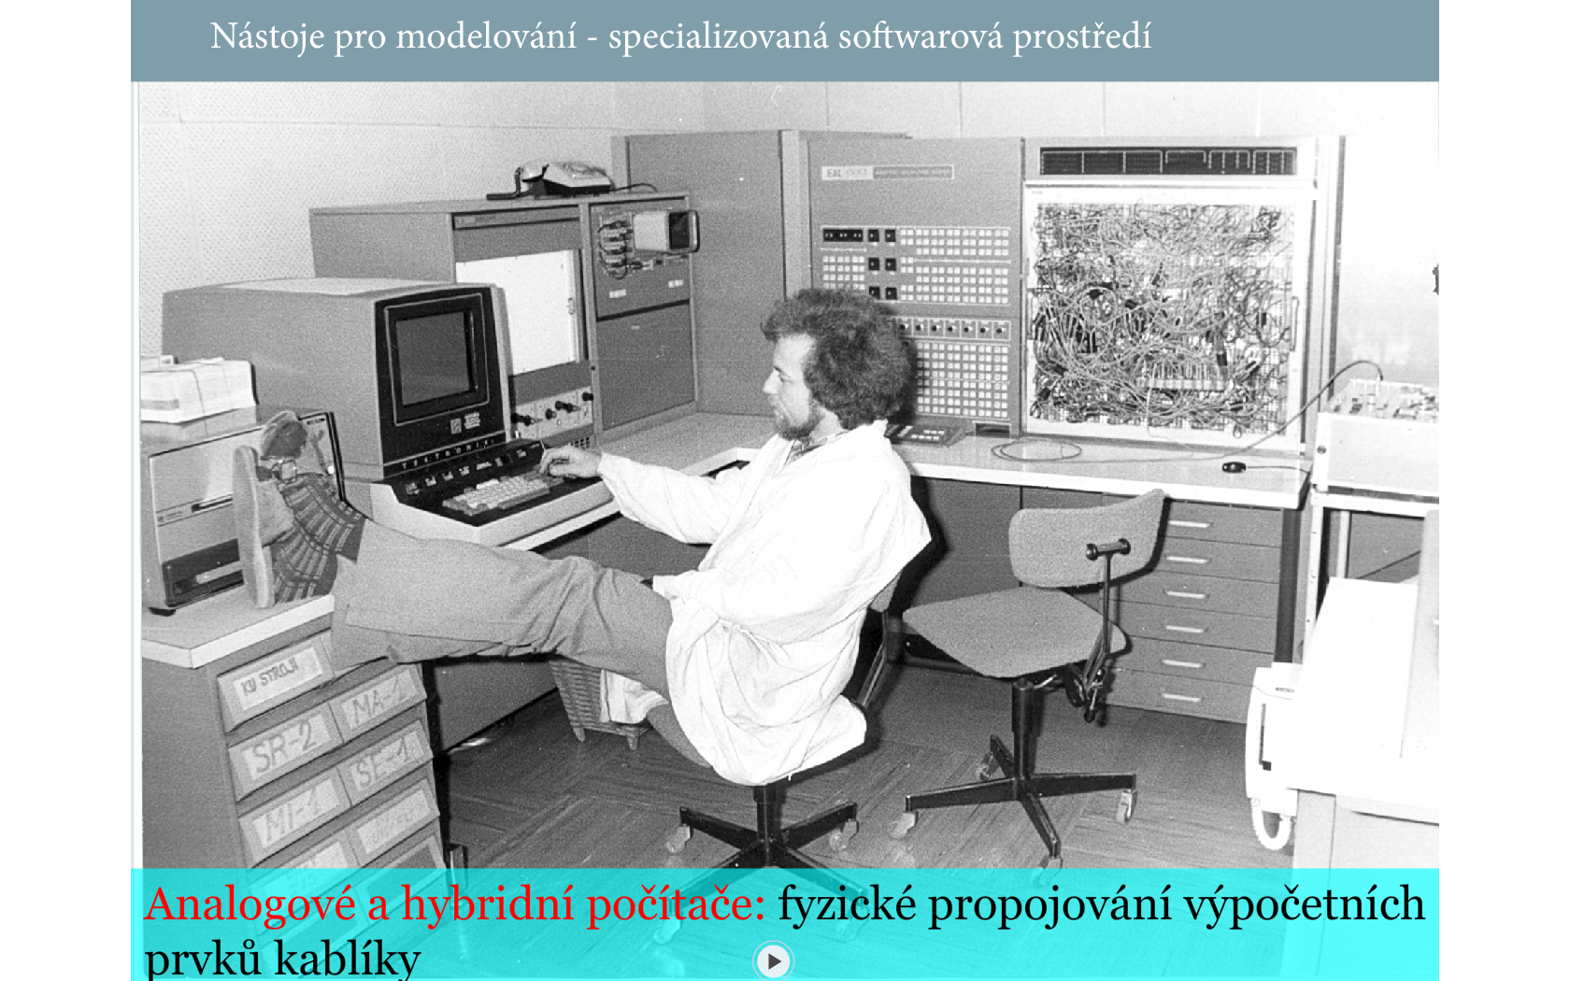
Modeling tools – Hybrid computer EAI 690
Modeling tools
Physical interconnection of computing elements by cables

Slide 44
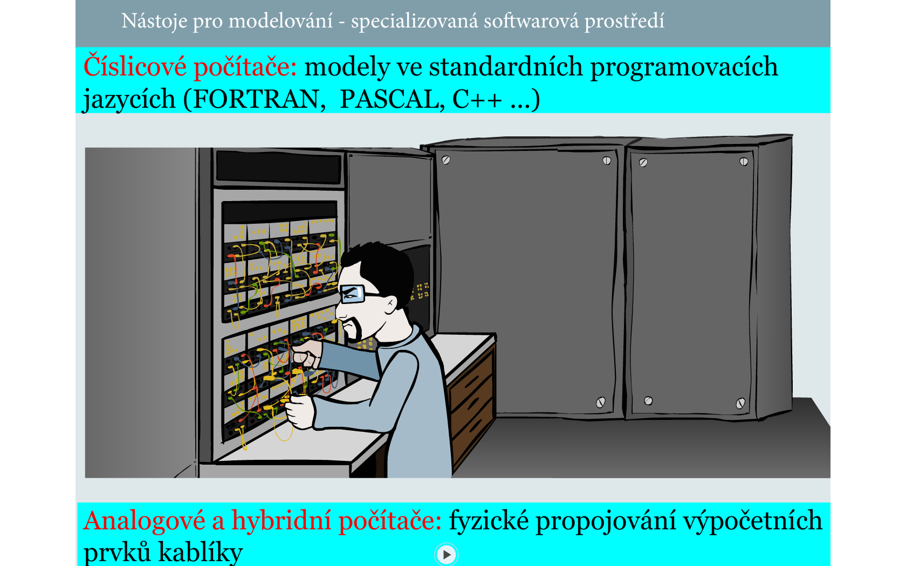
Modeling tools – Hybrid computer EAI 690
Physical interconnection of computing elements by cables

Slide 45
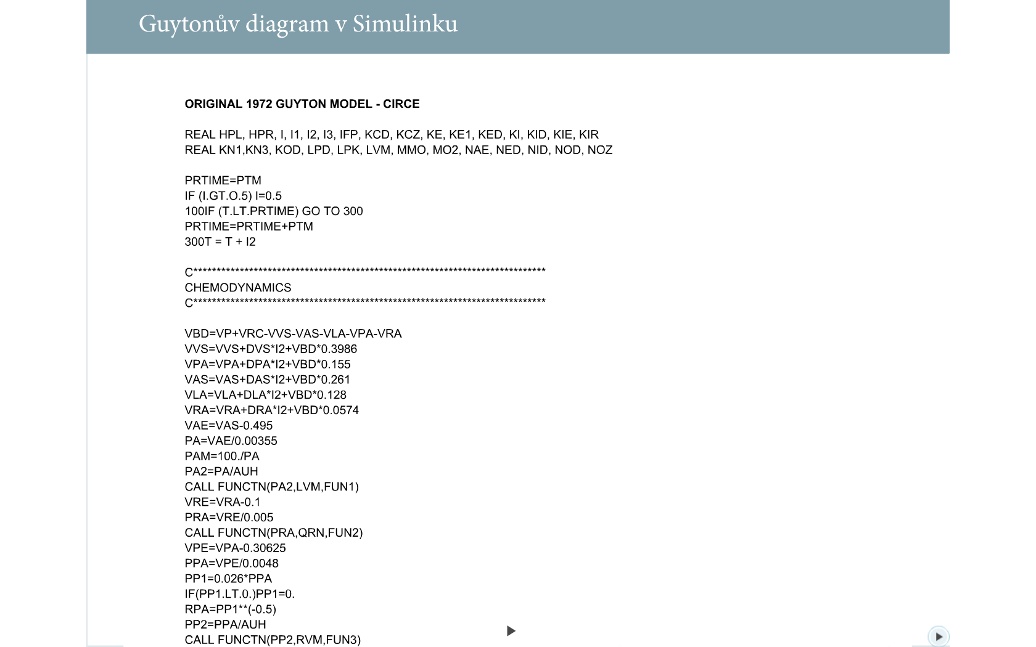
Modeling tools - classical programming languages, e.g. Fortran
Original implementation of Guyton's model in Fortran

Slide 46
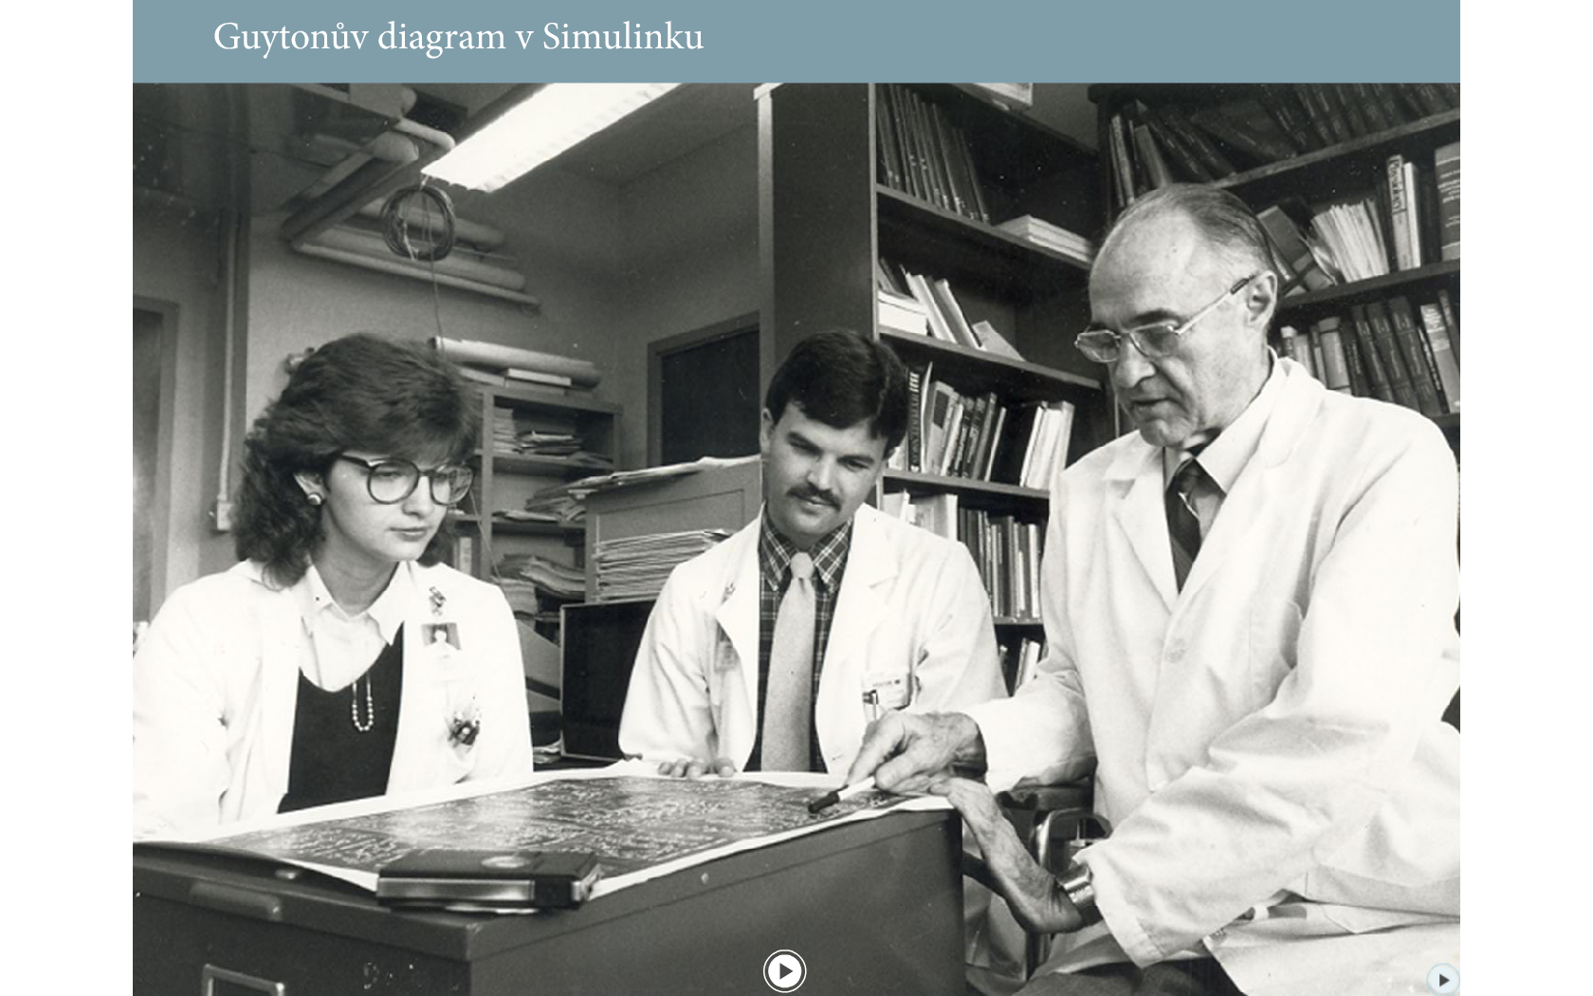
Guyton use diagram in medical education

Slide 47
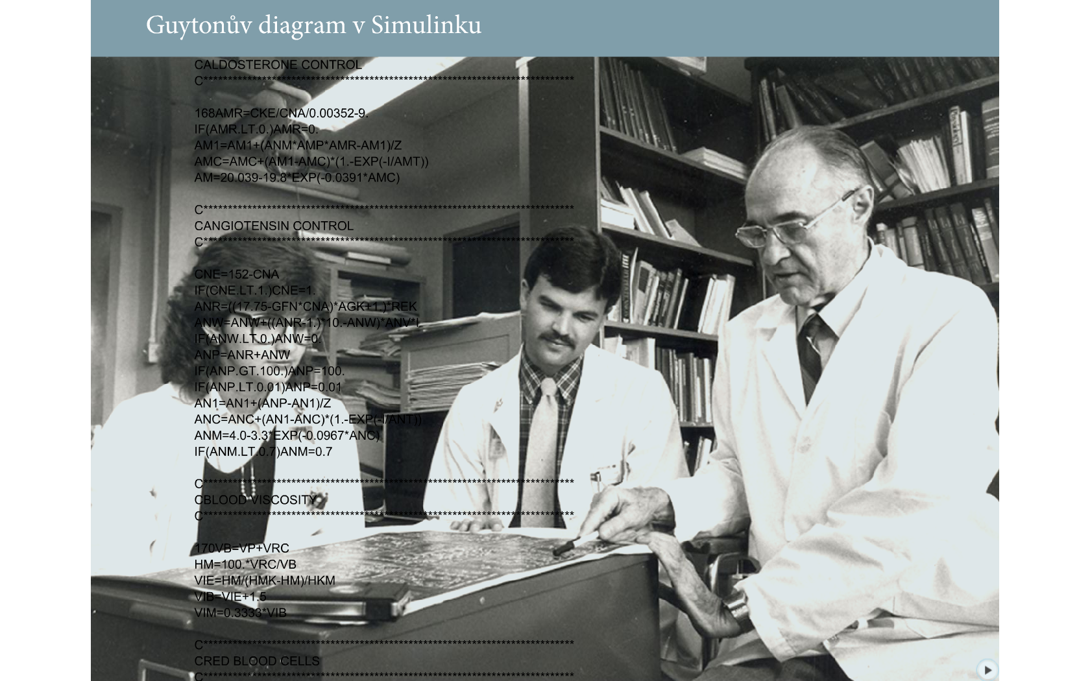
Modeling tools - classical programming languages, e.g. Fortran
Original implementation of Guyton's model in Fortran

Slide 48
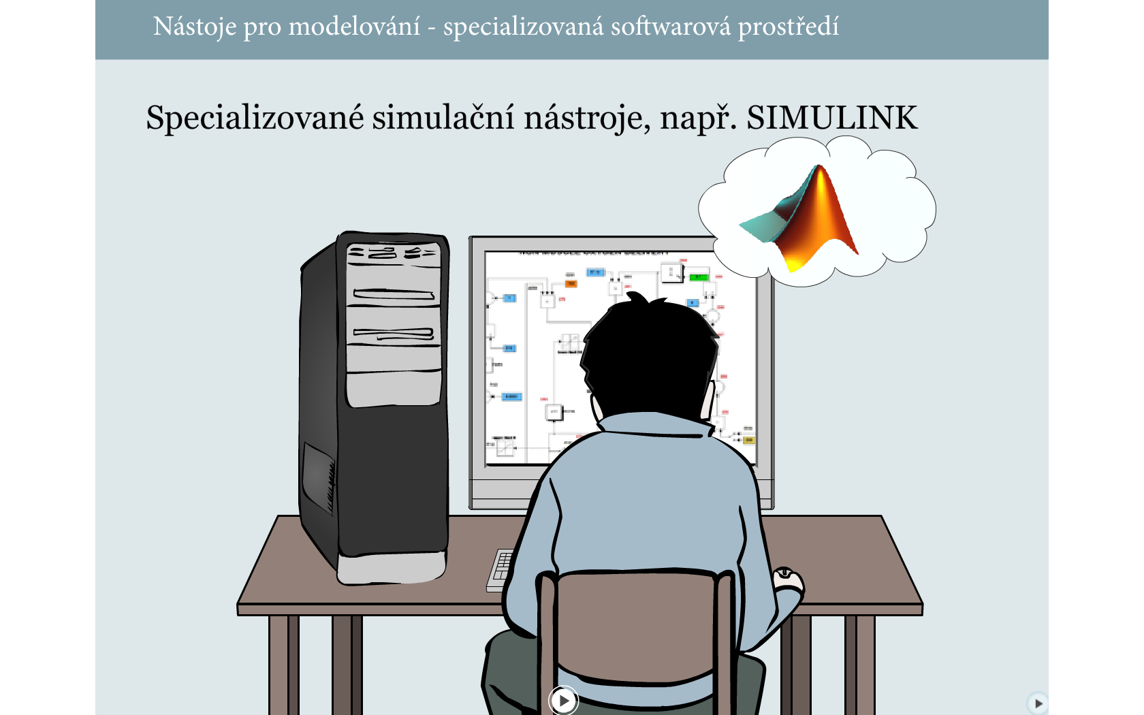
Modeling tools - Simulink

Slide 49
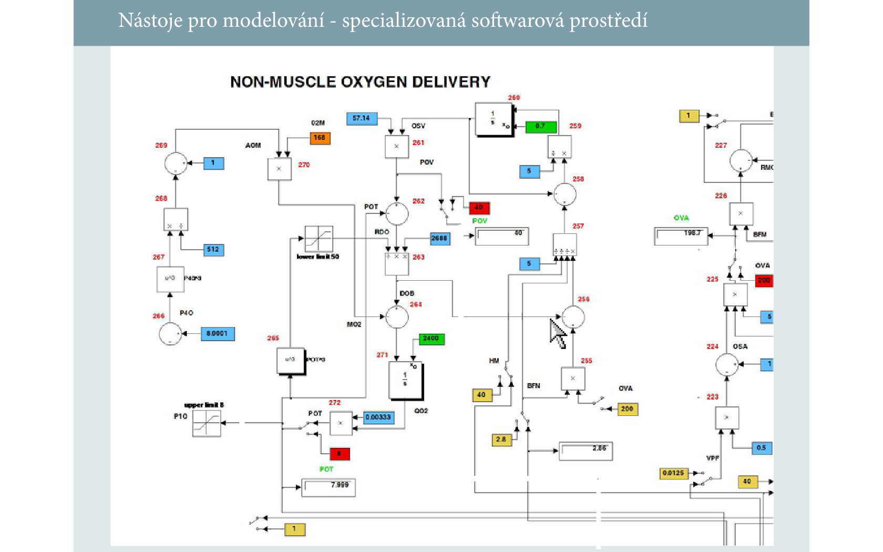
Modeling tools – Simulink, Gyton‘s model in Simulink

Slide 50
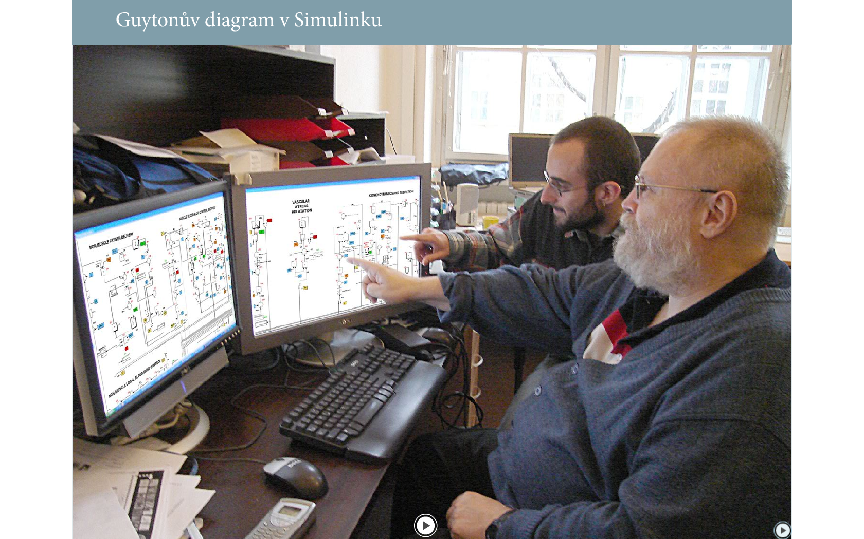
Gyton‘s model in Simulink – teaching tool for bioengineers

Slide 51
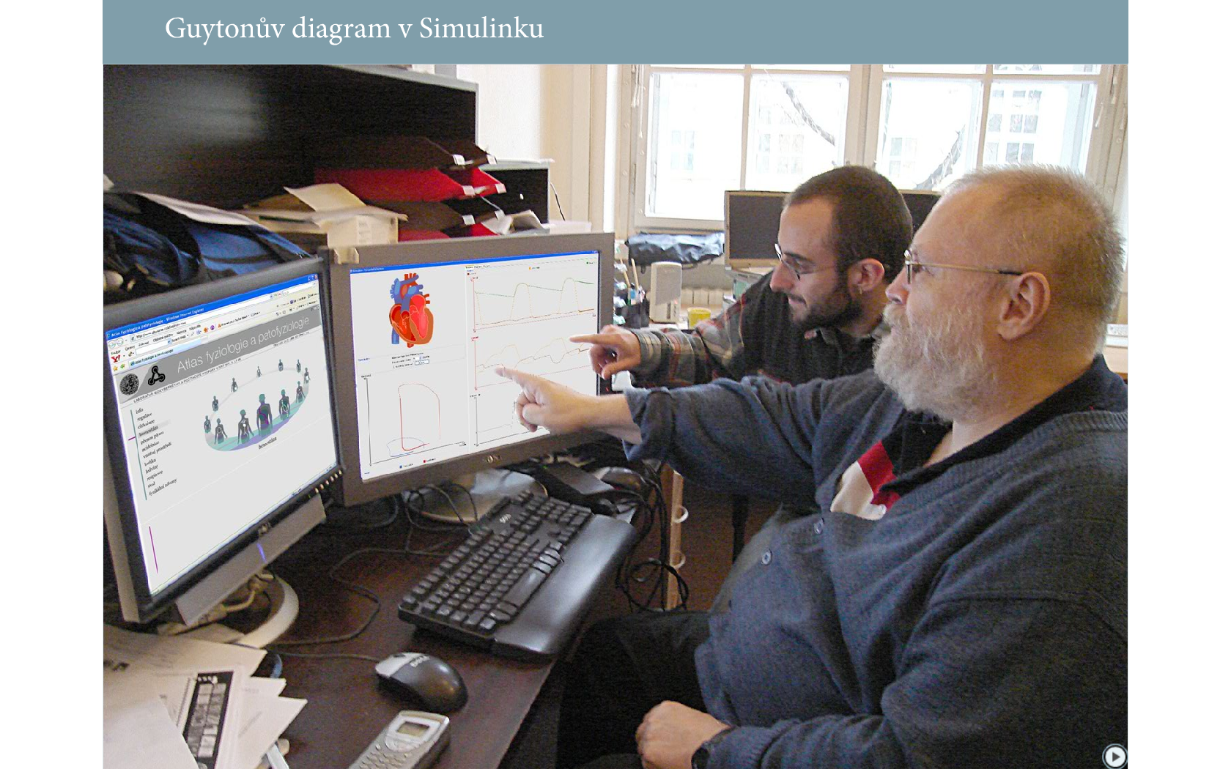
Teaching tool for medical students must be different (model-driven images)

Slide 52
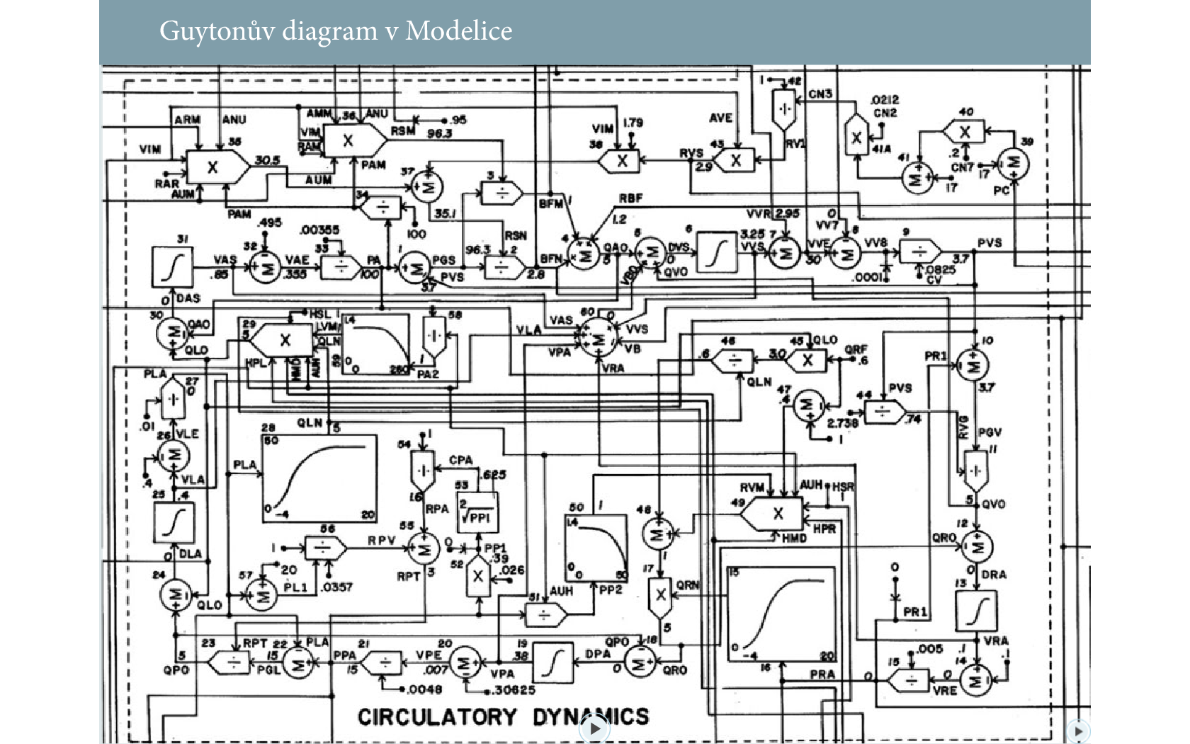
Guyton‘s model in Simulink

Slide 53
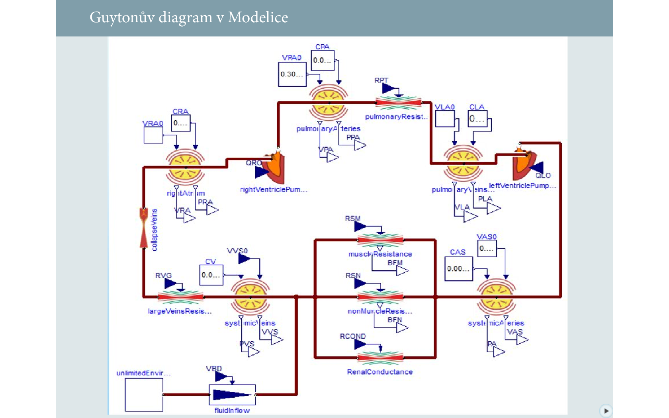
Guyton‘s model in Modelica

Slide 54
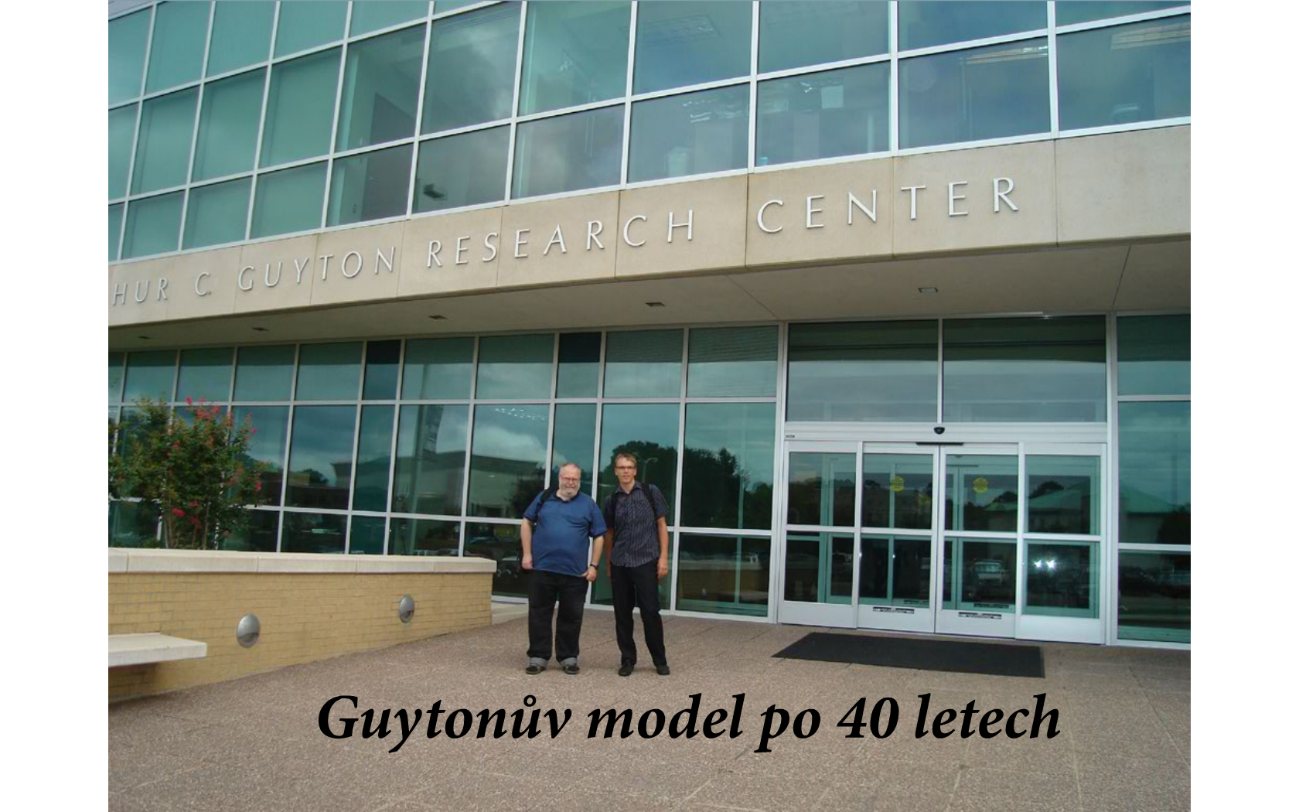
2019: Guyton's model after 47 years (1972 - 2019)

Slide 55
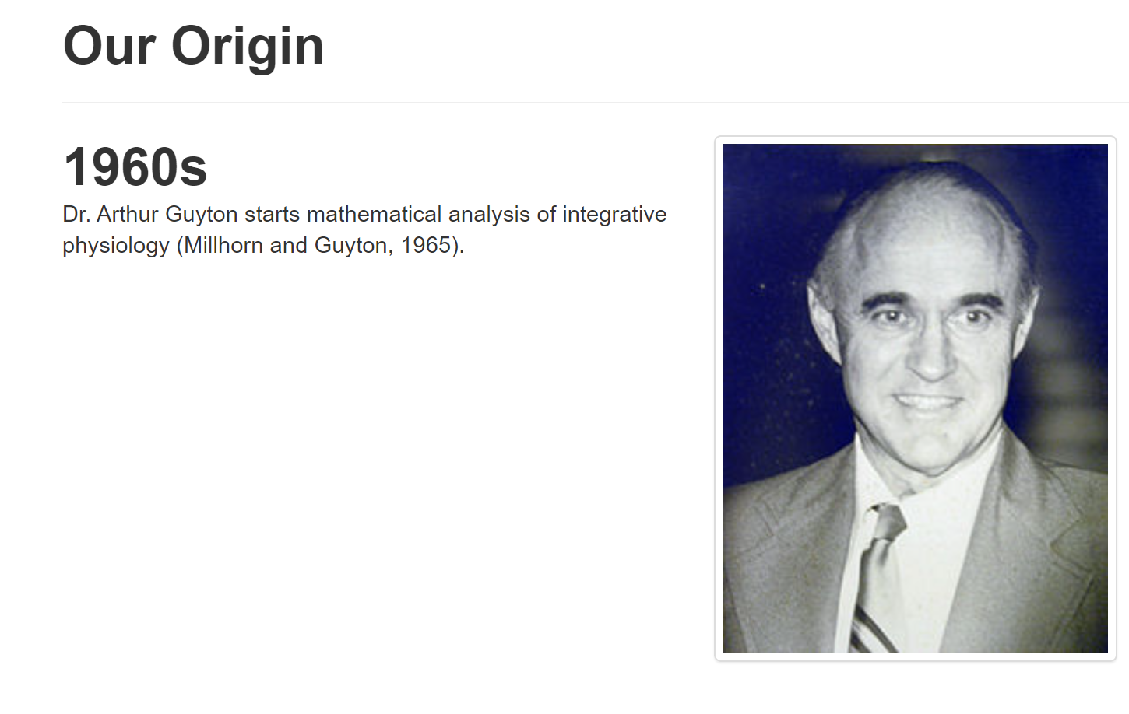
2019: Guyton's model after 47 years (1972 - 2019)

Slide 56

2019: Guyton's model after 47 years (1972 - 2019)

Slide 57

2019: Guyton's model after 47 years (1972 - 2019)

Slide 58

2019: Guyton's model after 47 years (1972 - 2019)

Slide 59

2019: Guyton's model after 47 years (1972 - 2019)

Slide 60

2019: Guyton's model after 47 years (1972 - 2019)

Slide 61

Thomas Coleman, co-author of Guyton's model, chief architect of the Hummod model in Prague (in 2010)

Slide 62

From Gyuton‘s model, 1972 to HumMod, 2010 in Modelica

Slide 63

Our model HumMod – Golem Edition in Modelica

Slide 64

Our model HumMod – Golem Edition in Modelica

Slide 65

Our model HumMod – Golem Edition in Modelica

Slide 66

Our model HumMod – Golem Edition in Modelica

Slide 67

Our model HumMod – Golem Edition in Modelica

Slide 68

Our model HumMod – Golem Edition in Modelica

Slide 69

Our model HumMod – Golem Edition in Modelica

Slide 70

Complicated model in education
Very many input and output variables

Slide 71

Complicated model in education
Very many input and output variables
For the average user (medical student) - a bit incomprehensible "toy"

Slide 72

Complicated model in education
Very many input and output variables
For the average user (medical student) - a bit incomprehensible "toy"
it's a bit like a student without a pilot course in an Airbus simulator

Slide 73

Our goal - explanation by simulation
To help students understand how the organism works in norm and pathology
Use simple models to help you understand how it works together

Slide 74

Our goal - explanation by simulation
Use simple models to help you understand how it works together

Slide 75

Překlad hlasem
33 / 5 000
Výsledky překladu
Understand how it works together
Our goal - explanation by simulation
Inputs
Outputs
Inputs
Outputs
Use simple models to help you understand how it works together

Slide 76

Our goal - explanation by simulation
Inputs
Outputs
Use simple models to help you understand how it works together
Inputs
Outputs
Use simple models to help you understand how it works together

Slide 77
Integrative physiology
Circulation
Kidney
Respiration
internal enviroment
Volume balance
Osmotic balance
Oxygen/ CO2 transport
Acid-Base homeostasis
Hemopoesis
Ionic balance
Glucose/lactate
Energy
Gastrointestinal tract

Slide 78
Homeostasis of internal enviroment
Disorders of the acid-base chemistry, influence of respiration, lungs and altered metabolism

Slide 79
Inputs
Balance between input and output flow
Storage
?
retention
Outputs
?
depletion

Slide 80
External environment of organism
Balance estimation
Concentrations
extracellular fluid - ECF
intracellular fluid - ICF
Metabolism

Slide 81
External environment of organism
Balance estimation
Concentrations
plasma
Lymph
capillaries
extracellular
fluid -ECF
interstitial fluid - ISF
intracellular fluid - ICF
Metabolism
Notes:
Extracelulární tekutina se skládá ze dvou částí – z krevní plazmy a z intersticiální tekutiny. Mezi plazmou a intersticiem dochází k intenzívní výměně látek v krevních kapilárách. Koncentrace jednotlivých iontů a dalších nízkomolekulárních látek jsou v plazmě a v intersticiální tekutině téměř stejná. Rozdílná je však koncentrace bílkovin. Bílkoviny krevní plazmy skrze neporušenou membránu kapilár do intersticia neprocházejí. Pokud se do intersticiální tekutiny nějaké bílkoviny z plazmy dostanou, jsou ihned odstraňovány do lymfatických cév a z lymfou se postupně dostávají zpět do oběhu.

Slide 82
External environment of organism
plasma
blood cells
intravascular
Lymph
(part of ICF)
fluid
capillaries
capillaries
extracellular
fluid -ECF
interstitial fluid - ISF
intracellular fluid - ICF
Metabolism
Notes:
V krvi necirkuluje jenom krevní plazma. Krev také obsahuje červené a bílé krvinky – dohromady tvoří tzv. intravaskulární tekutinu. Tekutina uvnitř krvinek je ovšem součástí ICT.

Slide 83
External environment of organism
plasma
blood cells
intravascular
Lymph
(part of ICF)
fluid
capillaries
capillaries
extracellular fluid -ECF
interstitial fluid - ISF
transcellular fluid
intracellular fluid - ICF
Metabolism
Notes:
V tělních dutinách obklopených buňkami (jako např. oční komory, mozkové komory) se nachází tzv. transcelulární tekutina – sem patří např. oční tekutina a mozkomíšní mok.
Složení tělesných tekutin je výslednicí mezi přítokem a odtokem jednotlivých látek do příslušných oddílů tělesných tekutin. Některé látky se mohou tvořit nebo být spotřebovávány v metabolismu (vodíkové ionty, CO2, O2, voda, kyselina mléčná, ketokyseliny aj.), látky mohou být přijímány z okolí organismu, nebo jsou do okolí do naopak vylučovány prostřednictvím jednotlivých orgánů.

Slide 84

External environment of organism
GIT
Lungs
„exchangers“
Kidney
plasma
blood cells
intravascular
Lymph
(part of ICF)
fluid
capillaries
extracellular fluid -ECF
interstitial fluid - ISF
transcellular fluid
intracellular fluid - ICF
Metabolism

Slide 85
External environment of organism
„exchangers“
GIT
Lungs
Kidney
plasma
blood cells
intravascular
Lymph
(part of ICF)
fluid
Circulation
capillaries
extracellular fluid -ECF
„mixing“
interstitial fluid - ISF
transcellular fluid
intracellular fluid - ICF
Metabolism

Slide 86
External environment of organism
GIT
Lungs
„exchangers“
Kidney
plasma
blood cells
intravascular
Lymph
(part of ICF)
fluid
Circulation
capillaries
extracellular fluid -ECF
„mixing“
interstitial fluid - ISF
transcellular fluid
intracellular fluid - ICF
Metabolism

Slide 87
Integrative Physiology
O2/CO2 transport disorders
O2/CO2 transport disorders
Circulation disorders
Respiratory disorders
Osmolarity disorders
Acid-Base disorders
Electrolyte disorders
Volume disorders
Gastrointestinal disorders
Kidney disorders

