Slide 1

Data Analysis for Humanities
Notes:
Welcome to Data Science in R
Who has done no programming before, really?
Target group: starting from scratch, optional course, motivated but not ready to risk an exam failure
This is not an academic seminar: rather a support group
NO consequences for your personal reputation!!!
be discrete regarding each other
Know your rights
no question is stupid enough to remain unasked
require slowdown, repetitions
ask in Czech if need be
Know your obligations
presence & participation
assignments
Goal: get yourselves started
to use R in your own projects
to learn more DSci & R during your projects, on the fly
communicate with professional programmers & statisticians
get inspired by published research
TIME, IMMERSION, PERSERVERANCE
like making your driving license
you may not love it but: external pressure on you to have it
eventually, most people get good enough to fix personal errands
only few drive a bus/heavy truck: most buy their service still
just give it this one term

Slide 2
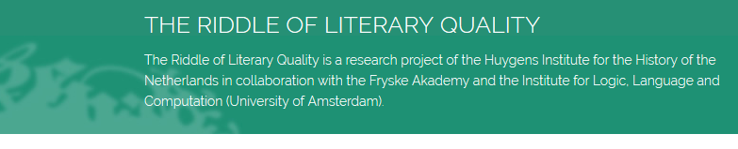
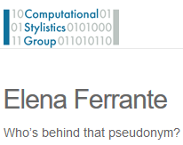

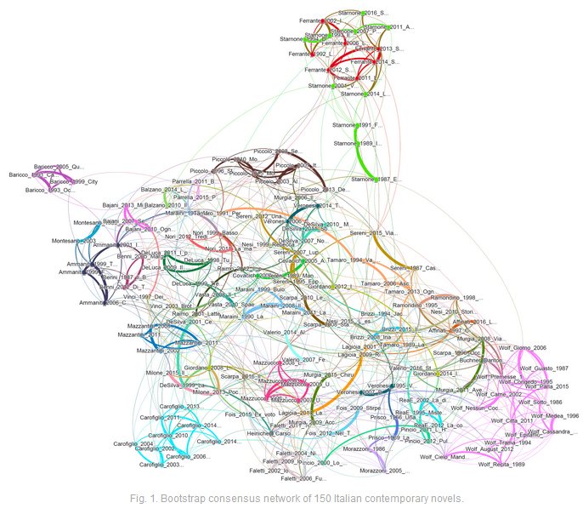
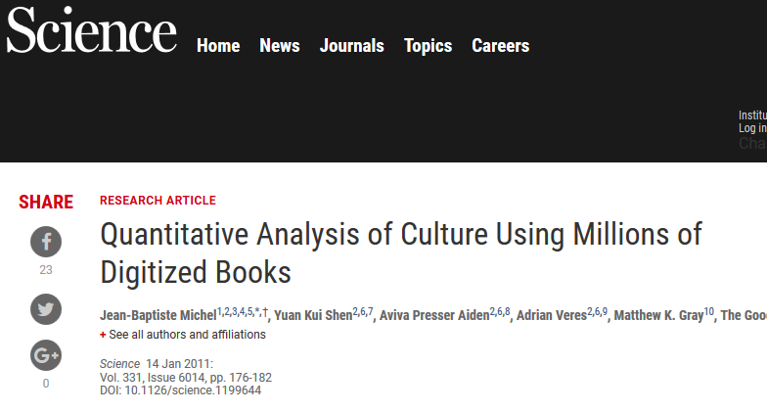
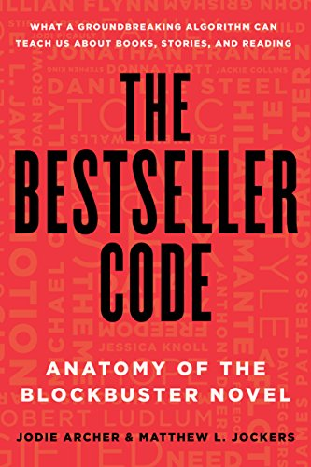

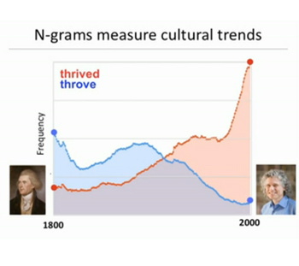
Notes:
Digital Humanities
Literary history, literary studies
Stylometry
Distant Reading
What makes a respected book/bestseller
Do women get fewer literary awards than men? Is there a text-inherent reason?

Slide 3
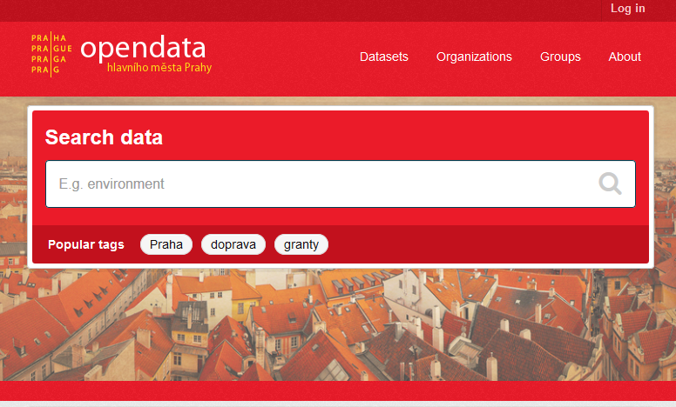
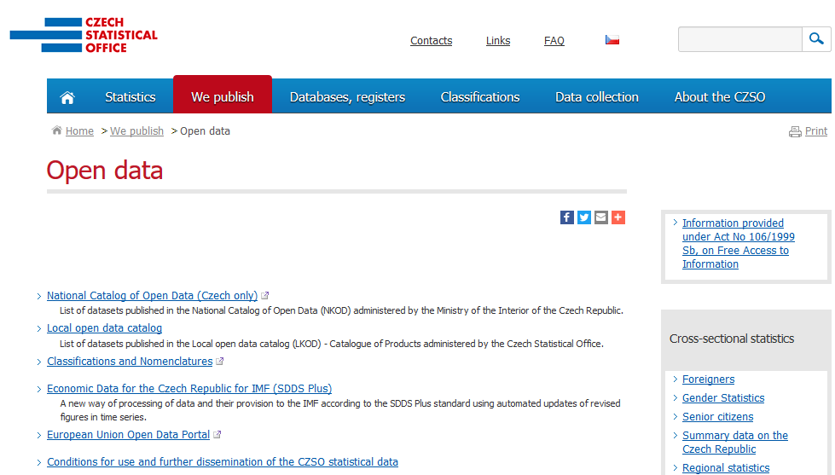
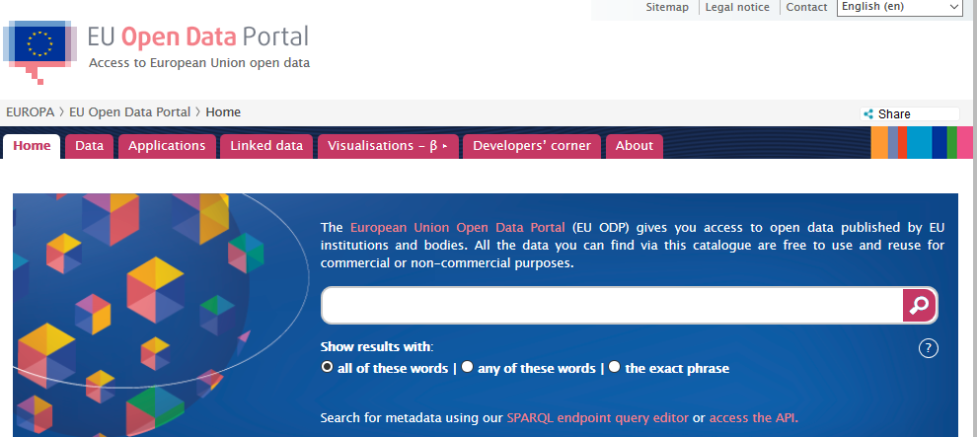
Notes:
NGO willing to fight for a matter? Taking a political or executive decision? Investigate first!
Support of critical thinking
Czech law on information access 2017: Governmental institutions are obliged to release their data in machine-readable and structured form. Cf. Linked Open Data!

Slide 4
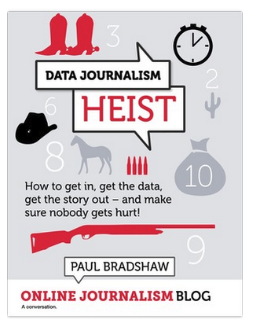
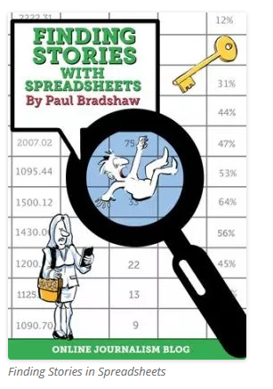
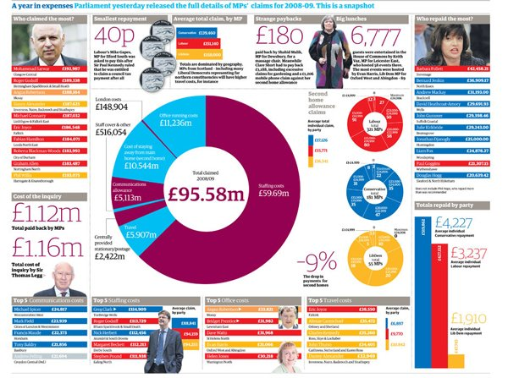
Notes:
Data-driven journalism is the current mainstream journalism.

Slide 5
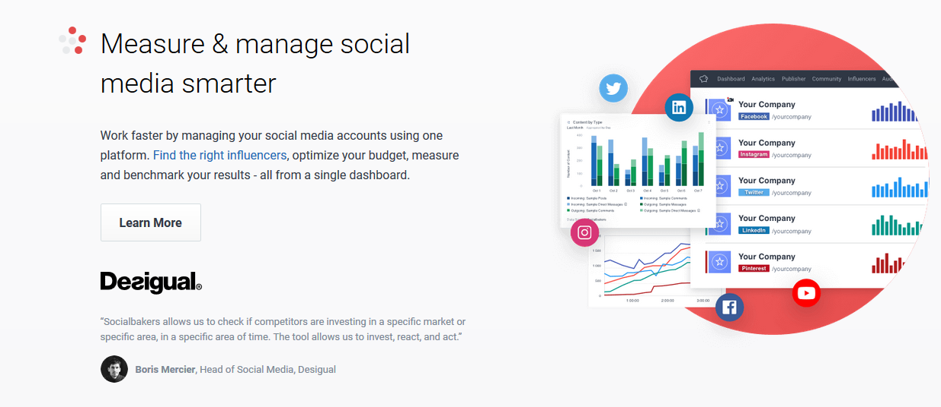
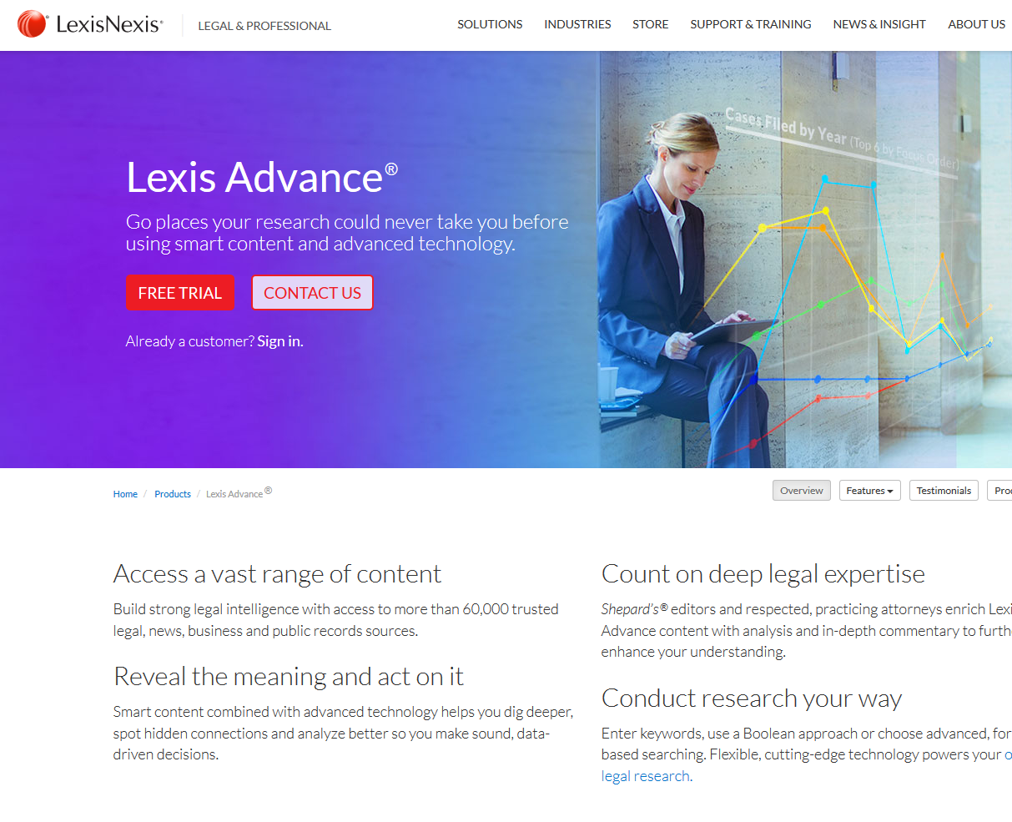
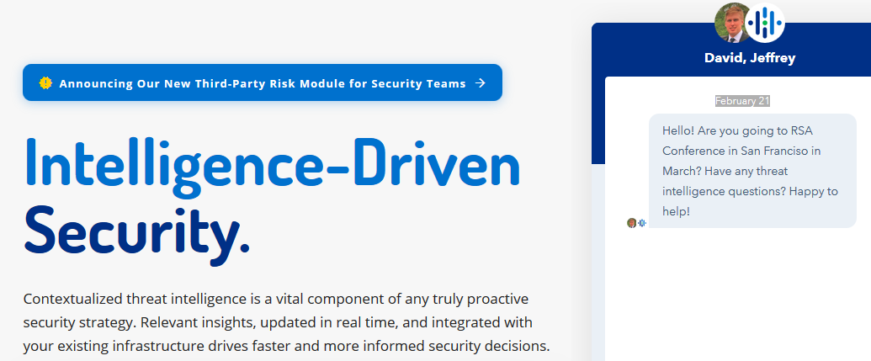
Notes:
Automatic analysis of big text amounts from diverse sources is useful in many industrial applications.
Buying a fancy application? Be informed of what expectations it can really meet given the current state of the art.
Or avoid spending money on applications that utilize scripts that you can (nearly) write yourself!

Slide 6
What you are going to learn
A few general programming concepts
Syntax of a programming language (R)
The tidy data concept
Data wrangling (make tidy tables from dirty noisy tables)
Read & draw plots (diagrams, graphs)
Summarize and interpret your data
Notes:
If you have interesting data and a research question, share it with the teachers - we can make it a case study in the late spring

Slide 7
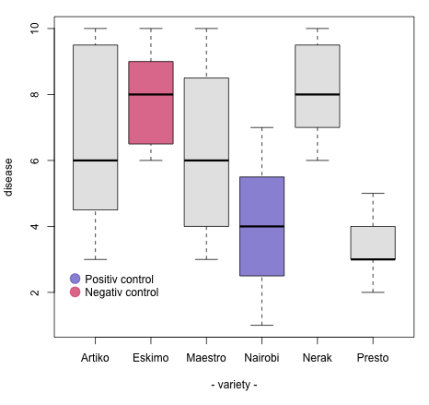
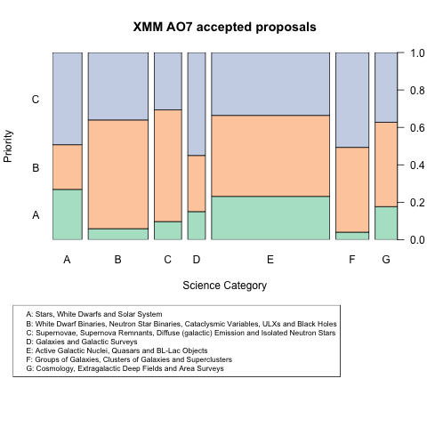
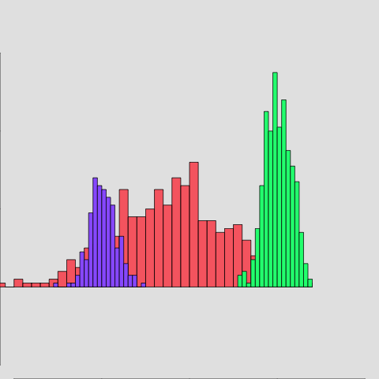
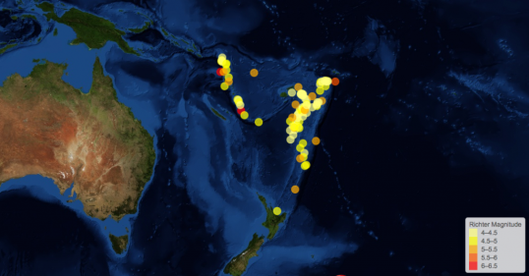
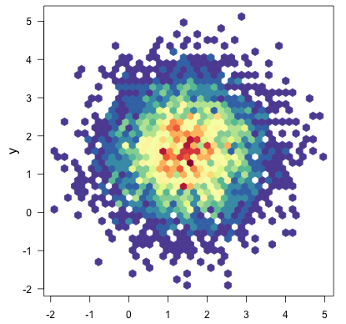
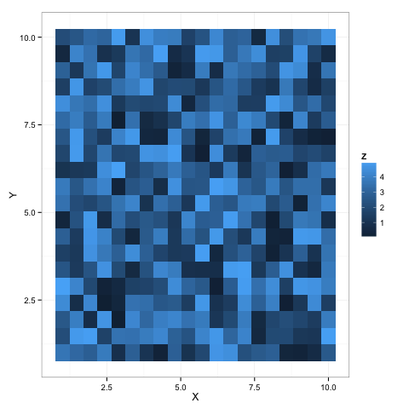
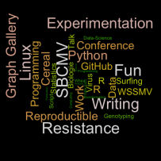
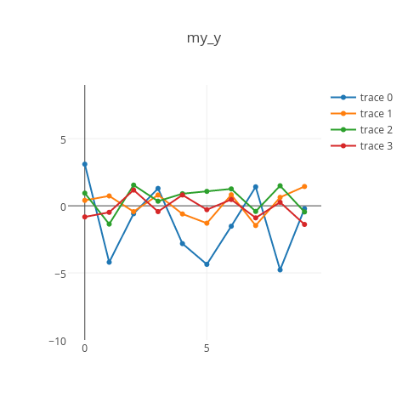
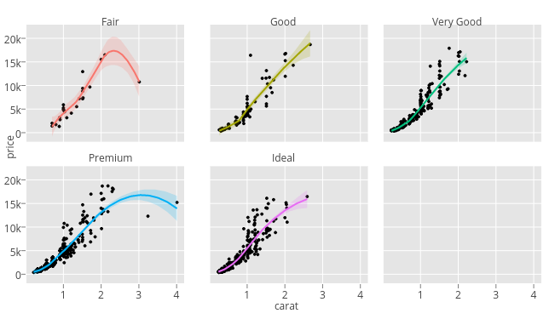
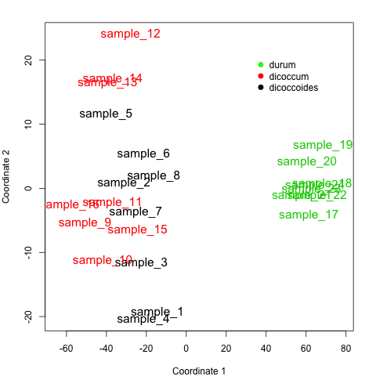
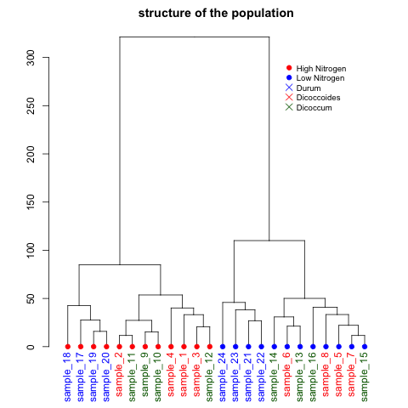
Notes:
R or Python for data analysis? Both. Advantage of R: a more consistent and comprehensive coverage of data analysis (packages are interoperable). We will learn the parts R is best at, feel free to do other stuff in Python.

Slide 8
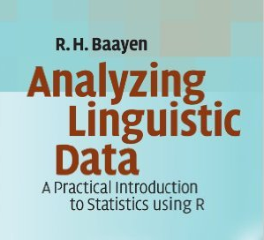
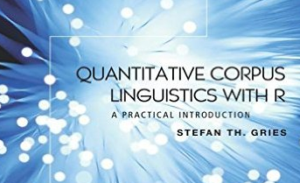
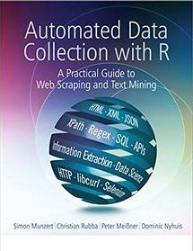
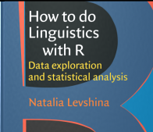
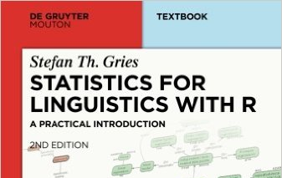
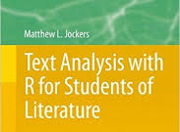
The math a linguist needs ain’t rocket science. And no one is asking you to be brilliant, just competent. The Lousy Linguist, 2010
http://thelousylinguist.blogspot.cz/2010/01/why-linguists-should-study-math.html
Notes:
Big data, machine learning, scientific visualization processed by programming. BUT: “scripting” programming languages accessible to non-computer scientists; many ready-made libraries for current scripting languages. You plug in ready-made code modules into your projects.
Statistics - complex field of inquiry: scary. BUT: Applying well-proven statistical methods: doable. Psychologists, social scientists, doctors in clinical studies...
Already a number of handbooks available, go with the stream, imitate study designs. When in doubt: consult a real statistician.
Necessity: learning by doing. Don't wait till you have fully understood what you have read. Don’t fret when you have to do something you have never done before. Usually you would make it.

Slide 9
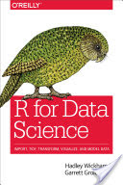
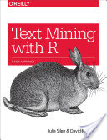
Notes:
R for Data Science – our main textbook. For free on the web.
Start with immediately useful stuff.

Slide 10
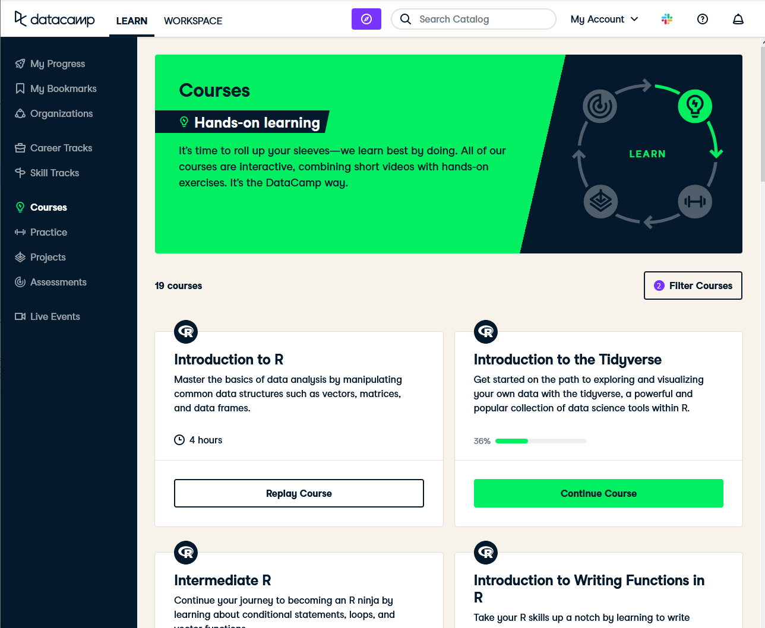
Notes:
Learn the traditional basics of R.

Slide 11
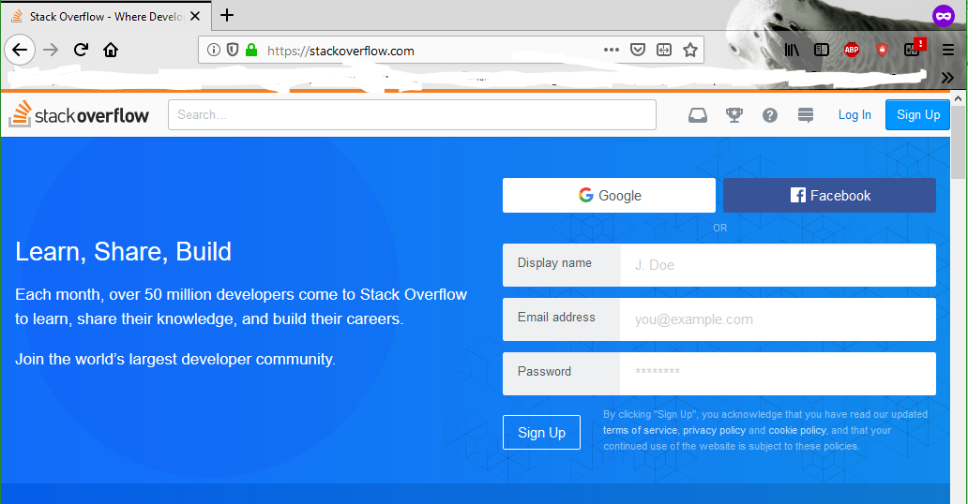
Notes:
Get help here.

