Slide 1

Modern Homes Meet Tradition
Sculpture for Home Decor & Indian Art — where aesthetics, culture, and meaning come together to transform a house into a story.

Slide 2
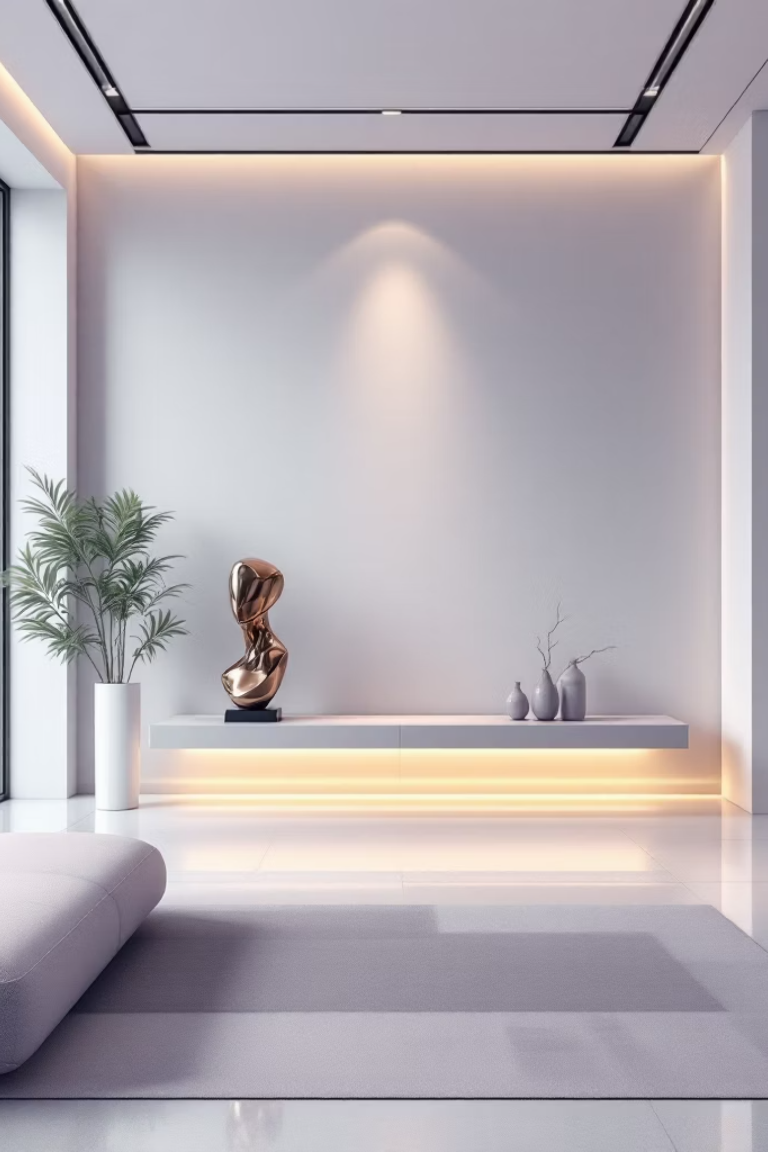
Art That Tells Your Story
A modern home showcases who we are and how we think. The moment someone walks in, the space should quietly tell a story — and that story often begins with art.
Sculpture for Home Decor
Popular Indian Paintings
Adds depth and presence — fills the silence without being loud.
Bring warmth, culture, and meaning to any interior.
Together
They transform a house into a lived-in, expressive space.

Slide 3

Good Art Is About More Than Looking Good
Sculpture
Made with proper mediums, a sculpture pulls the eye gently — without demanding attention. Unique, natural details give each piece character and personal meaning.
Indian Paintings
They reflect legacy, emotion, and artistic quality. From folk-inspired to contemporary, these paintings carry stories that feel increasingly familiar over time.

Slide 4
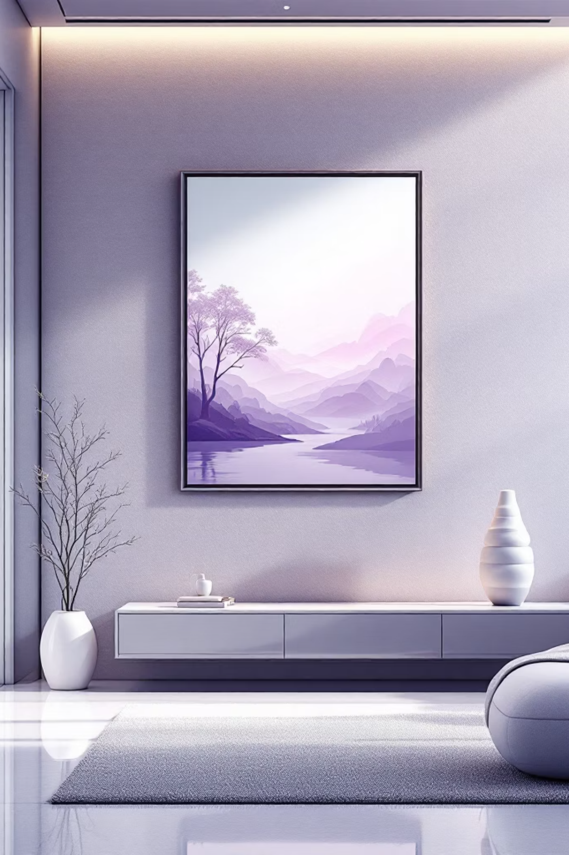

Art Works Best When It Belongs
Not forced. Not excessive. A minimal living room benefits from a bold sculpture — full attention, no crowding. Layered walls adorned with Indian paintings create rhythm and visual equilibrium.
Light, height, and spacing affect the experience of art just as much as the piece itself. When art and space speak the same language, the room feels complete.

Slide 5

Discover the Right Pieces
Form Art
Finding authentic art no longer needs endless searching. Form Art brings together talented artists and thoughtfully curated collections — simplifying art buying while keeping originality intact.
Whether you seek a refined sculpture for home decor or meaningful Indian paintings, variety and craftsmanship are key. Every piece comes with context and care.

Slide 6
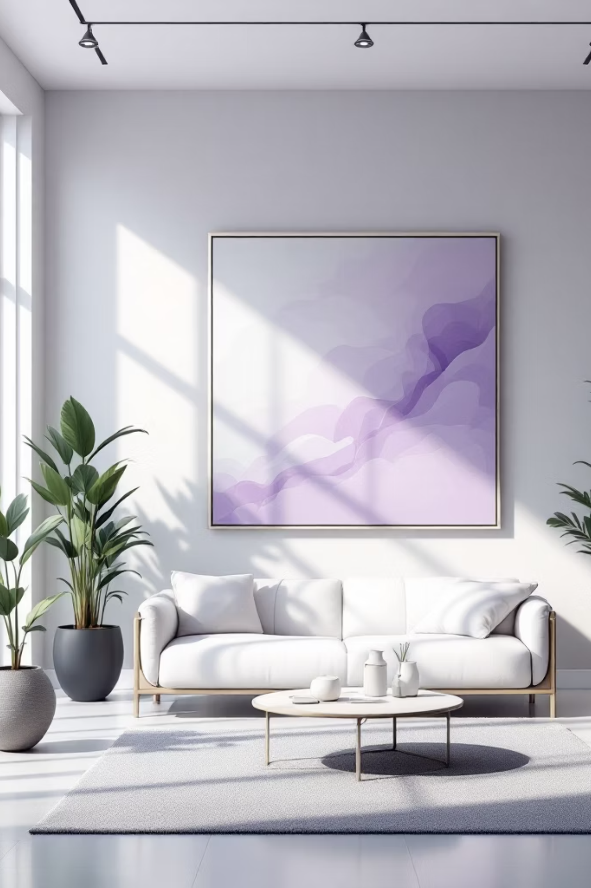
Art Becomes Part of Everyday Living
Art isn't something you replace often. It stays, grows, and evolves with your home.
Sculpture
Indian Paintings
A timeless piece becomes part of daily moments — noticed in morning light or evening calm.
Add emotional depth, grounding modern interiors in culture and tradition.
Resonance Over Trends
Choose pieces that speak to you — they'll keep speaking for years.

Slide 7
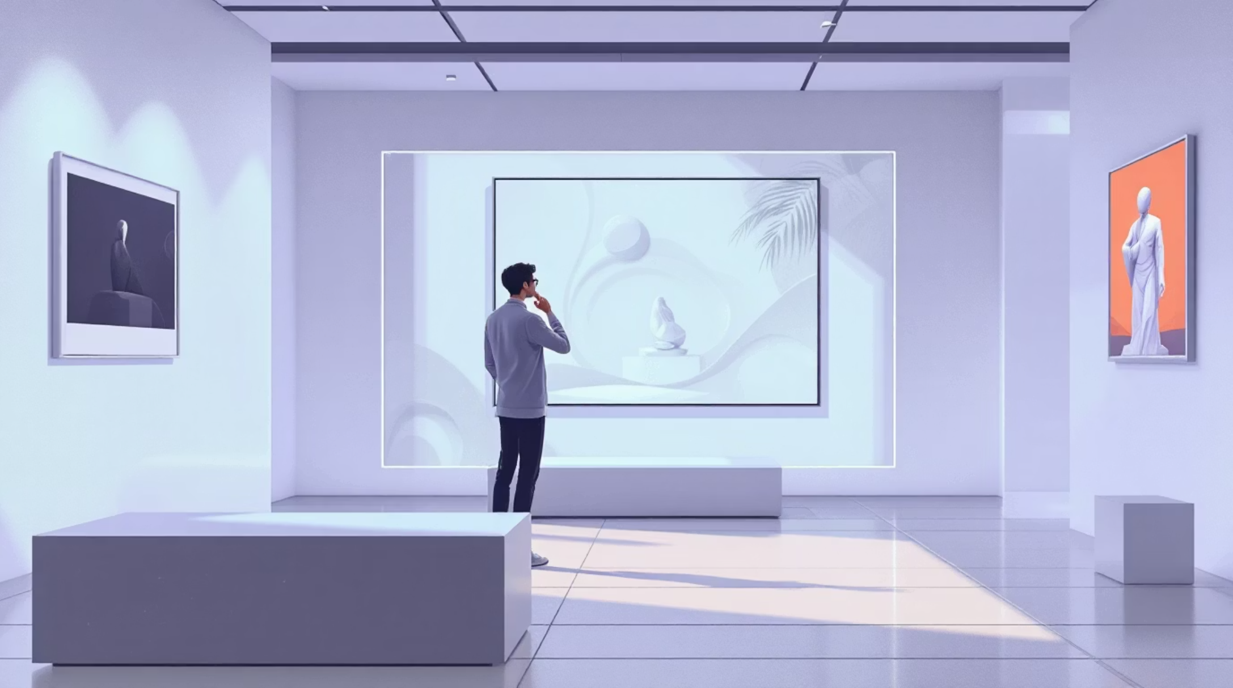
Begin Your Art Journey
Decorating with art is a personal process. There's no single right choice — what matters is how a piece makes you feel in your space.
Platforms like Form Art make this journey simpler and more meaningful. They help you choose art that feels right, not rushed.
When art feels right, it stays relevant. And relevance always leaves a lasting impression.

Slide 8
FAQs
1
2
Choosing a Sculpture
Indian Paintings in Modern Homes
Focus on size, placement, and the mood you want the space to reflect.
Yes — many styles blend traditional themes seamlessly with contemporary design.
3
4
Best Placement for Sculptures
Buying Art Online
Entryways, console tables, and well-lit corners work beautifully.
Trusted platforms like Form Art offer curated, authentic collections with confidence.

