Slide 1
Integrative physiology
Hemodynamics
Volume balance
osmotic balance
Oxygen transport
ionic balance
Acid-Base homeostasis

Slide 2
Pumpa
Pump
Potrubí
Pipes
Náplň
Filling

Slide 3
Cardiac Output
Frank-Starling law
The heart is a pump driven by its inflow (or pressure on its input)
End diastolic pressere

Slide 4
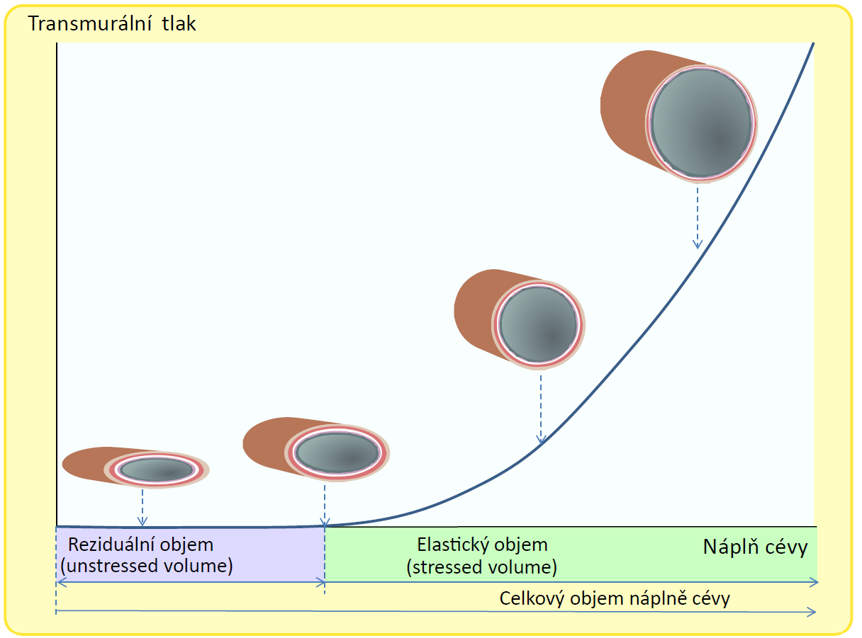
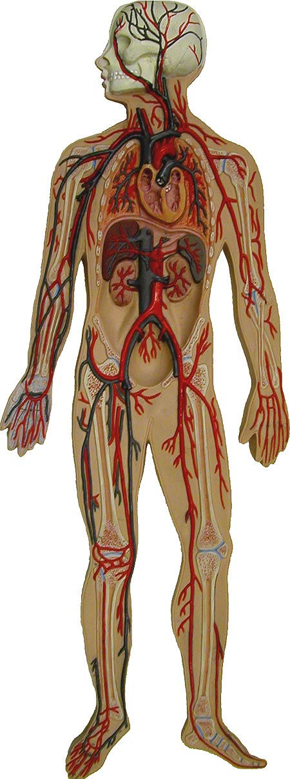
Basic properties of blood vessels
(Transmural pressure)
(The total volume of the vessel filling)

Slide 5
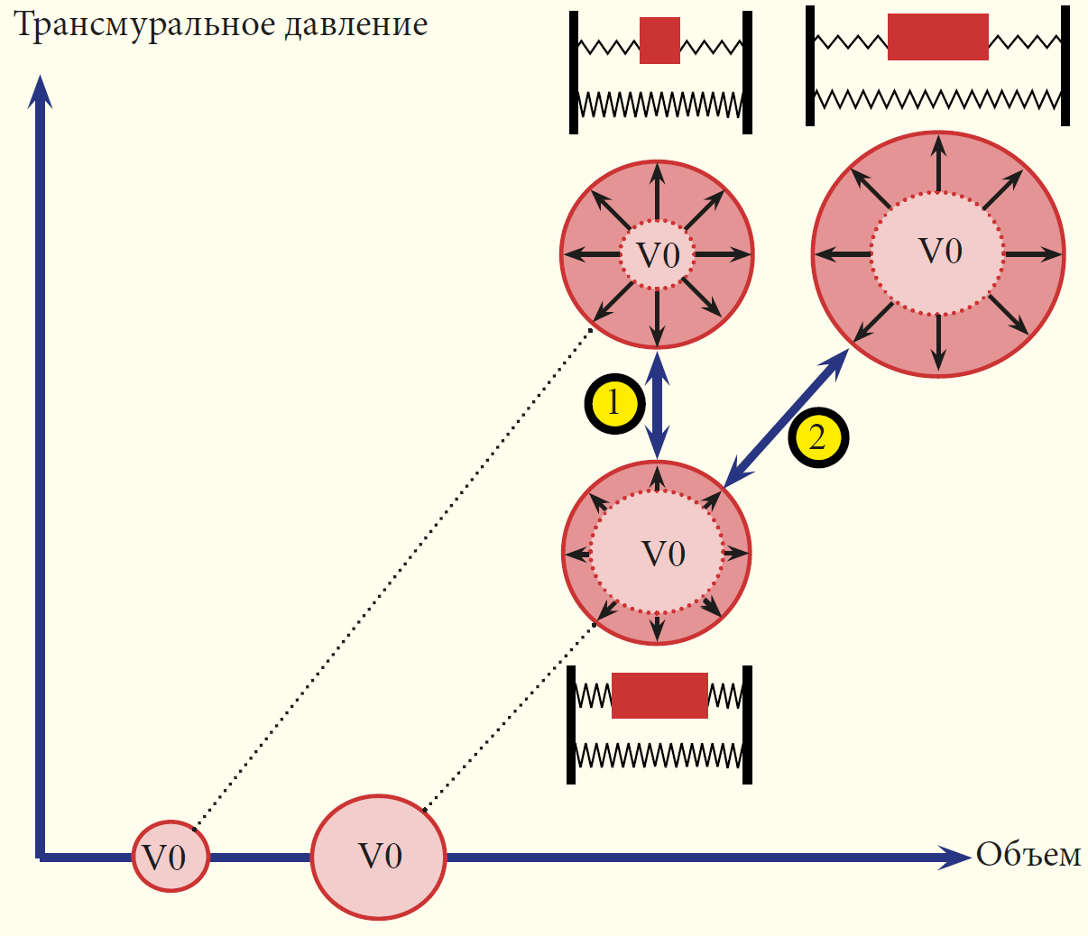

Transmurální tlak
V1
Zvýšení venózního tonu
Zvýšení objemu
Reziduální objem
Reziduální objem
V1
Objem

Slide 6
Transmurální tlak
V1
Zvýšení venózního tonu
Zvýšení objemu
Reziduální objem
Reziduální objem
V1
Objem

Slide 7
Transmurální tlak
V1
Zvýšení venózního tonu
Zvýšení objemu
Reziduální objem
Reziduální objem
V1
Objem

Slide 8
Transmural pressure
V1
Increase in venous tone
Volume increase
Reziduální objem
Reziduální objem
V1
Volume

Slide 9
Inlet pressure
Flow
The heart is a pump driven by its inflow (or pressure on its input)

Slide 10
Elastic arteries
Inlet pressure
Flow
Elastic veins
The heart is a pump driven by its inflow (or pressure on its input)
Capillary and arteriolar resistances

Slide 11
Elastic arteries
Inlet pressure
Flow
Elastic veins
The heart is a pump driven by its inflow (or pressure on its input)
pressure
Capillary and arteriolar resistances
volume

Slide 12
Elastic arteries
Inlet pressure
Flow
Elastic veins
The heart is a pump driven by its inflow (or pressure on its input)
pressure
Capillary and arteriolar resistances
volume

Slide 13
Elastic arteries
Inlet pressure
Flow
Elastic veins
The heart is a pump driven by its inflow (or pressure on its input)
pressure
Capillary and arteriolar resistances
volume

Slide 14
Elastic arteries
Inlet pressure
Flow
Elastic veins
The heart is a pump driven by its inflow (or pressure on its input)
pressure
Capillary and arteriolar resistances
volume

Slide 15
Elastic arteries
Inlet pressure
Flow
Elastic veins
The heart is a pump driven by its inflow (or pressure on its input)
pressure
Capillary and arteriolar resistances
volume

Slide 16
Elastic arteries
Inlet pressure
Flow
Elastic veins
The heart is a pump driven by its inflow (or pressure on its input)
pressure
P
Capillary and arteriolar resistances
V
V₀
volume
compliance C=dV/dP

Slide 17
Elastic arteries
Inlet pressure
Flow
Elastic veins
The heart is a pump driven by its inflow (or pressure on its input)
pressure
P
Capillary and arteriolar resistances
V
V₀
V₀
volume
compliance C=dV/dP

Slide 18
Elastic arteries
Inlet pressure
Flow
Elastic veins
The heart is a pump driven by its inflow (or pressure on its input)
pressure
P
Capillary and arteriolar resistances
V
V₀
volume
compliance C=dV/dP

Slide 19
Elastic arteries
Inlet pressure
Flow
Elastic veins
The heart is a pump driven by its inflow (or pressure on its input
pressure
P
Capillary and arteriolar resistances
V
V₀
volume
compliance C=dV/dP

Slide 20
Elastic arteries
Inlet pressure
Flow
Elastic veins
The heart is a pump driven by its inflow (or pressure on its input)
pressure
P
Capillary and arteriolar resistances
V
V₀
volume
compliance C=dV/dP

Slide 21
Elastic arteries
Inlet pressure
Flow
Elastic veins
The heart is a pump driven by its inflow (or pressure on its input
pressure
P
C₁
Capillary and arteriolar resistances
C₂
V
V₀
volume
compliance C=dV/dP

Slide 22
Elastic arteries
Inlet pressure
Flow
Elastic veins
The heart is a pump driven by its inflow (or pressure on its input
pressure
P
C₁
<
Capillary and arteriolar resistances
C₂
dV₁
dV₂
dP
V
V₀
volume
dV₁/dP< dV₂/dP
compliance C=dV/dP

Slide 23
Elastic arteries
Inlet pressure
Flow
Elastic veins
The heart is a pump driven by its inflow (or pressure on its input
pressure
P
C₁
<
Capillary and arteriolar resistances
C₂
V
V₀
volume
dV₁/dP< dV₂/dP
compliance C=dV/dP

Slide 24
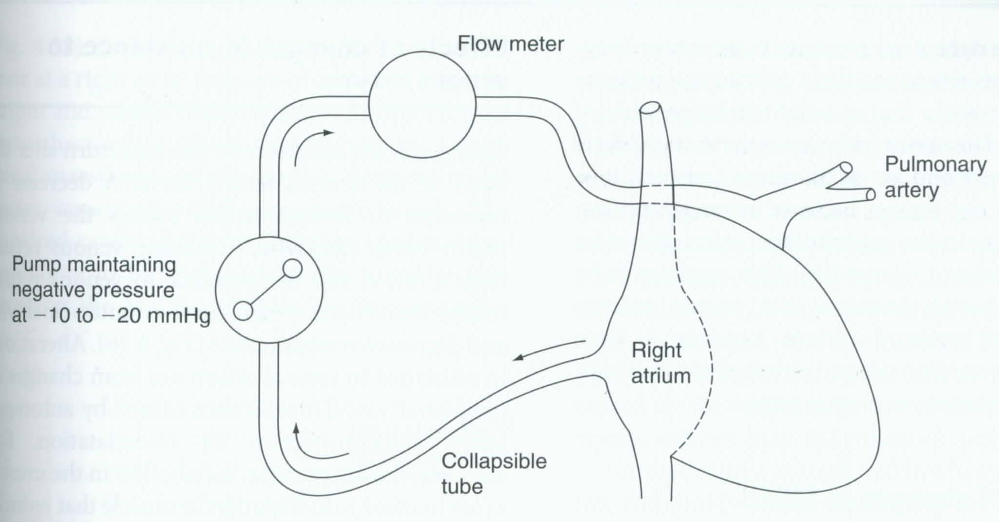
Guyton experiments
http://patf-biokyb.lf1.cuni.cz/~tribula/cirkulaceen/

Slide 25
Flow
Q
Elastic arteries
Elastic veins
P_{a}
The heart is a pump driven by its inflow (or pressure on its input
P_{v}
Capillary and arteriolar resistances

Slide 26
Flow
Q=0
Elastic arteries
Elastic veins
P_{a}
The heart is a pump driven by its inflow (or pressure on its input
P_{v}
Capillary and arteriolar resistances

Slide 27
Flow
Q=0
Elastic arteries
Elastic veins
P_{a}
The heart is a pump driven by its inflow (or pressure on its input
P_{v}
Capillary and arteriolar resistances

Slide 28
Flow
Q=0
Elastic arteries
Elastic veins
P_{a}
The heart is a pump driven by its inflow (or pressure on its input
P_{v}
Capillary and arteriolar resistances

Slide 29
Flow
Q=0
Elastic arteries
Elastic veins
P_{a} = Pm
P_{v}
P_{v} = P_{a} = P_{m}
Q
Capillary and arteriolar resistances
P_{m}
P_{m} – „mean circulatory pressure“
P_{v}

Slide 30
Flow
Q
Elastic arteries
Elastic veins
P_{a}
P_{v}
Q
Capillary and arteriolar resistances
P_{m}
P_{v}

Slide 31
Flow
Q
Elastic arteries
Elastic veins
P_{a}
P_{v}
Q
Capillary and arteriolar resistances
P_{m}
P_{v}

Slide 32
Flow
Q
Elastic arteries
Elastic veins
P_{a}
P_{v}
Q
Capillary and arteriolar resistances
P_{m}
P_{v}

Slide 33
Flow
Q
Elastic arteries
Elastic veins
P_{a}
P_{v}
P_{v}=0
Q
Capillary and arteriolar resistances
P_{m}
P_{v}

Slide 34
Flow
Q cannot rise
Elastic arteries
Elastic veins
P_{v}< 0
P_{a}
Elastic veins collapses
P_{v}
P_{v}<0
Q
Capillary and arteriolar resistances
P_{m}
P_{v}

Slide 35
Flow
Q=0
Elastic arteries
Elastic veins
P_{a} = Pm
P_{v}
P_{v}= P_{m}
Q
Capillary and arteriolar resistances
P_{m}
P_{v}

Slide 36
Flow
Q
Elastic arteries
Elastic veins
P_{a}
P_{v}
Q
Capillary and arteriolar resistances
P_{m}
P_{v}

Slide 37
Flow
Q
Flow
Elastic arteries
Elastic veins
P_{a}
P_{v}
Q
Capillary and arteriolar resistances
P_{m}
P_{v}

Slide 38
Flow
Q
Elastic arteries
Elastic veins
P_{a}
P_{v}
Q
Capillary and arteriolar resistances
P_{m}
P_{v}

Slide 39
Flow
Q
Elastic arteries
Elastic veins
P_{a}
P_{v}
Q
Capillary and arteriolar resistances
P_{m}
P_{v}

Slide 40
Flow
Q
Elastic arteries
Elastic veins
P_{a}
P_{v}
P_{v}=0
Q
Capillary and arteriolar resistances
P_{m}
P_{v}

Slide 41
Flow
Q cannot rise
Elastic arteries
Elastic veins
P_{a}
Elastic veins collapes
P_{v}
P_{v}<0
Q
Capillary and arteriolar resistances
P_{m}
P_{v}

Slide 42
Flow
Q=0
Elastic arteries
Elastic veins
P_{a} = Pm
P_{v}
P_{v}= P_{m}
Q
Capillary and arteriolar resistances
P_{m}
P_{v}

Slide 43
Flow
Q=0
Elastic arteries
Elastic veins
P_{a} = Pm
P_{v}
P_{v}= P_{m}
Q
Capillary and arteriolar resistances
P_{m}
P_{v}

Slide 44
Flow
Q
Elastic arteries
Elastic veins
P_{a}
P_{v}
Q
Capillary and arteriolar resistances
P_{m}
P_{v}

Slide 45
Flow
Q
Flow
Elastic arteries
Elastic veins
P_{a}
P_{v}
Q
Capillary and arteriolar resistances
P_{m}
P_{v}

Slide 46
Flow
Q
Elastic arteries
Elastic veins
P_{a}
P_{v}
Q
Capillary and arteriolar resistances
P_{m}
P_{v}

Slide 47
Flow
Q
Elastic arteries
Elastic veins
P_{a}
P_{v}
Q
Capillary and arteriolar resistances
P_{m}
P_{v}

Slide 48
Flow
Q
Elastic arteries
Elastic veins
P_{a}
P_{v}
P_{v}=0
Q
Capillary and arteriolar resistances
P_{m}
P_{v}

Slide 49
Flow
Q cannot rise
Elastic arteries
Elastic veins
P_{a}
Elastic veins collapes
P_{v}
P_{v}<0
Q
Capillary and arteriolar resistances
P_{m}
P_{v}

Slide 50
Flow
Q=0
Elastic arteries
Elastic veins
P_{a} = Pm
P_{v}
P_{v}= P_{m}
Q
Capillary and arteriolar resistances
P_{m}
P_{v}

Slide 51
Flow
Q=0
Elastic arteries
Elastic veins
P_{a} = Pm
Venotonus
P_{v}
P_{v}= P_{m}
Q
Capillary and arteriolar resistances
P_{m}
P_{m}
P_{v}

Slide 52
Flow
Q=0
Elastic arteries
Elastic veins
P_{a} = Pm
Venotonus
P_{v}
P_{v}= P_{m}
Blood Volume
Q
Capillary and arteriolar resistances
P_{m}
P_{m}
P_{v}

Slide 53
Flow
Q=0
Elastic arteries
Elastic veins
P_{a} = Pm
Venotonus
P_{v}
P_{v}= P_{m}
Blood Volume
Q
Capillary and arteriolar resistances
P_{m}
P_{m}
P_{v}

Slide 54
Flow
Q
Elastic arteries
Elastic veins
P_{a}
Venotonus
P_{v}
Blood Volume
Q
Capillary and arteriolar resistances
P_{m}
P_{m}
P_{v}

Slide 55
Flow
Q
Flow
Elastic arteries
Elastic veins
P_{a}
Venotonus
P_{v}
Blood Volume
Q
Capillary and arteriolar resistances
P_{m}
P_{m}
P_{v}

Slide 56
Flow
Q
Elastic arteries
Elastic veins
P_{a}
Venotonus
P_{v}
Blood Volume
Q
Capillary and arteriolar resistances
P_{m}
P_{m}
P_{v}

Slide 57
Flow
Q
Elastic arteries
Elastic veins
P_{a}
Venotonus
P_{v}
Blood Volume
Q
Capillary and arteriolar resistances
P_{m}
P_{m}
P_{v}

Slide 58
Flow
Q
Elastic arteries
Elastic veins
P_{a}
Venotonus
P_{v}
P_{v}=0
Blood Volume
Q
Capillary and arteriolar resistances
P_{m}
P_{m}
P_{v}

Slide 59
Flow
Q cannot rise
Elastic arteries
Elastic veins
P_{a}
Elastic veins collapes
Venotonus
P_{v}
P_{v}<0
Blood Volume
Q
Capillary and arteriolar resistances
P_{m}
P_{m}
P_{v}

Slide 60
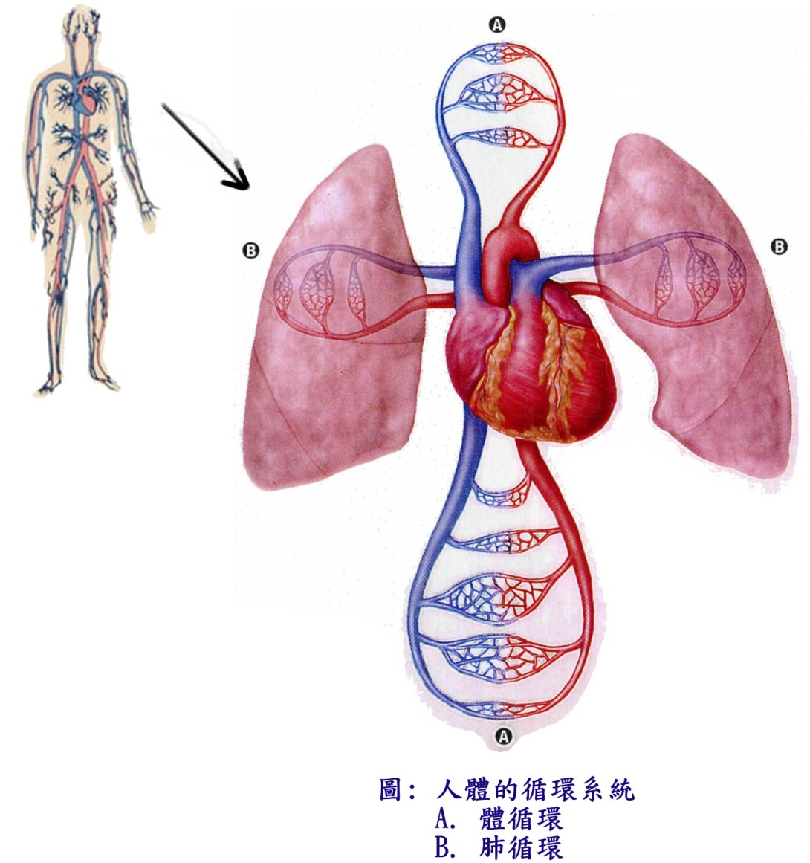
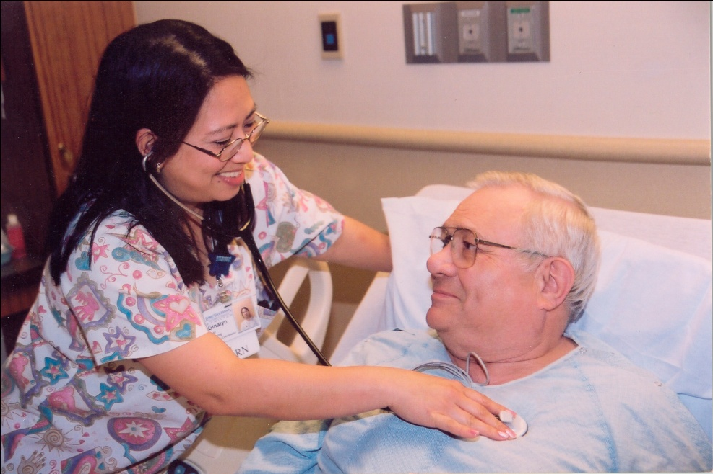
Heart + Vessels
http://patf-biokyb.lf1.cuni.cz/~tribula/cirkulaceen/

Slide 61
Cardiac output
0
End diastolic pressure

Slide 62
Cardiac output
Increase of peripheral resistance
0
End diastolic pressure

Slide 63
Cardiac output
Decrease of peripheral resistance
Increase of peripheral resistance
0
End diastolic pressure

Slide 64
Cardiac output
Increase blood volume
or (increase of venotone)
Decrease of peripheral resistance
Increase of peripheral resistance
0
End diastolic pressure

Slide 65
Cardiac output
Increase blood volume
or (increase of venotone)
Decrease of peripheral resistance
Decrease blood volume
or (decrease of venotone)
Increase of peripheral resistance
0
End diastolic pressure

Slide 66
Cardiac output
Frank-Starling curve
Venous return curve
End diastolic pressure

Slide 67
Cardiac output
Frank-Starling curve
Venous return curve
End diastolic pressure

Slide 68
Cardiac output
Frank-Starling curve
Venous return curve
End diastolic pressure

Slide 69
Cardiac output
Frank-Starling curve
Venous return curve
End diastolic pressure

Slide 70
Cardiac output
Frank-Starling curve
Venous return curve
End diastolic pressure

Slide 71
Cardiac output
Frank-Starling curve
Venous return curve
End diastolic pressure

Slide 72
Cardiac output
Frank-Starling curve
Venous return curve
End diastolic pressure

Slide 73
Cardiac output
diuretics
kardiotonics
Increasing the volume of circulating blood venokonstriction,
insufficiency
vasoconstriction
End diastolic pressure increase
! pulmonary edema, swelling
End diastolic pressure

Slide 74
Starling curve and venous return curve
Cardiac
output
Starling curve
Venous return curve
preload
Normal circulation
Notes:
74

Slide 75
Starling curve and venous return curve
inotropy,
heart rate
Cardiac
output
Cardiac
output
Starling curve
inotropy,
heart rate
Venous return curve
preload
preload
Normal circulation
Starling curve changes
Notes:
75

Slide 76
Starling curve and venous return curve
inotropy,
heart rate
Cardiac
output
Cardiac
output
Starling curve
inotropy,
heart rate
Venous return curve
preload
preload
Normal circulation
Starling curve changes
Cardiac
output
resistance
resistance
preload
Venous return curve changes
Notes:
76

Slide 77
Starling curve and venous return curve
inotropy,
heart rate
Cardiac
output
Cardiac
output
Starling curve
inotropy,
heart rate
Venous return curve
preload
preload
Normal circulation
Starling curve changes
Cardiac
output
resistance
Cardiac
output
venotonus,
blood volume
resistance
venotonus,
blood volume
preload
preload
Venous return curve changes
Venous return curve changes
Notes:
77

Slide 78
Starling curve and venous return curve
inotropy,
heart rate
Cardiac
output
Cardiac
output
Starling curve
inotropy,
heart rate
Venous return curve
preload
preload
Normal circulation
Starling curve changes
Cardiac
output
resistance
Cardiac
output
venotonus,
blood volume
resistance
venotonus,
blood volume
preload
preload
Venous return curve changes
Venous return curve changes
Notes:
78

Slide 79
Basic Priciples of Hemodynamics in Shock
Cardiac
output
Starling curve
Venous return curve
preload
Normal circulation
Notes:
79

Slide 80
Cardiac output
Cardiac insufficiency
Retention volume
The increase in venous tone
Vasoconstriction
End diastolic pressure
Cardiogenic shock
preload
Notes:
80

Slide 81
Basic Priciples of Hemodynamics in Shock
Cardiac
output
Cardiac
output
Starling curve
inotropy
resistance
venotonus
Venous return curve
preload
preload
Normal circulation
Cardiogenic shock
Notes:
81

Slide 82
Cardiac output
Increased heart rate and inotropy
Loss of volume
Vasoconstriction
Compensation - an increase of venous tone
Hypovolemic shock
preload
Notes:
82

Slide 83
Basic Priciples of Hemodynamics in Shock
Cardiac
output
Cardiac
output
Starling curve
inotropy
resistance
venotonus
Venous return curve
preload
preload
Normal circulation
Cardiogenic shock
blood volume
resistance
heart rate
inotropy
preload
Hypovolemic shock
Notes:
83

Slide 84
Cardiac output
Increased heart rate and inotropy
cardiodepression
vasodilatation
Loss of volume – transsudation to ISF
Distributive shock
preload
Notes:
84

Slide 85
Basic Priciples of Hemodynamics in Shock
Cardiac
output
Cardiac
output
Starling curve
inotropy
resistance
venotonus
Venous return curve
preload
preload
Normal circulation
Cardiogenic shock
blood volume
resistance
resistance
heart rate
blood volume
inotropy
heart rate
inotropy
inotropy
preload
preload
Hypovolemic shock
Distributive shock
Notes:
85

Slide 86
Basic Priciples of Hemodynamics in Shock
Cardiac
output
Cardiac
output
Starling curve
inotropy
resistance
venotonus
Venous return curve
preload
preload
Normal circulation
Cardiogenic shock
Notes:
86

Slide 87
Basic Priciples of Hemodynamics in Shock
Cardiac
output
Cardiac
output
Starling curve
inotropy
resistance
venotonus
Venous return curve
preload
preload
Normal circulation
Cardiogenic shock
blood volume
resistance
heart rate
inotropy
preload
Hypovolemic shock
Notes:
87

Slide 88
Basic Priciples of Hemodynamics in Shock
Cardiac
output
Cardiac
output
Starling curve
inotropy
resistance
venotonus
Venous return curve
preload
preload
Normal circulation
Cardiogenic shock
blood volume
resistance
resistance
heart rate
blood volume
inotropy
heart rate
inotropy
inotropy
preload
preload
Hypovolemic shock
Distributive shock
Notes:
88

Slide 89
Basic Priciples of Hemodynamics in Shock
Cardiac
output
Cardiac
output
Starling curve
inotropy
resistance
venotonus
Venous return curve
preload
preload
Normal circulation
Cardiogenic shock
blood volume
resistance
resistance
heart rate
blood volume
inotropy
heart rate
inotropy
inotropy
preload
preload
Hypovolemic shock
Distributive shock
Notes:
89

Slide 90
Integrative physiology
Hemodynamics
Volume balance
osmotic balance
Oxygen transport
ionic balance
Acid-Base homeostasis

Slide 91
Oxygen delivery
Circulation
PiO2
PaO2
Hb
SaO2
Ventilation
CaO2*Q

Slide 92
Oxygen delivery
Circulation
PiO2
PaO2
Hb
SaO2
Ventilation
CaO2*Q
ATP/ADP ratio etc.
Metabolic requirement
VO2
Cells
Oxygen comsumption

Slide 93
Oxygen delivery
Circulation
PvO2
PaO2
Hb
SaO2
Ventilation
CaO2*Q
CvO2
PaO2
Diffusion
ATP/ADP ratio etc.
PistO2
Metabolic requirement
VO2
Cells
Oxygen comsumption

Slide 94
Oxygen delivery
Circulation
PiO2
PaO2
Hb
SaO2
Ventilation
CaO2*Q
CvO2
PaO2
Diffusion
ATP/ADP ratio etc.
PistO2
Metabolic requirement
VO2
criticalDO2
VO2
Cells
Oxygen comsumption
Oxygen delivery - DO2

Slide 95
Integrative physiology
Hemodynamics
Volume balance
osmotic balance
Oxygen transport
ionic balance
Acid-Base homeostasis

Slide 96
Blood Volume
Extracellular fluid volume
Arterial Pressure

Slide 97
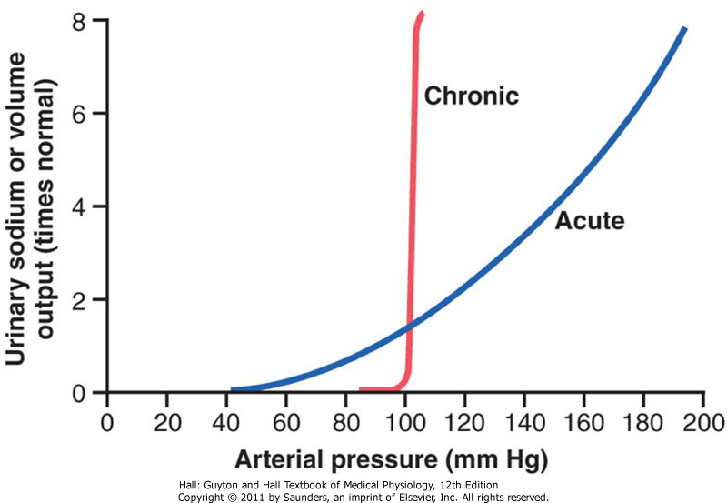

Slide 98
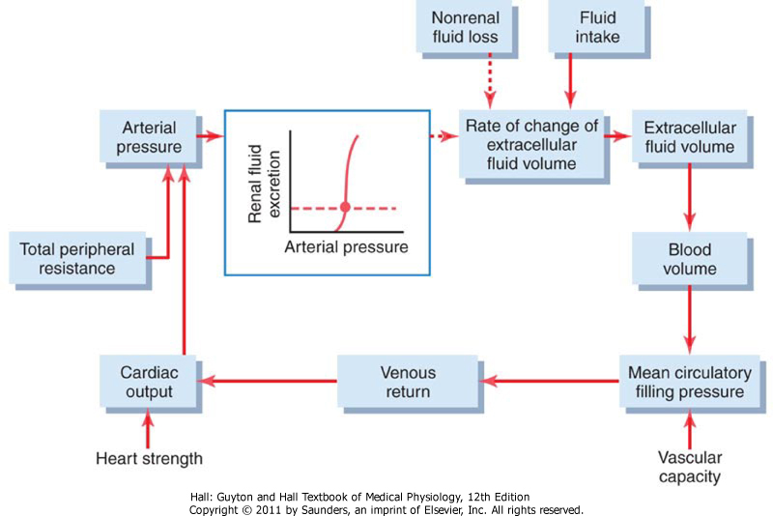
return

Slide 99
Starling curve and venous return curve

Slide 100
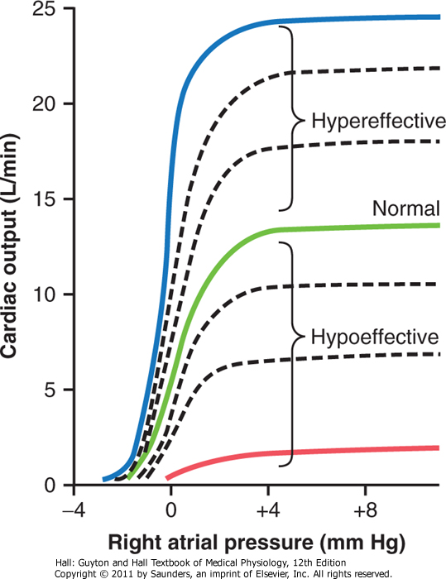

Slide 101
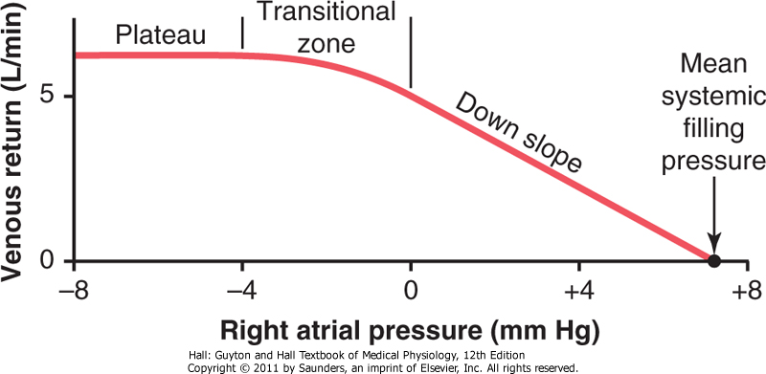

Slide 102
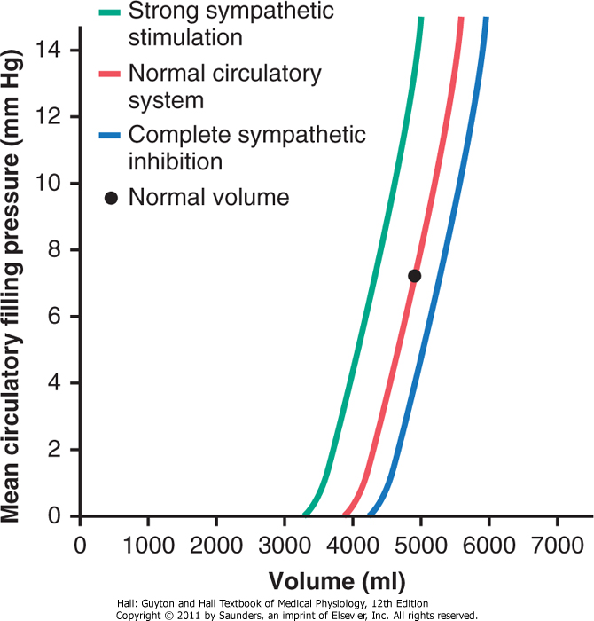

Slide 103
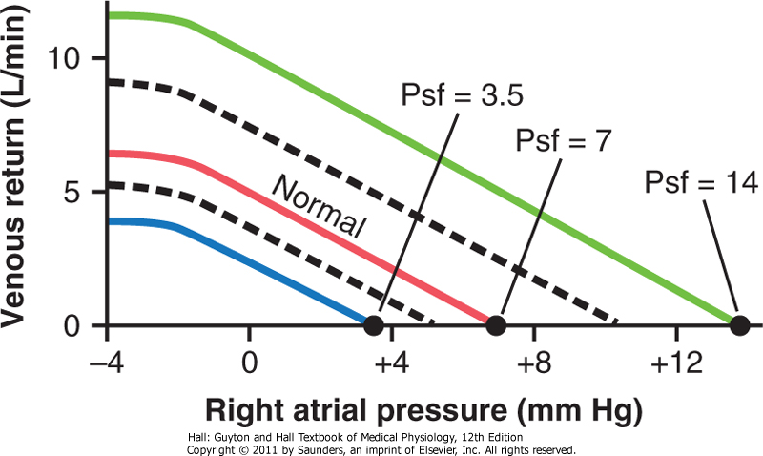

Slide 104
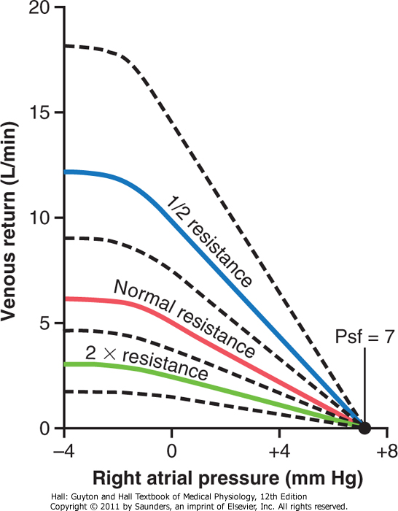

Slide 105
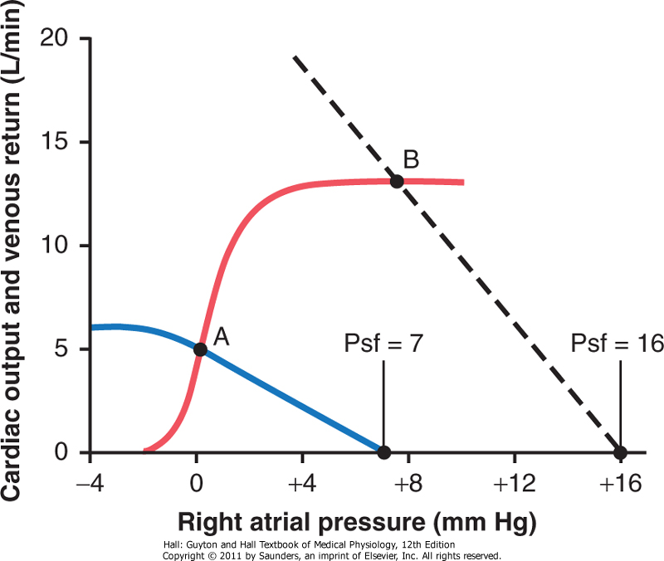

Slide 106
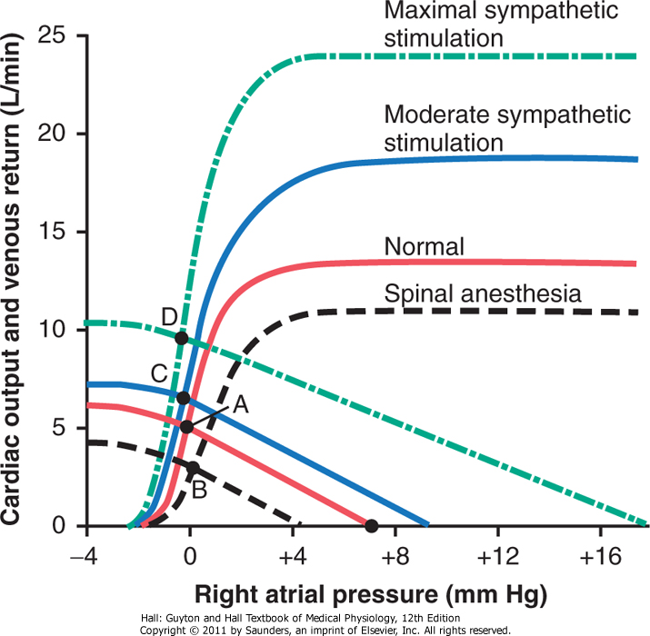

Slide 107
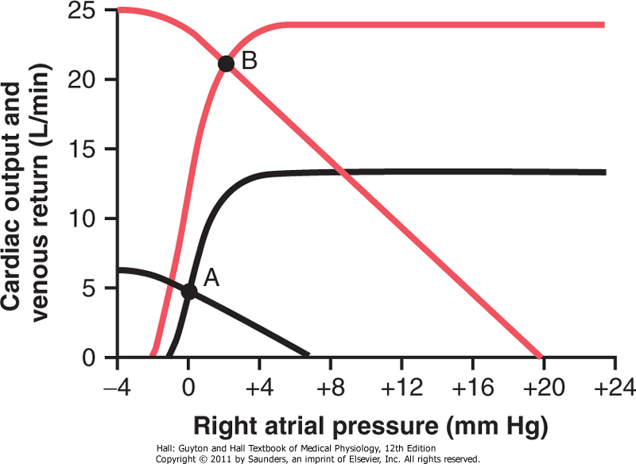
Strenous excercise
Rest

Slide 108
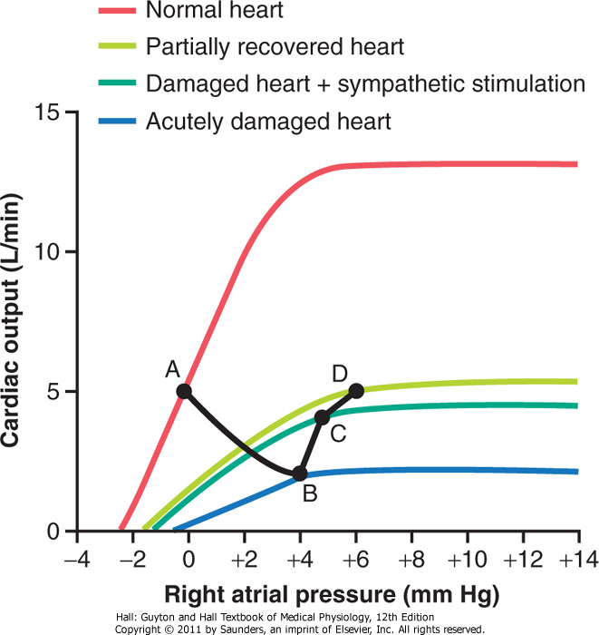

Slide 109
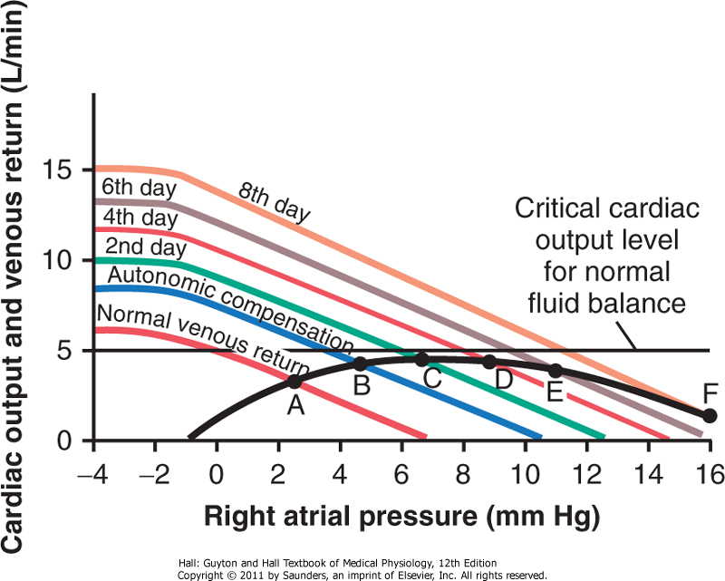
Decompensated cardiac failure

Slide 110
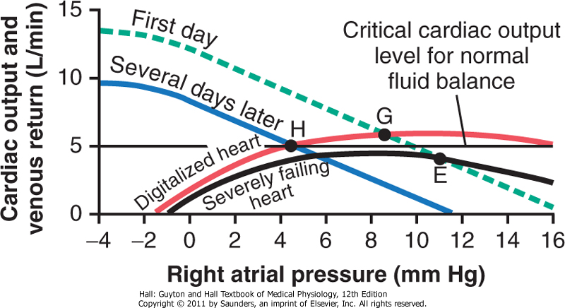
Treatment od decompensated cardiac failure

Slide 111
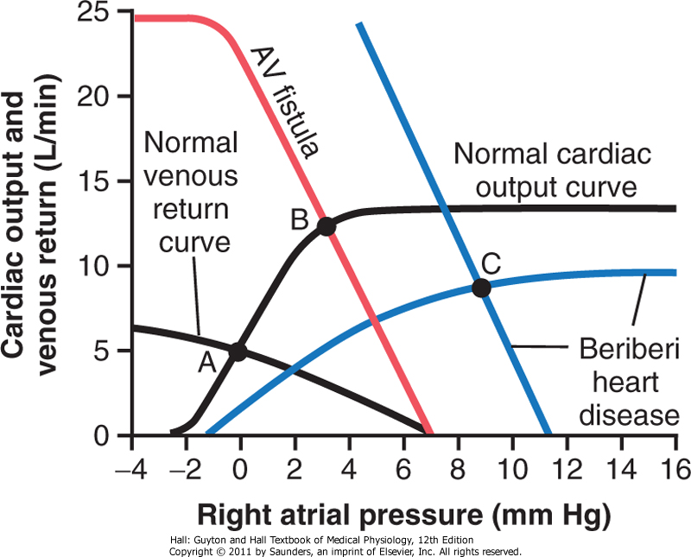
High-output cardiac failure
return

