Slide 1
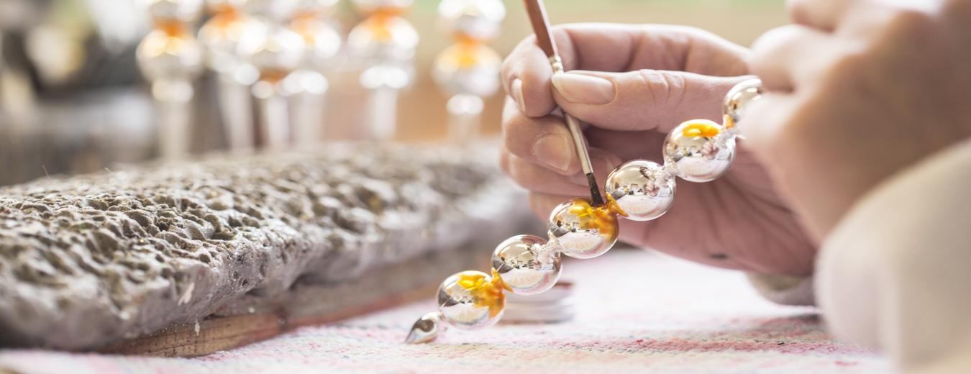
Photo report
with students’ memes
Poniklá and Jilemnice
March 2024

Slide 2

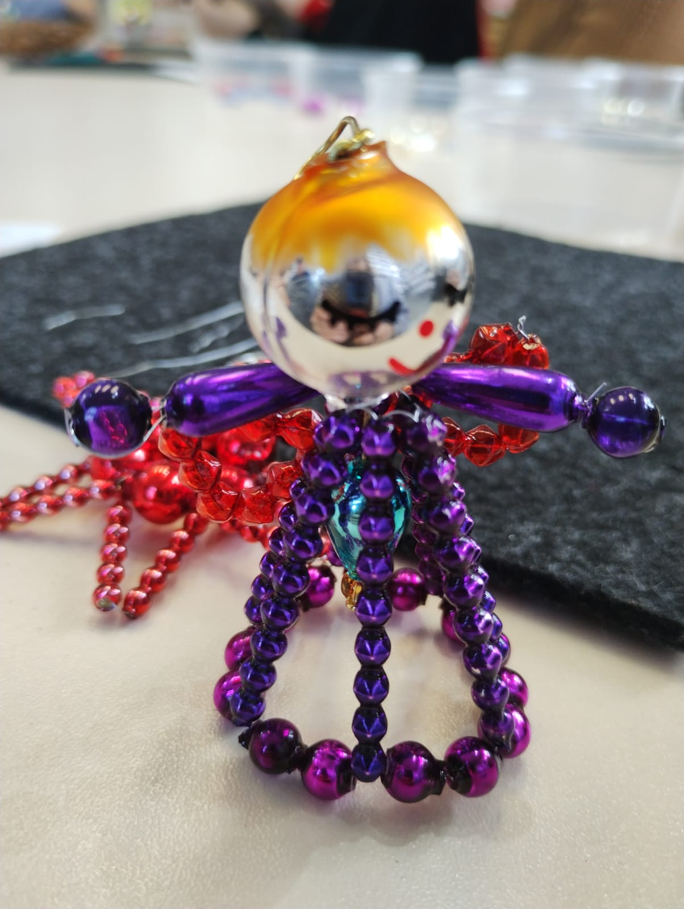
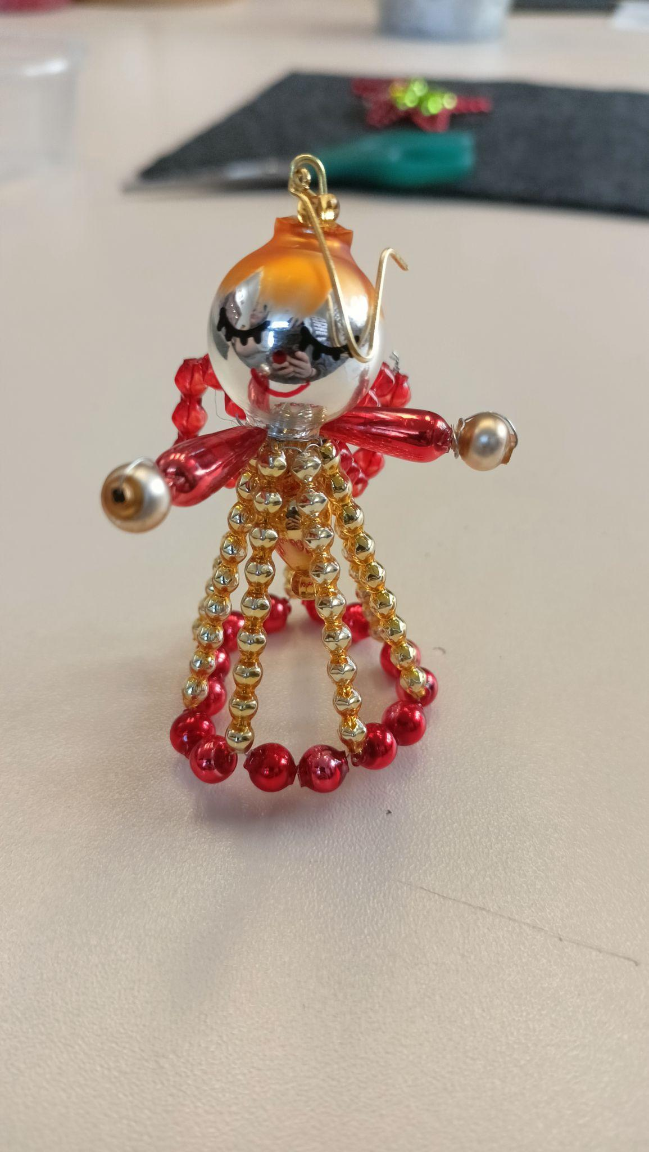
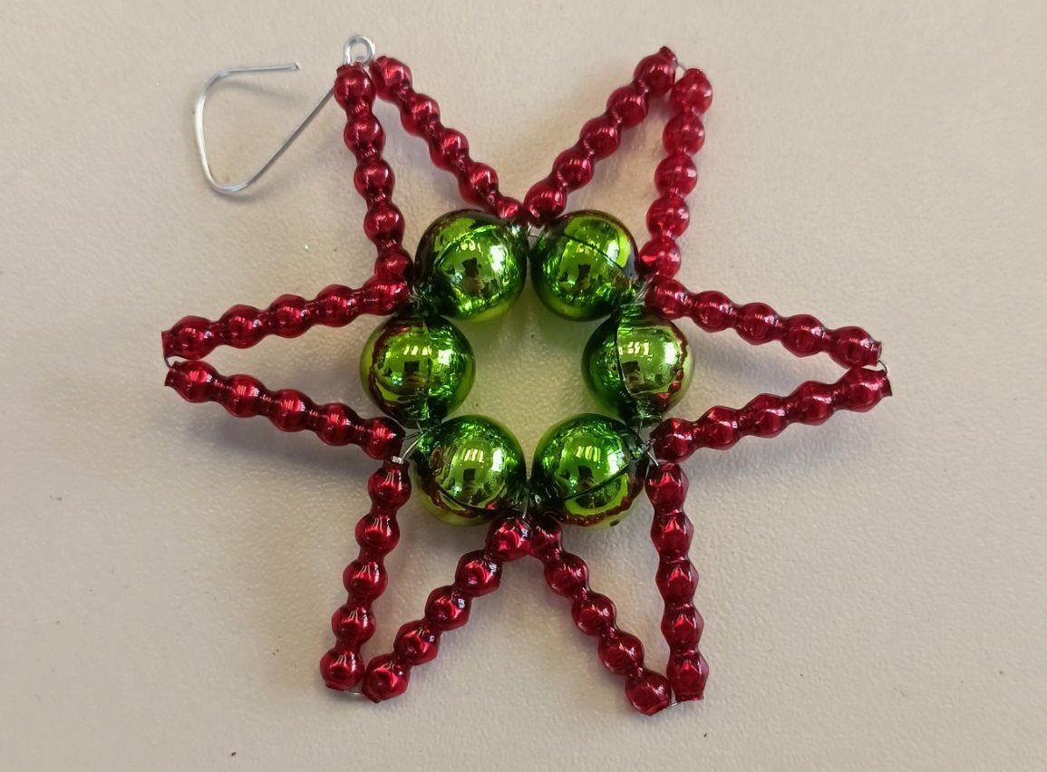
Glass angel figurines
photo

Slide 3
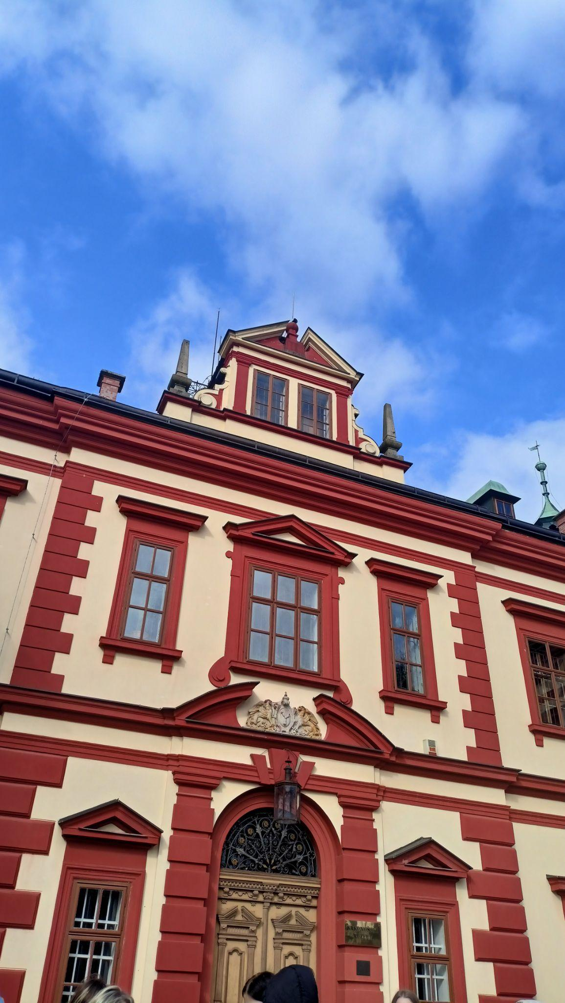
Outside of the castle

Slide 4
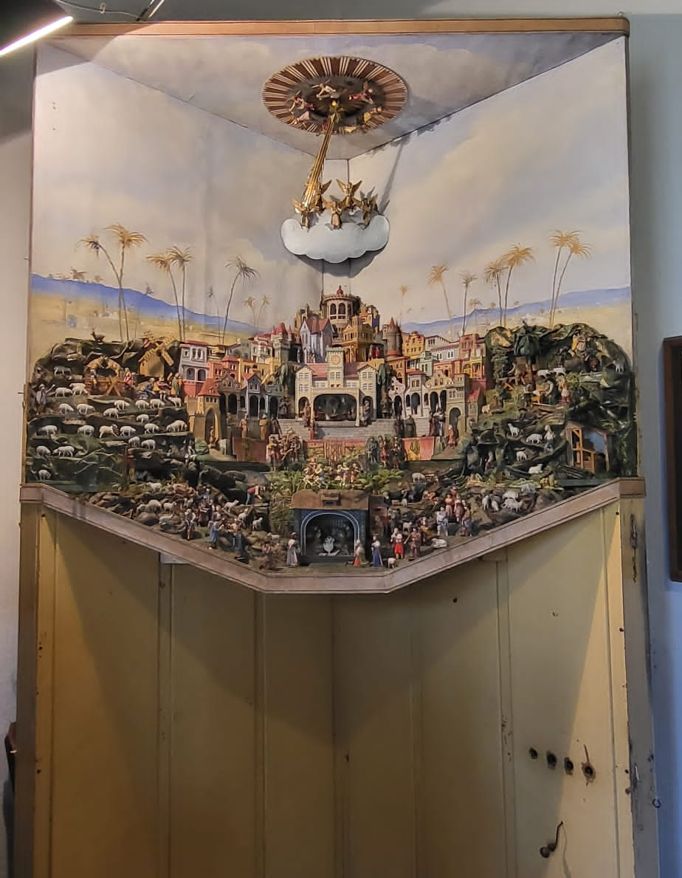
Bethlehem
photo
The nativity scene

Slide 5
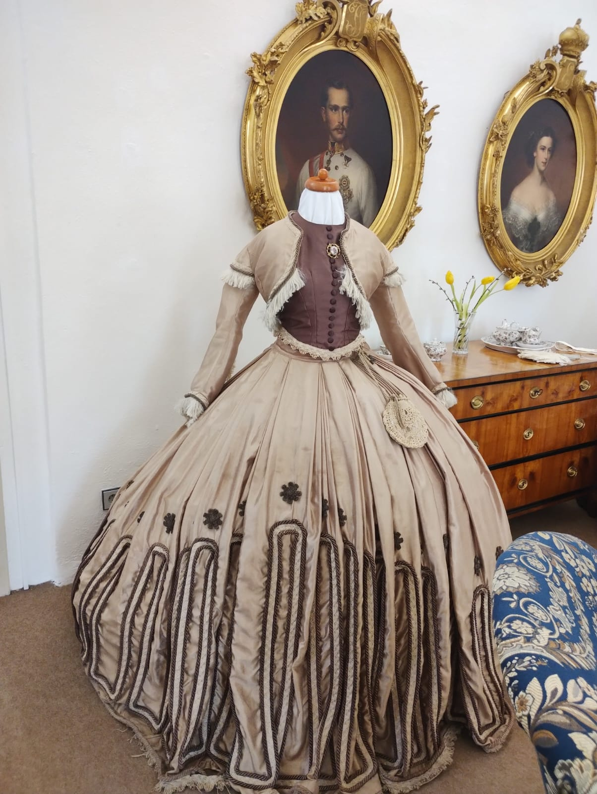
A dress from the 18th century
photo

Slide 6
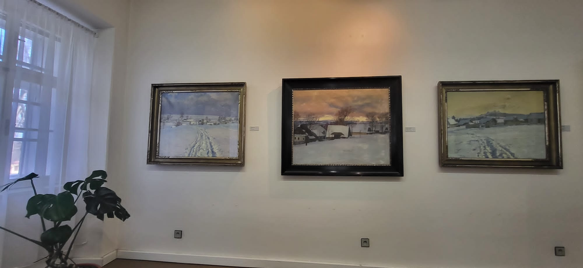
Paintings of František Kaván
photo
Actually he attended our Czech grammar school

Slide 7
Photo report
Poniklá and Jilemnice
March 2024

Slide 8
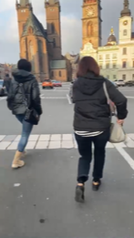
morning run
fast and furious

Slide 9
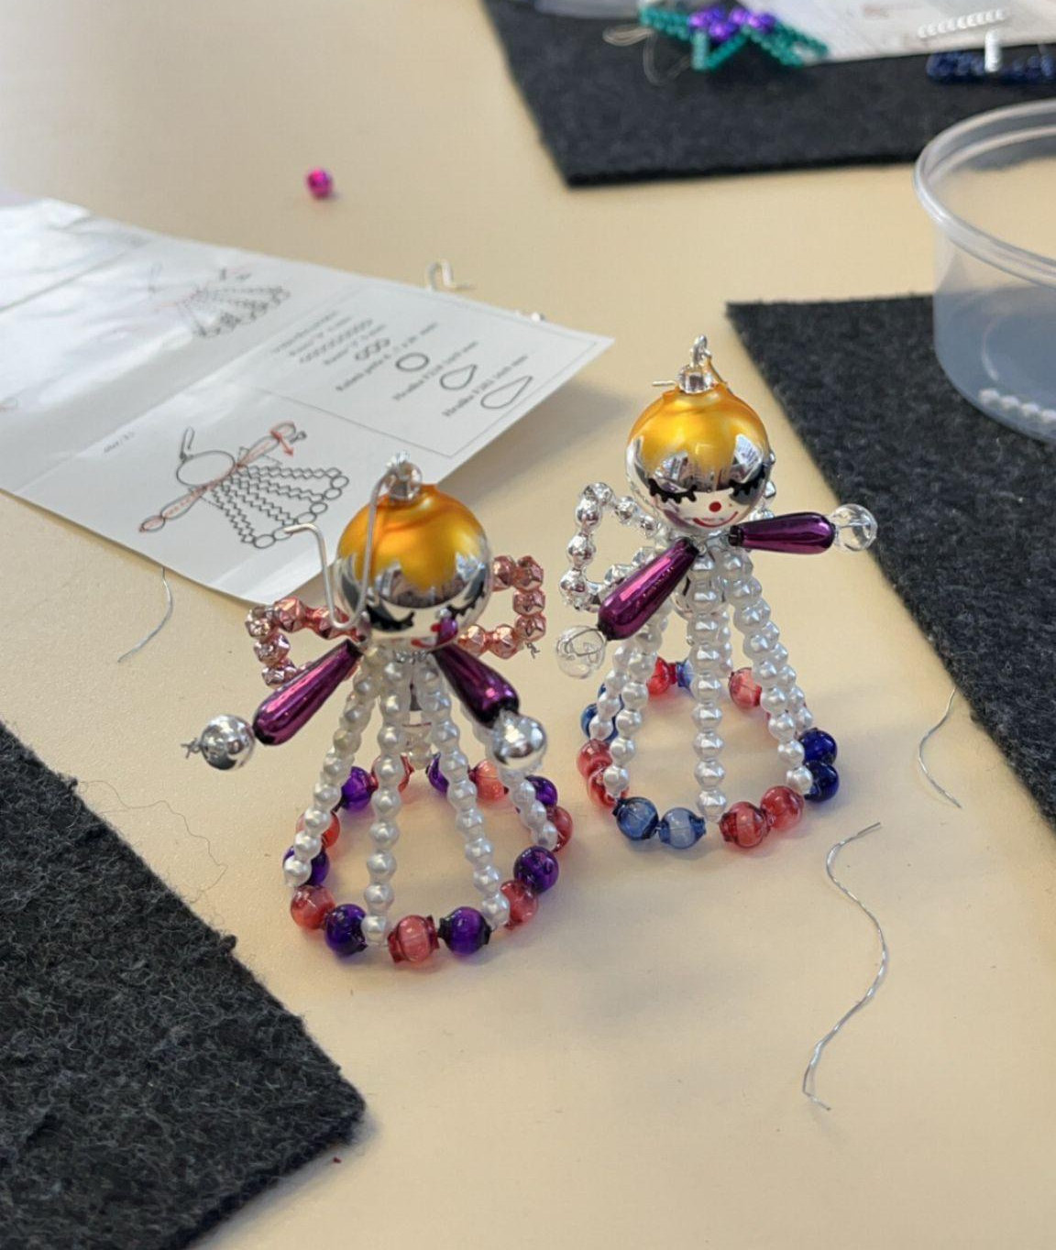
finally it's done
it was a hard process

Slide 10
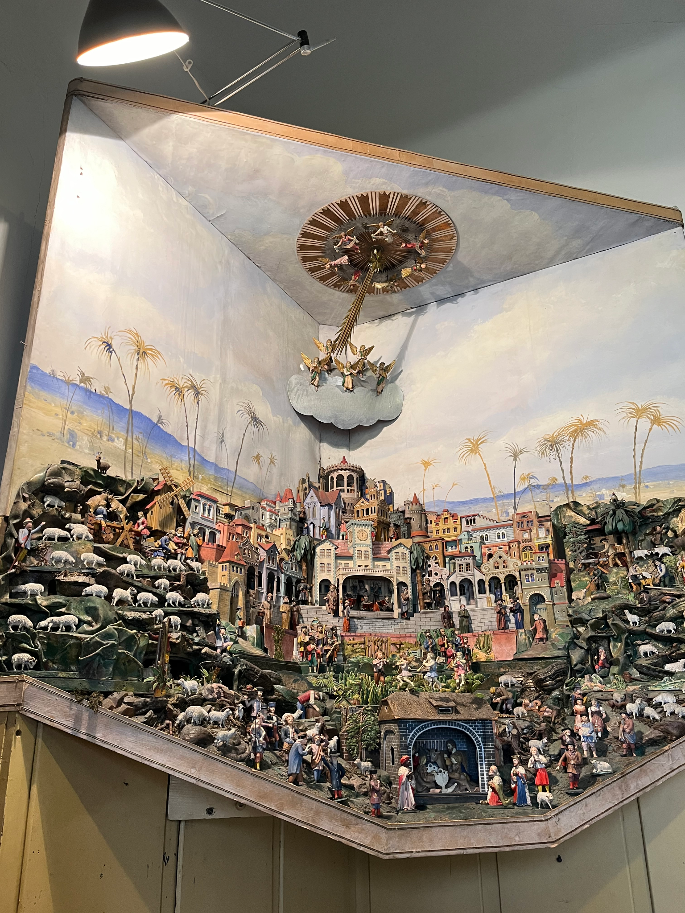
four minutes in heaven
photo
this sound is still ringing in my head

Slide 11
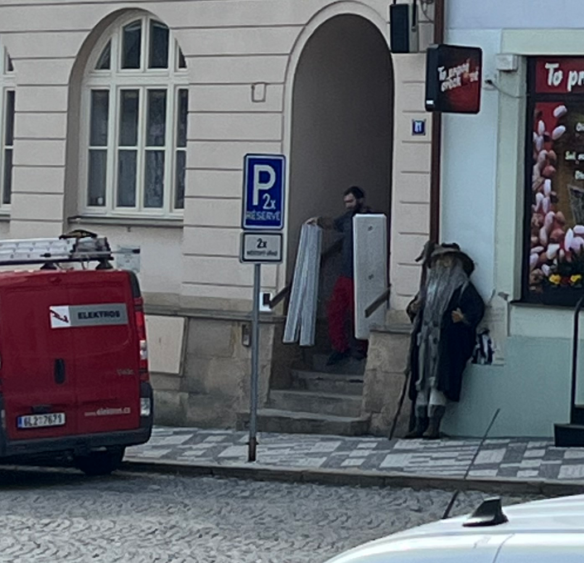
he is real!!!
photo
he looks better than in the photos :)

Slide 12
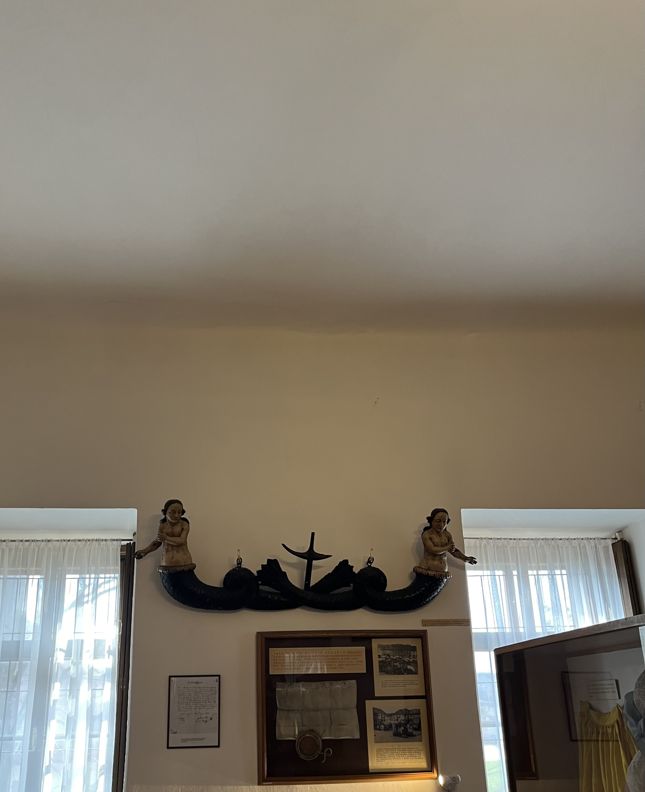
two mermaids
photo
it made us impressed:)

Slide 13

It was a good trip.

Slide 14
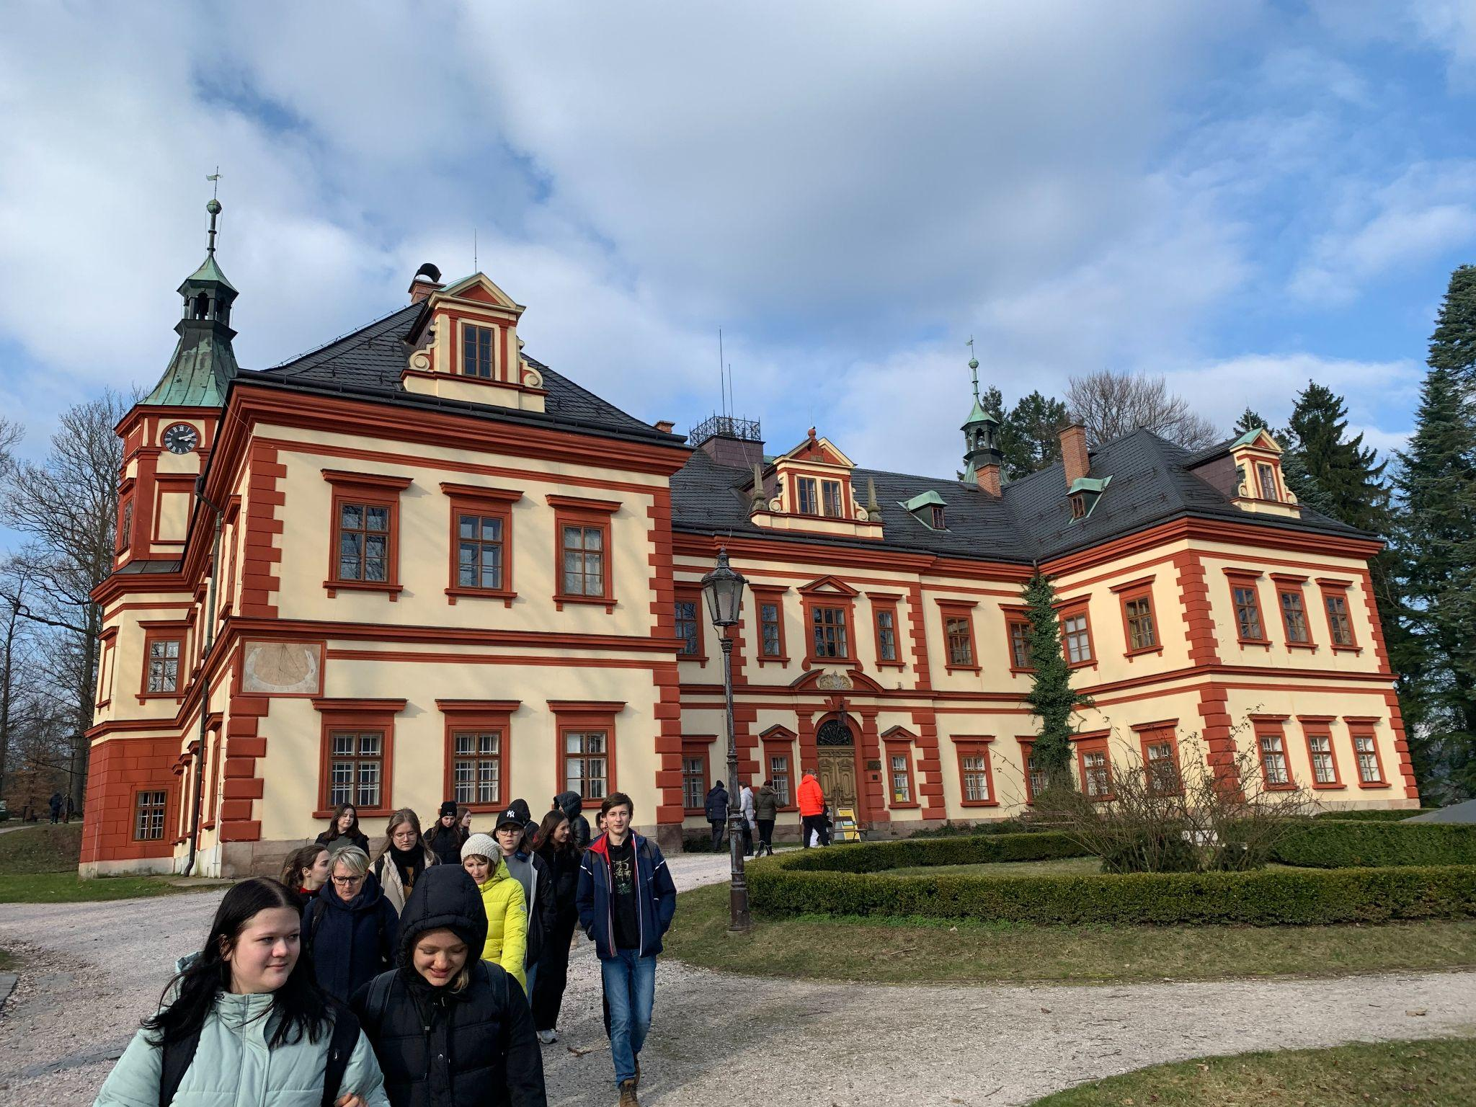
✨Pretty Building✨
photo
it´s pretty

Slide 15
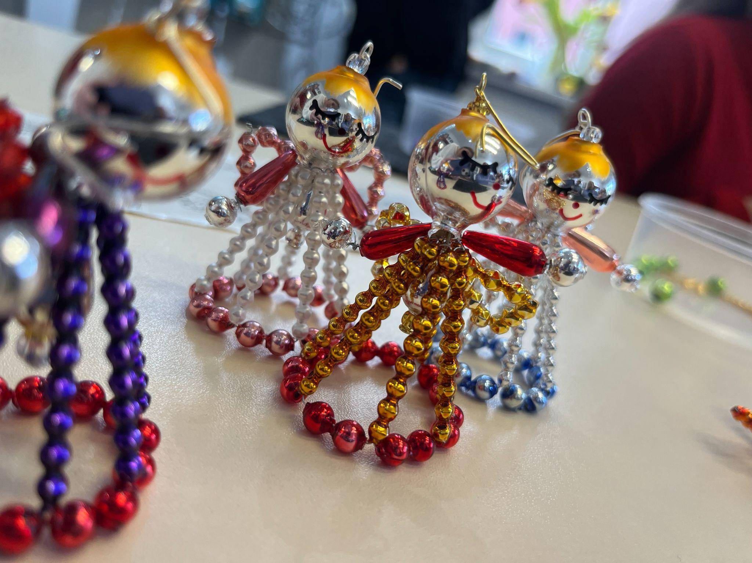
✨Angel Selfie✨

Slide 16
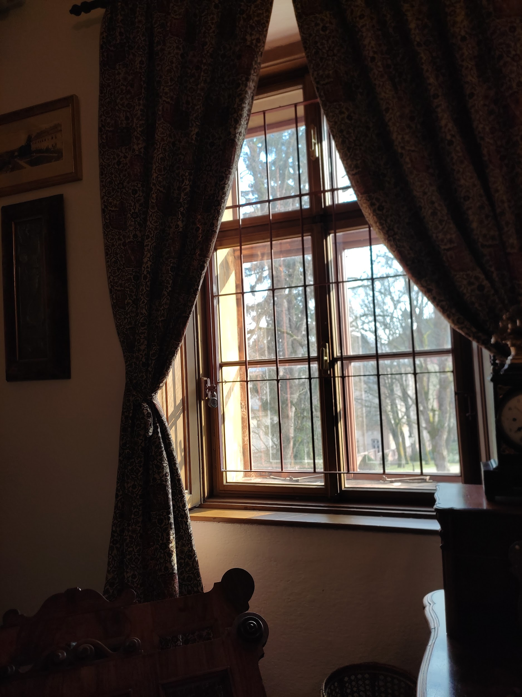
AESTHETIC MAYBE :)
photo
WINDOW OF THE CASTLE

Slide 17
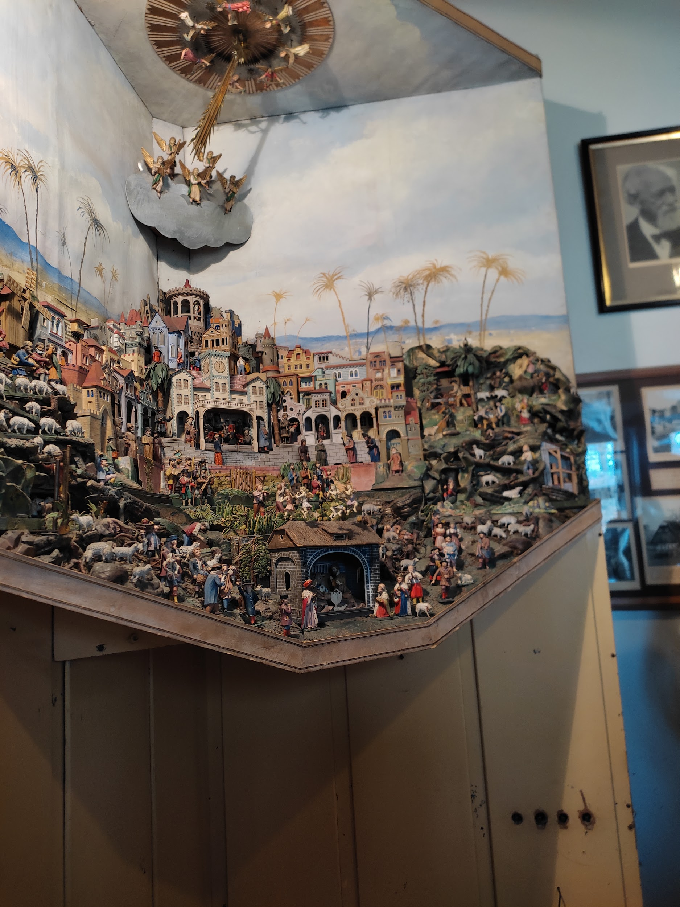
BETLEM
photo
SOMETHING ABOUT 113 YEARS OLD

Slide 18
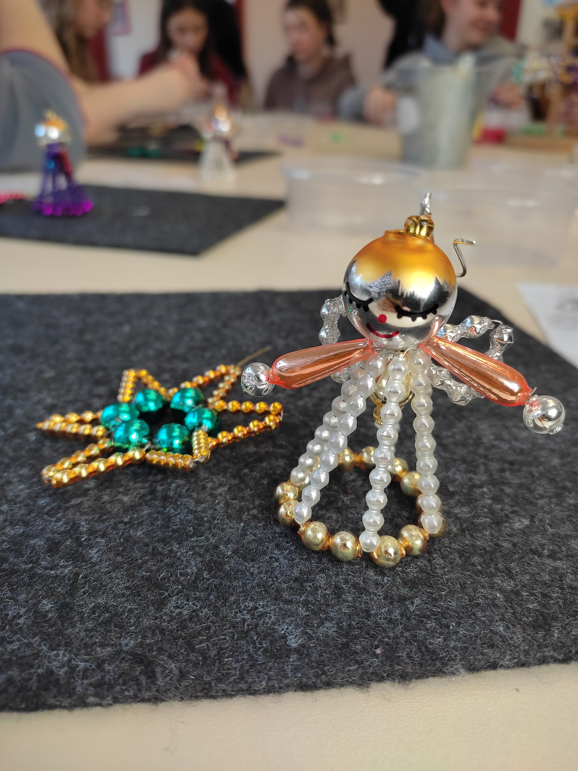
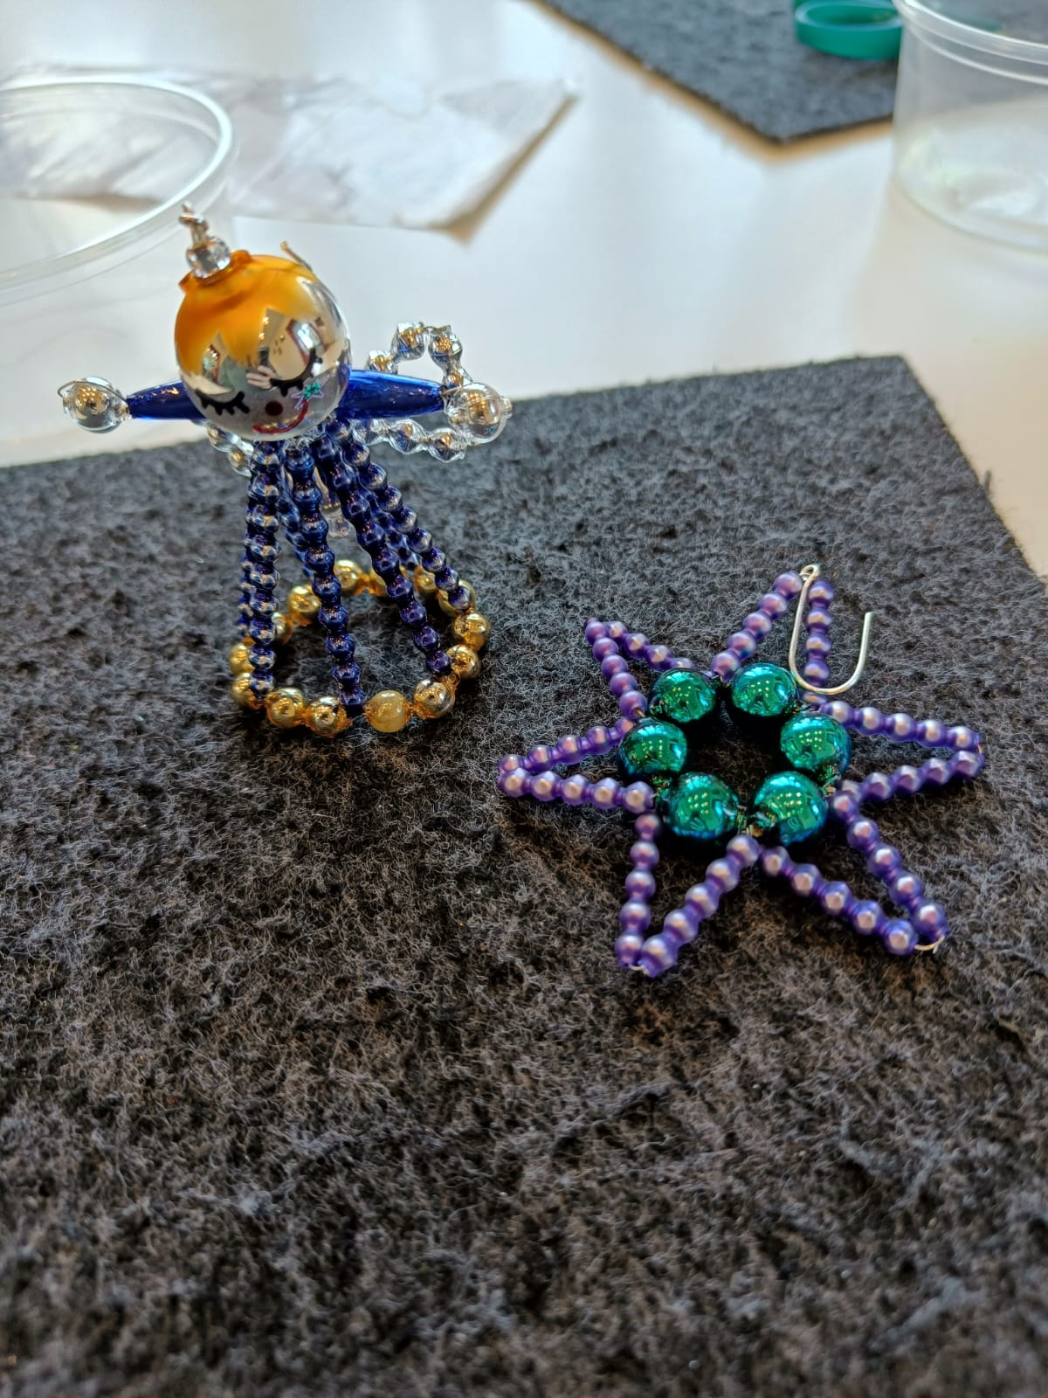
CHRISTMAS ORNAMENTS
photo
A TEST OF PATIENCE :)

Slide 19
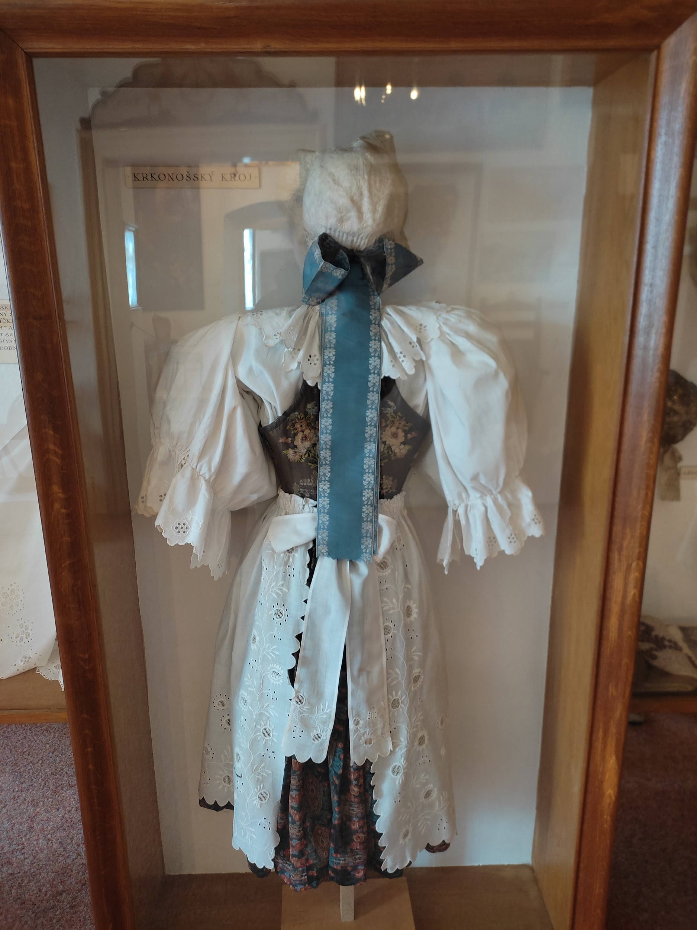
costume
photo
a typical one for Krkonoše

Slide 20
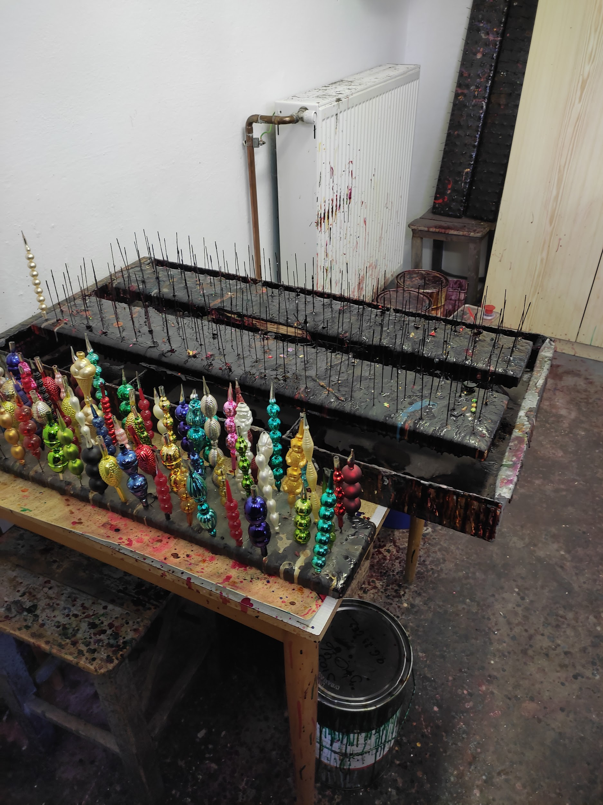
glass colouring
photo
the smell of acetone

Slide 21
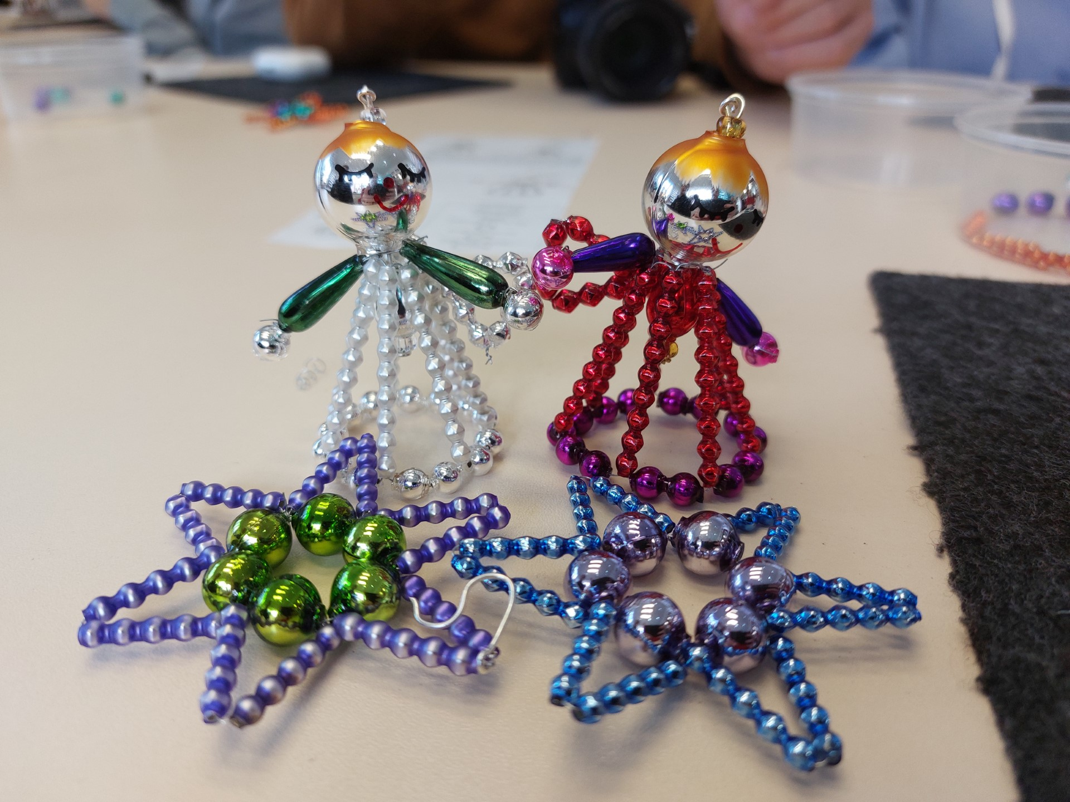
Glassworks Poniklá
Pretty angels and stars…

Slide 22

Museum Krkonoše
photo
Polish colors everywhere

Slide 23
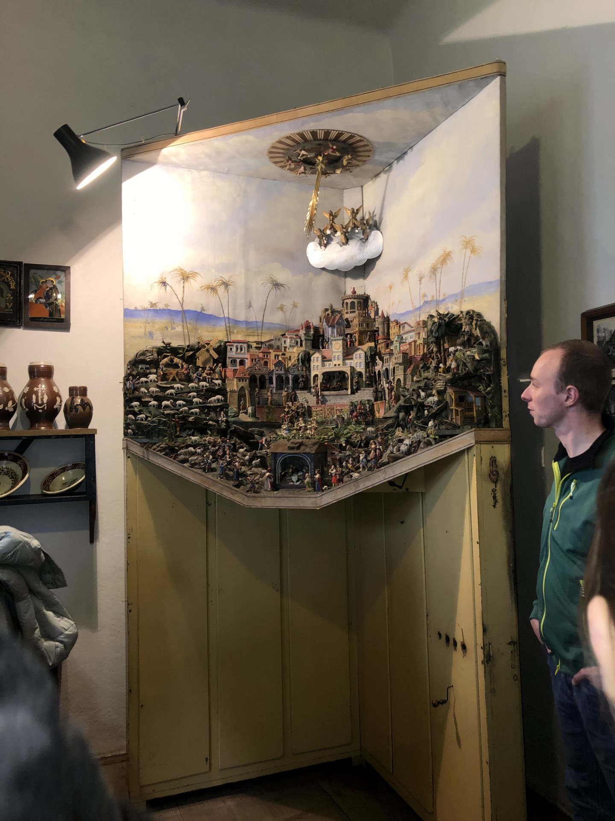
Mechanical Betlém
photo
The Kuků was kucool

Slide 24
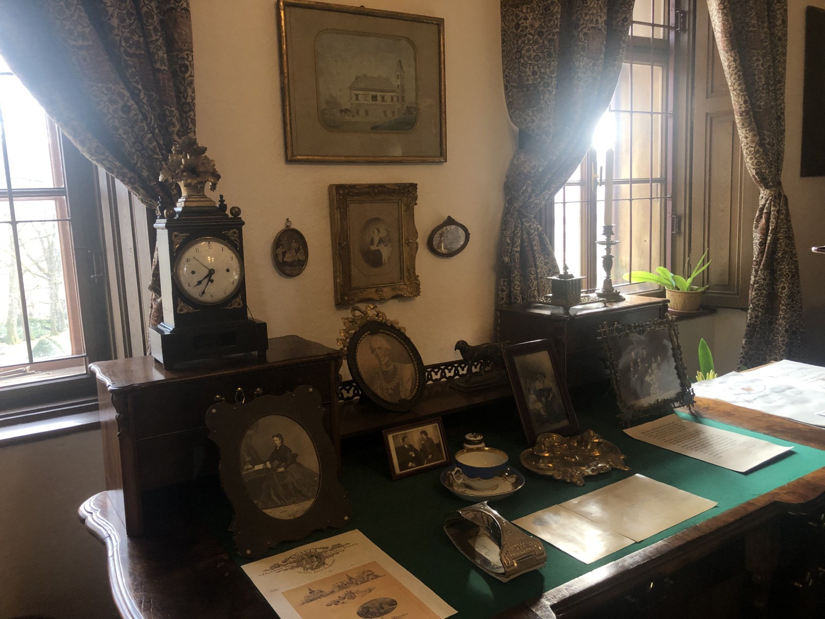
Harrach’s office
photo
Sure looks interesting

Slide 25
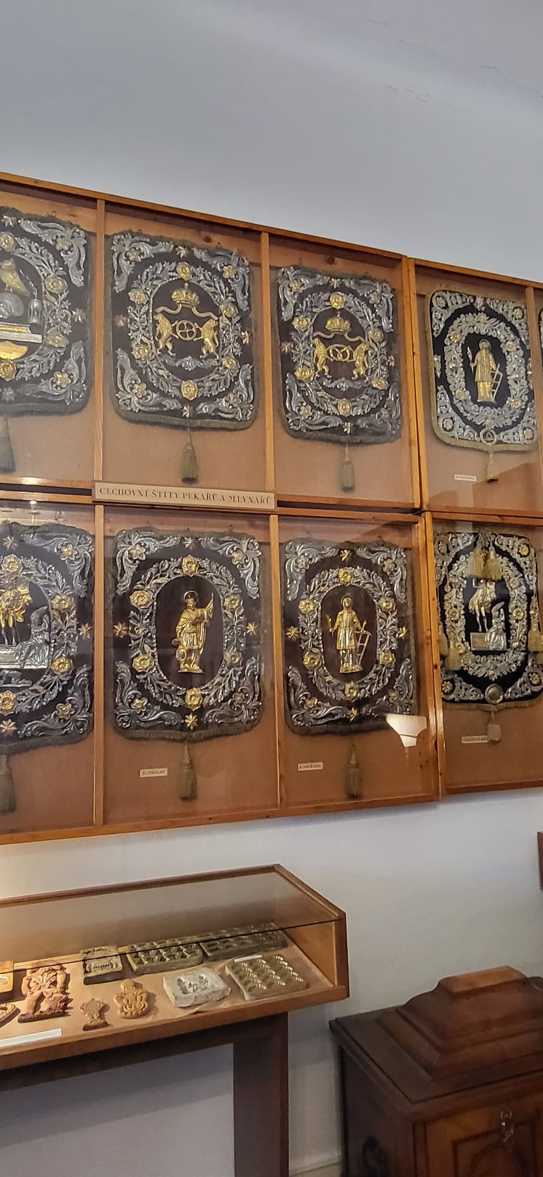
Funeral shields
photo
Really cheerful

Slide 26
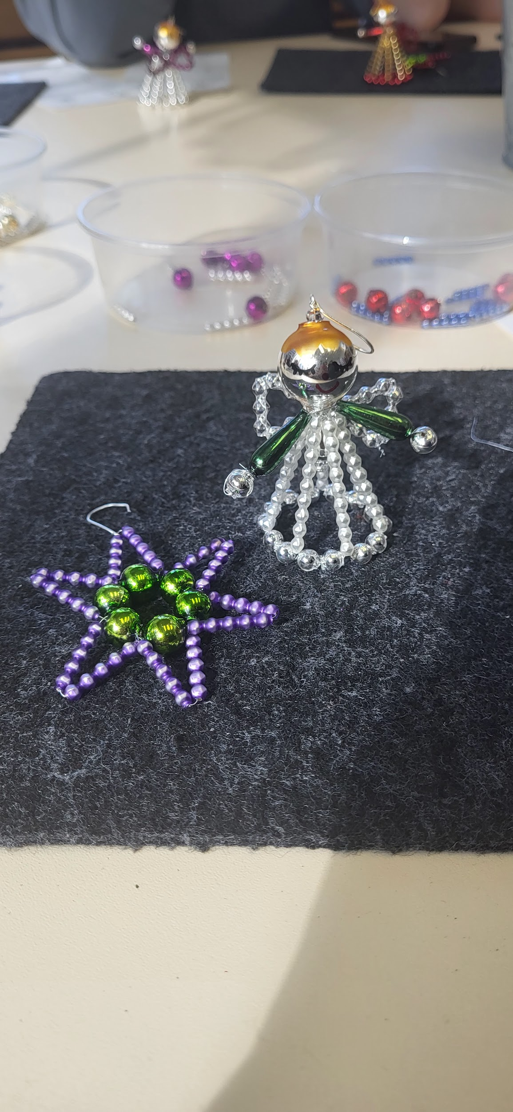
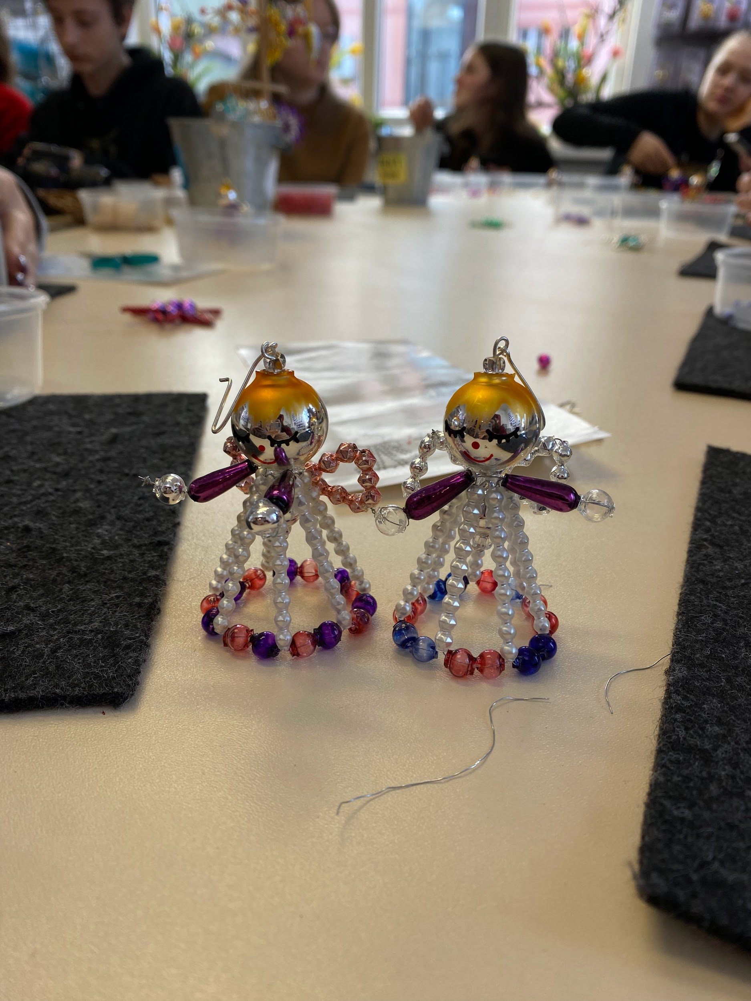
making angels :)
photo
(very stressful but worth it)
Barbora Vodičková, Nina Klim <3

Slide 27
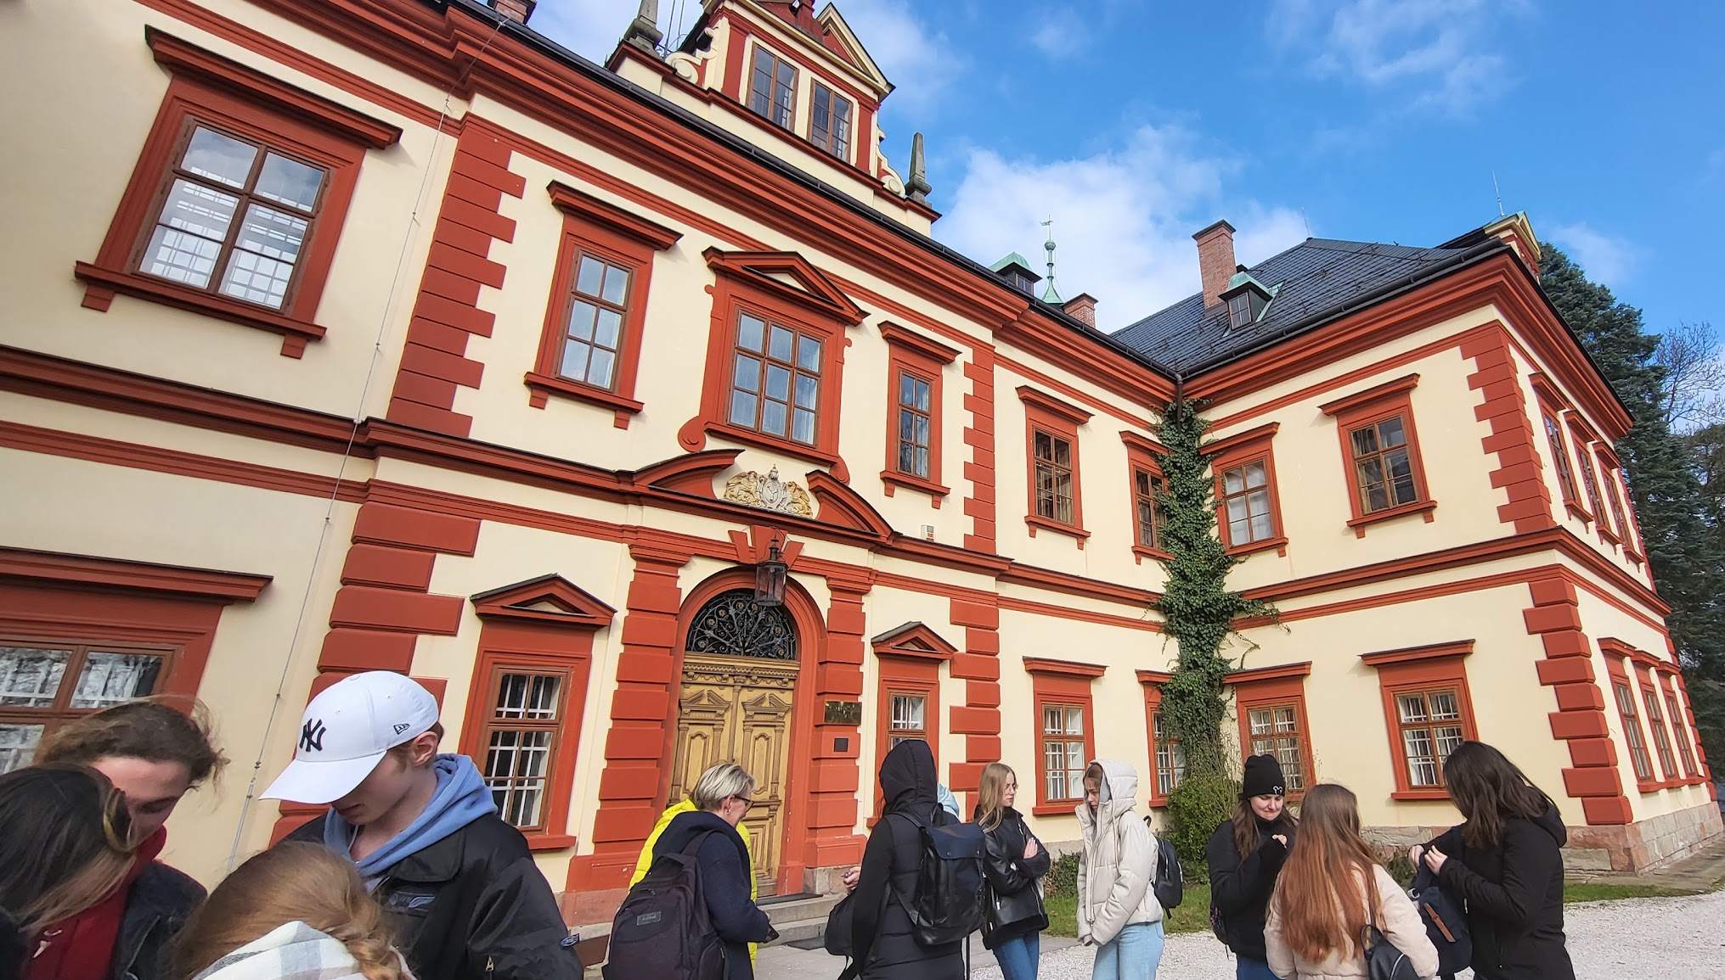
going to the Krkonose museum
photo
(very excited)

Slide 28
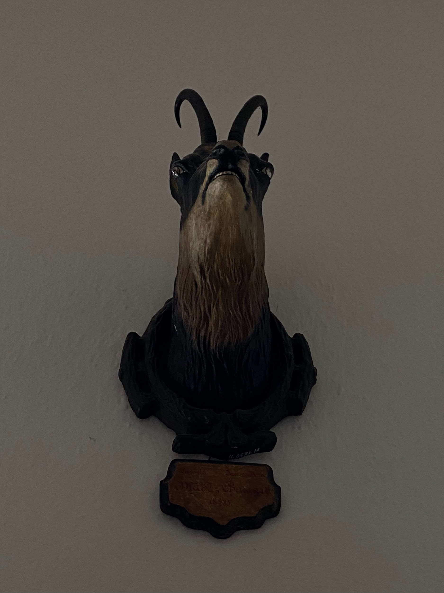
goat
photo
(very inspiring)

Slide 29

szopka
photo
(we don't know how to call it in english :)

Slide 30
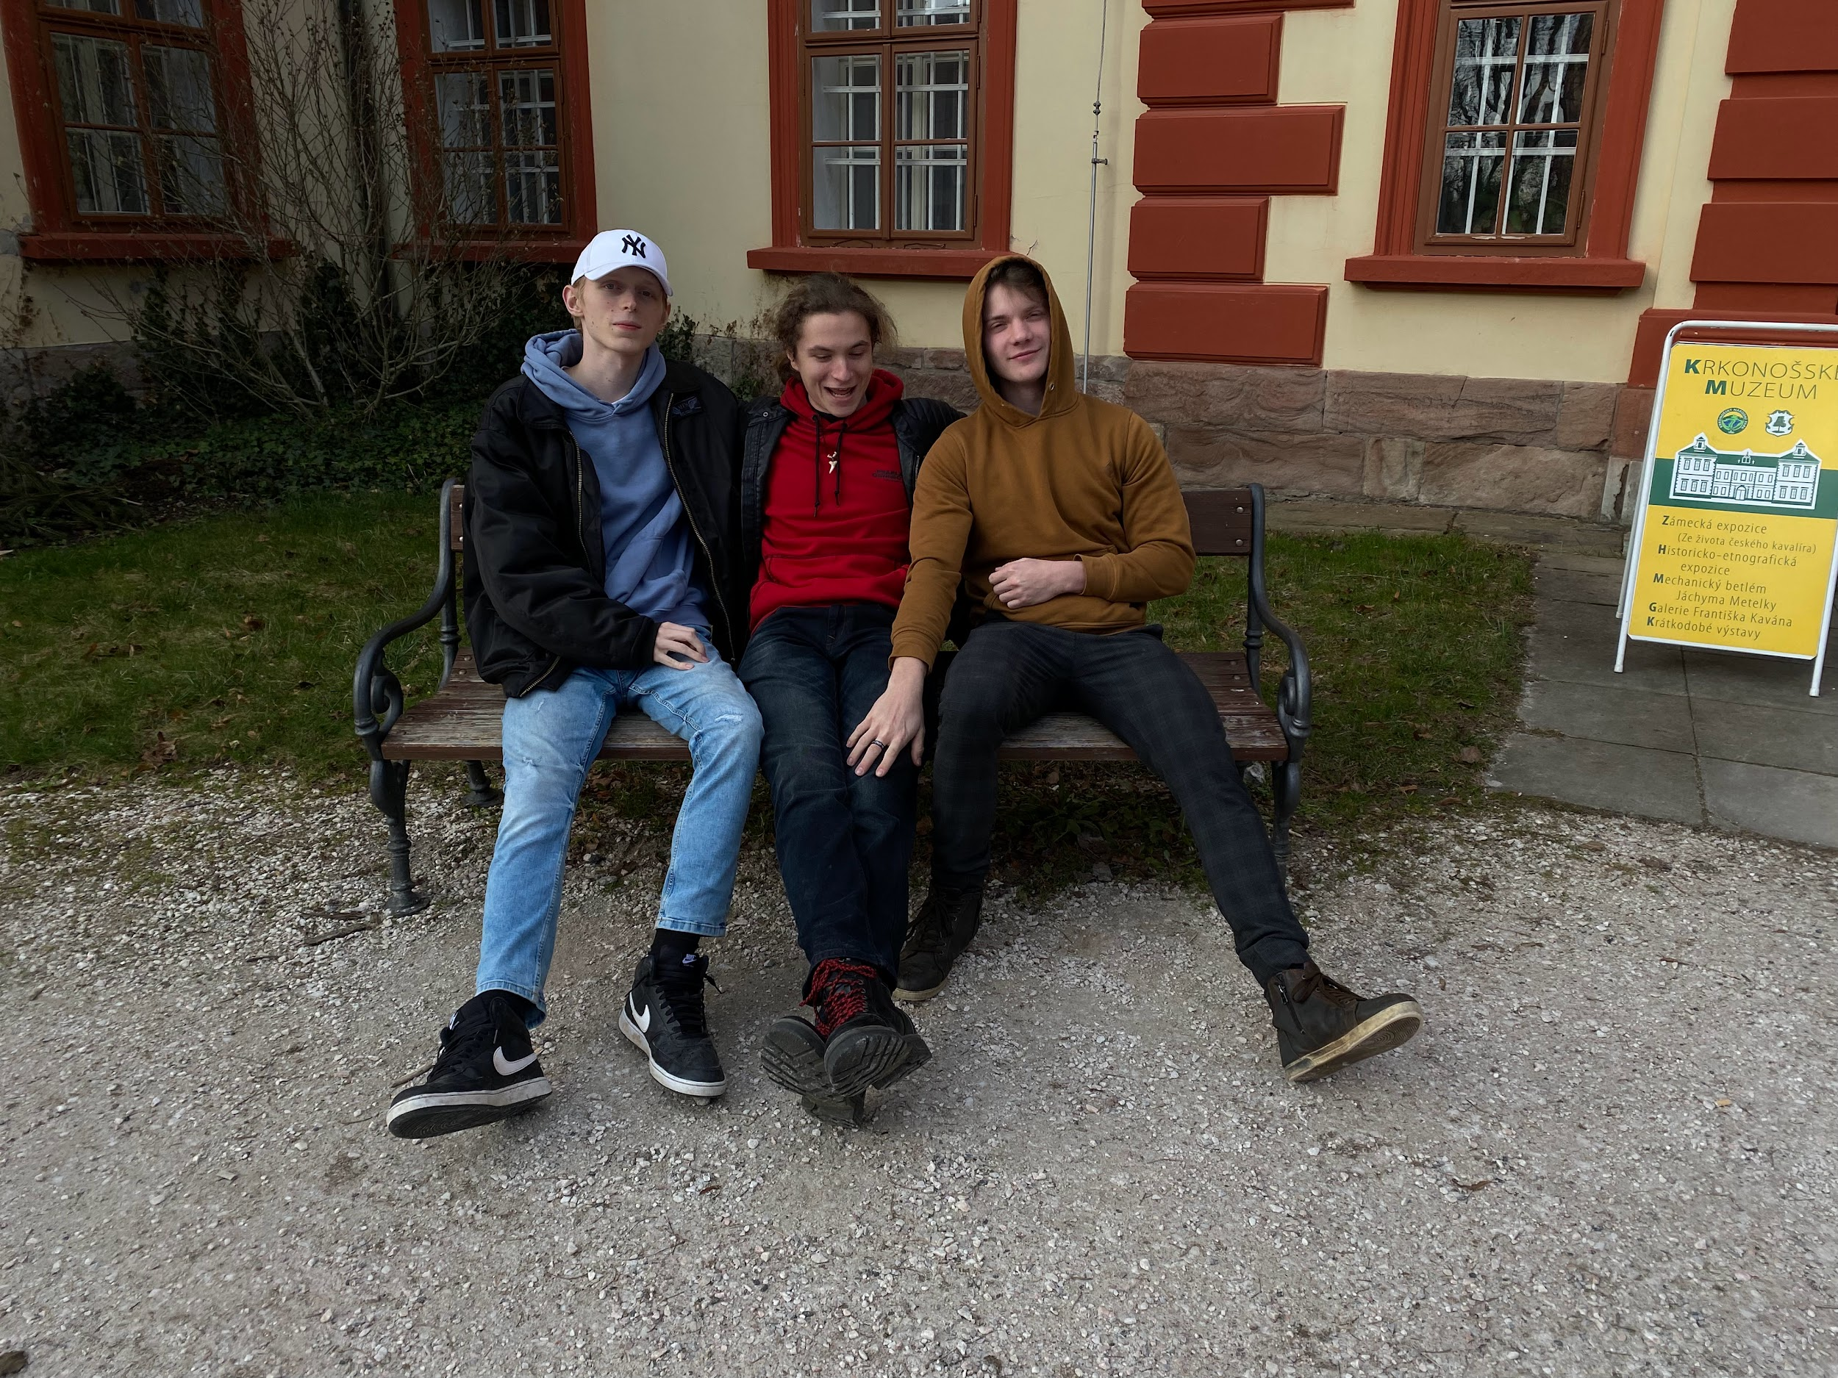
the biggest fans of the museum
photo

