Slide 1
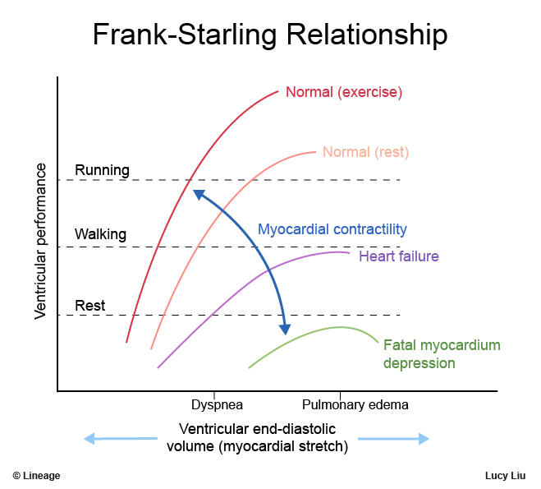
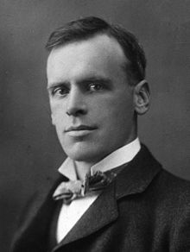
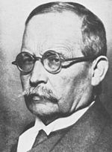
Otto Frank (1865-1944)
Ernest Starling (1866-1924)

Slide 2
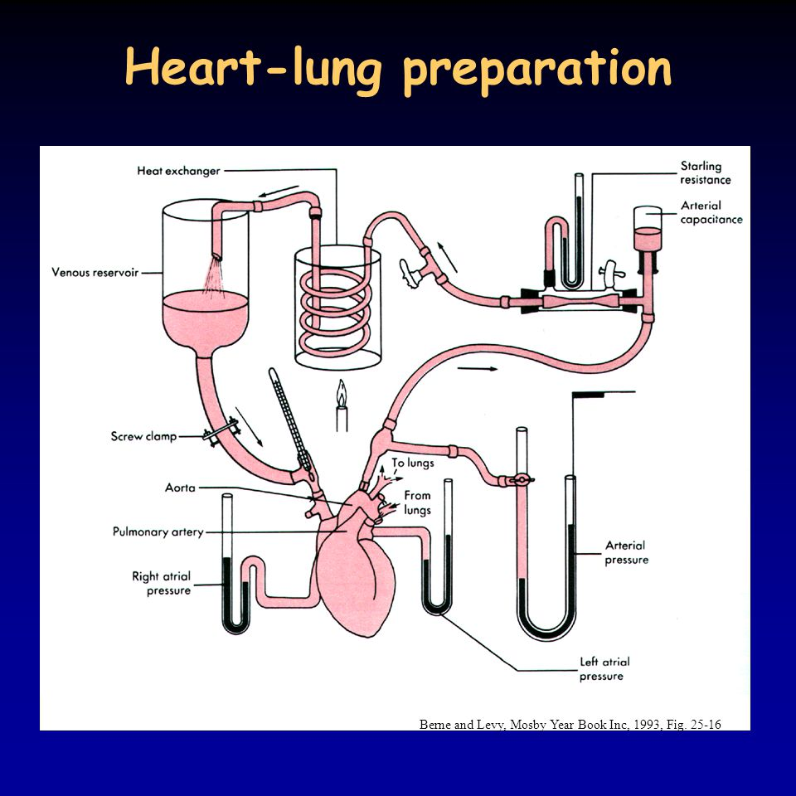

Slide 3
PRESSURE
VOLUME

Slide 4
PRESSURE
constant pressure
Isobaric maxima curve
VOLUME

Slide 5
PRESSURE
Isovolumic maxima curve
D
Isobaric maxima curve
VOLUME

Slide 6
PRESSURE
Isovolumic maxima curve
Isobaric maxima curve
žabí srdce: O. Frank 1898
VOLUME

Slide 7
PRESSURE
Isovolumic maxima curve
Curve of the maxima of afterloaded contractions
Isobaric maxima curve
VOLUME

Slide 8
PRESSURE
Isovolumic maxima curve
Curve of the maxima of afterloaded contractions
Isobaric maxima curve
VOLUME

Slide 9
PRESSURE
Isovolumic maxima curve
Curve of the maxima of afterloaded contractions
Isobaric maxima curve
VOLUME

Slide 10
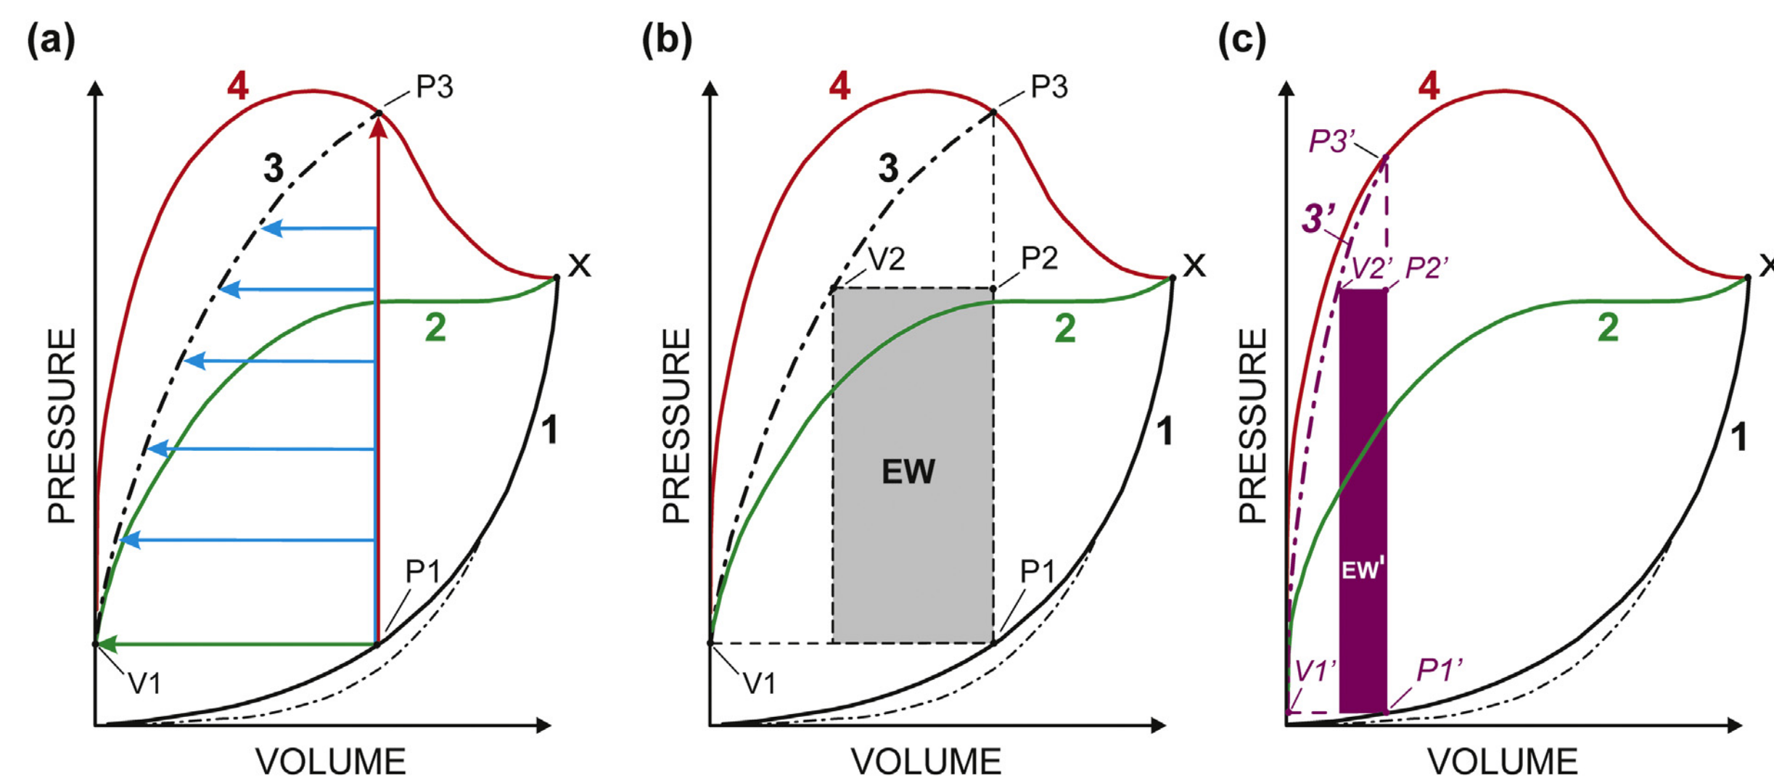

Slide 11
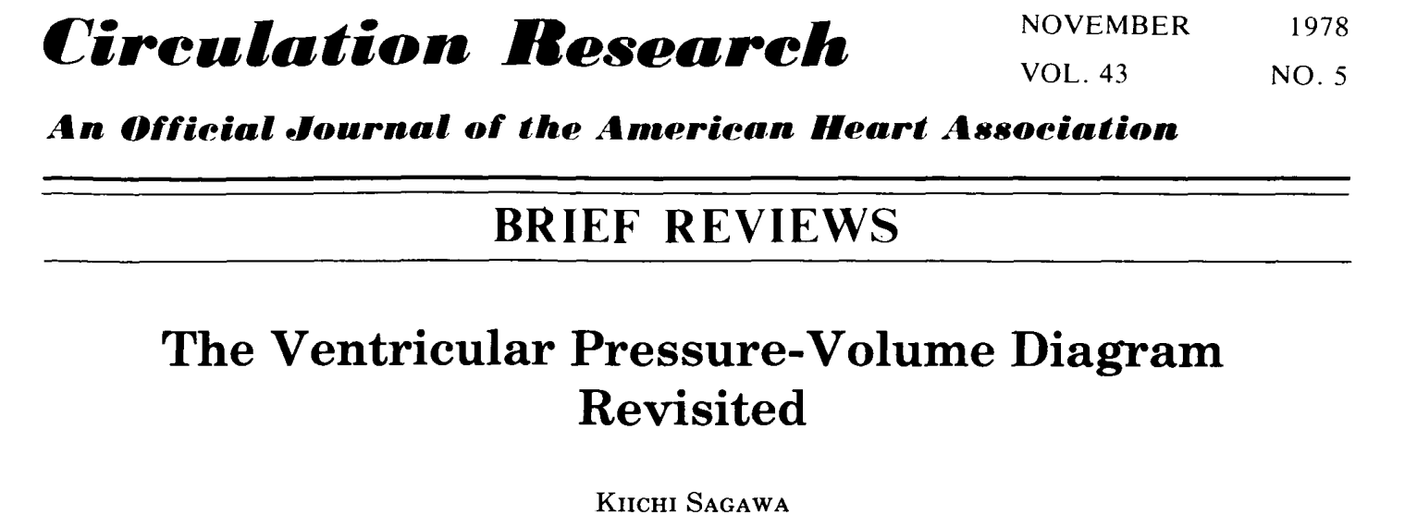
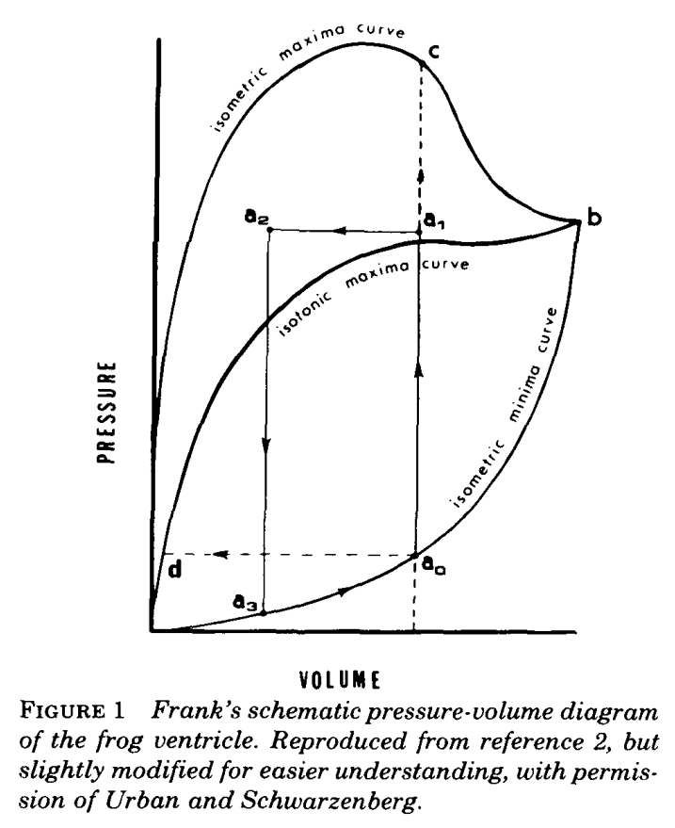
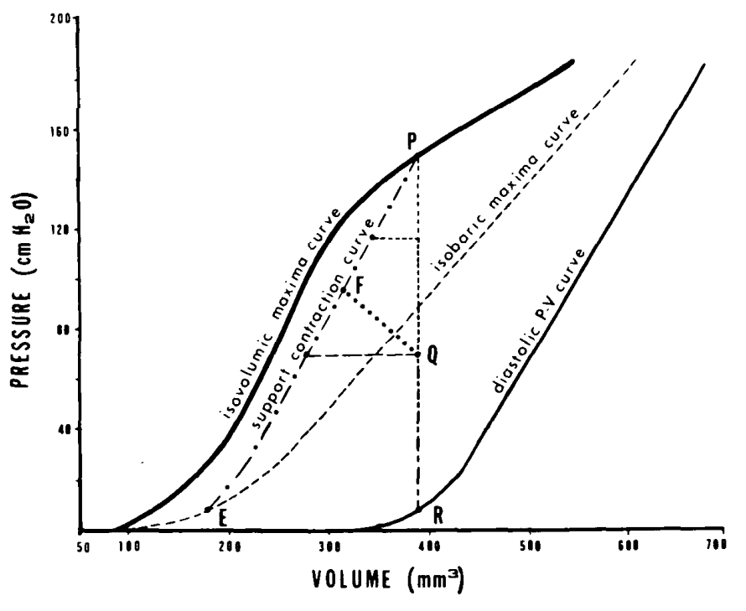

Slide 12
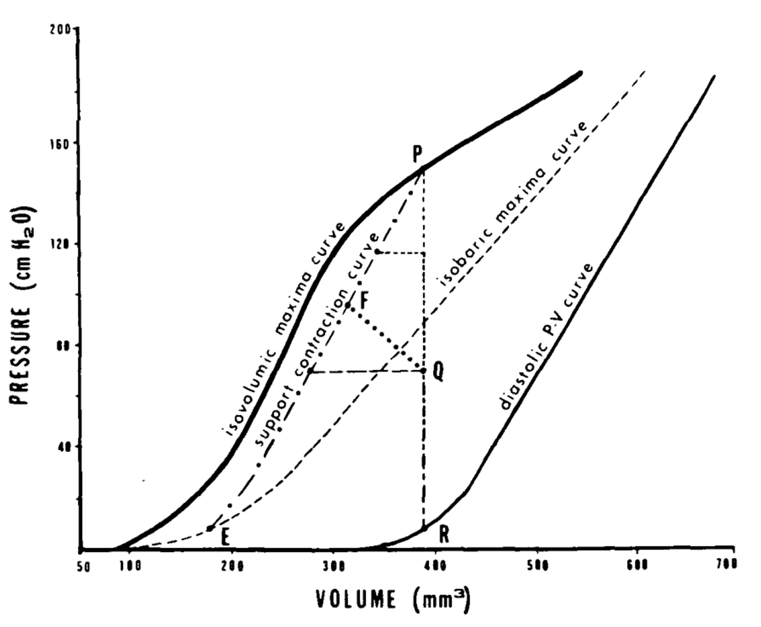
PRESSURE
Sagawa
Frank
zzzz
Isovolumic maxima curve
Isobaric maxima curve
Curve of the maxima of afterloaded contractions
VOLUME

Slide 13
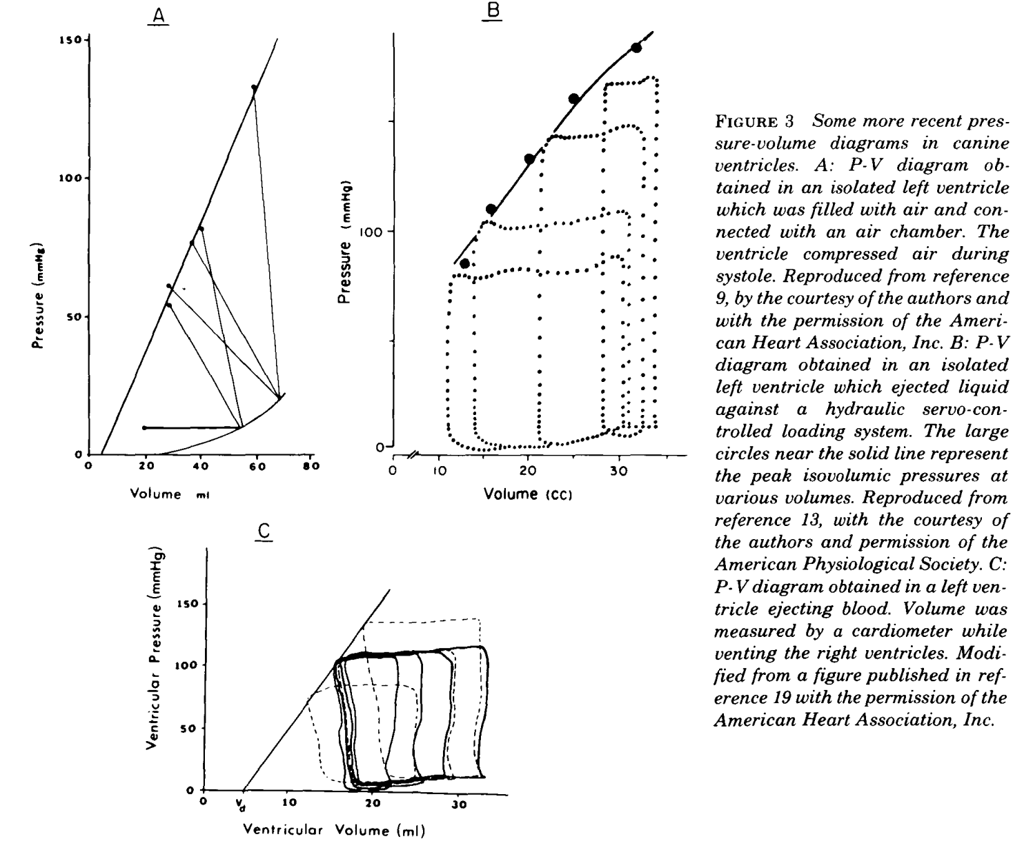

Slide 14
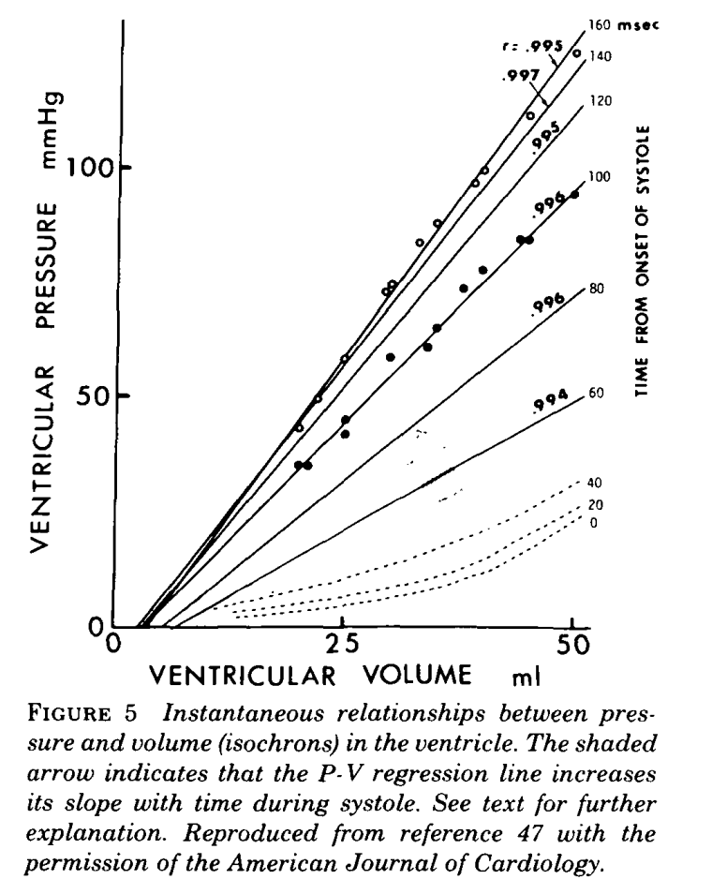

Slide 15
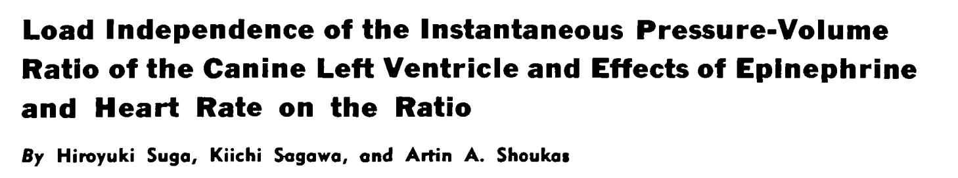
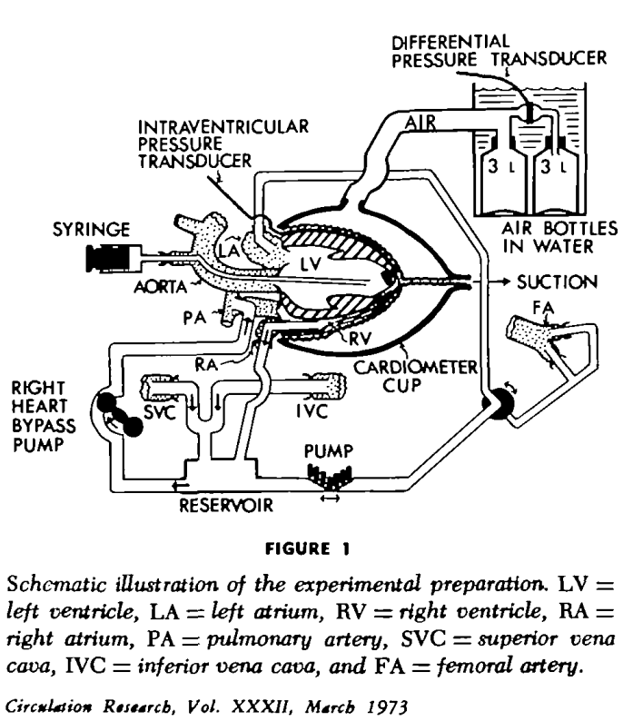
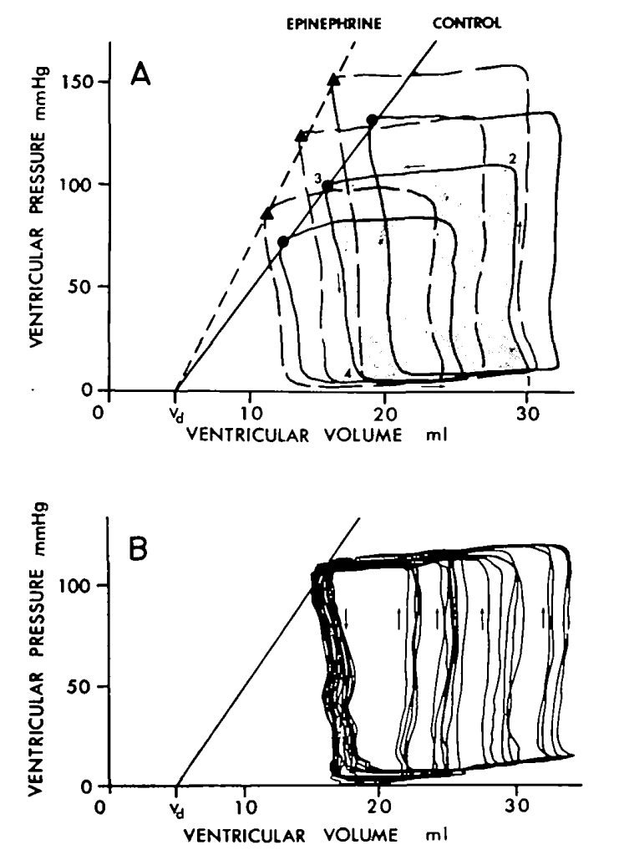
1973

Slide 16
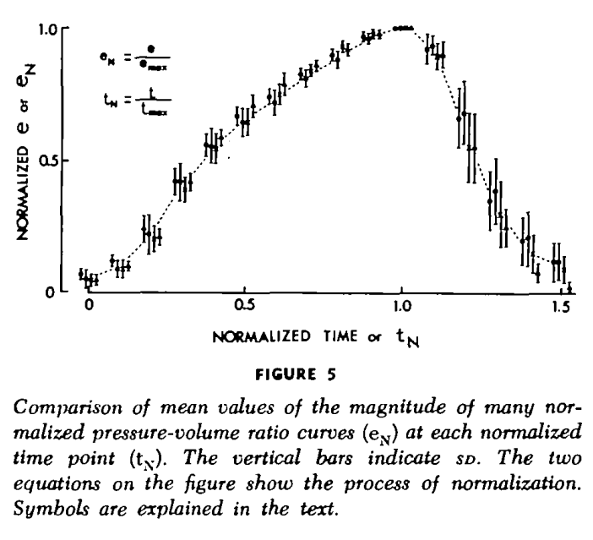

Slide 17
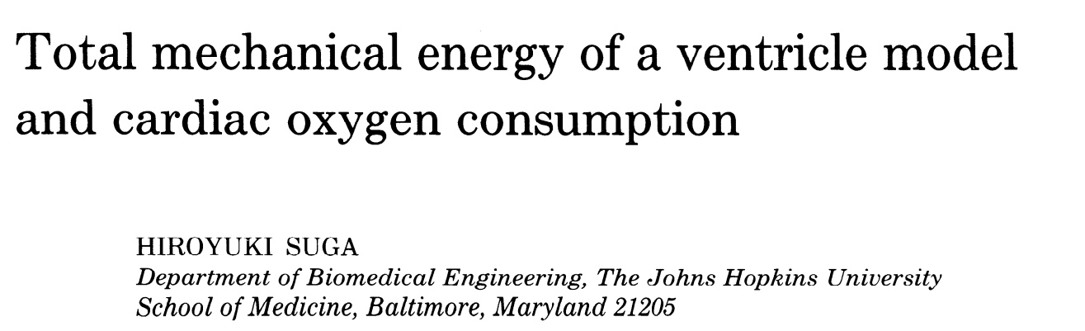
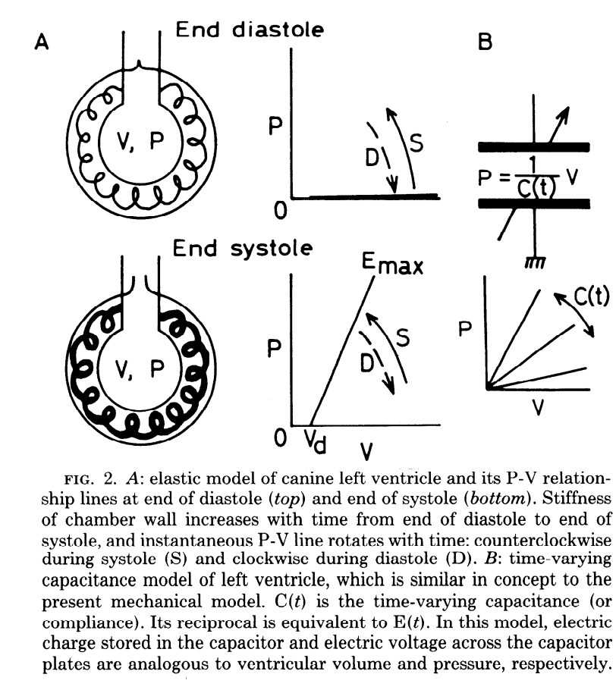
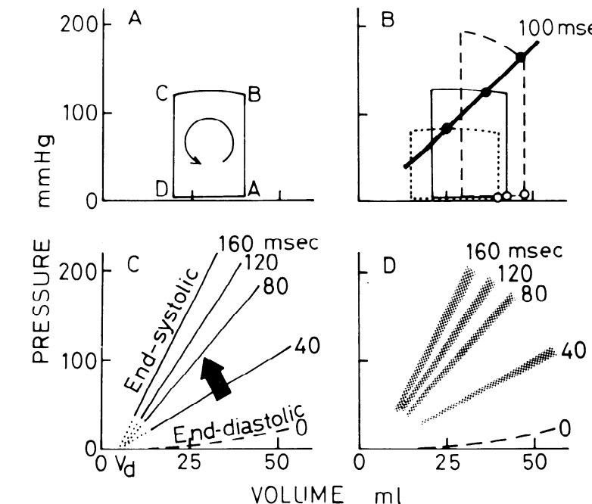
1979

Slide 18
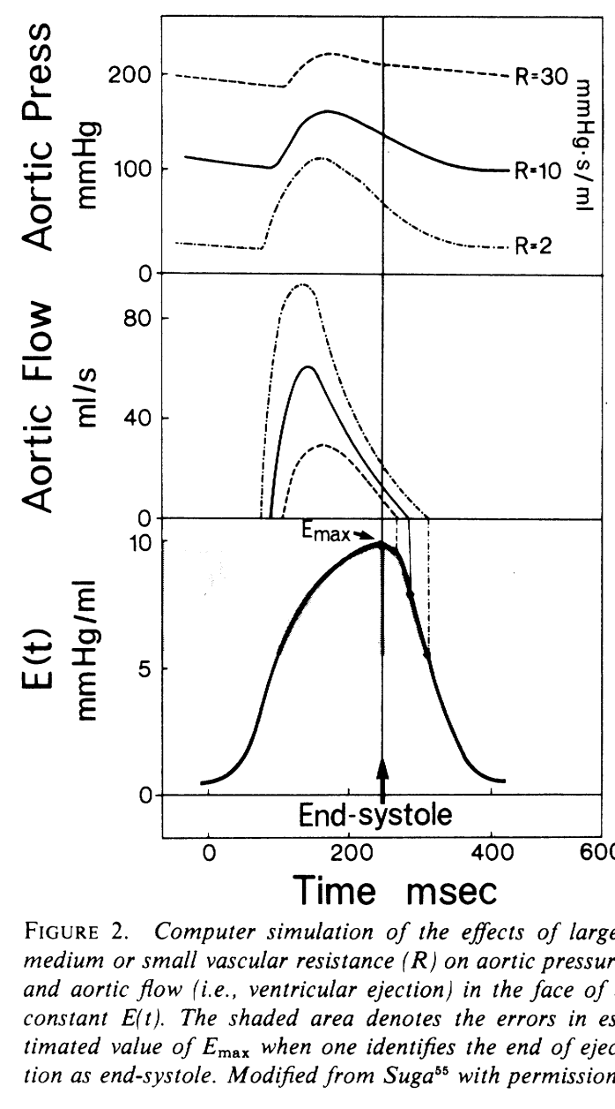
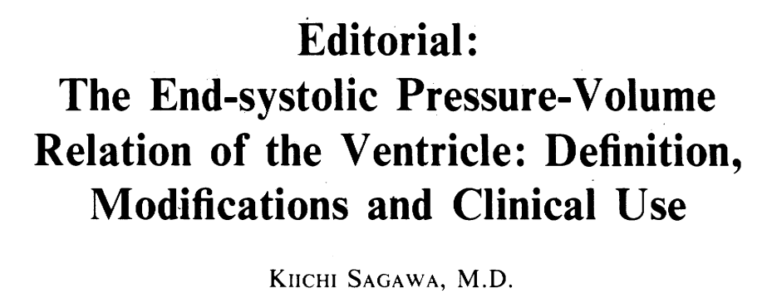
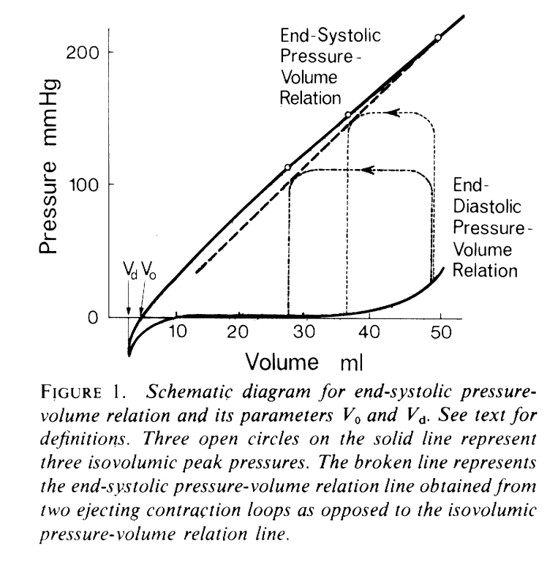
1980

Slide 19
1980

Slide 20
1980

