Slide 1
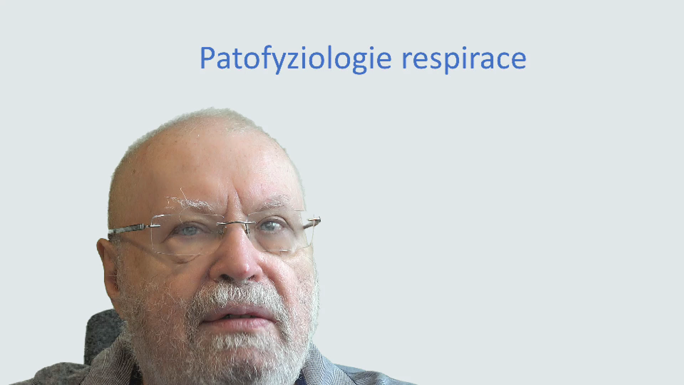
Covid and Respiration
Jiří Kofránek
email: kofranek@gmail.com

Slide 2
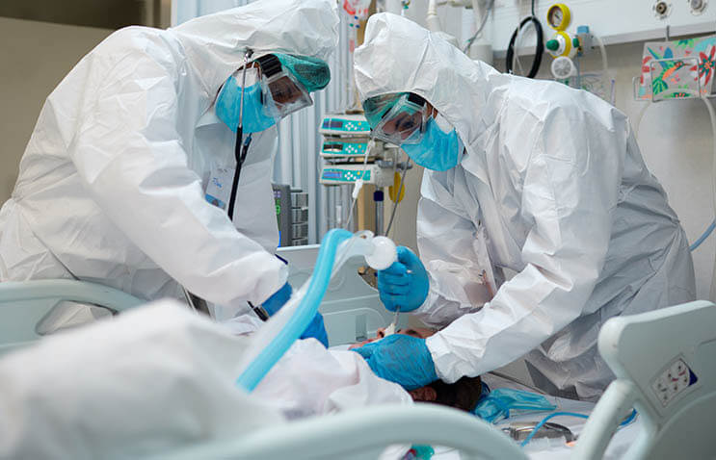
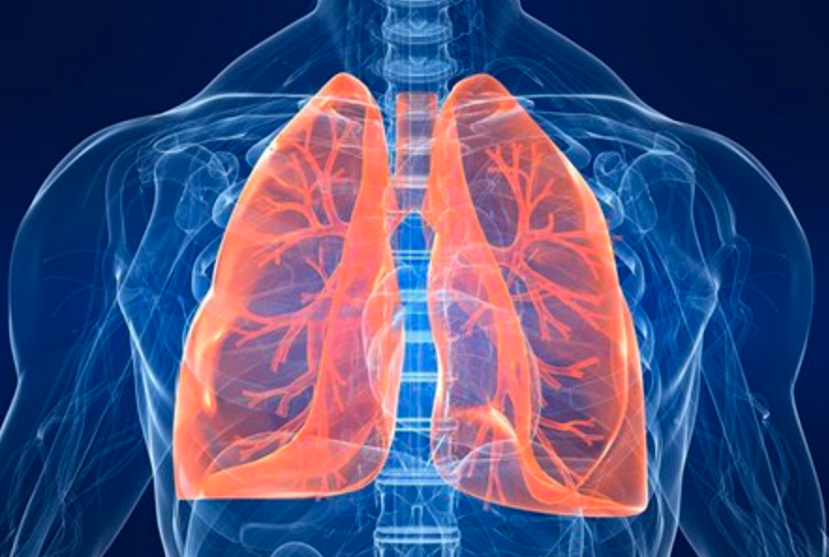
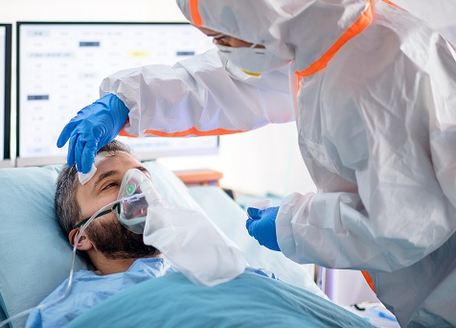
Covid and respiration

Slide 3
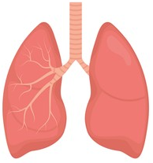
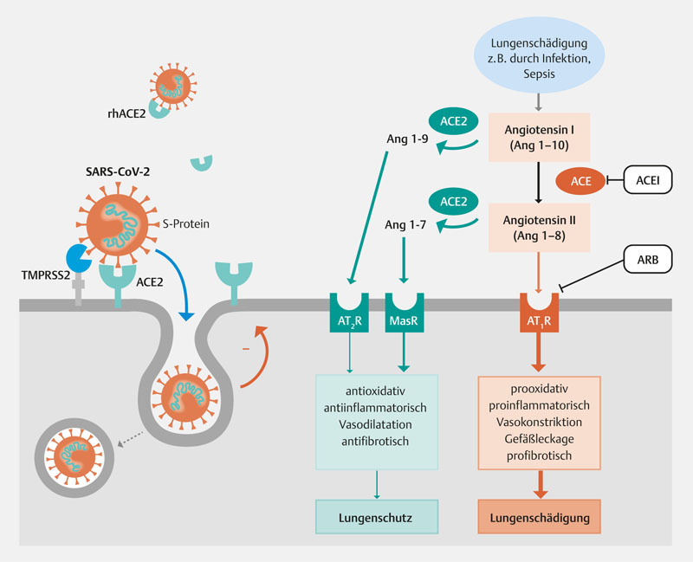
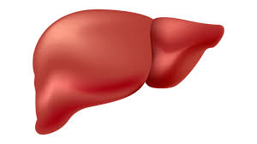
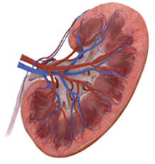
RAS system:
  Volume and blood pressure homeostasis
Lung damage e.g. through infection, Sepsis
Poškození plic
např. infekcí,
Sepse
Angiotensinogen
Angiotensin I
(Ang 1-10)
Renin
Angiotenzin I
(Ang 1-10)
Angiotensin I
(Ang 1-10)
ACE
Angiotensin II
(Ang 1-8)
Angiotenzin II
(Ang 1-8)
Decrease in renal perfusion (juxtaglomerular apparatus)
Angiotensin II
(Ang 1-8)
AT₁R
AT₁R
AT₁R
AT₁R
AT₁R
Increased sympathetic activity
Vasoconstriction arterioles: rise in blood pressure
Adrenal cortex: aldosterone secretion
Tubular reabsorption of Na⁺, Cl⁻ and excretion of K⁺
Neurohypophysis:
ADH secretion
prooxidační, prozánětlivý, vazokonstrikce, prosakování cév, profibrotický
antioxidační, protizánětlivý, vazodilatační, antifibrotický
prooxidative, proinflammatory, vasoconstriction, vascular leakage, profibrotic
antioxidant,
anti-inflammatory, vasodilation, antifibrotic
Collecting duct: H₂O absorption
Lung protection
Poškození plic
Ochrana plic
Lung damage
Water and salt retention. Total blood volume and blood pressure are rising. Renal perfusion increases.
Notes:
The covid virus binds to the ACE receptor, which belongs to the RAS system. The RAS system has an essential regulatory role in maintaining body fluid volume and blood pressure.

Slide 4
RAS system:
  Volume and blood pressure homeostasis
Lung damage e.g. through infection, Sepsis
Poškození plic
např. infekcí,
Sepse
Angiotensinogen
Angiotensin I
(Ang 1-10)
Renin
Angiotenzin I
(Ang 1-10)
Angiotensin I
(Ang 1-10)
ACE
Angiotensin II
(Ang 1-8)
Angiotenzin II
(Ang 1-8)
Decrease in renal perfusion (juxtaglomerular apparatus)
Angiotensin II
(Ang 1-8)
AT₁R
AT₁R
AT₁R
AT₁R
AT₁R
Increased sympathetic activity
Vasoconstriction arterioles: rise in blood pressure
Adrenal cortex: aldosterone secretion
Tubular reabsorption of Na⁺, Cl⁻ and excretion of K⁺
Neurohypophysis:
ADH secretion
prooxidační, prozánětlivý, vazokonstrikce, prosakování cév, profibrotický
antioxidační, protizánětlivý, vazodilatační, antifibrotický
prooxidative, proinflammatory, vasoconstriction, vascular leakage, profibrotic
antioxidant,
anti-inflammatory, vasodilation, antifibrotic
Collecting duct: H₂O absorption
Lung protection
Poškození plic
Ochrana plic
Lung damage
Water and salt retention. Total blood volume and blood pressure are rising. Renal perfusion increases.
Notes:
But this is not the only task of the RAS. RAS also affects pro- and anti-inflammatory homeostasis.
The binding of angiotensin 1 to the AT1R receptor causes prooxidative, proinflammatory, induced vascular leakage, and acts profibrotically in inflammatory repair.

Slide 5
RAS system:
  Volume and blood pressure homeostasis
  Inflamantory and antiinflamantory homeostasis
Angiotensinogen
Angiotensin I
(Ang 1-10)
ACE
Angiotensin II
(Ang 1-8)
antioxidant,
anti-inflammatory, vasodilation, antifibrotic
prooxidative, proinflammatory, vasoconstriction, vascular leakage, profibrotic
Lung protection
Lung damage
Notes:
The binding of Angiotensin 1-9 and Angiotensin 1-7 has an antioxidant, anti-inflammatory, and anti-fibrotic effect.
The AT1R and AT2R receptors trigger opposing events.
Under normal circumstances, anti-inflammatory regulation prevails.
After the lung damage, sepsis, and other pro inflammatory stimuli, the balance shifts to the AT1R side.
ACE2 counteracts the negative effects of the Ang II / AT 1 R axis on lung damage. ACE2 is produced in airway epithelial cells, including type II alveolar epithelial cells in the lungs.

Slide 6
RAS system:
  Volume and blood pressure homeostasis
  Inflamantory and antiinflamantory homeostasis
Lung damage e.g. through infection, Sepsis
Poškození plic
např. infekcí,
Sepse
Angiotenzin I
(Ang 1-10)
Angiotensin I
(Ang 1-10)
ACE
Angiotenzin II
(Ang 1-8)
Angiotensin II
(Ang 1-8)
prooxidační, prozánětlivý, vazokonstrikce, prosakování cév, profibrotický
antioxidační, protizánětlivý, vazodilatační, antifibrotický
prooxidative, proinflammatory, vasoconstriction, vascular leakage, profibrotic
antioxidant,
anti-inflammatory, vasodilation, antifibrotic
Lung protection
Poškození plic
Ochrana plic
Lung damage
Notes:
The binding of Angiotensin 1-9 and Angiotensin 1-7 has an antioxidant, anti-inflammatory, and anti-fibrotic effect.
The AT1R and AT2R receptors trigger opposing events.
Under normal circumstances, anti-inflammatory regulation prevails.
After the lung damage, sepsis, and other pro inflammatory stimuli, the balance shifts to the AT1R side.
ACE2 counteracts the negative effects of the Ang II / AT 1 R axis on lung damage. ACE2 is produced in airway epithelial cells, including type II alveolar epithelial cells in the lungs.

Slide 7
Lung damage e.g. through infection, Sepsis
Poškození plic
např. infekcí,
Sepse
Angiotenzin I
(Ang 1-10)
Angiotensin I
(Ang 1-10)
ACE
Angiotenzin II
(Ang 1-8)
Angiotensin II
(Ang 1-8)
prooxidační, prozánětlivý, vazokonstrikce, prosakování cév, profibrotický
antioxidační, protizánětlivý, vazodilatační, antifibrotický
prooxidative, proinflammatory, vasoconstriction, vascular leakage, profibrotic
antioxidant,
anti-inflammatory, vasodilation, antifibrotic
Lung protection
Poškození plic
Ochrana plic
Lung damage
DOI: 10.1055/a-1152-3469
Notes:
SARS-CoV-2 binds to the membrane-bound ACE2 of the host cell via its viral spike protein. This allows the virus to enter the cell and then replicate.
SARS-CoV-2 also requires the cellular serine protease TMPRSS2 for cellular uptake.
Down regulation will reduce the number of available ACE2 receptors.
A downregulation of ACE2 by SARS-CoV-2, as has been demonstrated for the SARS-CoV infection, could shift the balance between the axes in the RAS in favor of the damaging effect in the lungs.

Slide 8
Lung damage e.g. through infection, Sepsis
Poškození plic
např. infekcí,
Sepse
Angiotenzin I
(Ang 1-10)
ACE2
Angiotensin I
(Ang 1-10)
ACE
Angiotenzin II
(Ang 1-8)
ACE2
Angiotensin II
(Ang 1-8)
prooxidační, prozánětlivý, vazokonstrikce, prosakování cév, profibrotický
antioxidační, protizánětlivý, vazodilatační, antifibrotický
prooxidative, proinflammatory, vasoconstriction, vascular leakage, profibrotic
antioxidant,
anti-inflammatory, vasodilation, antifibrotic
Lung protection
Poškození plic
Ochrana plic
Lung damage
DOI: 10.1055/a-1152-3469
Notes:
The down-regulation results in a strengthening of the Angiotensin II axis, which leads to inflammatory lung damage.

Slide 9
Lung damage e.g. through infection, Sepsis
Poškození plic
např. infekcí,
Sepse
Angiotenzin I
(Ang 1-10)
ACE2
Angiotensin I
(Ang 1-10)
ACE
Angiotenzin II
(Ang 1-8)
ACE2
Angiotensin II
(Ang 1-8)
prooxidační, prozánětlivý, vazokonstrikce, prosakování cév, profibrotický
antioxidační, protizánětlivý, vazodilatační, antifibrotický
prooxidative, proinflammatory, vasoconstriction, vascular leakage, profibrotic
antioxidant,
anti-inflammatory, vasodilation, antifibrotic
Lung protection
Poškození plic
Ochrana plic
Lung damage
DOI: 10.1055/a-1152-3469
Notes:
SARS-CoV-2 binds to the membrane-bound ACE2 of the host cell via its viral spike protein. This allows the virus to enter the cell and then replicate. S
ARS-CoV-2 also requires the cellular serine protease TMPRSS2 for cellular uptake.
ACE2, as a predominantly membrane-bound enzyme, can be broken down in vivo into a soluble form that circulates in body fluids.
Whether a therapy with the soluble form as recombinant human ACE2 (rhACE2) can slow down the spread of the infection by competitive binding to the virus is being investigated.
In addition, an inhibitor of TMPRSS2 that has already been approved for other diseases could be considered for the treatment of SARS-CoV-2 by inhibiting viral cell entry.

Slide 10
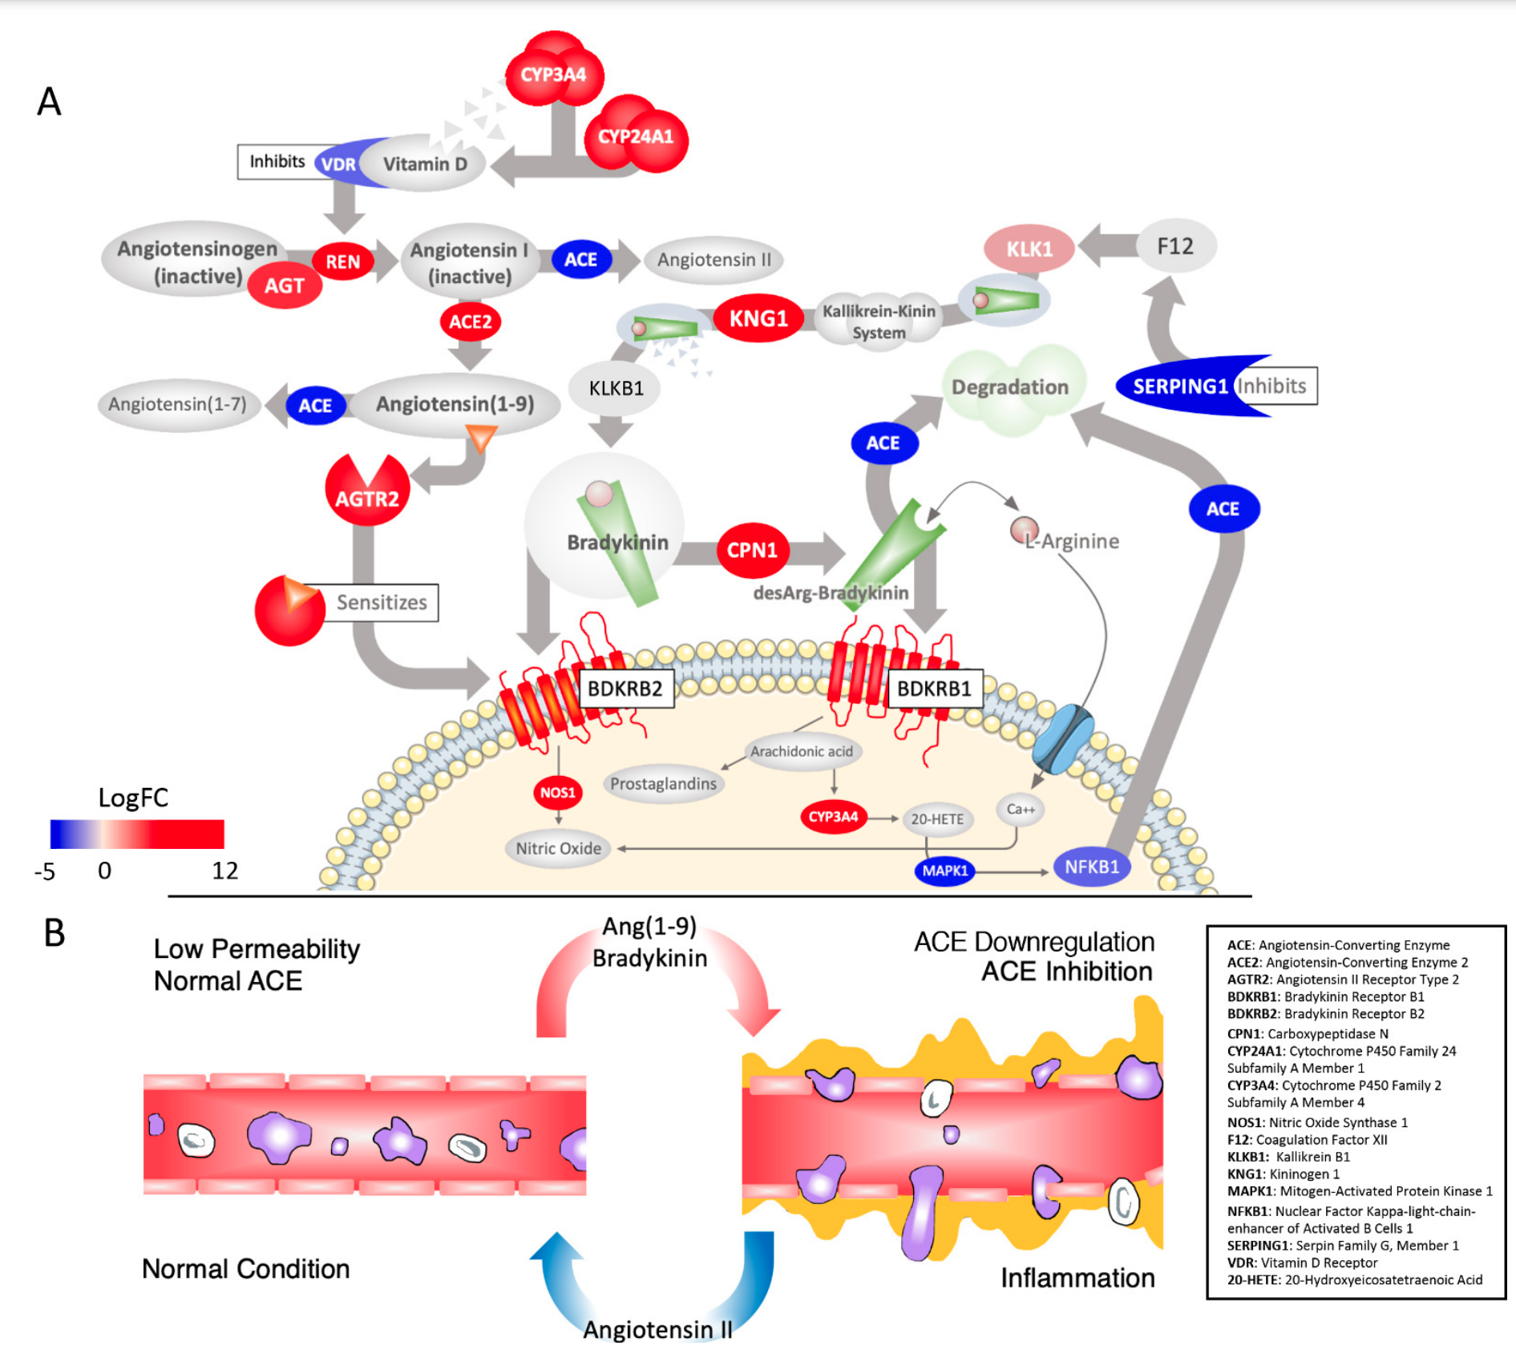
In inflamatory lungs
Upregulation
Downregulation
DOI: https://elifesciences.org/articles/59177
Notes:
The result of gene expression data from cells in bronchoalveolar lavage fluid (BALF) from COVID-19 patients were used to sequence the virus. Comparison with BALF from controls identifies a critical imbalance in RAS represented by decreased expression of ACE in combination with increases in ACE2, renin, angiotensin, key RAS receptors, kinogen and many kallikrein enzymes that activate it, and both bradykinin receptors

Slide 11
Lung damage e.g. through infection, Sepsis
In inflamatory lungs
Poškození plic
např. infekcí,
Sepse
Angiotenzin I
(Ang 1-10)
ACE2
Angiotensin I
(Ang 1-10)
ACE
Angiotenzin II
(Ang 1-8)
ACE2
Angiotensin II
(Ang 1-8)
prooxidační, prozánětlivý, vazokonstrikce, prosakování cév, profibrotický
antioxidační, protizánětlivý, vazodilatační, antifibrotický
prooxidative, proinflammatory, vasoconstriction, vascular leakage, profibrotic
antioxidant,
anti-inflammatory, vasodilation, antifibrotic
Lung protection
Poškození plic
Ochrana plic
Lung damage
DOI: 10.1055/a-1152-3469
Notes:
Downregulation of ACE2 after covid virus infection enhances the binding of angiotensin 2 to AT1R receptors, which enhances the inflammatory response in the lungs.

Slide 12
Lung damage e.g. through infection, Sepsis
Poškození plic
např. infekcí,
Sepse
In inflamatory lungs
ACE2
Angiotenzin I
(Ang 1-10)
Angiotensin I
(Ang 1-10)
ACE
ACE2
Angiotenzin II
(Ang 1-8)
Angiotensin II
(Ang 1-8)
prooxidační, prozánětlivý, vazokonstrikce, prosakování cév, profibrotický
antioxidační, protizánětlivý, vazodilatační, antifibrotický
prooxidative, proinflammatory, vasoconstriction, vascular leakage, profibrotic
antioxidant,
anti-inflammatory, vasodilation, antifibrotic
Lung protection
Poškození plic
Ochrana plic
Lung damage
Notes:
The results of bronchial lavage in inflammatory lungs show that ACE activity is reduced, and ACE2 activity is reactively increased, which counteracts ongoing inflammation.

Slide 13
Degradation
Lung damage e.g. through infection, Sepsis
Poškození plic
např. infekcí,
Sepse
In inflamatory lungs
Kalikrein-kinin
system
ACE2
Angiotenzin I
(Ang 1-10)
Angiotensin I
(Ang 1-10)
ACE
ACE
ACE2
Angiotenzin II
(Ang 1-8)
Bradykinin
Angiotensin II
(Ang 1-8)
Bradykinin receptors
sensitizes
prooxidační, prozánětlivý, vazokonstrikce, prosakování cév, profibrotický
antioxidační, protizánětlivý, vazodilatační, antifibrotický
prooxidative, proinflammatory, vasoconstriction, vascular leakage, profibrotic
antioxidant,
anti-inflammatory, vasodilation, antifibrotic
Lung protection
Poškození plic
Ochrana plic
Lung damage
Notes:
However, the main problem arises in that AT1R sensitizes the bradykinin receptor. Bradykinin degradation is reduced.

Slide 14
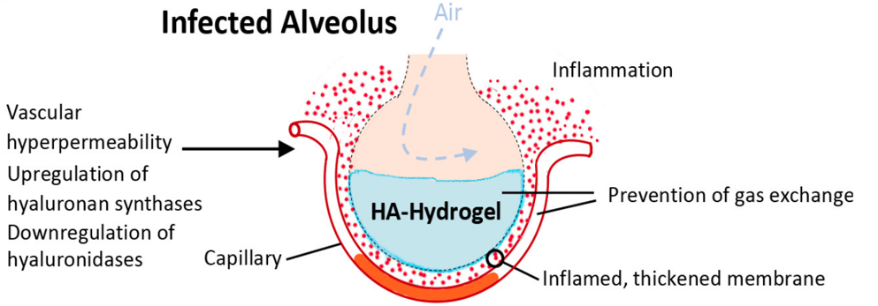
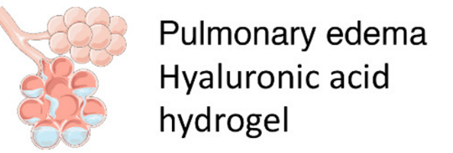
Degradation
Lung damage e.g. through infection, Sepsis
Poškození plic
např. infekcí,
Sepse
In inflamatory lungs
Kalikrein-kinin
system
ACE2
Angiotenzin I
(Ang 1-10)
Angiotensin I
(Ang 1-10)
ACE
ACE
ACE2
Angiotenzin II
(Ang 1-8)
Bradykinin
Angiotensin II
(Ang 1-8)
Bradykinin receptors
sensitizes
prooxidační, prozánětlivý, vazokonstrikce, prosakování cév, profibrotický
antioxidační, protizánětlivý, vazodilatační, antifibrotický
prooxidative, proinflammatory, vasoconstriction, vascular leakage, profibrotic
antioxidant,
anti-inflammatory, vasodilation, antifibrotic
Lung protection
Poškození plic
Ochrana plic
Lung damage
Notes:
BK-induced hyperpermeability of the lung microvasculature leads to the formation of a HA-hydrogel that inhibits gas exchange in the alveoli of COVID-19 patient

Slide 15
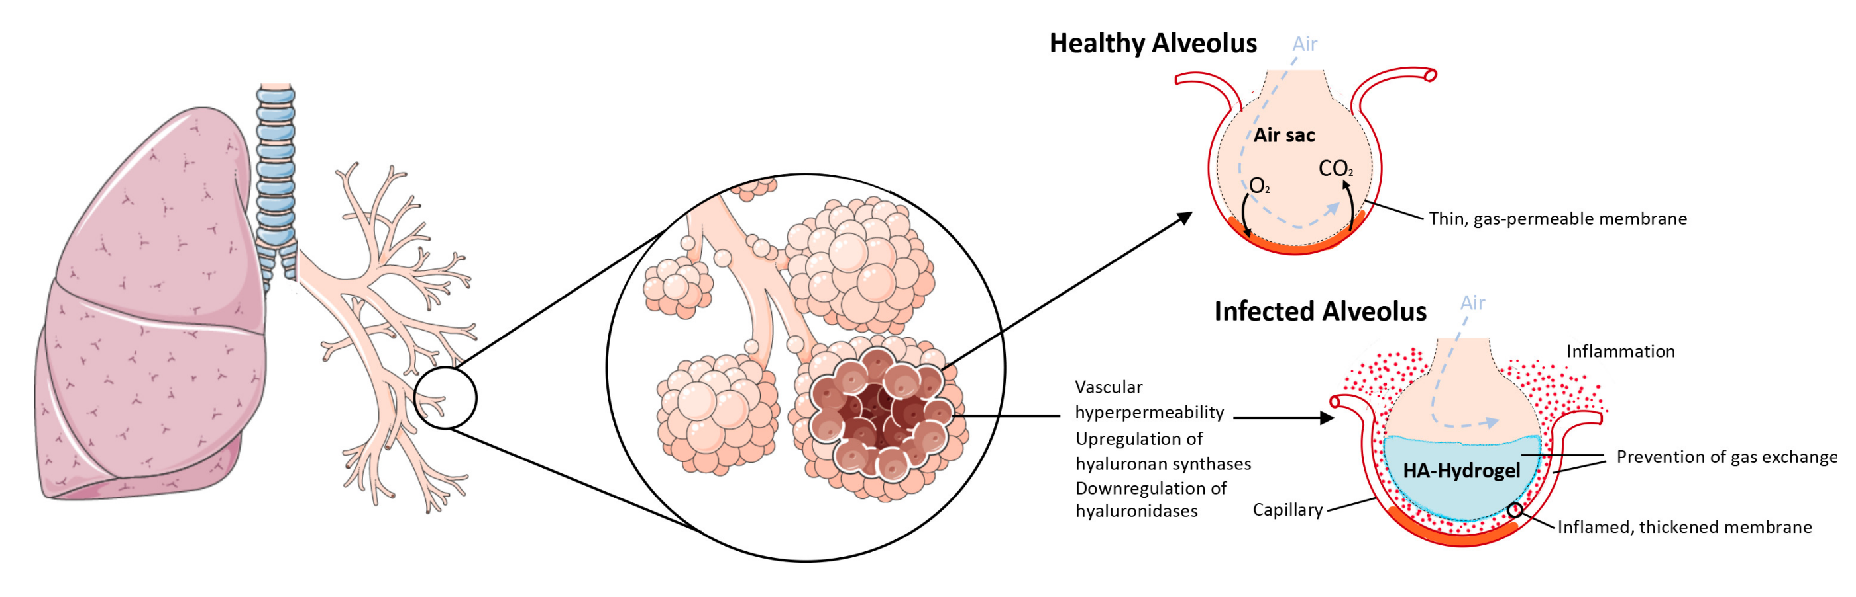
The upregulation of hyaluronan synthases and downregulation of hyaluronidases combined with the BK-induced hyperpermeability of the lung microvasculature leads to the formation of a HA-hydrogel that inhibits gas exchange in the alveoli of COVID-19 patie
DOI: https://elifesciences.org/articles/59177

Slide 16
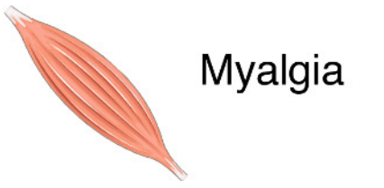
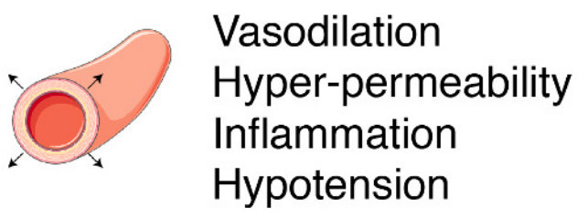
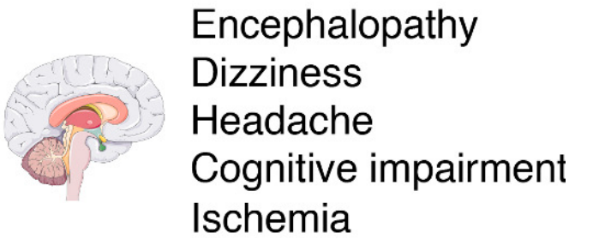
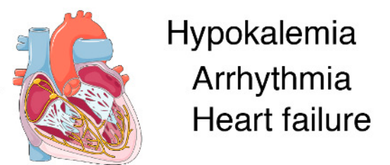
Degradation
Lung damage e.g. through infection, Sepsis
Poškození plic
např. infekcí,
Sepse
Bradykinin action - is responsible for many of the symptoms of COVID-19
Kalikrein-kinin
system
ACE2
Angiotenzin I
(Ang 1-10)
Angiotensin I
(Ang 1-10)
ACE
ACE
ACE2
Angiotenzin II
(Ang 1-8)
Bradykinin
Angiotensin II
(Ang 1-8)
Bradykinin receptors
sensitizes
prooxidační, prozánětlivý, vazokonstrikce, prosakování cév, profibrotický
antioxidační, protizánětlivý, vazodilatační, antifibrotický
prooxidative, proinflammatory, vasoconstriction, vascular leakage, profibrotic
antioxidant,
anti-inflammatory, vasodilation, antifibrotic
Lung protection
Poškození plic
Ochrana plic
Lung damage

Slide 17
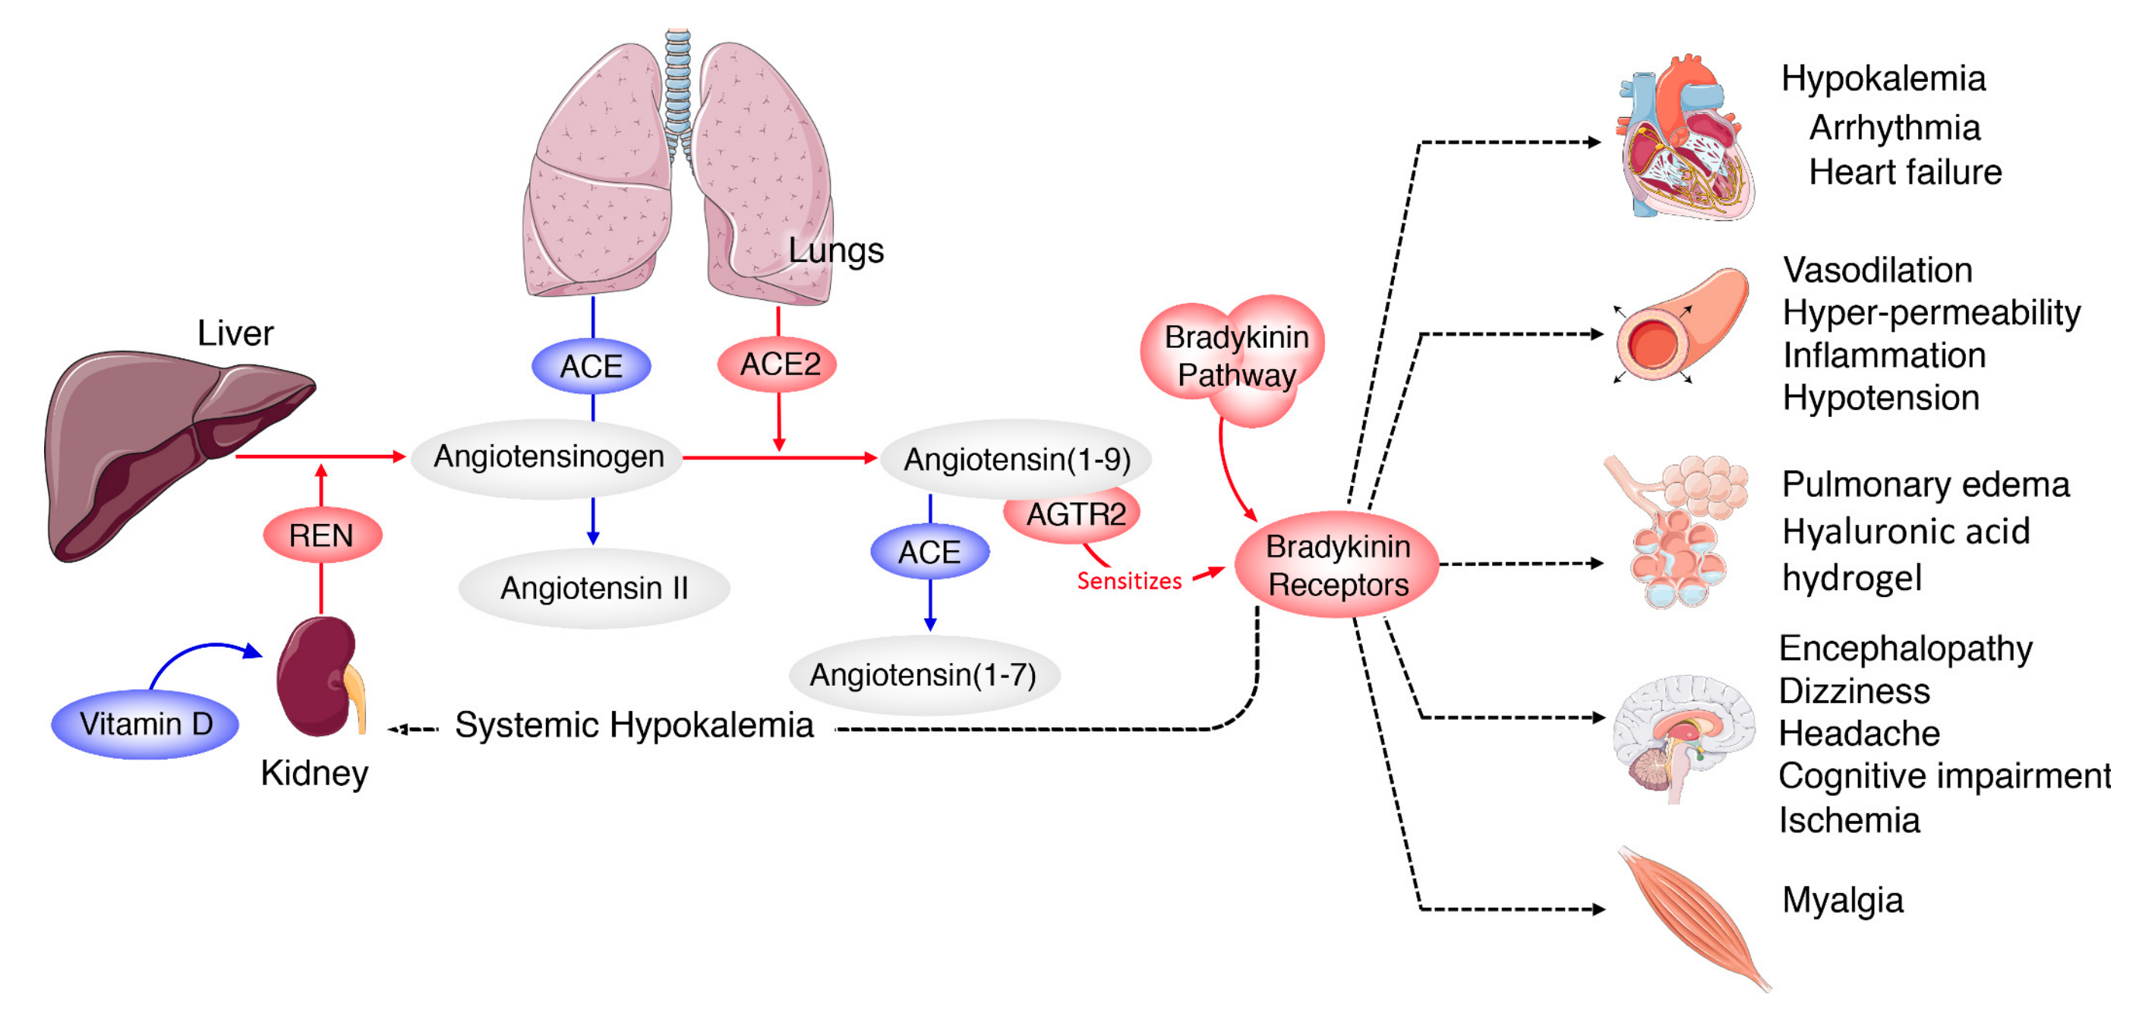
Bradykinin action - is responsible for many of the symptoms of COVID-19
Upregulation
Downregulation
Garvin et al.: A mechanistic model and therapeutic interventions for COVID-19 involving a RAS-mediated bradykinin storm. eLife 2020;9:e59177. DOI: https://doi.org/10.7554/eLife.59177
Notes:
Systemic-level effects of critically imbalanced RAS and BK pathways.
The gene expression patterns from COVID BAL samples reveal a RAS that is skewed toward low levels of ACE that result in higher levels of Ang1-9 and BK.
High levels of ACE normally present in the lungs are responsible for generating system-wide angiotensin-derived peptides.
The Bradykinin-Storm is likely to affect major organs that are regulated by angiotensin derivatives.
These include altered electrolyte balance from affected kidney and heart tissue, arrhythmia in dysregulated cardiac tissue, neurological disruptions in the brain, myalgia in muscles and severe alterations in oxygen uptake in the lung itself. Red colors indicate upregulation and blue downregulation.

Slide 18
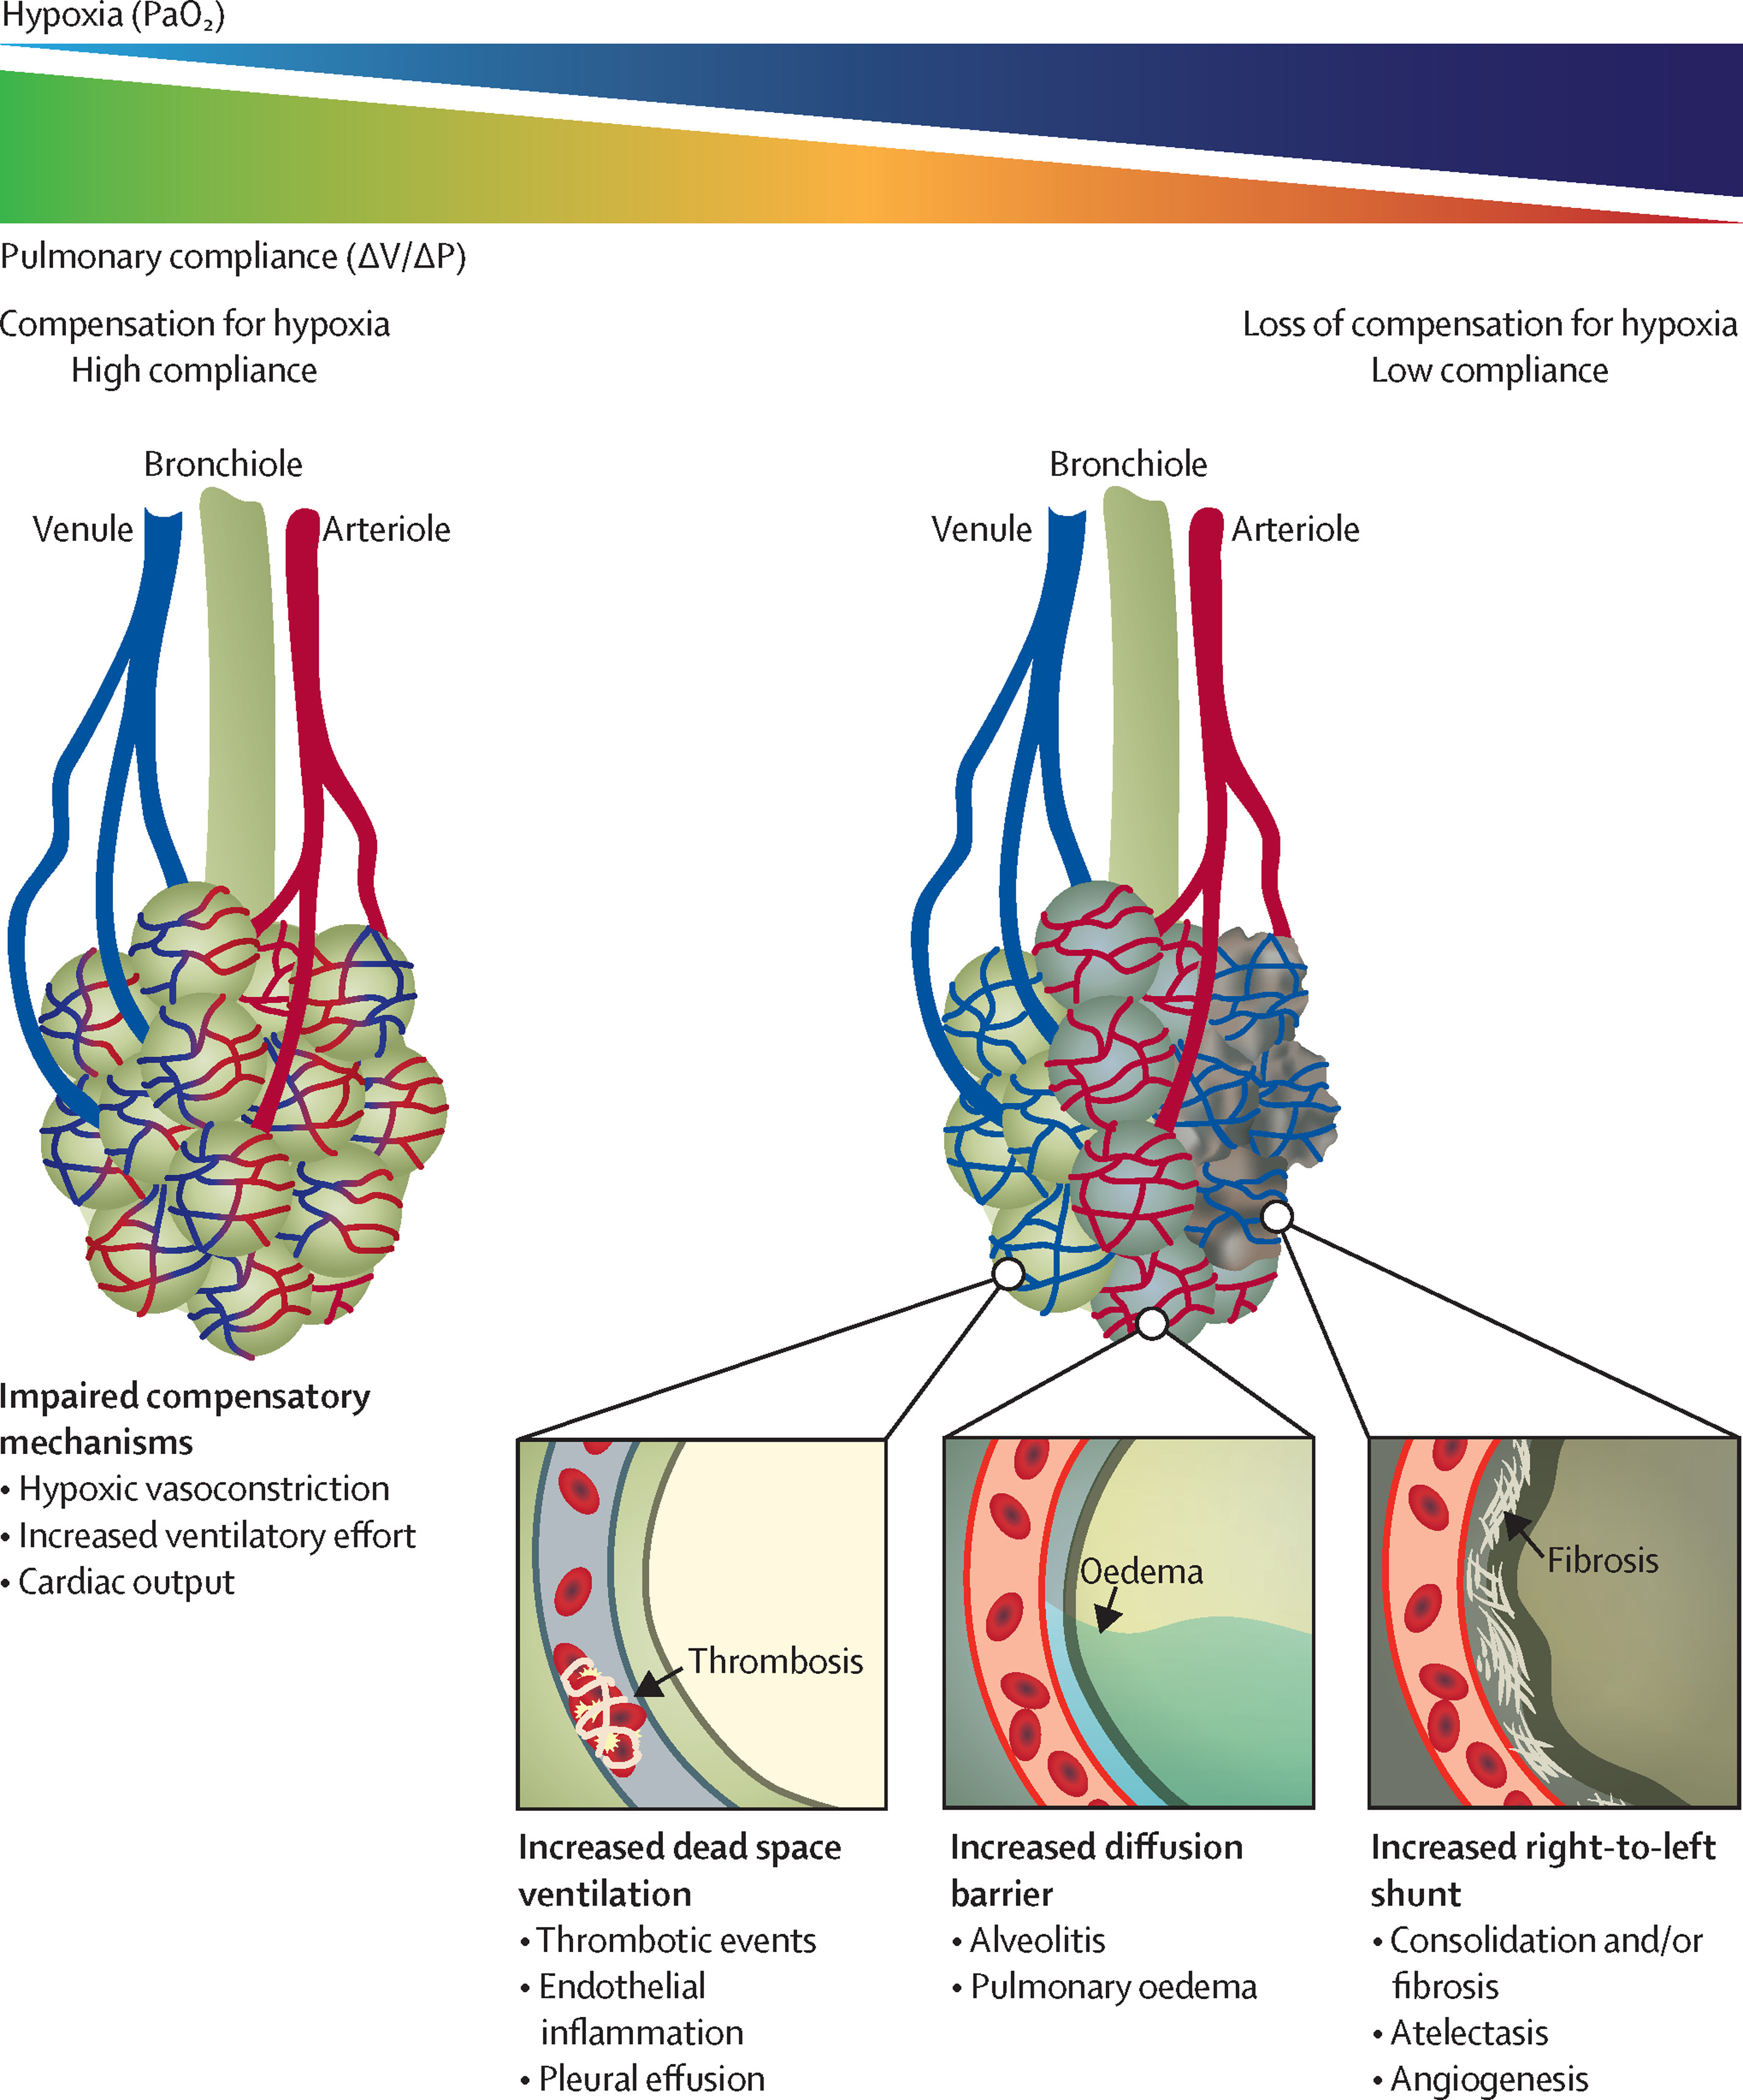
The Lancet Respiratory Medicine 2021 9622-642DOI: (10.1016/S2213-2600(21)00218-6)
Notes:
Hypoxia and lung failure in COVID-19
Conceptual and simplified view of COVID-19 lung pathogenesis. In most patients, hypoxia is the principal and most severe COVID-19 symptom; although still debated, compensatory mechanisms to maintain oxygen delivery such as increased respiratory effort, hypoxic vasoconstriction, and cardiac output are thought to eventually lose efficacy with increasing COVID-19 severity.
With a further reduction in functional lung capacity, hypoxia becomes life-threatening and frequently necessitates intensive care support.
Mechanisms contributing to COVID-19 severity include increased dead space ventilation secondary to endothelial inflammation and microthrombi, an elevated diffusion barrier secondary to alveolitis and pulmonary oedema, and right-to-left shunt formation secondary to atelectasis, which is related to increased oedema and fibrosis in the long term; these mechanisms collectively reduce gas-exchange capacity. ΔP=change in pleural pressure. ΔV=change in volume. PaO2=partial pressure of arterial oxygen.

Slide 19
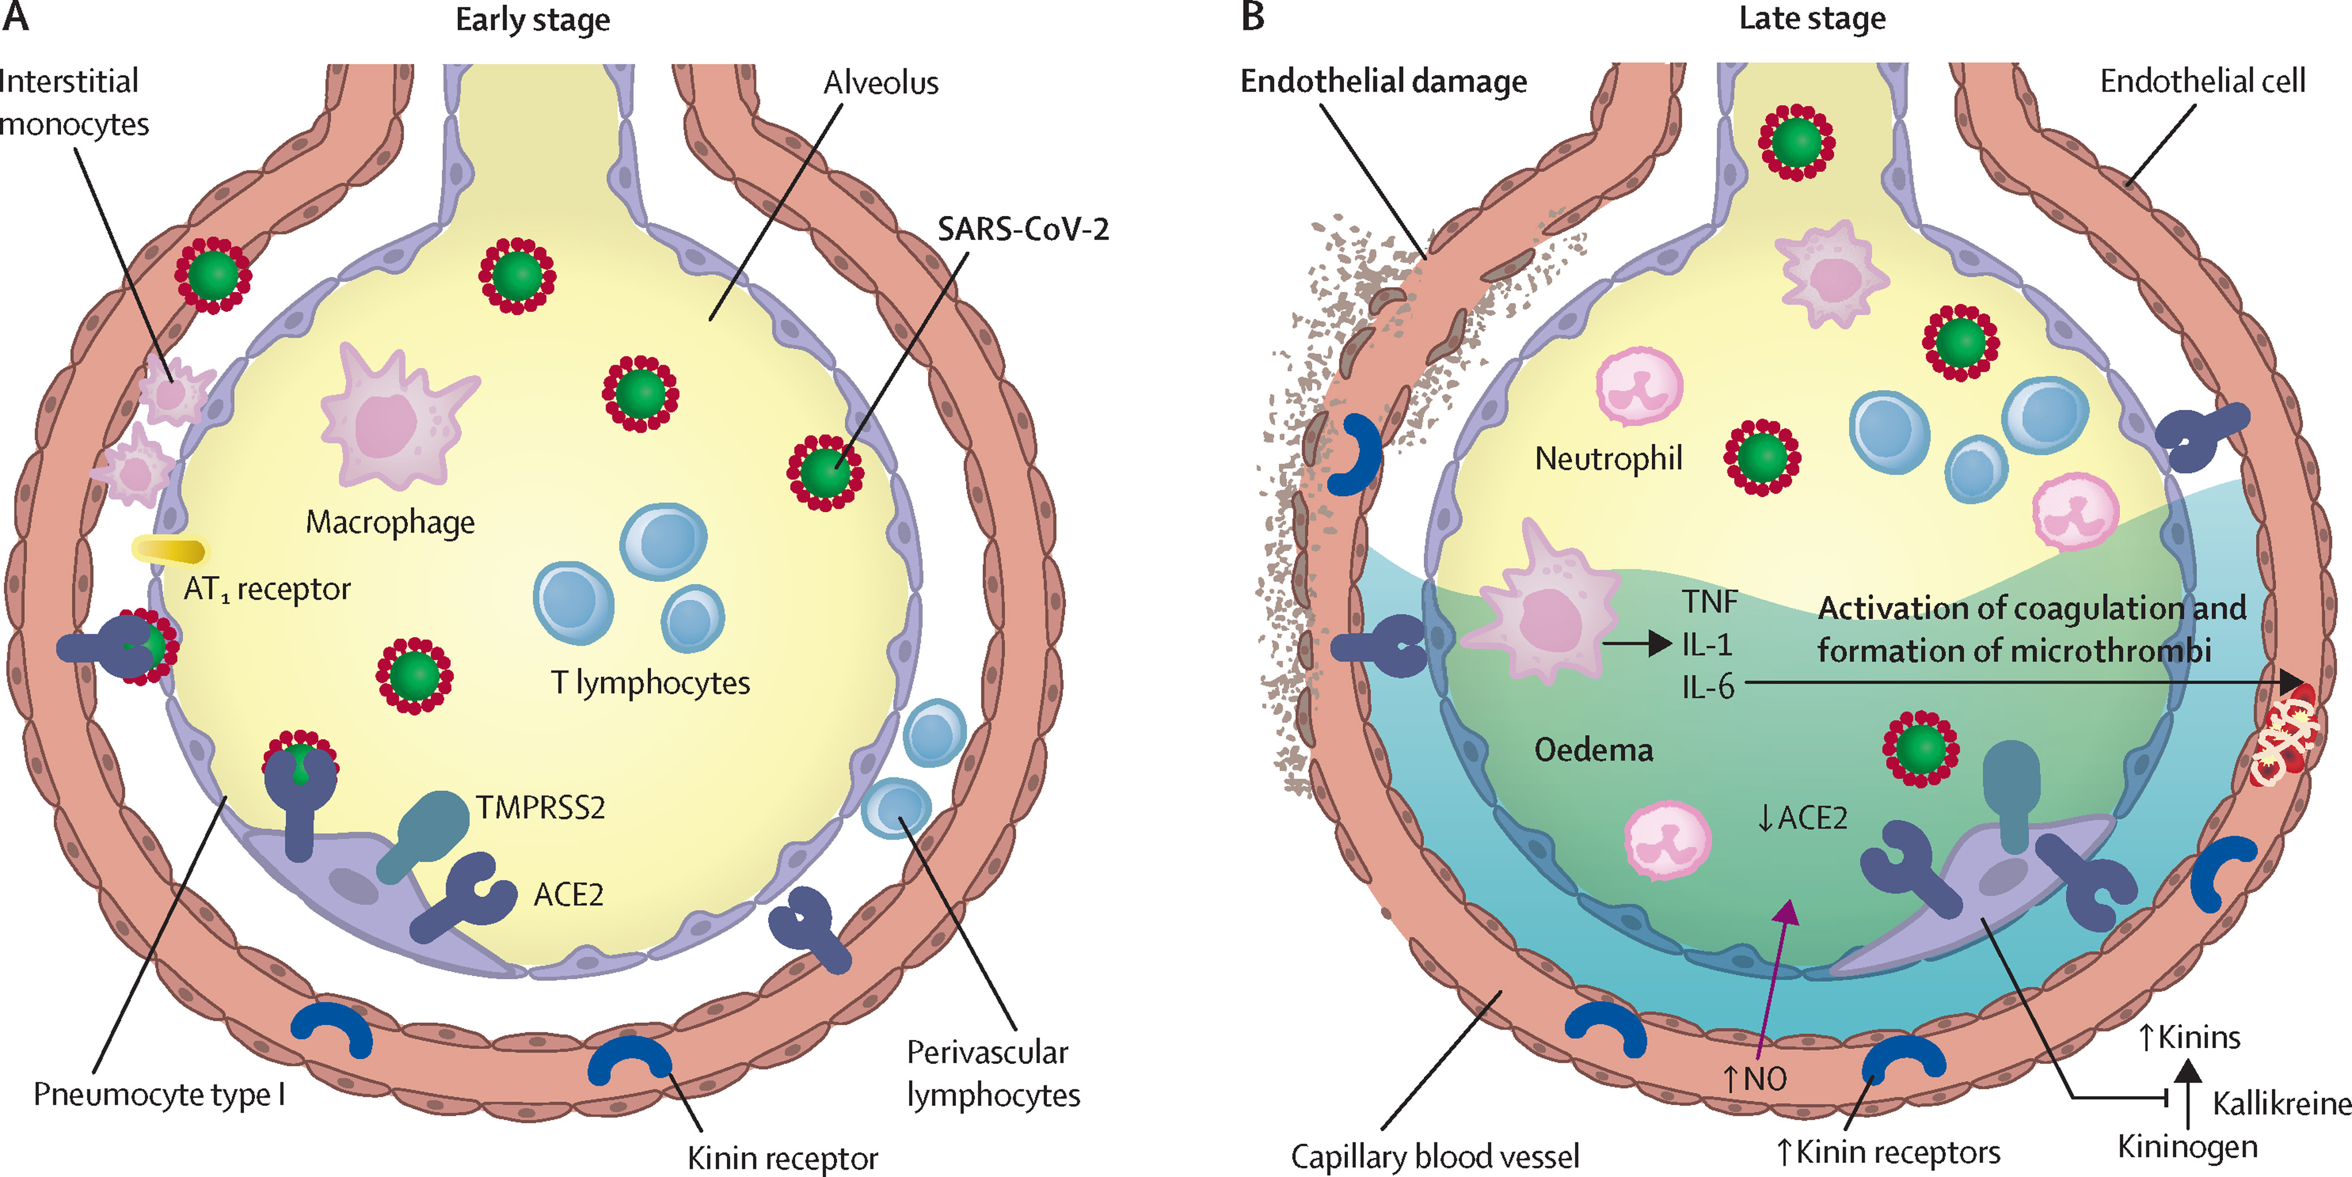
The Lancet Respiratory Medicine 2021 9622-642DOI: (10.1016/S2213-2600(21)00218-6)
Notes:
Inflammatory mechanisms, alveolar epithelial and endothelial damage, and coagulopathy in COVID-19
In the early stage of disease, SARS-CoV-2 infects the bronchial epithelial cells as well as type I and type II alveolar pneumocytes and capillary endothelial cells. The serine protease TMPRSS2 promotes viral uptake by cleaving ACE2 and activating the SARS-CoV-2 S-protein. During early infection, viral copy numbers can be high in the lower respiratory tract. Inflammatory signalling molecules are released by infected cells and alveolar macrophages, in addition to recruited T lymphocytes, monocytes, and neutrophils.
(B)
With disease progression, plasma and tissue kallikreins release vasoactive peptides known as kinins that activate kinin receptors on the lung endothelium, which in turn leads to vascular smooth muscle relaxation and increased vascular permeability. This process is controlled by the ACE2 receptor. Without ACE2 blocking the ligands of kinin receptor B1, the lungs are prone to vascular leakage, angioedema, and downstream activation of coagulation.
Dysregulated proinflammatory cytokine (TNF, IL-1, IL-6) and NO nitric oxide release and signalling contribute to these processes. As a consequence, pulmonary oedema fills the alveolar spaces, followed by hyaline membrane formation, compatible with early-phase acute respiratory distress syndrome. Anomalous coagulation frequently results in the formation of microthrombi and subsequent thrombotic sequelae. ACE2=angiotensin-converting enzyme 2. AT1 receptor=type 1 angiotensin II receptor. IL=interleukin. NO=nitric oxide. TMPRSS2=transmembrane protease serine 2. TNF=tumour necrosis factor.

Slide 20
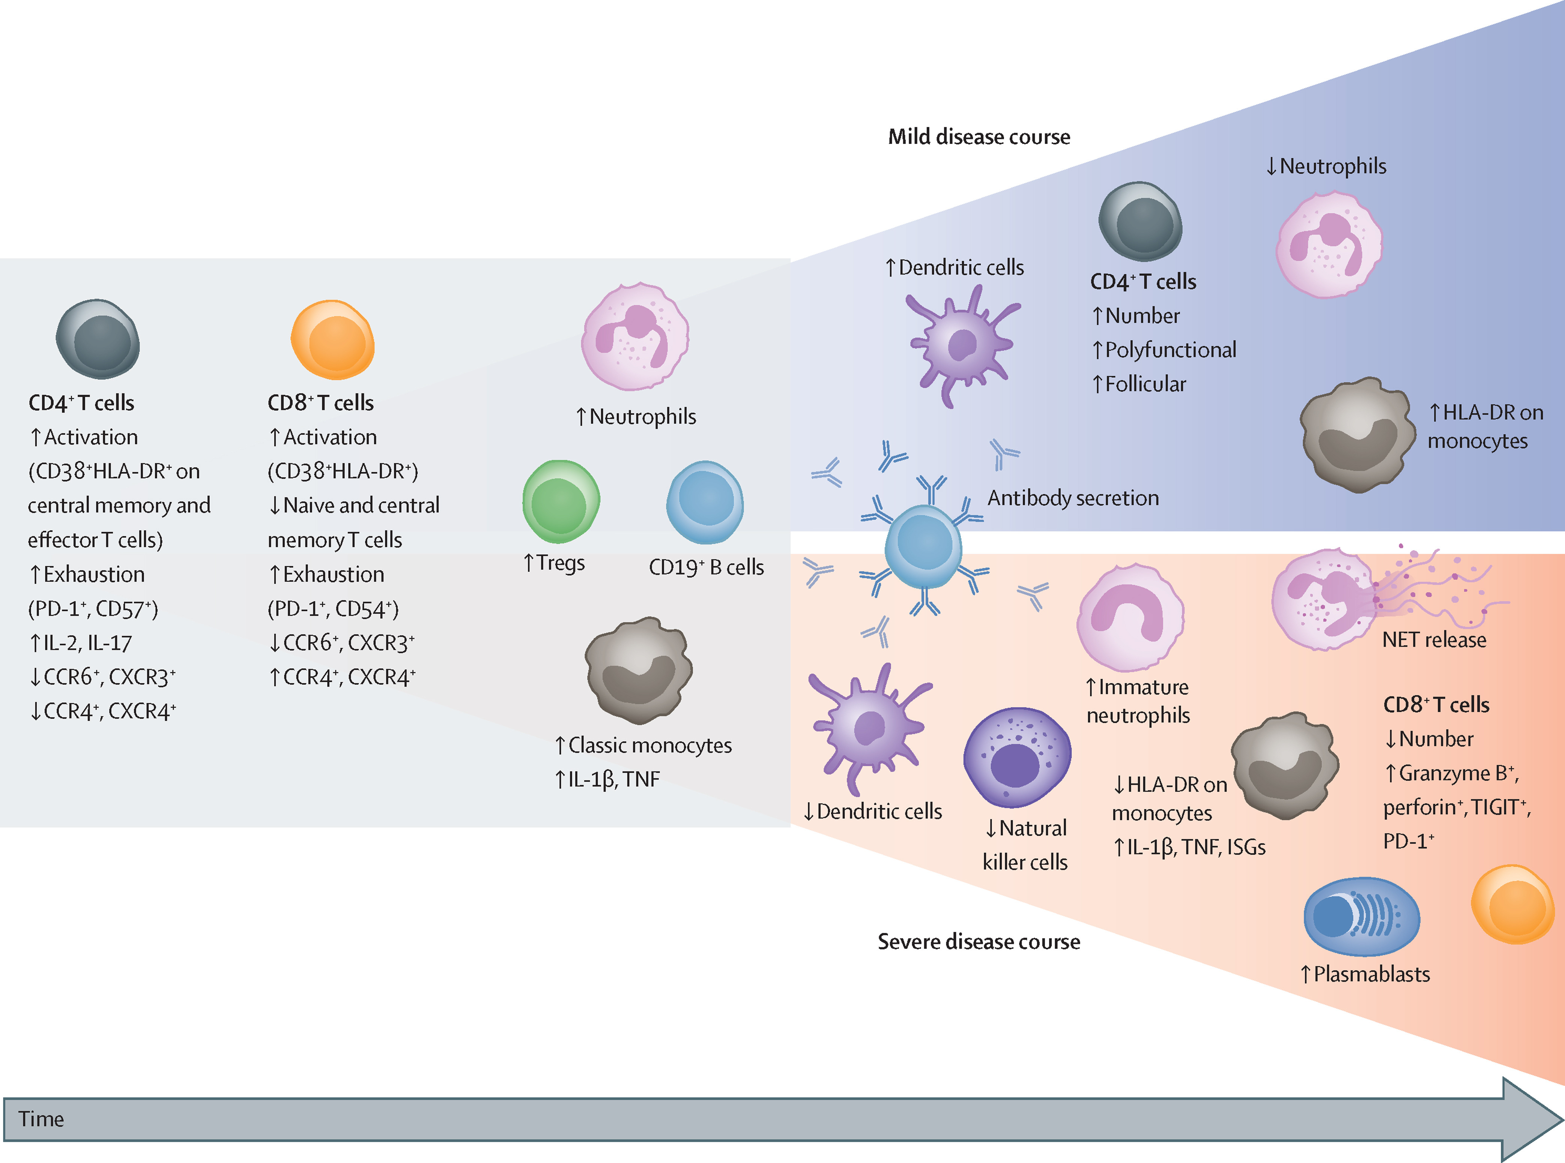
The Lancet Respiratory Medicine 2021 9622-642DOI: (10.1016/S2213-2600(21)00218-6)
Notes:
Severity-dependent changes in peripheral blood immune cells during COVID-19
COVID-19 is associated with a marked decrease in circulating effector CD4⁺ and CD8⁺ T lymphocytes, leading to an increase in Tregs. In addition to a numerical loss, the high proportion of exhausted and suppressed T cells expressing CTLA-4, PD-1, or TIGIT suggest compromised T-cell immunity. Both CD4⁺ and CD8⁺ T cells show early upregulation of activation markers such as CD38 and HLA-DR concurrent with an altered chemokine receptor pattern (a decrease in CCR6 and CXCR3). Circulating CD4⁺ T cells are skewed towards an IL-2 and IL-17-positive profile. Early in the course of COVID-19, the numbers of B cells and monocytes remain unchanged, whereas mild neutrophilia is frequently observed. Blue area: patients with favourable outcomes have an increased number of circulating dendritic cells and intermediate monocytes that upregulate HLA-DR expression, suggesting recovery of immunocompetence. T-cell numbers recover with an increase in polyfunctional and follicular helper T cells. These changes are accompanied by a humoral antibody response produced by activated and expanded B cells. During recovery, neutrophil numbers normalise. Red area: a more severe disease course is characterised by a decrease in dendritic cells, natural killer cells, and monocytes; monocytes further downregulate HLA-DR expression but upregulate IL-1β, TNF, and ISGs. Although low in number, CD8⁺ T cells in severe COVID-19 show substantial upregulation of their effector molecules, such as granzyme B and perforin. Of note, the numbers of B cells decrease, whereas plasmablasts are increased in the blood; specific antibodies are also produced in patients with severe COVID-19. Profound changes occur among myeloid cells including egress of immature neutrophils and myeloid-derived suppressor cells from the bone marrow, and enhanced formation of NETs. NET formation is likely to be an important contributor to the development of organ and endothelial injury in conjunction with activation of the complement and coagulation cascades. CCR=C-C chemokine receptor. CTLA-4=cytotoxic T-lymphocyte protein 4. CXCR=C-X-C chemokine receptor. HLA-DR=HLA DR isotype. IL=interleukin. ISGs=interferon-stimulated genes. NETs=neutrophil extracellular traps. PD-1=programmed cell death 1. TIGIT=T-cell immunoglobulin and ITIM domain. TNF=tumour necrosis factor. Tregs=regulatory T cells.

Slide 21
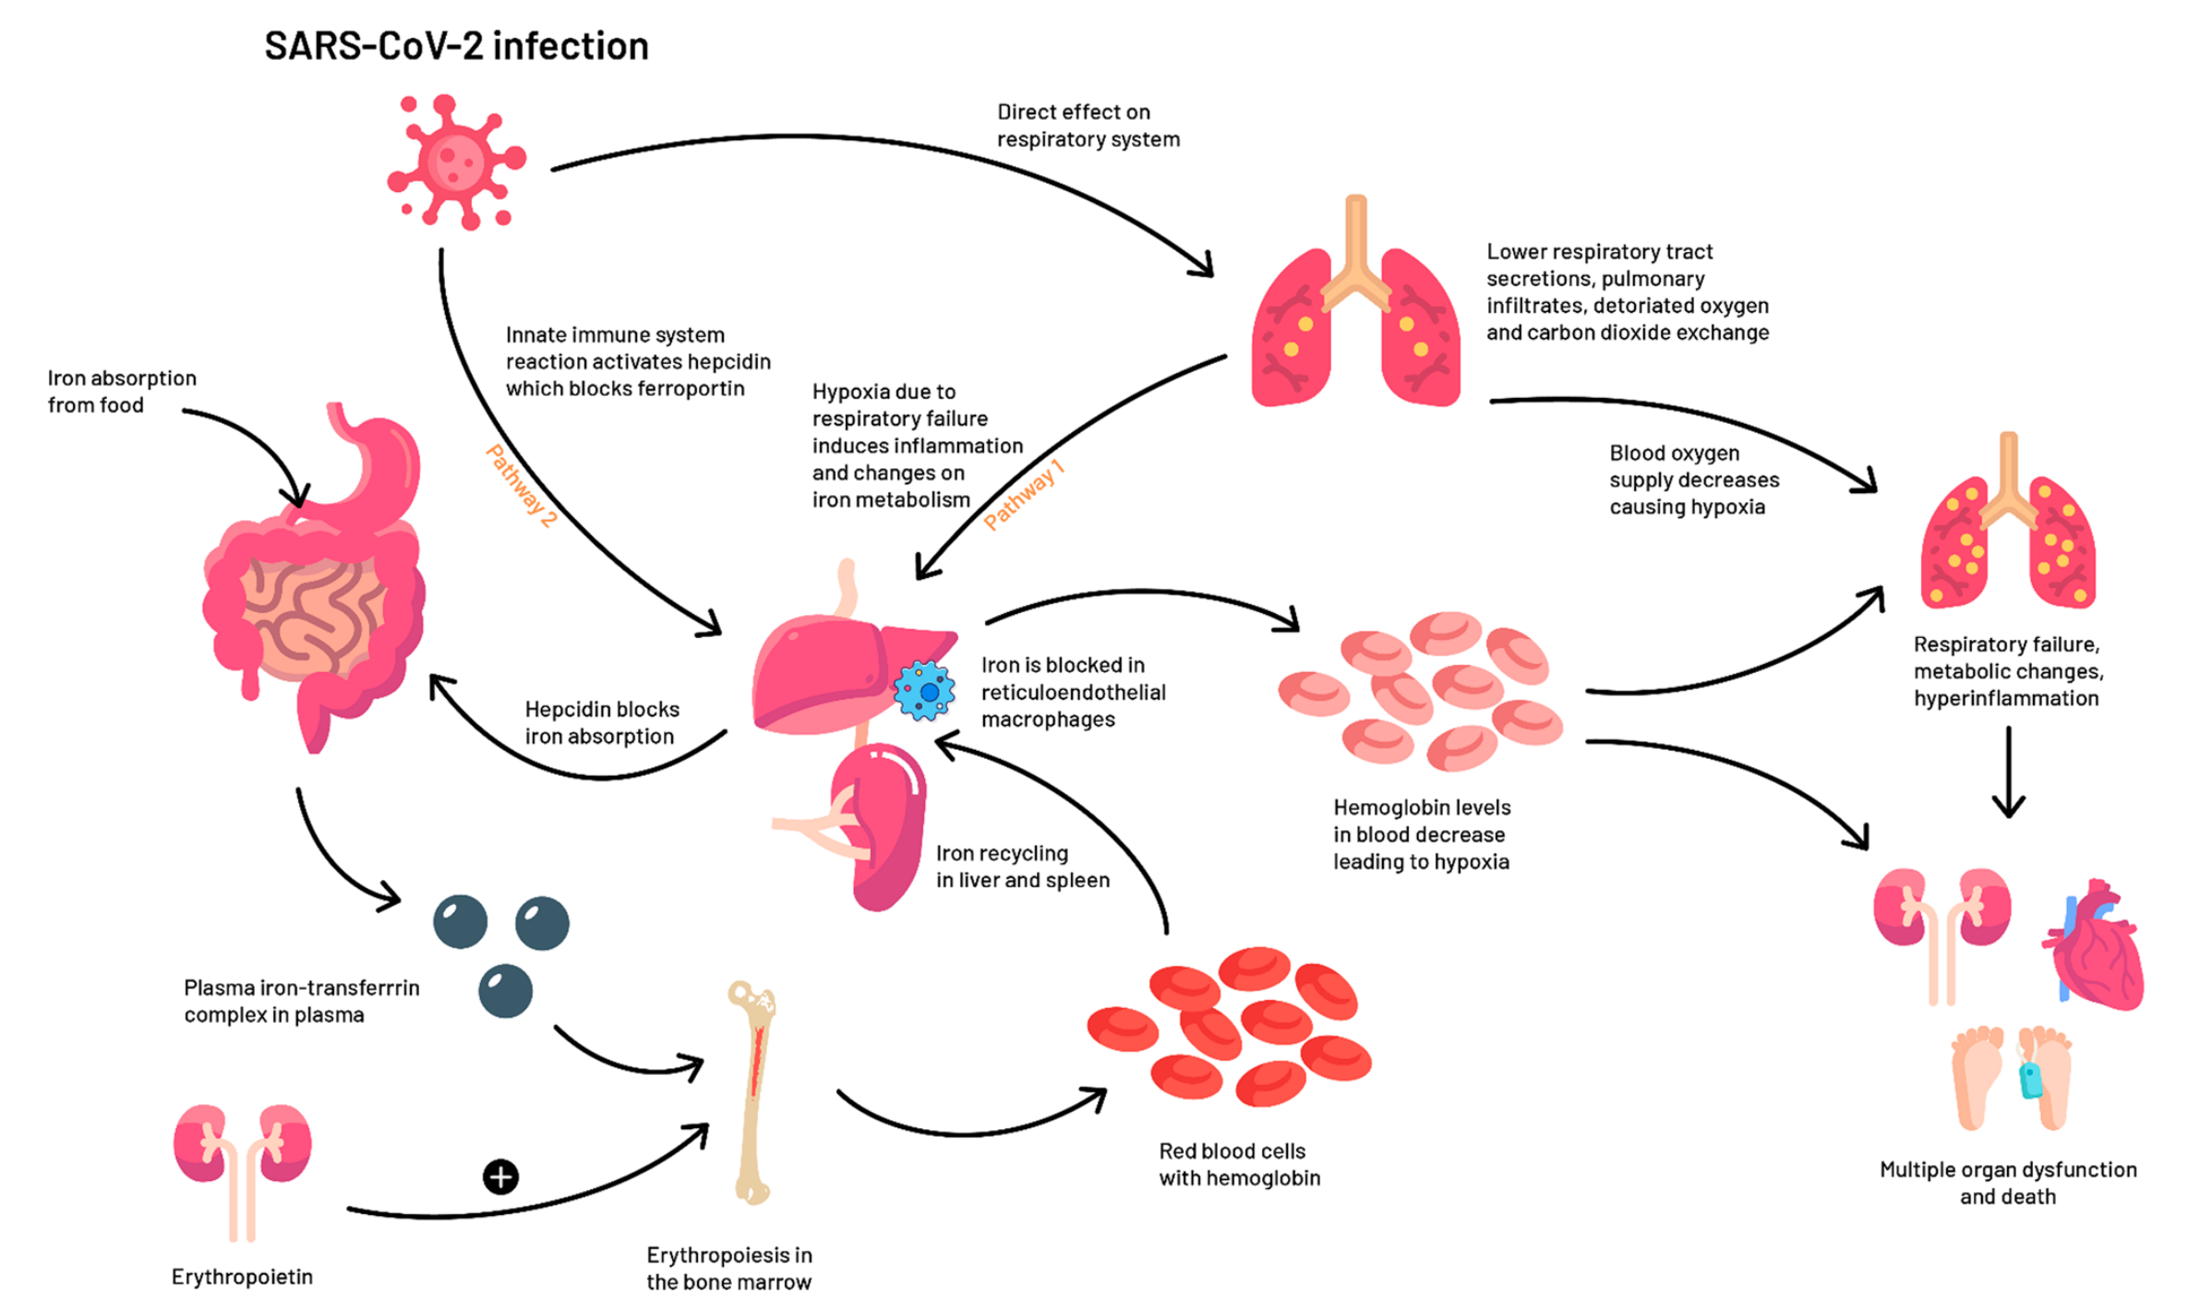
August 2020 European Journal of Epidemiology 35(10229) DOI:10.1007/s10654-020-00678-5
Notes:
The potential role of red blood cell dynamics and iron homeostasis in the clinical presentation of COVID-19. The figure shows two potential pathways through which iron metabolism may be involved in the pathophysiology of COVID-19. Pathway 1: the virus inflicts hypoxia via direct deleterious effects on the respiratory system, altering the inflammatory response leading to anemia. Pathway 2: the innate immune system may aim to decrease the bioavailability of iron in order to prevent an expanding viral load in the acute-phase of the infection. This leads to the activation of hepcidin, sequestration of iron within cells, increased levels of ferritin and decreased hemoglobin, culminating in hypoxia

Slide 22
August 2020 European Journal of Epidemiology 35(10229) DOI:10.1007/s10654-020-00678-5
Notes:
The potential role of red blood cell dynamics and iron homeostasis in the clinical presentation of COVID-19. The figure shows two potential pathways through which iron metabolism may be involved in the pathophysiology of COVID-19. Pathway 1: the virus inflicts hypoxia via direct deleterious effects on the respiratory system, altering the inflammatory response leading to anemia. Pathway 2: the innate immune system may aim to decrease the bioavailability of iron in order to prevent an expanding viral load in the acute-phase of the infection. This leads to the activation of hepcidin, sequestration of iron within cells, increased levels of ferritin and decreased hemoglobin, culminating in hypoxia

Slide 23
August 2020 European Journal of Epidemiology 35(10229) DOI:10.1007/s10654-020-00678-5
Notes:
The potential role of red blood cell dynamics and iron homeostasis in the clinical presentation of COVID-19. The figure shows two potential pathways through which iron metabolism may be involved in the pathophysiology of COVID-19. Pathway 1: the virus inflicts hypoxia via direct deleterious effects on the respiratory system, altering the inflammatory response leading to anemia. Pathway 2: the innate immune system may aim to decrease the bioavailability of iron in order to prevent an expanding viral load in the acute-phase of the infection. This leads to the activation of hepcidin, sequestration of iron within cells, increased levels of ferritin and decreased hemoglobin, culminating in hypoxia

Slide 24
August 2020 European Journal of Epidemiology 35(10229) DOI:10.1007/s10654-020-00678-5
Notes:
The potential role of red blood cell dynamics and iron homeostasis in the clinical presentation of COVID-19. The figure shows two potential pathways through which iron metabolism may be involved in the pathophysiology of COVID-19. Pathway 1: the virus inflicts hypoxia via direct deleterious effects on the respiratory system, altering the inflammatory response leading to anemia. Pathway 2: the innate immune system may aim to decrease the bioavailability of iron in order to prevent an expanding viral load in the acute-phase of the infection. This leads to the activation of hepcidin, sequestration of iron within cells, increased levels of ferritin and decreased hemoglobin, culminating in hypoxia

Slide 25
August 2020 European Journal of Epidemiology 35(10229) DOI:10.1007/s10654-020-00678-5
Notes:
The potential role of red blood cell dynamics and iron homeostasis in the clinical presentation of COVID-19. The figure shows two potential pathways through which iron metabolism may be involved in the pathophysiology of COVID-19. Pathway 1: the virus inflicts hypoxia via direct deleterious effects on the respiratory system, altering the inflammatory response leading to anemia. Pathway 2: the innate immune system may aim to decrease the bioavailability of iron in order to prevent an expanding viral load in the acute-phase of the infection. This leads to the activation of hepcidin, sequestration of iron within cells, increased levels of ferritin and decreased hemoglobin, culminating in hypoxia

Slide 26

Integrativní fyziologie
Thank you for your attention
Poruchy cirkulace
Poruchy objemu
Poruchy respirace
All questions, ambiguities and requests for a more detailed explanation - do not hesitate to contact us by email or by phone
Poruchy osmolarity
Homeostáza
vnitřního prostředí
Přenos O2/CO2
Poruchy hemopoezy
Poruchy elektrolytů
Jiří Kofránek
Tel.: 777-68-68-68
email: kofranek@gmail.com
Poruchy regulace glukózy
Poruchy acidobazické rovnováhy
Poruchy neuroendokrinních regulací
Poruchy gastrointestinálního traktu
Poruchy ledvin

Slide 27
Integrativní fyziologie
Děkuji za pozornost
Poruchy cirkulace
Poruchy objemu
Poruchy respirace
Veškeré dotazy, nejasnosti a žádosti o podrobnější vysvětlení – neváhejte se obrátit přes email nebo i přes telefon
Poruchy osmolarity
Homeostáza
vnitřního prostředí
Přenos O2/CO2
Poruchy hemopoezy
Poruchy elektrolytů
Jiří Kofránek
Tel.: 777-68-68-68
email: kofranek@gmail.com
Poruchy regulace glukózy
Poruchy acidobazické rovnováhy
Poruchy neuroendokrinních regulací
Poruchy gastrointestinálního traktu
Poruchy ledvin

