Slide 1

Delhi Cafe Hopping: Best Cafes in Delhi
From caffeine-obsessed coffee nerds to brunch aesthetes — Best cafes in Delhi is exploding. Here's your curated guide to the best spots worth braving the traffic for.

Slide 2

The Daily Grind: Best Coffee in Delhi
Not all brews are equal. These are the spots where the beans actually taste like coffee.
House of Espresso
Where serious coffee nerds hang out. No frills, just pure caffeine — the best coffee place in Delhi that truly respects the bean.
Bizi Bean
Consistent, local, and a top contender for a quick, strong fix. One of Delhi's most beloved neighborhood coffee spots.

Slide 3
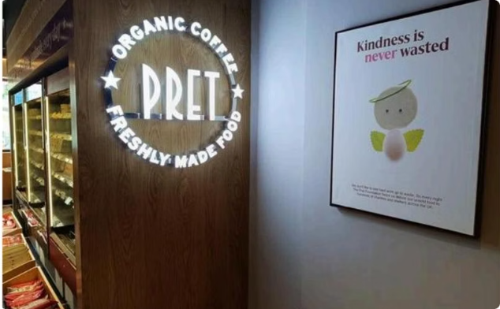
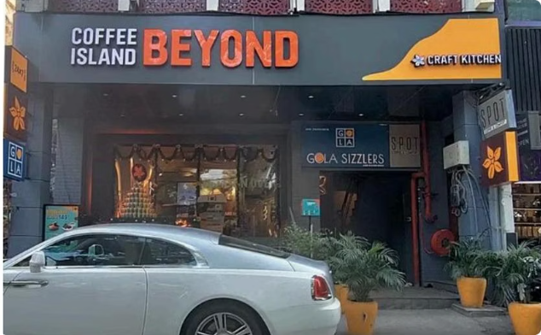

More Must-Try Coffee Spots
Pret A Manger
Coffee Island Beyond
Barista Coffee
The global giant is a lifesaver for "I need coffee and a sandwich right now" mornings. Reliable for the office crowd.
Tucked away and totally worth the drive. Specialty brews that earn it a firm spot on the best coffee shortlist.
The absolute OG. Nostalgic, accessible, and still one of the most reliable options across the NCR.

Slide 4
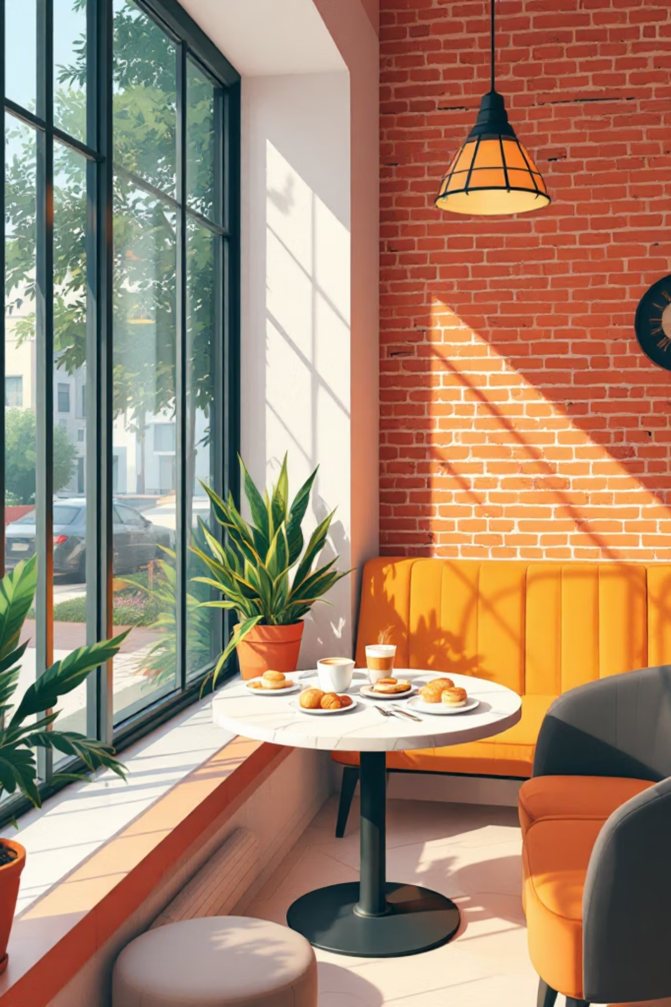
The Aesthetic Hunt: Best Cafes in Delhi 2026
The city's dining scene moves fast. Here are the spots everyone is actually talking about right now.

Slide 5
Cafes Worth the Hype
Melt House
Coco Café by Cococart
Bean & Co.
Grilled cheese, rich hot chocolate, cozy brunch vibes. Come to melt your heart.
A must for chocolate fans. Stylish atmosphere, loads of goodies — dessert comes first here.
Casual and ultra-modern. The best cafe in Delhi when you actually want to hear yourself think.
Drizzle & Dust
Coffee Brat & Co.
So Instagrammable. Freshly baked goodies, perfect lighting — a top cafe pick for 2026.
Edgy name, even better coffee. Easy to get to and makes everything "just right" without trying too hard.

Slide 6
Real Tips for the Delhi Denizen
🚗 Traffic is the Boss
📱 App Hacks
Heading out on a Saturday? Leave 40 minutes earlier than you think. Delhi traffic doesn't care about your latte plans.
Check EazyDiner first. The "PayEazy" deals often save enough to cover that extra espresso shot.
💻 Work from Cafe?
🍰 Get the Dessert
Not every spot is laptop-friendly. Check the vibe before setting up your "office."
Don't just stick to Americanos — spots like Melt House have killer bakeries. The cakes are where the real soul is.

Slide 7

FAQs
1
Best cafes in Delhi?
Melt House, Bean & Co., and Drizzle & Dust are top picks right now.
2
Best coffee place in Delhi?
House of Espresso and Bizi Bean lead the pack for quality brews.
3
Good for working?
Some cafes are laptop-friendly — it depends on the place and crowd.
4
How to avoid waiting?
Visit during off-hours or use EazyDiner to check availability and snag deals.

Slide 8


Delhi Lives for Its Food & Gossip
Put on your largest oversize shirt and bring your appetite. Skip the queues, open EazyDiner, and let the weekend plans become reality — smoggy air and congested roads included.
PRO TIP
Use EazyDiner for menus, locations, and the best bank offers — the discounts are just a bonus on top of a great cup.

