Slide 1
Acute respiratory distress syndrom

Slide 2
Lymph. vessel
Na⁺
-4
interstitium
+2
Hydraulic pressures (torr)
+7
-6
+13
kapilára
-12
-16
-28
Oncotic pressures (torr)
Starling equilibrium in pulmonary capillaries

Slide 3
– ISF volume increase
Dilution – drop of ISFoncotic pressure
Lymph. vessel
Rise of hydraulic ISF pressure
Rise oc capillary reapsorbtion
Na⁺
interstitium
3. – rise of lymhatic flow
Filtration to alveoli
2
3
1
ARDS
2. – increase of ISF volume
ISF – storage for edematous fluid
blood
capillary
5
10
20
Left atruim pressure
Defensive mechanisms against pulmonary edema

Slide 4
Acute Respiratory Distress Syndrome ARDS
Activation of alveolar macrophages
Collapse of alveoli
Surfactant production damage
VA/Q
Lymphatic vessel
hypoxia
Inflammatory activation of alveolar cells
Penetration of protein rich fluid
Na⁺
interstitium
Deposits of fibrine (hyaline membanes)
Endothelium activation
Adhesion of thrombocytes
Activation of coagulation – inhibition of fibrinolysis
Neutrophyles activation
Blood capillary
Neutrophyles migration

Slide 5
Manifestations of ARDS
Dyspnoea - decreased pO2
Decreased compliance – breathing is faster and shallower, increased respiratory effort
Dry irritating cough (sometimes pink sputum)
CO2 often reduced!! = hypocapnia - respiratory alkalosis

Slide 6
Causes of ARDS
Shock and inflammatory states
  Circulatory shock and severe hypotension
  Pulmonary embolization
  DIC
  Extensive burns
  Extensive pneumonia
  Sepsis and septic shock
  Transfusion-related acute lung injury (TRALI)
Damage from the alveolar side
  Inhalation of toxic gases and fumes
  Long-term toxicity of O2
  Aspiration of gastric contents
  Aspiration of water during drowning
Other
  Contusions and chest injuries
  Head injury
  Pancreatitis
  Heroin poisoning

Slide 7
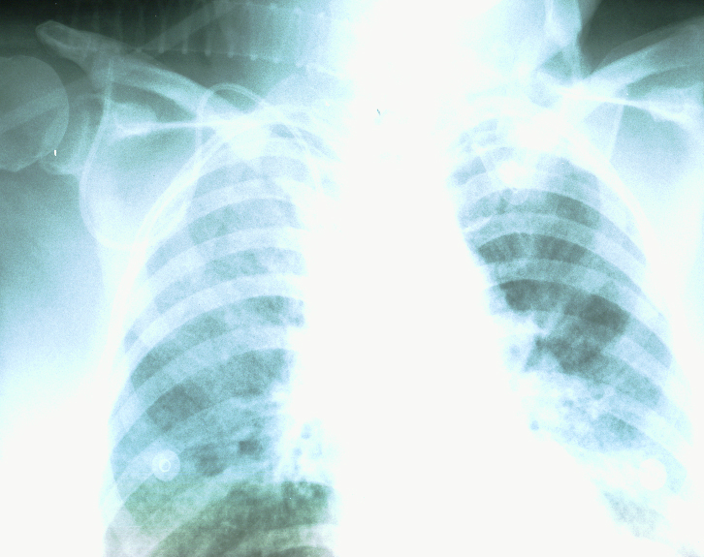
Acute Respiratory Distress Syndrome ARDS

Slide 8
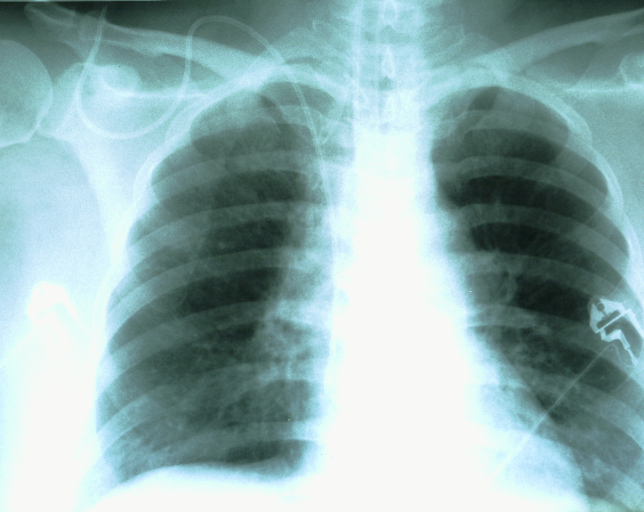
Acute Respiratory Distress Syndrome ARDS

Slide 9
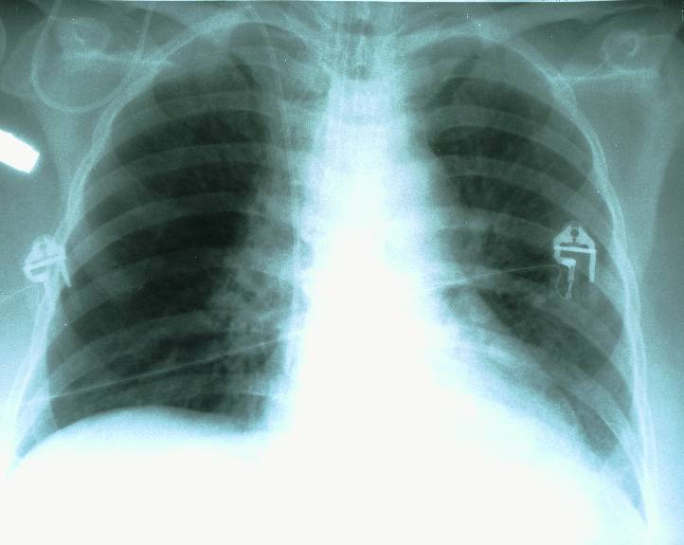
Acute Respiratory Distress Syndrome ARDS

Slide 10
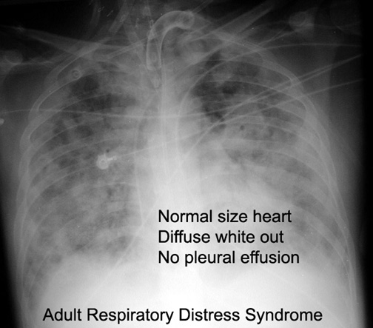

Slide 11
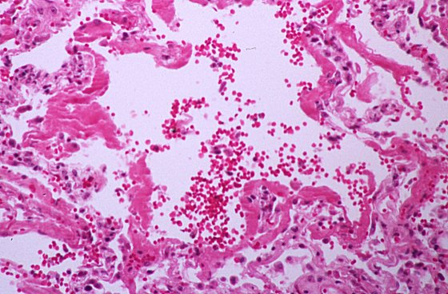
ARDS

Slide 12
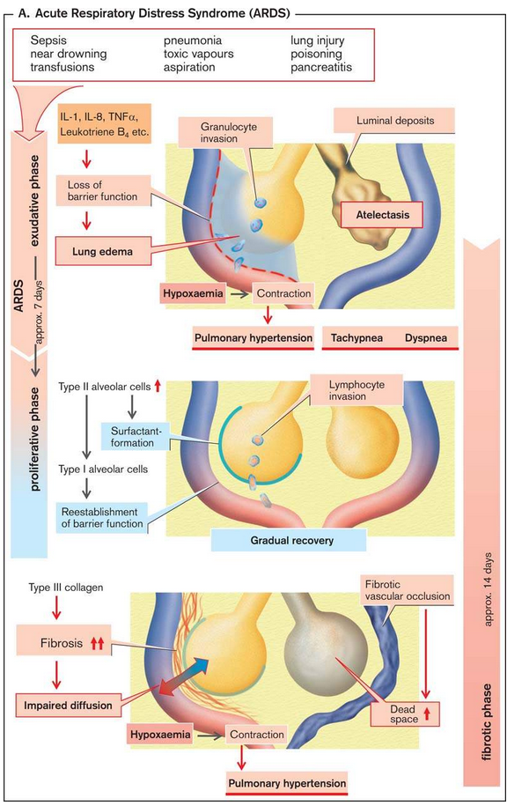

Slide 14
Acute Respiratory Distress Syndrome ARDS
Acute respiratory distress + risk factor (infection, aspiration, pankreatitis, trauma)
Hypoxemia
BIlateral pulmonary inflitration on RTG
Normal right atrial pressure (pulmonary wedge pressure< 18 torr)
ARDS
norm
5
10
20
Left atrial pressure (pulmonary wedge pressure)

Slide 15
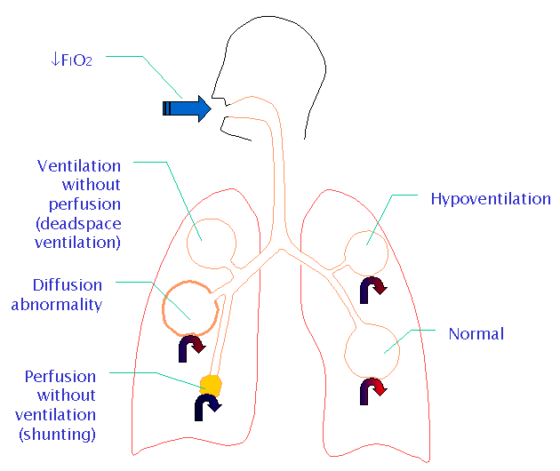
Summary

