Slide 1
Personalities
Matěj Valík

Slide 2
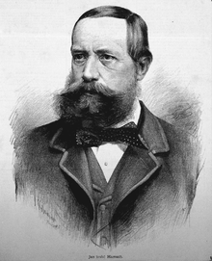
Jan Harrach
  Czech Nobleman of the Harrach family, politician, patron and businessman
  Born on November 2, 1828, in Vienna
  Resided in Hrádek u Nechanic
  Influenced by patriotic educators, notably Jan Erazim Vocel
  Married twice, fathering nine children

Slide 3
Public Activities
Supported Czech National Awakening
Cultural and political development
Helped building the National Theater in Prague
Knight of the Order of the Golden Fleece

Slide 4
Contributions to Culture and Politics
Advocated for Czech interests in the Austrian Empire
Supported Czech literature, notably funding K. J. Erben's works
Construction of the National Theater in Prague
Development of the National Museum in Prague

Slide 5
Relation to Krkonoše
Owned large lands in Jilemnice
Improvement of tourist trails
Brought skies from Norway to Krkonoše for his employes
Improved infrastructure and tourism
  Renovated Jilemnice Castle and supported local schools

Slide 6
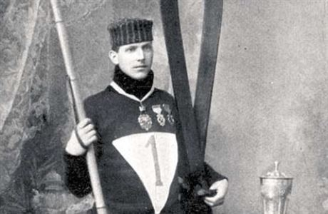
Bohumil Hanč
Czech athlete, skier, and cross-country skier
Born on November 19, 1886, in Benecko
Victory in Crown Lands Championship 1907 - 1913 in the 50 km cross-country skiing race
Patriotic
Performed in amateur theatre

Slide 7
His last race
1913 - participated in the championship race
Weather worsened during the race
He was later found freezing and exhausted
Was rescued but died later of heart failiure
His friend Václav Vrbata, who accompanied him, was found dead in the cold aswell

