Slide 1
Alveolar Ventilation Controls Rate of Breathing by Influencing pCO2 and pO2
VA
pO₂
VE=VD+VA
Respir. Centre
pCO₂
VA
Only when pO₂ is low
pCO₂
pO₂
pCO₂
pO₂

Slide 2
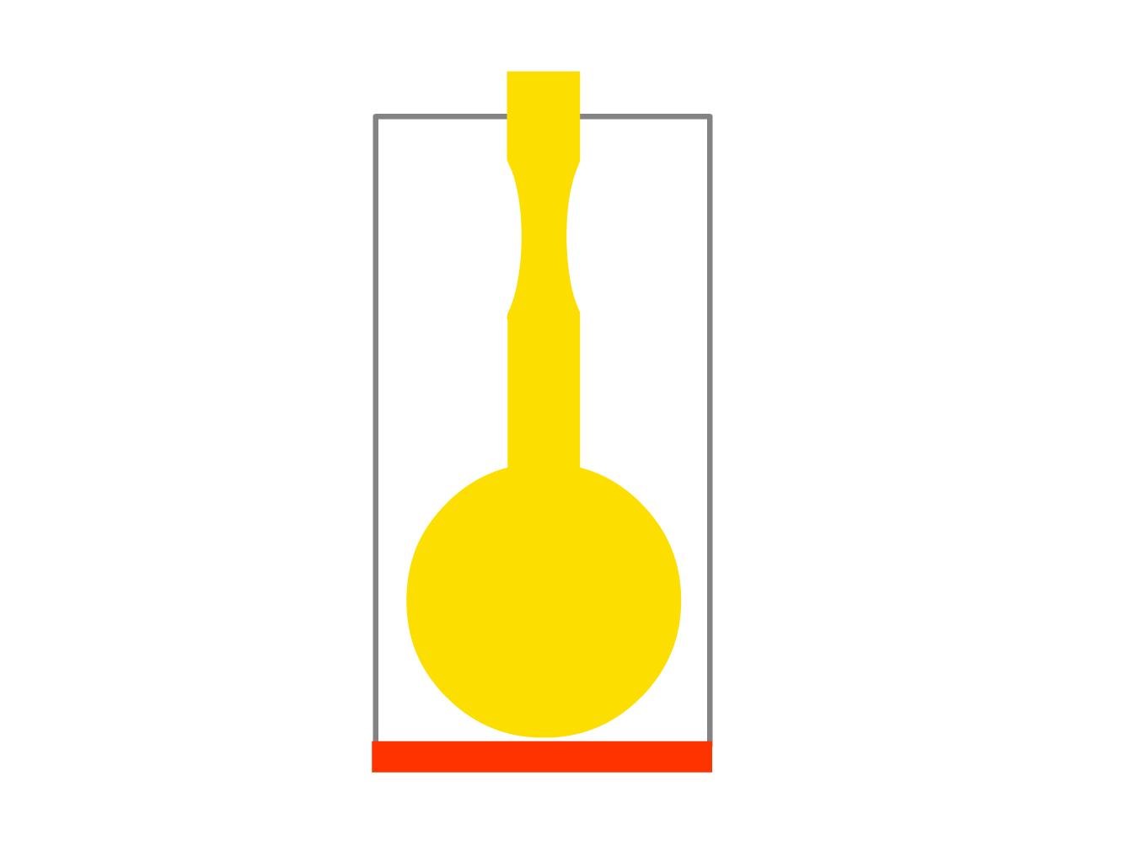
It is expiration that is difficult with intrathoratic obstruction

Slide 3
Air Captioning – premature closure of bronchioli
The air trapped in alveoli during expiration exerts pressure on the alveolar membrane
The trapped air
Air captioning
Tendency to alveolar membrane destruction and evolution of emphysema bullae, thus enlarging the dead space
Norm
End of inspiration
norm
emphysema
End of expiration
VD
VA
The alveolus doesn’t manage
to empty itself, thus, alveolar ventilation decreases
VA
VD

Slide 4
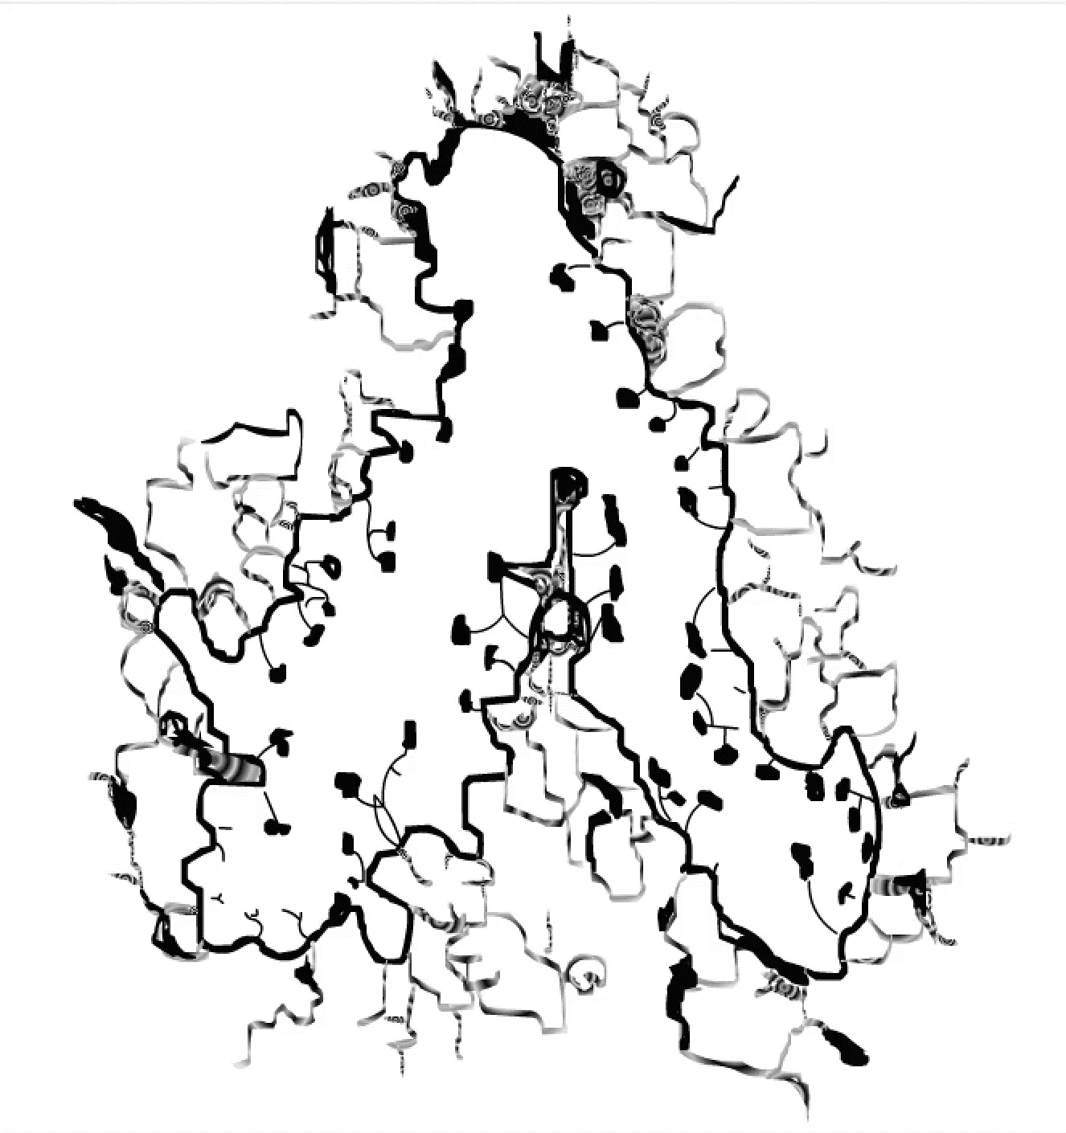

Slide 5
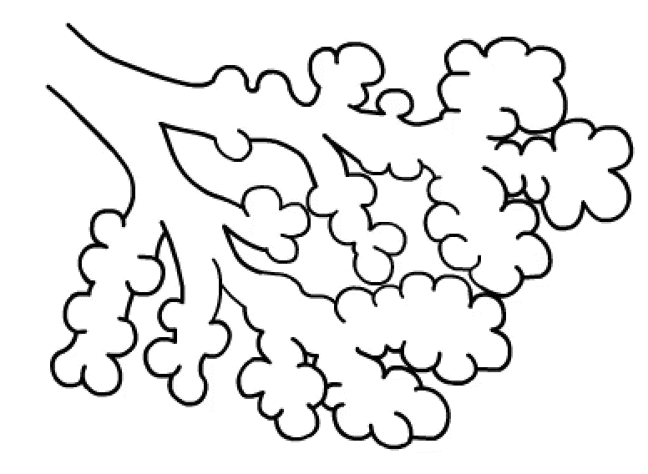
Non-emphysematous lung
VE = VD + VA

Slide 6
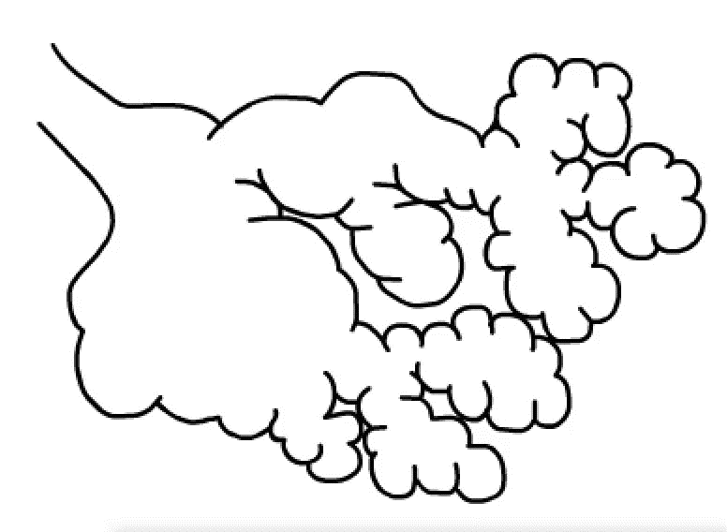
Centrilobular emphysema
VE = VD + VA
VE = VD + VA

Slide 7
Alveolar Ventilation Controls Rate of Breathing by Influencing pCO2 and pO2
VA
pO₂
VE=VD+VA
Respir. Centre
pCO₂
VA
Only when pO₂ is low
pCO₂
pO₂
pCO₂
pO₂

Slide 8
Emphysematous form of the chronic obstructive lung disease
VE = VD + VA
VE = VD + VA
VE = VD + VA
emphysema
compensation
Normalization of VA
Emphysema
Respiratory centre
Norm
pCO₂
normal pCO₂
pO₂
normal pO₂
„pink puffers“
VA
VD
Normal P_{a}O₂ – no hypoxia (until total resp. failure)
Greater VE to bring to normal VA
Greater volume must be ventilated per minute
Increased respiratory work
Feeling of dyspnoea

Slide 9
Obstructive form of the chronic obstructive lung disease
VE = VD + VA
obstruction
VE = VD + VA
compensation
VE = VD + VA
Compensatory increase VA
obstruction
Respir. centre
pCO₂
normal pCO₂
pO₂
pO₂ stays
VA
Alveolar
Hypoventilation
„blue bloaters“
Normal P_{a}CO₂, lower PaO₂ – hypoxia
Increased VE in order to increase the VA

Slide 10
Obstructive form of the chronic obstructive lung disease
VE = VD + VA
obstruction
VE = VD + VA
compensation
VE = VD + VA
Compensatory increase of VA
obstruction
Respir. centre
pCO₂
normal pCO₂
pO₂
pO₂ stays
VA
alveolar
hypoventilation
„blue bloaters“
Normal P_{a}CO₂, decreased PaO₂ – hypoxia
Why pCO₂ “manages” to normalize and pO₂ not?
Increased VE in order to increase VA

Slide 11
Obstructive form of the chronic obstructive lung disease
VE = VD + VA
obstruction
VE = VD + VA
VA = (VA1 + VA2)
VE = VD + (VA1+VA2)
obstruction
VE = VD + ( VA1 + VA2)
VA
VA
pO₂
pCO₂
pCO₂
pO₂
VA
VA
pCO₂
pCO₂
pO₂
pO₂
Hypoventilated alveolus
Hyperventilated alveolus

Slide 12
Obstructive form of the chronic obstructive lung disease
VE = VD + ( VA1 + VA2)
VA
VA
pO₂
pCO₂
pCO₂
pO₂
pO₂
pCO₂
Total O₂
Total CO₂
VA
VA
pCO₂
pCO₂
Norma
Norma
pO₂
pCO₂
pO₂
pO₂
VA
VA
VA
VA
Hypoventilated alveolus
Hyperventilated alveolus
pO₂
pCO₂

Slide 13
Obstructive form of the chronic obstructive lung disease
VE = VD + ( VA1 + VA2)
compensation
VE = VD + VA1 + VA2
VA
VA
pO₂
Compensatory increase of VA1, VA2
pO₂
pCO₂
pCO₂
Respir. centre
VA
VA
pO₂
pCO₂
pO₂
pCO₂
norm.
Total O₂
Total CO₂
VA
VA
pCO₂
pCO₂
Norma
Norma
pO₂
pCO₂
pO₂
pO₂
VA
VA
VA
VA
Hypoventilated alveolus
Hyperventilated alveolus
pO₂
pCO₂
norm.

Slide 14
Obstructive form of the chronic obstructive lung disease
VE = VD + ( VA1 + VA2)
compensation
VE = VD + VA1 + VA2
VA
VA
pO₂
Compensatory increase of VA1, VA2
pO₂
pCO₂
pCO₂
Respir. centre
VA
VA
pO₂
pCO₂
pO₂
pCO₂
norm.
„blue bloaters“
VA
VA
pCO₂
pCO₂
pO₂
pO₂
Hypoventilated alveolus
Hyperventilated alveolus

Slide 15
Obstructive form of the chronic obstructive lung disease
VE = VD + ( VA1 + VA2)
compensation
VE = VD + VA1 + VA2
VA
VA
pO₂
Compensatory increase of VA1, VA2
pO₂
pCO₂
pCO₂
Respir. centre
VA
VA
pO₂
pCO₂
pO₂
pCO₂
norm.
Decrease inflow of hypoxic blood
„blue bloaters“
VA
VA
Edema
Arteriolar vasoconstriction in hypoventilated alveoli
pCO₂
pCO₂
Right heart insufficiencyy
pO₂
pO₂
Hypoventilated alveolus
Hyperventilated alveolus
Precapillary pulmonary hypertension
Cor pulmonale

Slide 16
Partial respiratory insufficiency
VE = VD + ( VA1 + VA2)
compensation
VE = VD + VA1 + VA2
VA
VA
Compensatory increase of VA1, VA2
pO₂
pO₂
pCO₂
pCO₂
Respir. centre
VA
VA
pO₂
pCO₂
pO₂
pCO₂
norm.
Partial respiratory insufficiency
VA
VA
Hyperventilated alveoli are able to maintain normal pCO₂ level, but they are not keep up normal level of pO₂, therefore pO₂ drop.
Patient suffer from normocapnia a hypoxia.
pCO₂
pCO₂
pO₂
pO₂
Hypoventilated alveolus
Hyperventilated alveolus

Slide 17
Global respiratory insufficiency
VE = VD + ( VA1 + VA2)
compensation
VE = VD + VA1 + VA2
VA
VA
pO₂
Compensatory increase of VA1, VA2
pO₂
pCO₂
pCO₂
Respir. centre
VA
VA
pO₂
pCO₂
pO₂
pCO₂
Global respiratory infufficiency
VA
VA
Hyperventilated alveoli are unable to maintain normal pCO₂ level, pCO2 level rises. Pacient suffer from both hypercapnia a hypoxia.
pCO₂
pCO₂
pO₂
pO₂
Hypoventilated alveolus
Hyperventilated alveolus

