Slide 1

The Postcard Hideaway Netravali
A unique luxury resort experience in South Goa, nestled among the Western Ghats

Slide 2
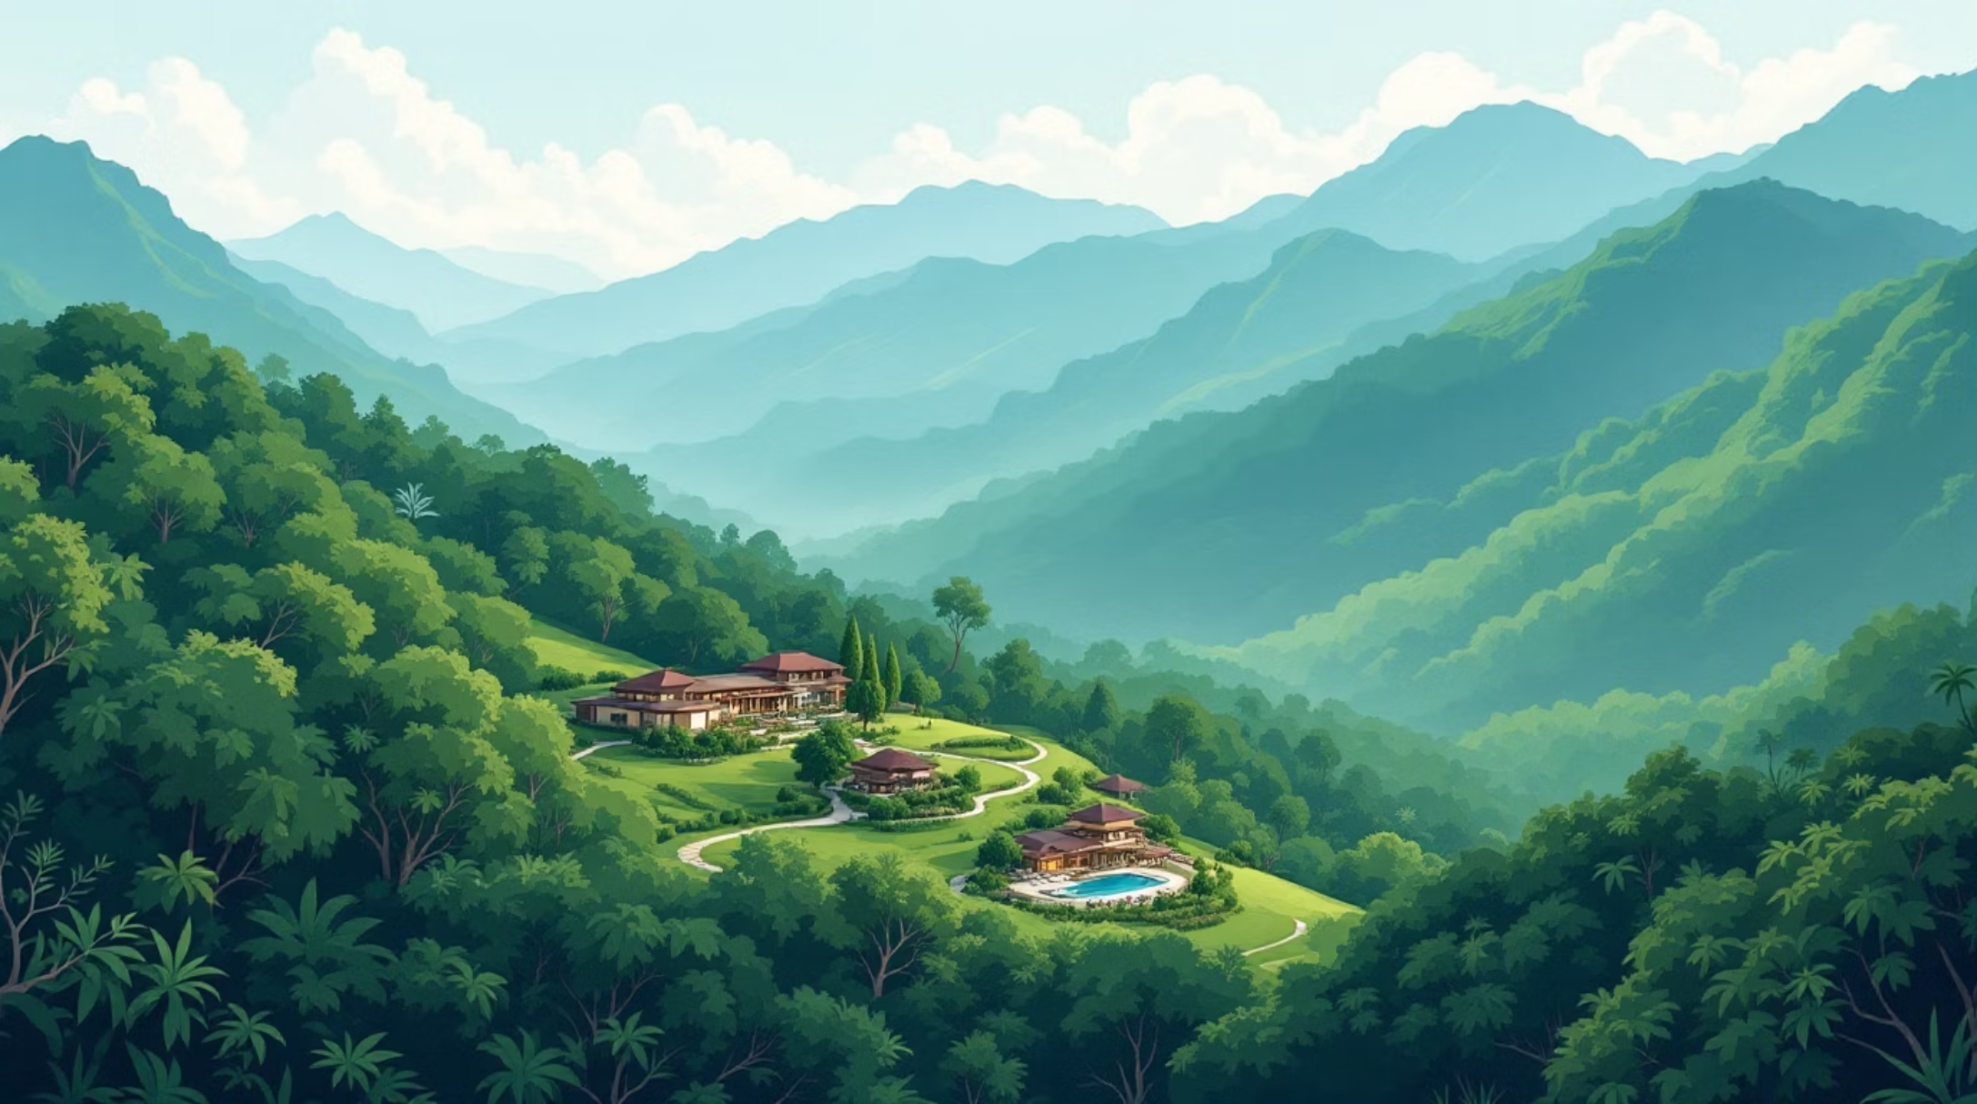
A Different Kind of Goa
While most South Goa resorts focus on beaches and ocean views, The Postcard Hideaway Netravali offers something entirely different. Set on twenty acres of verdant surroundings, this exclusive retreat provides endless vistas of the Western Ghats highlands.
Twenty discrete, ultra-modern rooms blend seamlessly with nature, creating an atmosphere of tranquility impossible to find at traditional beachfront properties.

Slide 3
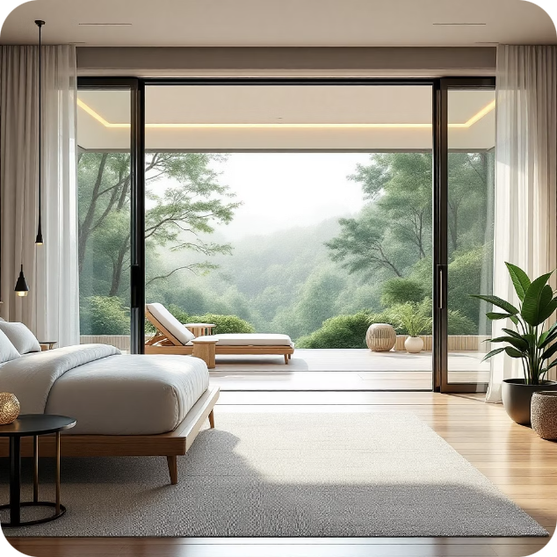
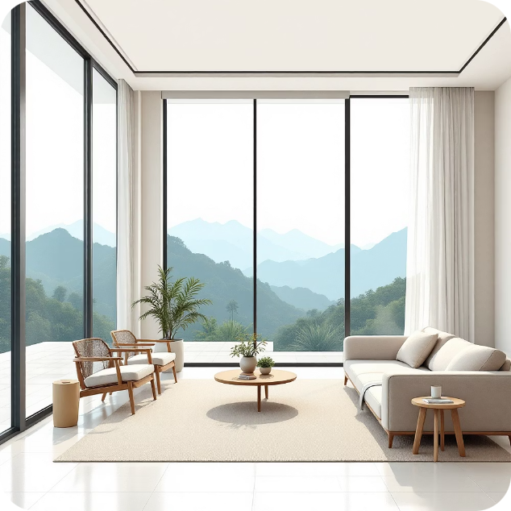
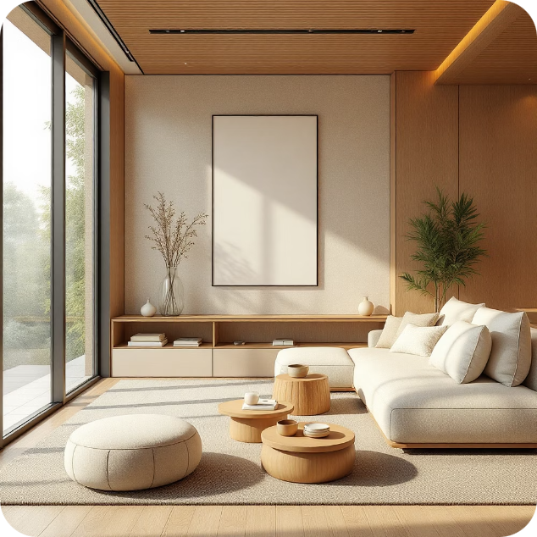
Twenty Suites of Seclusion
Private Patios
Premier Rooms
Modern Design
Each suite features a private patio for complete immersion in nature
Rooms tucked behind tall trees offer breathtaking views of the highlands
Ultra-modern accommodations that blend with the surrounding environment

Slide 4

Wildlife Encounters
Black Panthers
Great Pied Hornbills
Spot elusive black panthers in their natural habitat
Marvel at magnificent hornbills soaring through the forest
Giant Squirrels
Observe enormous squirrels in their native environment

Slide 5

Experiences That Connect
01
02
Nature Trails
Dolphin Safari
Guided walks through the Western Ghats to discover sublime flora and fauna
Boat ride at Palolem beach to see dolphins in morning waters
03
Water Odyssey
Jungle trek through Netravali Wildlife Sanctuary to natural streams and waterfalls

Slide 6

Wellness in Nature
Arrive at an environment free of urban worries, surrounded by the sounds of birds, water, and foliage. This natural symphony instantly relieves the strains of daily existence.
Yoga Pavilion
Practice yoga with the Western Ghats as your backdrop, establishing connection with both nature and yourself

Slide 7

Goan Cuisine, Farm to Table
Organic Garden
Konkan Thali
Ingredients sourced from the resort's own organic garden for the freshest flavors
Traditional Goan dishes showcasing regional culinary traditions
Panjim Ros Omelette
Unique local specialties prepared with authentic ingredients

Slide 8




Culinary Adventures
Rural Markets
Visit local markets and interact with residents
Cooking Classes
Learn from skilled chefs to prepare Goan specialties
Authentic Dishes
Cook vegetable Xacuti, prawn curry, and vindaloo

Slide 9

Spice Farm Experience
Tanshikar Spice Farm
Stroll through 25 acres of organic spices farmed in the Western Ghats' tropical jungle. Learn about sustainable farming practices and discover the spices that give Goan cuisine its unique flavors.
This educational journey emphasizes the value of sustainable agriculture while connecting guests to local food traditions.

Slide 10

True Luxury Redefined
"True luxury is found in meaningful connections with the environment, culture, and oneself rather than just lavish amenities."
The Postcard Hideaway Netravali offers a unique blend of ultra-modern conveniences and deep connection to local environment and culture. This hidden treasure invites guests to discover a side of Goa that many never see—a place where luxury means authentic experiences, not just opulent accommodations.

