Slide 1


E-Golem and Bodylight project
Web Simulators – new kind of digital textbooks
Jiří Kofránek, Tomáš Kulhánek
1st Faculty of Medicine, Charles University
&
Creative Connections s.r.o.
Notes:
In this presentation, we would like to introduce you to the e-Golem project, which is dedicated to the creation of a new kind of digital textbook with a simulation model in the background, executable in an internet browser on any device, computer, tablet, or smartphone on any operating system.

Slide 2
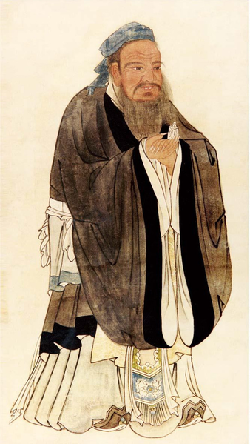
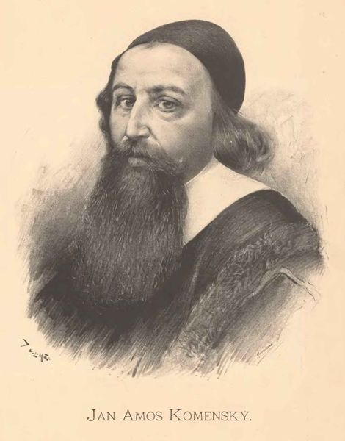
„I hear and I forget. I see, and I remember. I do, and I understand.“ (Confucius)
5th century BC
17th century
Schola ludus (school by play)
John Amos Comenius
Notes:
In the fifth century BC, the wise Confucius noted: "I hear, and I forget. I see, and I remember. I do, and I understand.„
After more than two thousand years, in the seventeenth century, the founder of European pedagogy, John Amos Comenius, supported the principles of active teaching in his books.

Slide 3
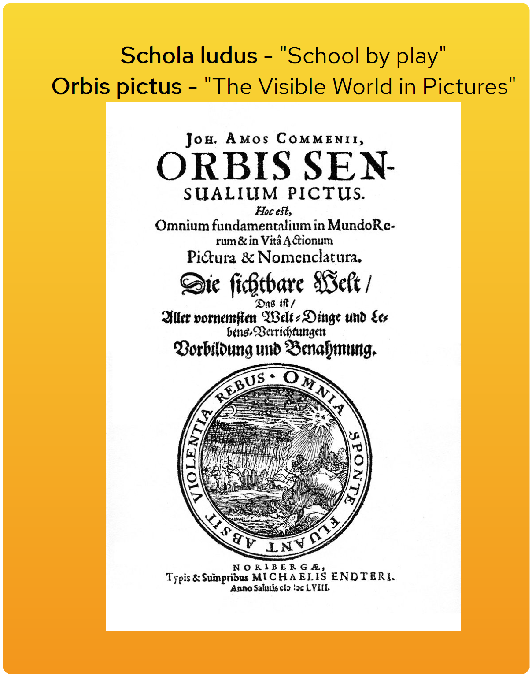
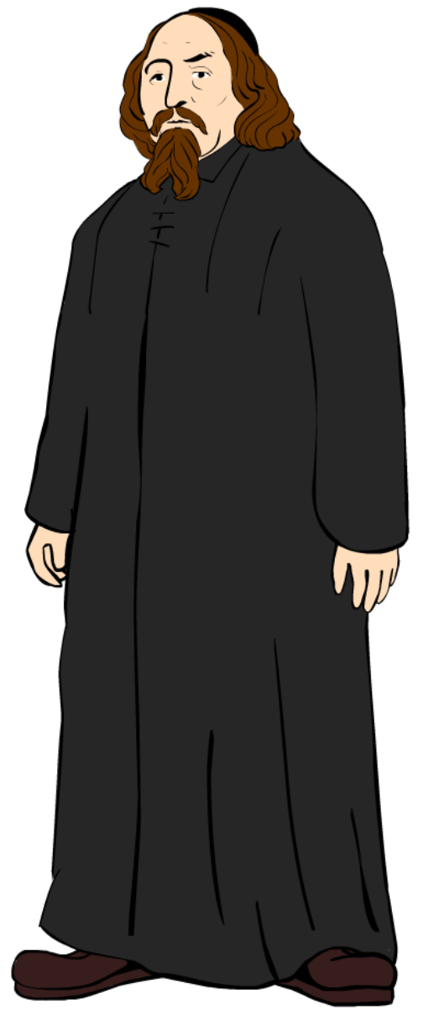
17th century
John Amos Comenius - founder of European pedagogy
Notes:
In books, as well as in his teaching practice, Comenius strove for active, playful teaching.

Slide 4
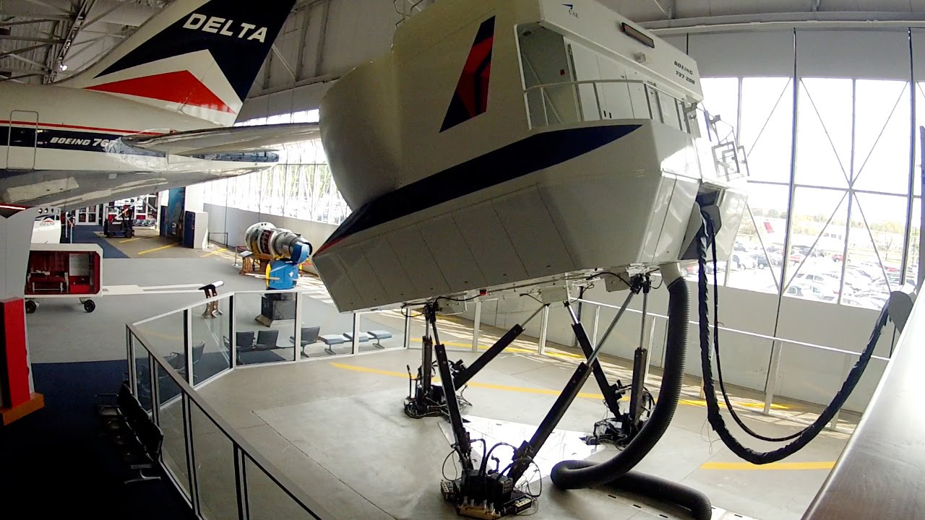
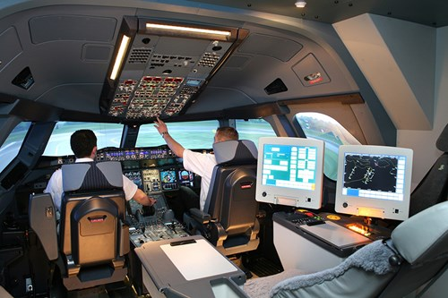
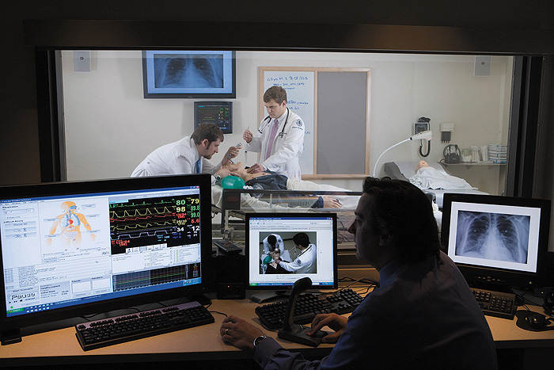
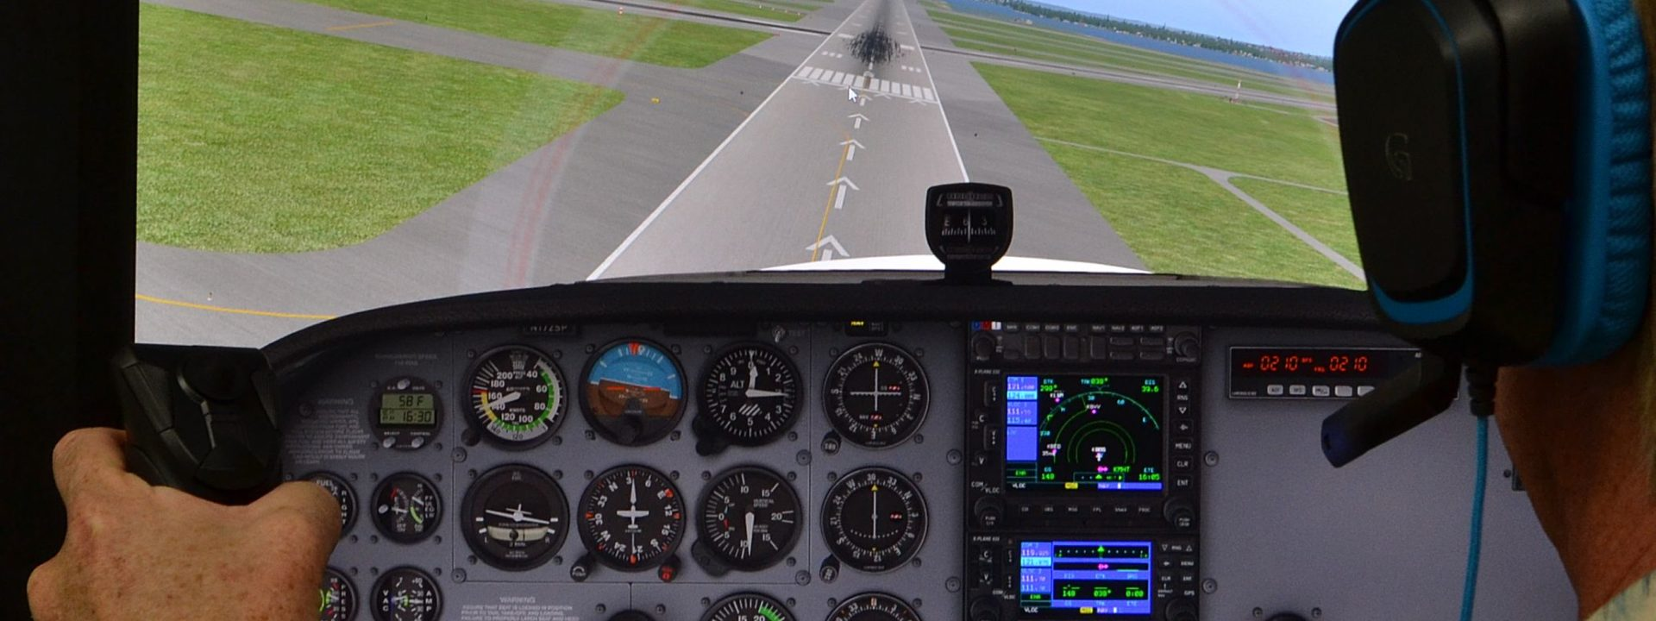
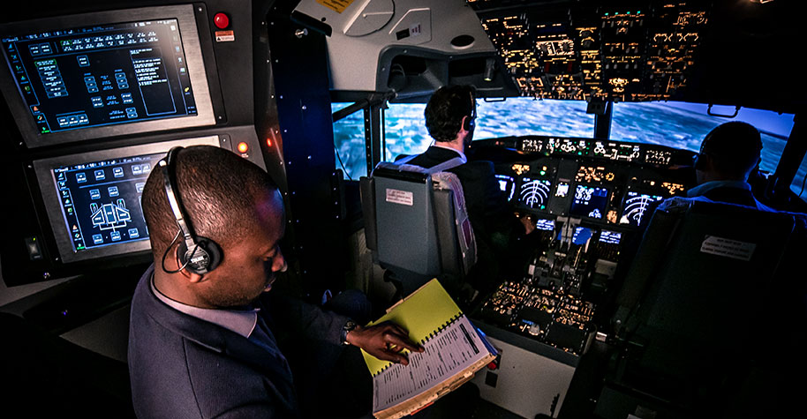
21st century
Learning by doing
Notes:
Confucian experiences from ancient China and Comenius' efforts to playfully teaching confirms modern active teaching methods, widely using simulation games and simulators. Simulators are a very effective teaching tool in many fields, for example, in training pilots. They make it possible to practice work procedures in virtual reality and acquire practical habits that have taken much more time in actual reality.

Slide 5

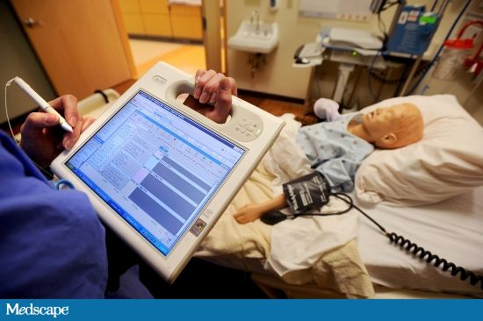
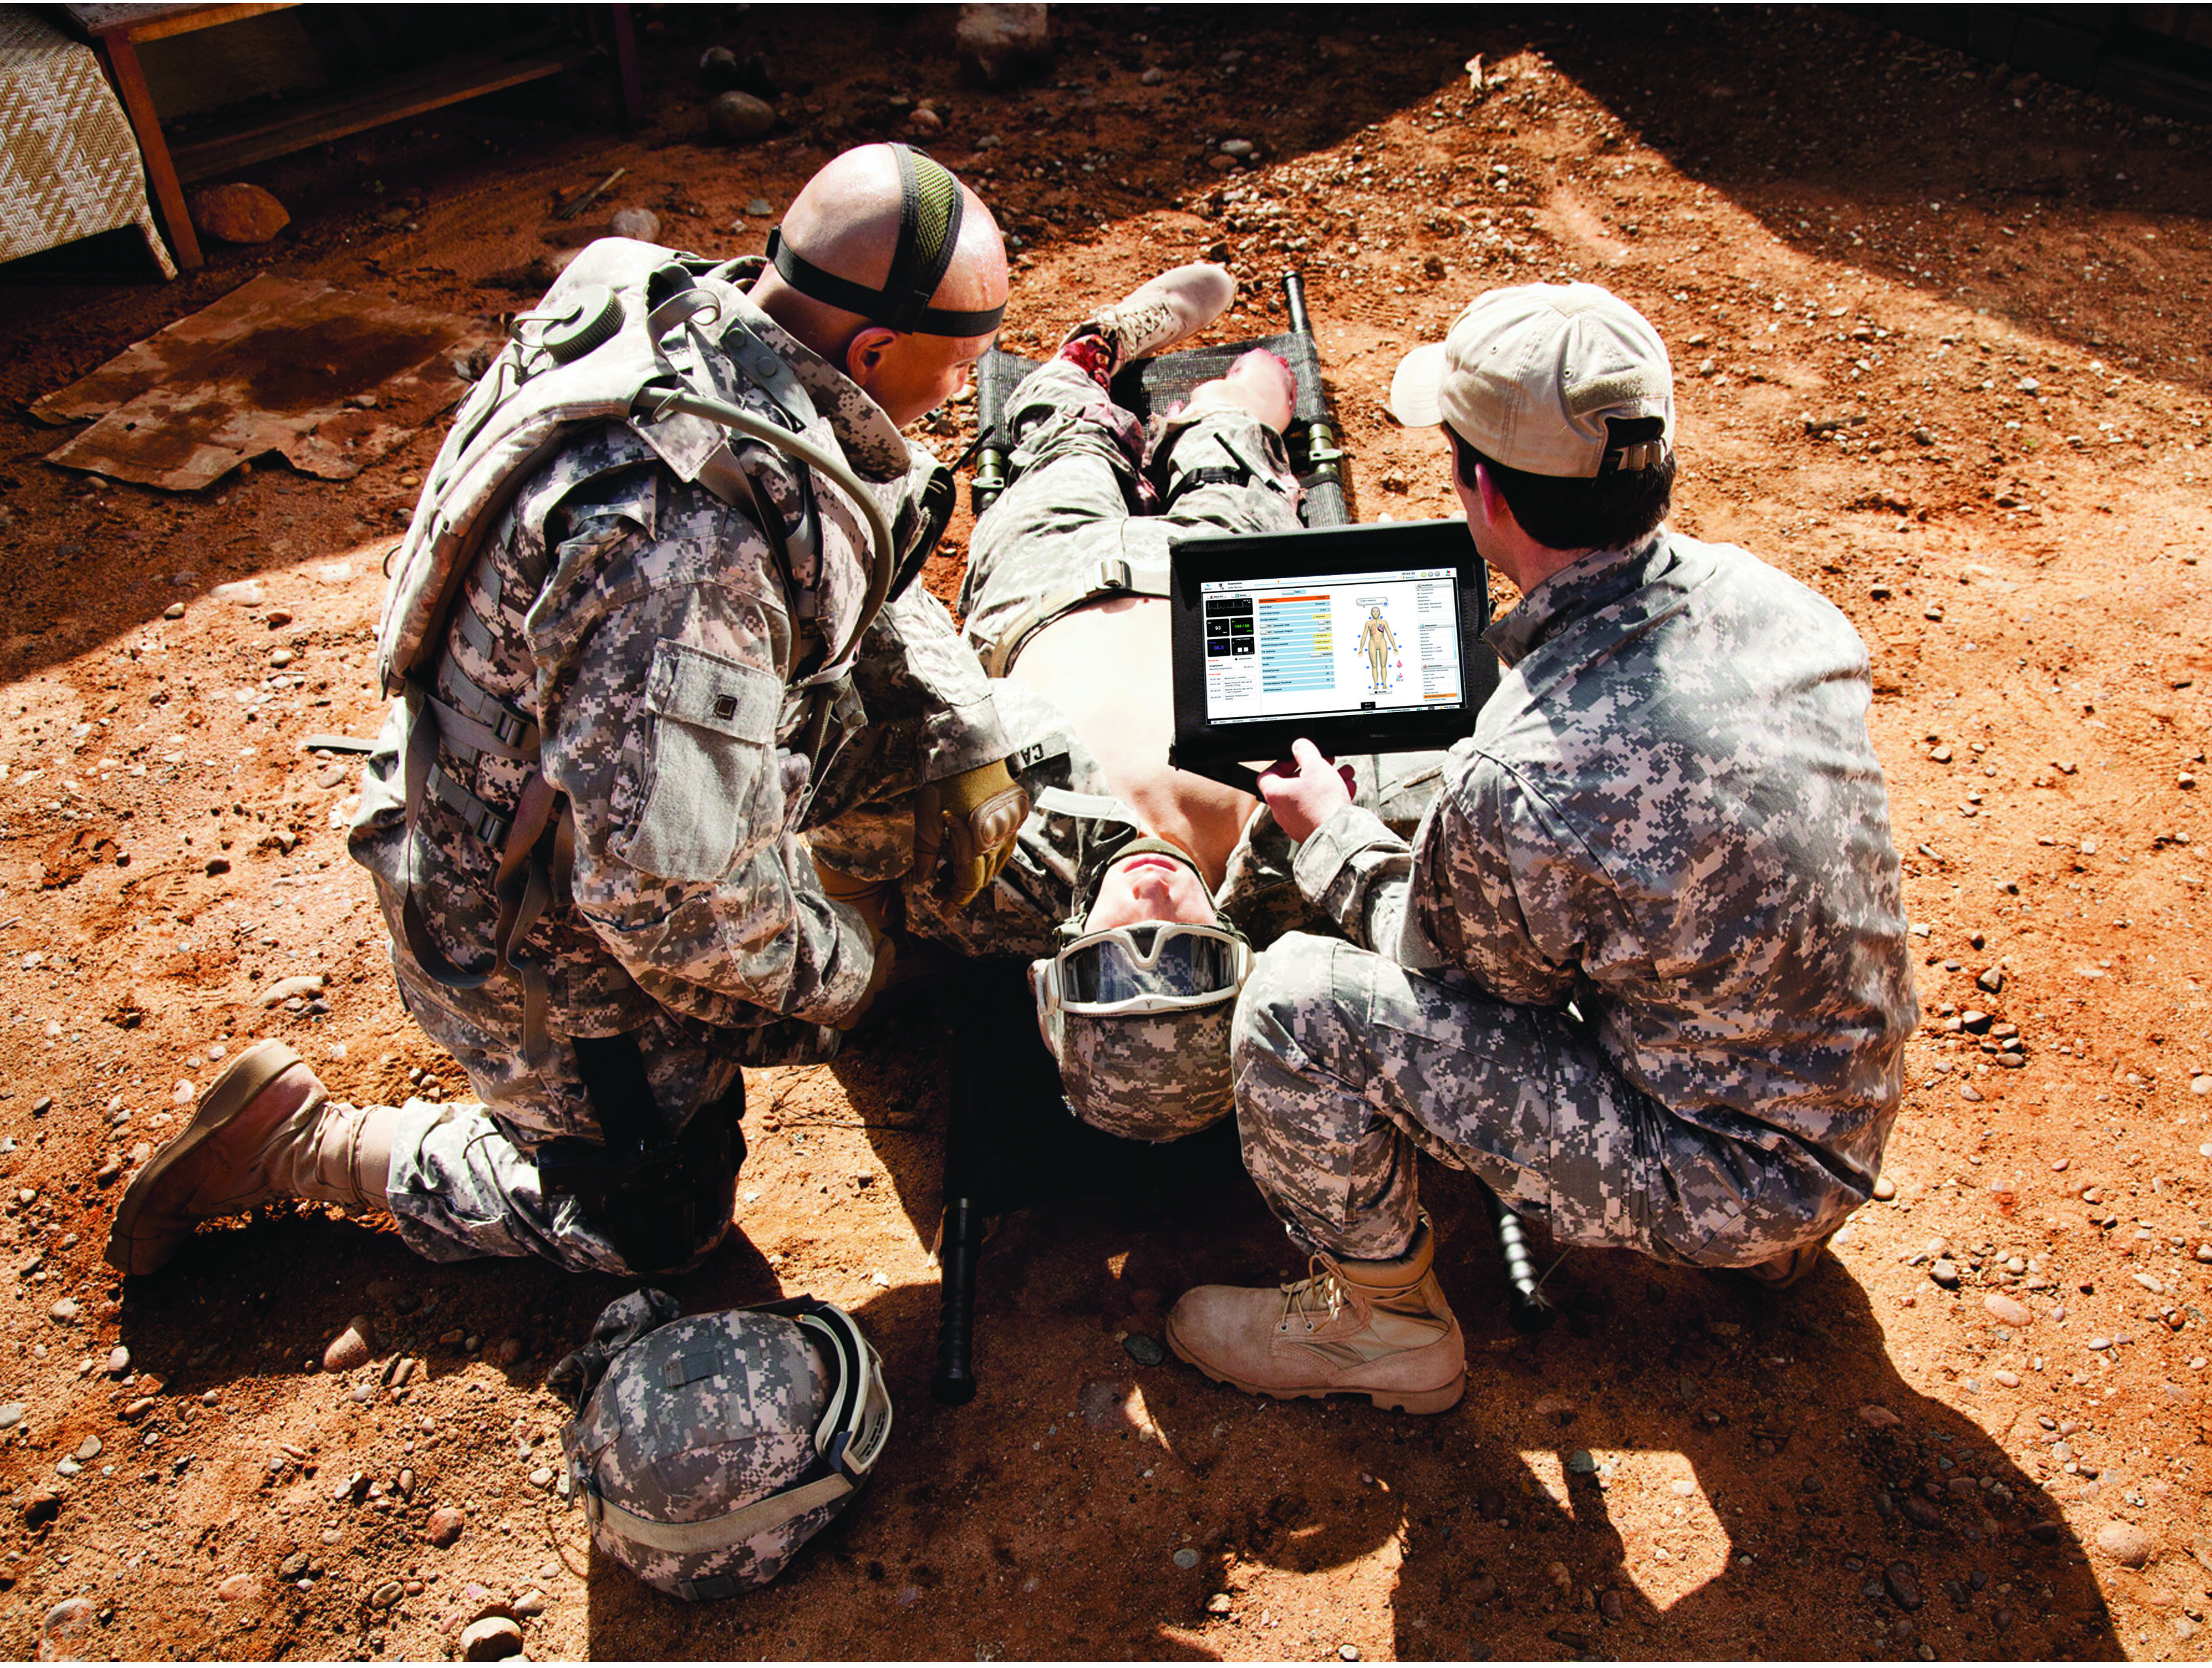
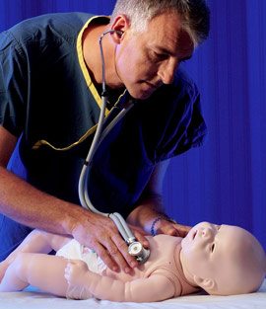
21st century
Learning by doing
Notes:
Like flight simulators, medical simulators allow an entirely new way of teaching, where a student can practice diagnostic and therapeutic tasks in virtual reality without danger to the patient.
Simulators automatically respond to the administration of drugs and various infusions and respond to the settings of connected medical devices - such as anesthesia equipment, artificial ventilation, artificial kidney, etc.

Slide 6



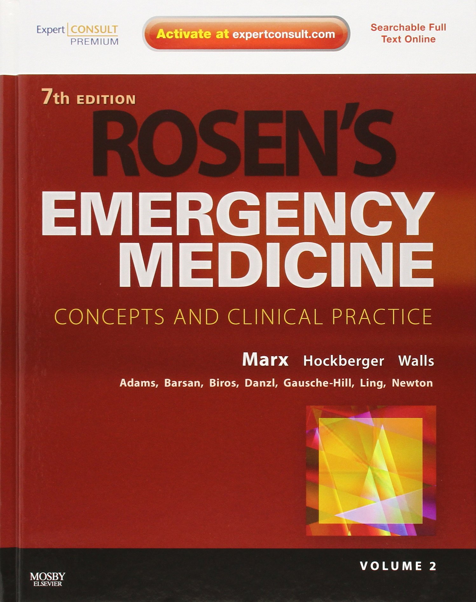

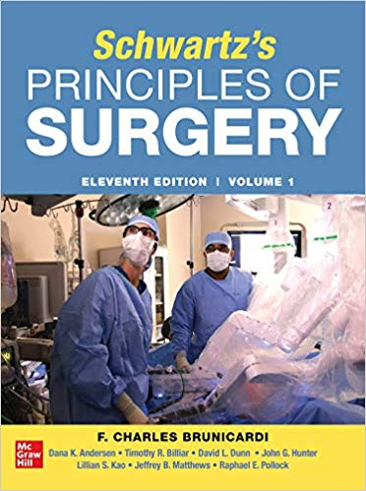
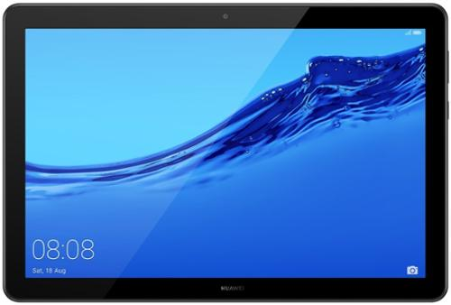
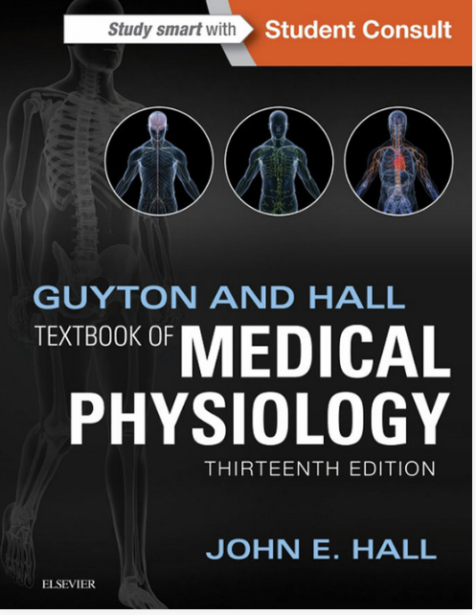

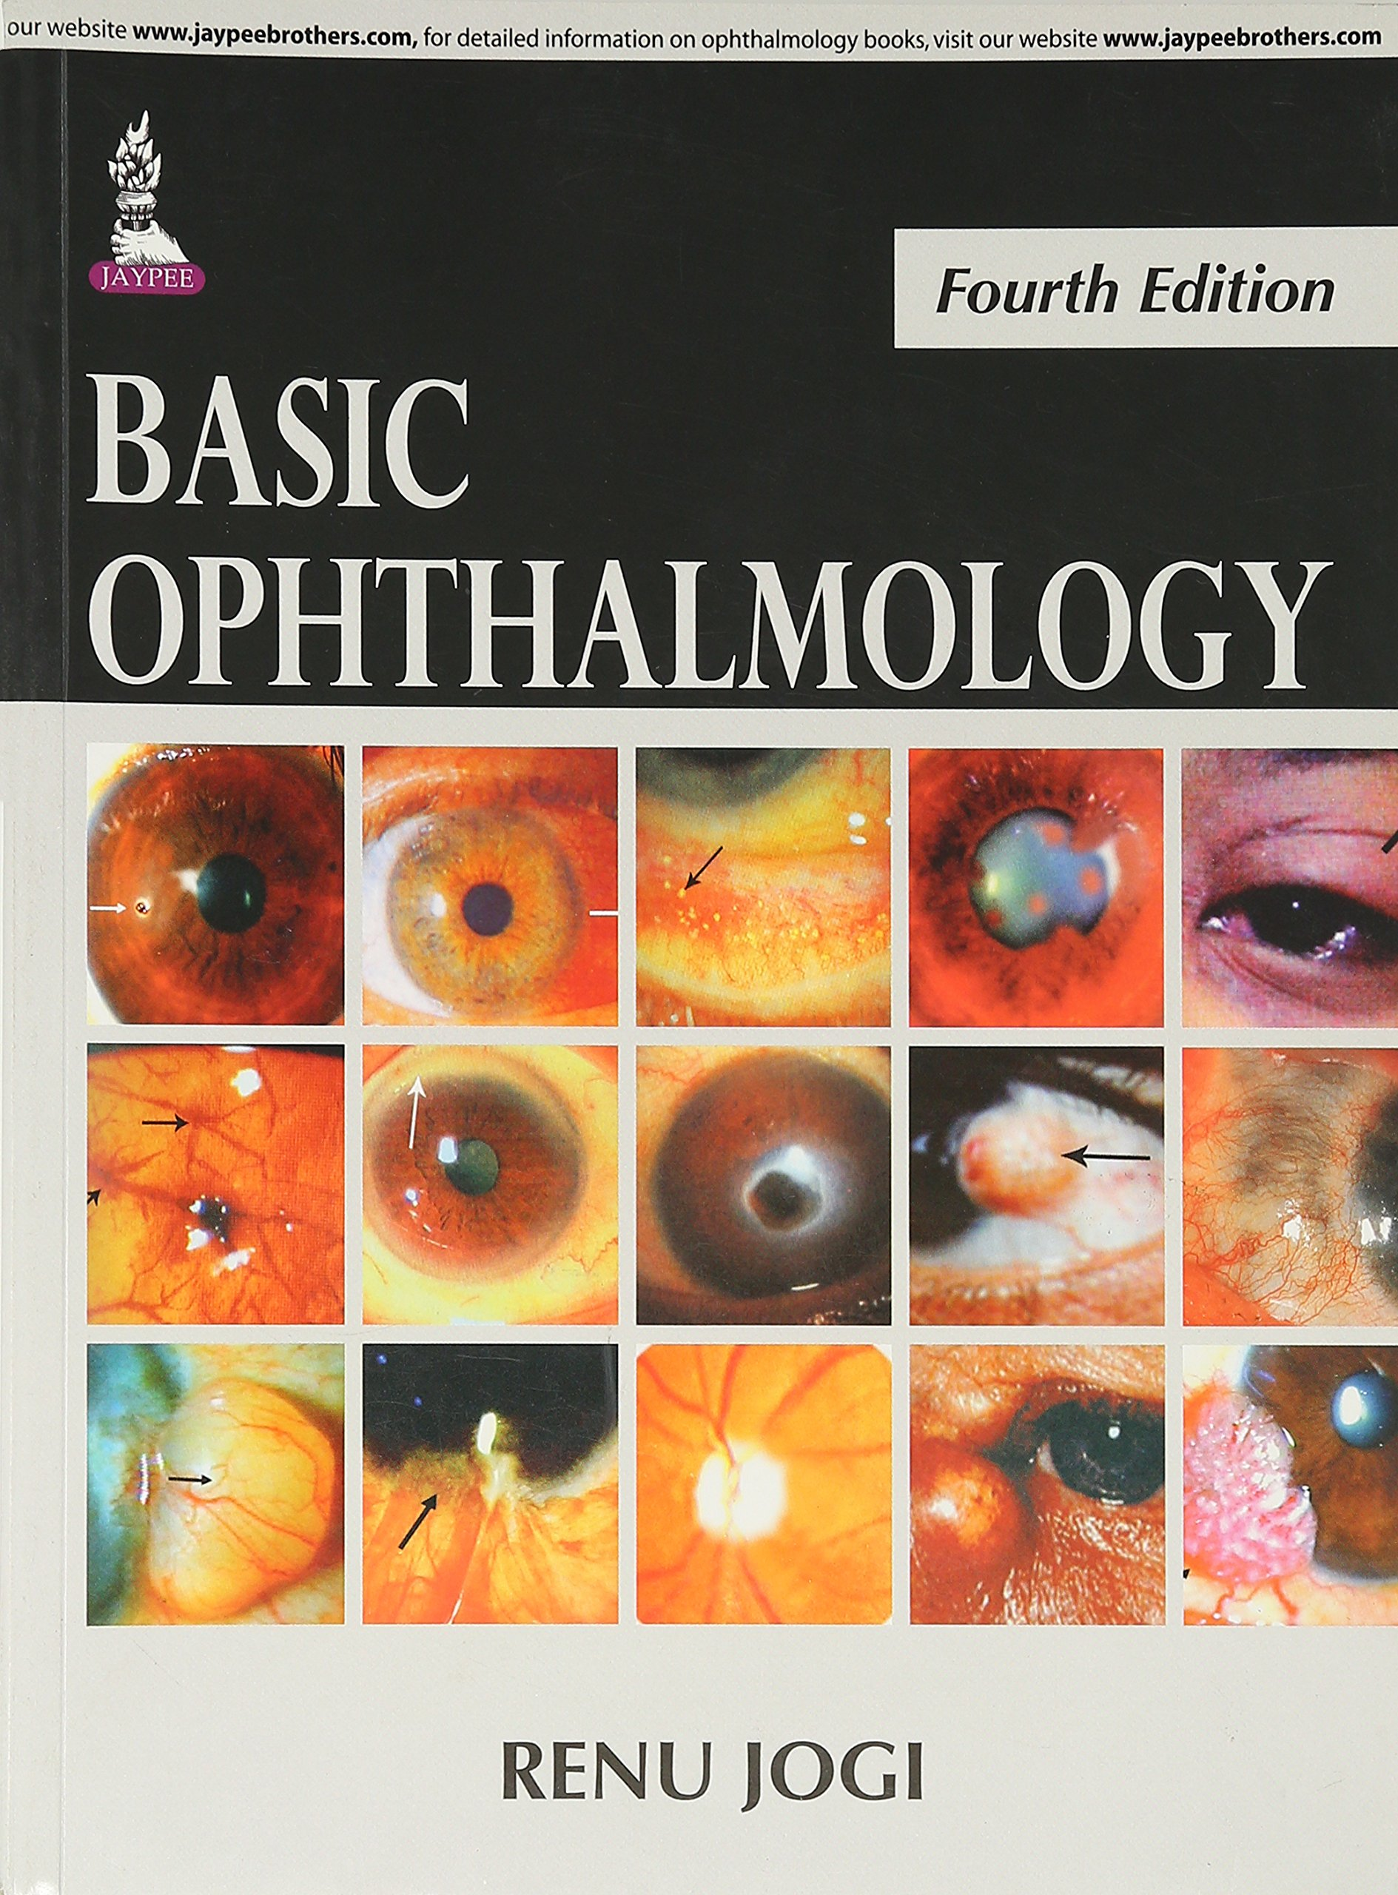
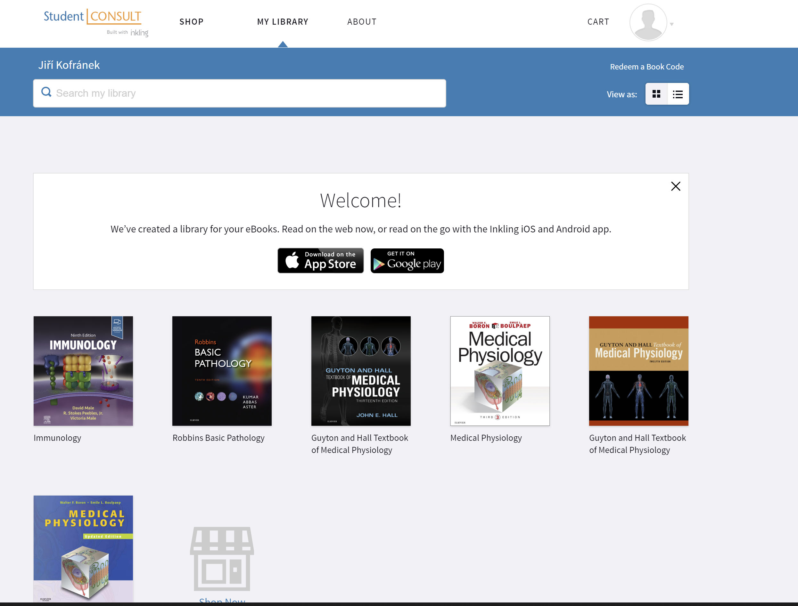
Digital version of the book + accompanying material
21st century
Notes:
Despite the development of electronic readers, classical textbooks have not lost their meaning. Many modern textbooks have accompanying electronic material, including an electronic version of printed book, animated images, multimedia, and other resources.

Slide 7

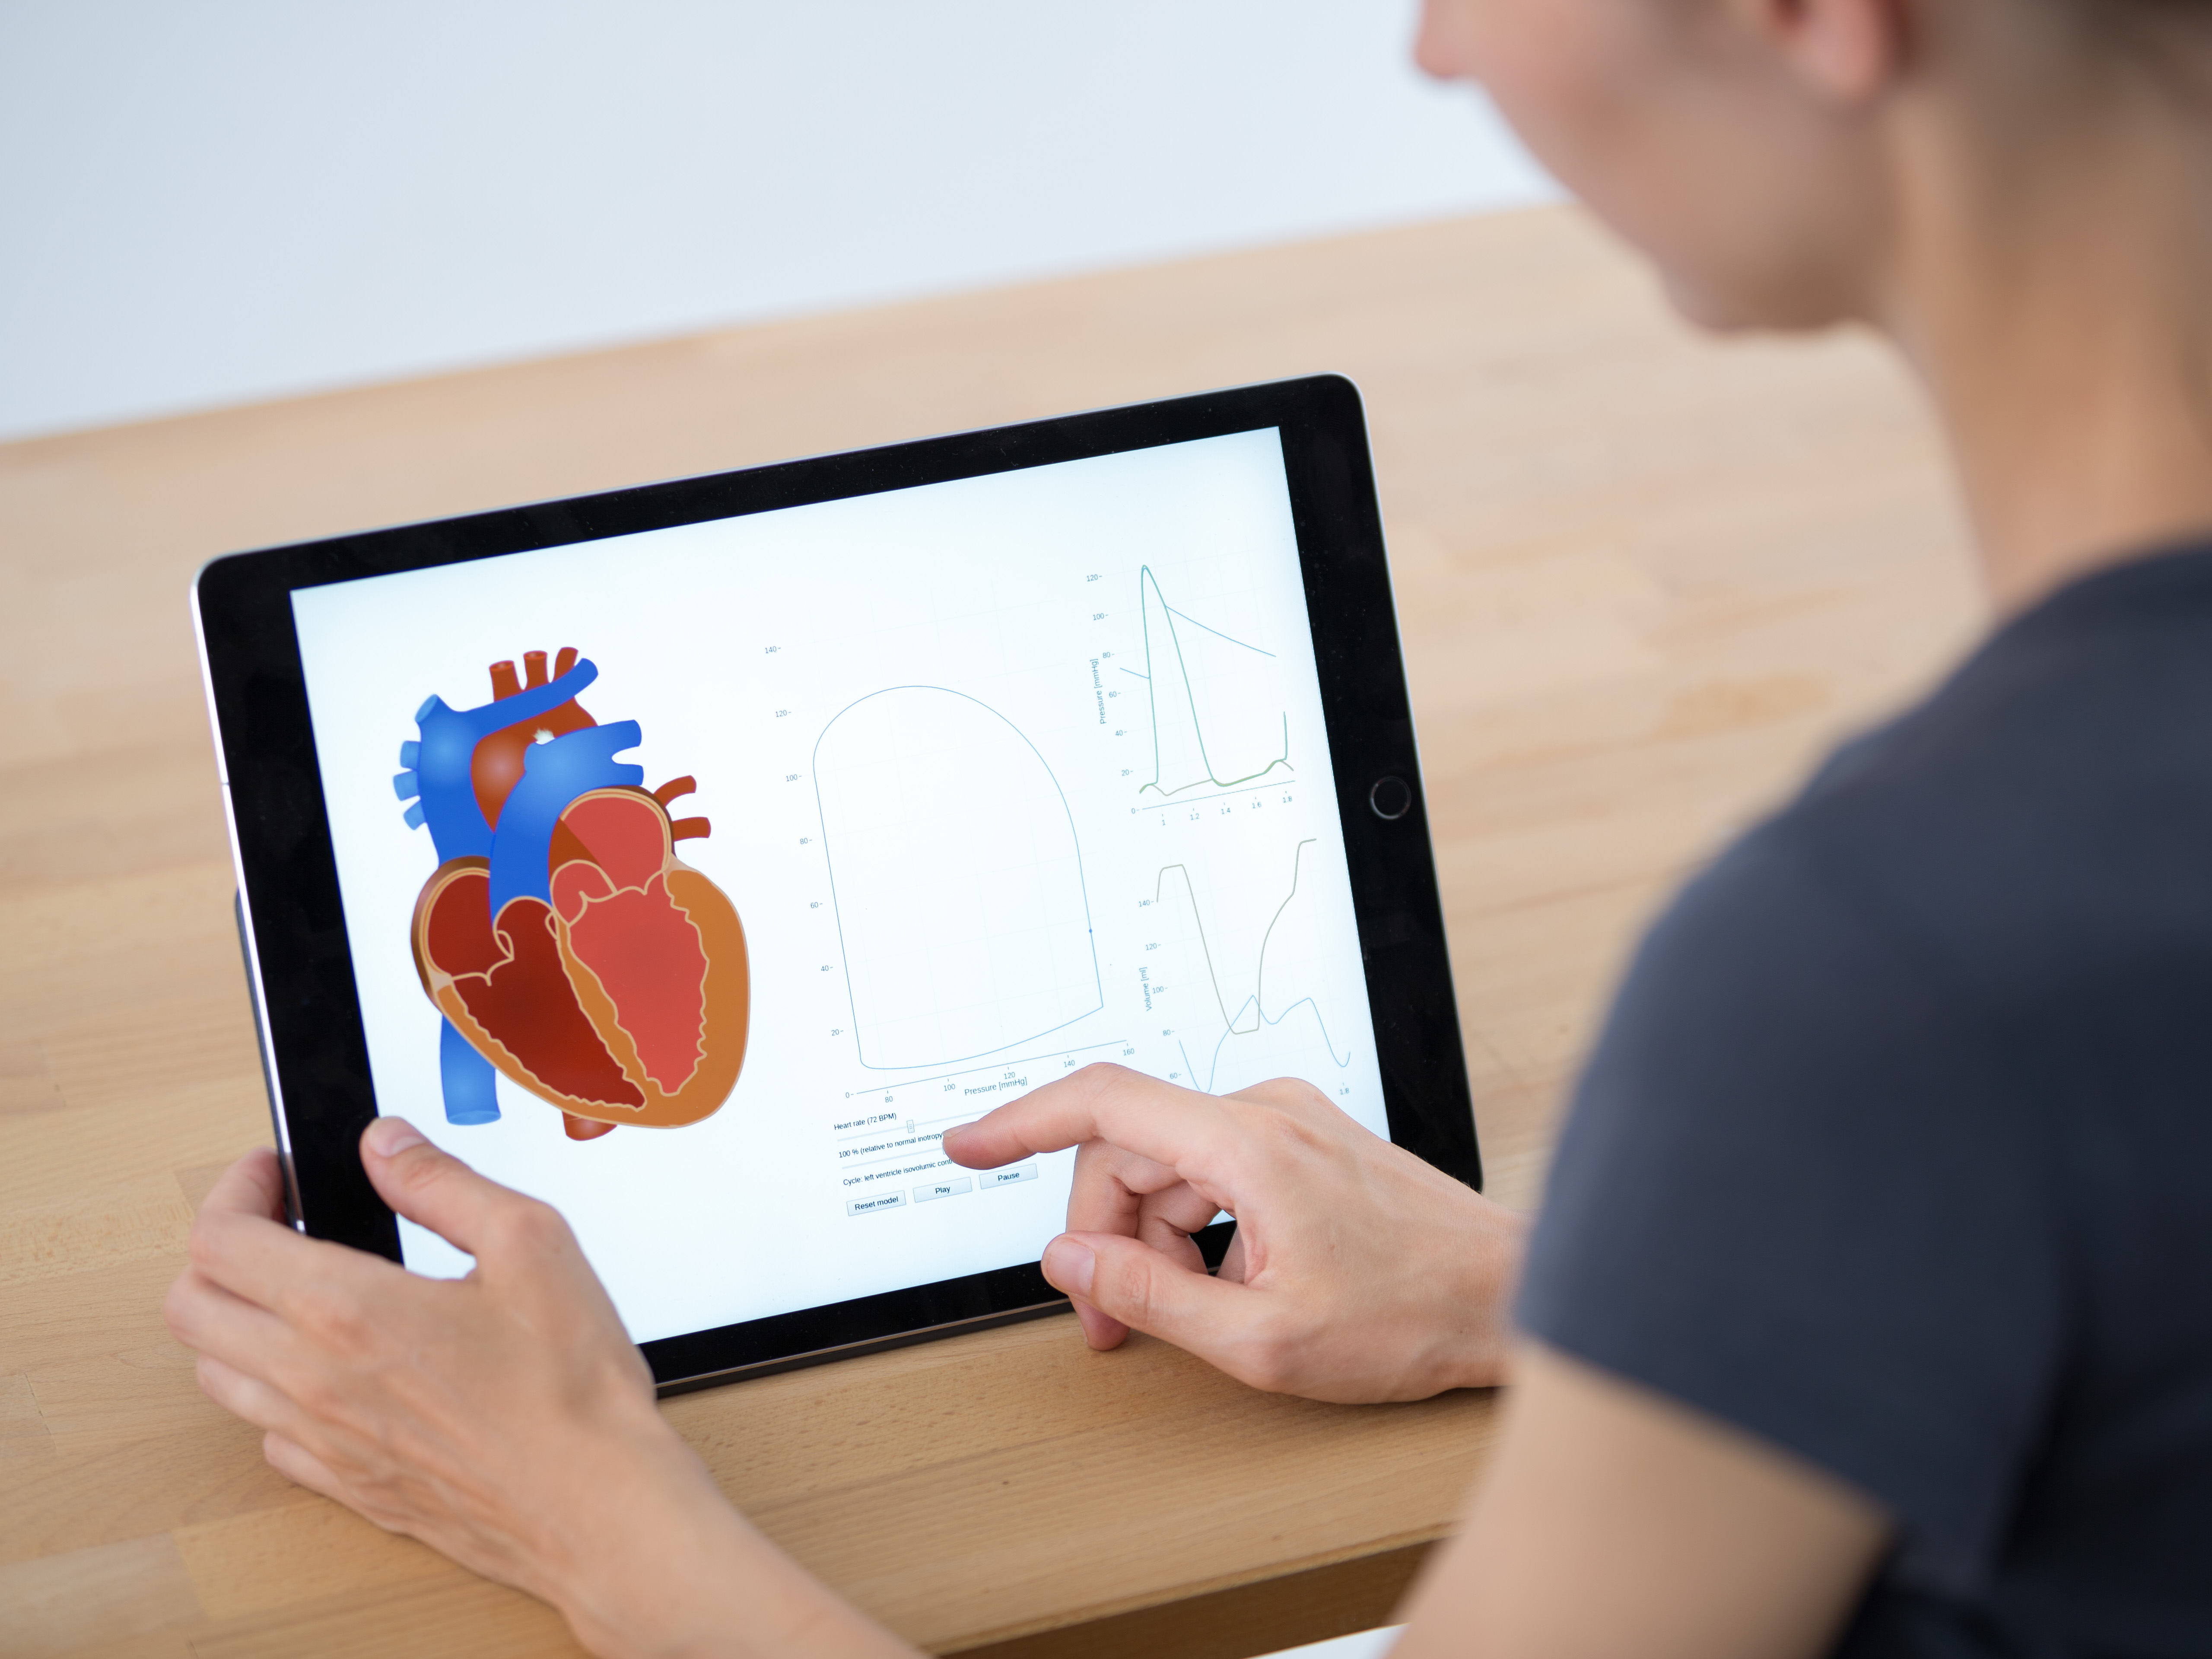

New kind of digital books
INTERNET
Educational simulation games
Digital version of the book + accompanying material
HYPERTEXT
21st century
+
INTERACTIVE MULTIMEDIA
+
SIMULATION
Notes:
However, the development of the Internet fundamentally changes the possibilities of contemporary electronic learning.
In addition to hypertext and multimedia, teaching materials may include simulation models. Simulation games offer new opportunities for explaining the complex interconnected systems of the organism, their behavior in norms, and in various pathologies. The simulation model on the background of the interactive picture allows for a more straightforward explanation of the causal relationships and contributes to a better understanding of the mutual context of the explained processes.
A tablet with an Internet browser no longer has to be just a passive display of printed text in a textbook. Any device with an internet browser is enough to work with an interactive simulation textbook.
Nothing needs to be installed. Today's Internet browsers have the computing capacity of desktop computers in the 1990s. In-browser simulators can use this capacity, with interactive illustrations linked to a background simulation model.

Slide 8
Interactive Simulation
Digital Textbooks
INTERNET
Educational simulation games
HYPERTEXT
+
INTERACTIVE MULTIMEDIA
+
SIMULATION
Notes:
This way, we create a new type of electronic digital textbook executable in a web browser, which we could call interactive simulation textbooks.

Slide 9
Interactive Simulation
Digital Textbooks
INTERNET
Simulation model
HYPERTEXT
+
INTERACTIVE MULTIMEDIA
+
SIMULATION
Graphics
Notes:
Interactive simulation textbooks expand the possibilities of classic digital textbooks. In addition to hypertext, multimedia, and interactive graphics, they contain a hidden simulator in the background. The outputs of the simulation model can be displayed as a graph, and the simulation model can also control interactive graphics. The images can thus appear as a kind of puppet, controlled by a model in the background.

Slide 10
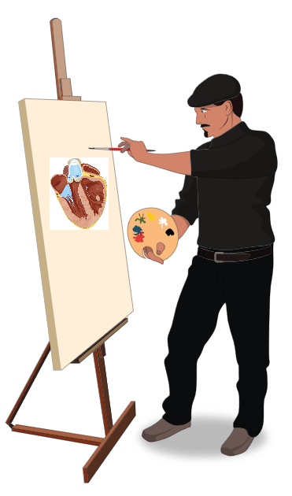

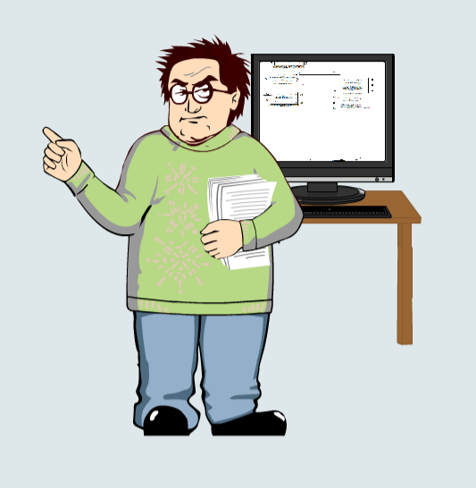

How to create Interactive Simulation Texbooks?
Graphics
MULTIDISCIPLINARY COOPERATION
Simulation model
Study text
ARTIST
EDUCATOR
Mathematical model
Graphics
Software for simulation model
PROGRAMMER
MODELLER
Notes:
Creating interactive simulation books is not easy. It requires multidisciplinary cooperation.
Interactive simulation textbooks combine study text with a simulation model and interactive graphics.
The artist creates interactive pictures, and the Modeler creates simulation models behind the background simulation games. Simulation models can also control animated images. Animated graphics, figuratively speaking, hang on the threads of simulation models like puppets in a puppet theater.
The key is the educator, who formulates the study text and conceptual design of the whole simulation textbook.
An important person is a programmer whose task is to stitch the whole application together.

Slide 11
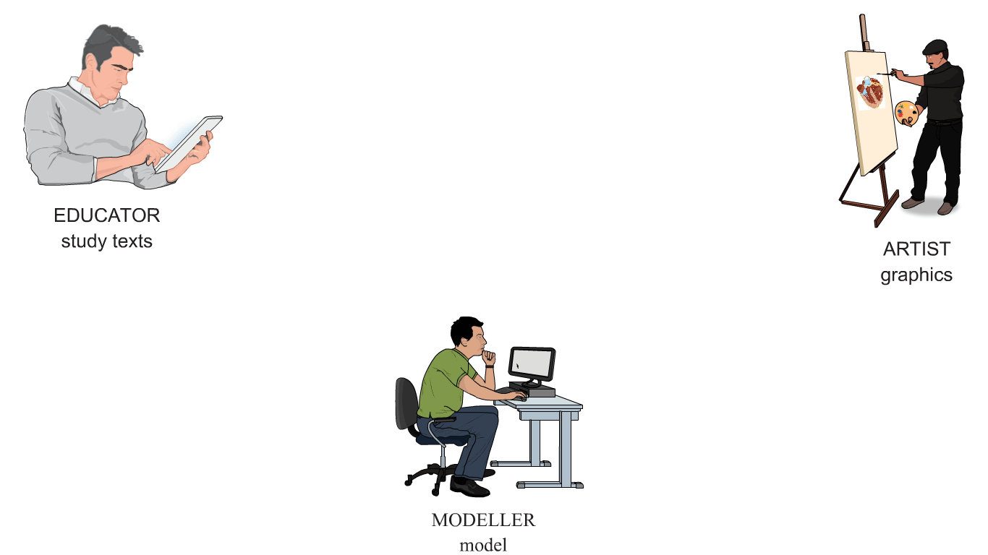
https://bodylight.physiome.cz/
MODELLER
mathematical model
PROGRAMMER
software
Notes:
The fundamental problem is to create a tool that will allow the four professionals to work together and link the results of the four professionals into a single textbook.
This tool is our bodylight.js technology.
This technology is based on new standards and new technologies that have been adopted in recent years.

Slide 12
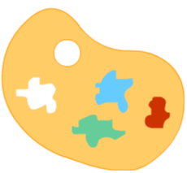


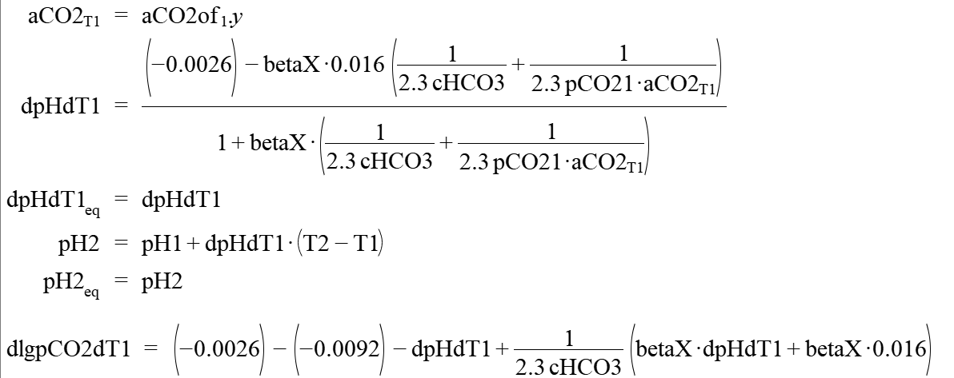
Graphics design
NEW TECHNOLOGY FOR INTERACTIVE GRAPHIC DESIGN
JavaScript+HTML 5
ARTIST
NEW TECHNOLOGY FOR SIMULATION MODEL CREATION
Mathematical model
EQUATION BASED
MODELLING
LANGUAGE
Source code of simulation model in C
MODELLER
Notes:
We use new technology for interactive graphic design.
The artist creates interactive animations using software tools for creating interactive graphics - such as the Adobe Animate tool. The result is an animated image made in JavaScript and HTML 5.
The new technology for creating simulation models significantly facilitates the creation of simulation models.
Modeler creates mathematical models using equation-based modeling language. These languages allow us to describe a model using a set of equations. Finding the algorithm of their solution is the task of the compiler. We use the standardized equation-based language Modelica.
The Modelica development environment is available in an open-source version produced by the Open Source Modelica Consortium and in several commercial implementations - such as Dymola by Dassault Systemes or System Modeler by Wolfram.
The result of the program translation from the Modelica language is the source code of the simulation model in the C programming language.

Slide 13



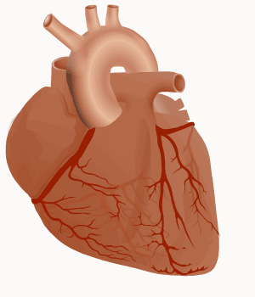

STANDARDS:
INTERNET
BROWSERS
HTML5 (animation canvas)
JavaScript (standard ECMAScript 6)
WebAssembly (speed up)
Web Components (reusability)
STANDARD:
STANDARDS:
STANDARDIZED
MODELLING
LANGUAGE
FMI - Function Mockup Interface standard (interface between computer simulation models)
Source code of simulation model in C
Function Mockup Units
WebAssembly + JavaScript
NEW DESIGN TOOLS
STANDARDS:
INTERACTIVE
ANIMATIONS
HTML 5 (animation canvas)
JavaScript (standard ECMA Script 6)
Web Components (reusability)
Notes:
New standards for web browsers have been agreed upon in recent years.
The HTML 5 standard brought animation canvas for displaying moving images.
JavaScript capabilities have been enhanced using ECMAScript 6.
Another standard is a low-level language for Internet browsers called Web Assembly. Modern browsers have built-in tools that understand the source code of WebAssembly, which leads to a significant acceleration of code execution. Thanks to Web Assembly, browsers can perform extensive numerically complex simulation calculations.
The Web Components standard allows us to create reusable web components as new HTML elements.
Another standard is the Function Mock-up Interface - FMI. FMI standard allows the interconnection of simulation models. The Modelica compiler, according to this standard, generates the source code of the simulation model in the standardized form of so-called Function Mock-up units.
In our technology, the source code of the simulation model compiled into FMU units is transpiled into WebAssembly and JavaScript.
Adobe Animate generates interactive graphics into HTML5 and JavaScript standards. In our technology, we transform interactive graphics into reusable web components.

Slide 14

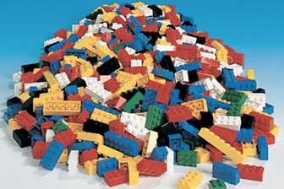
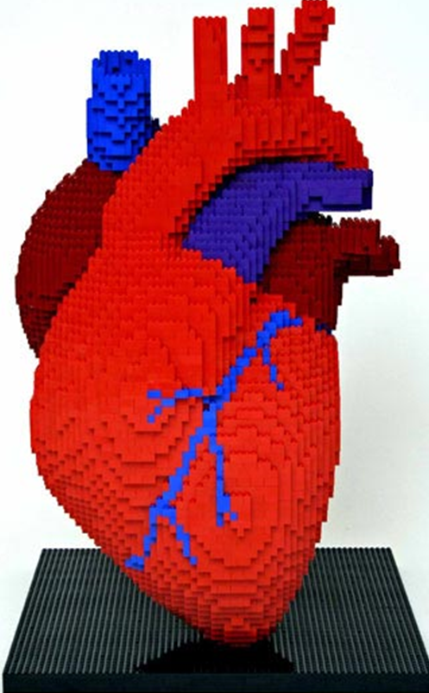
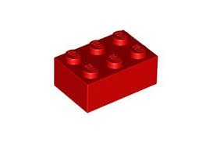
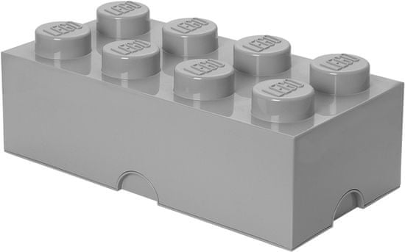
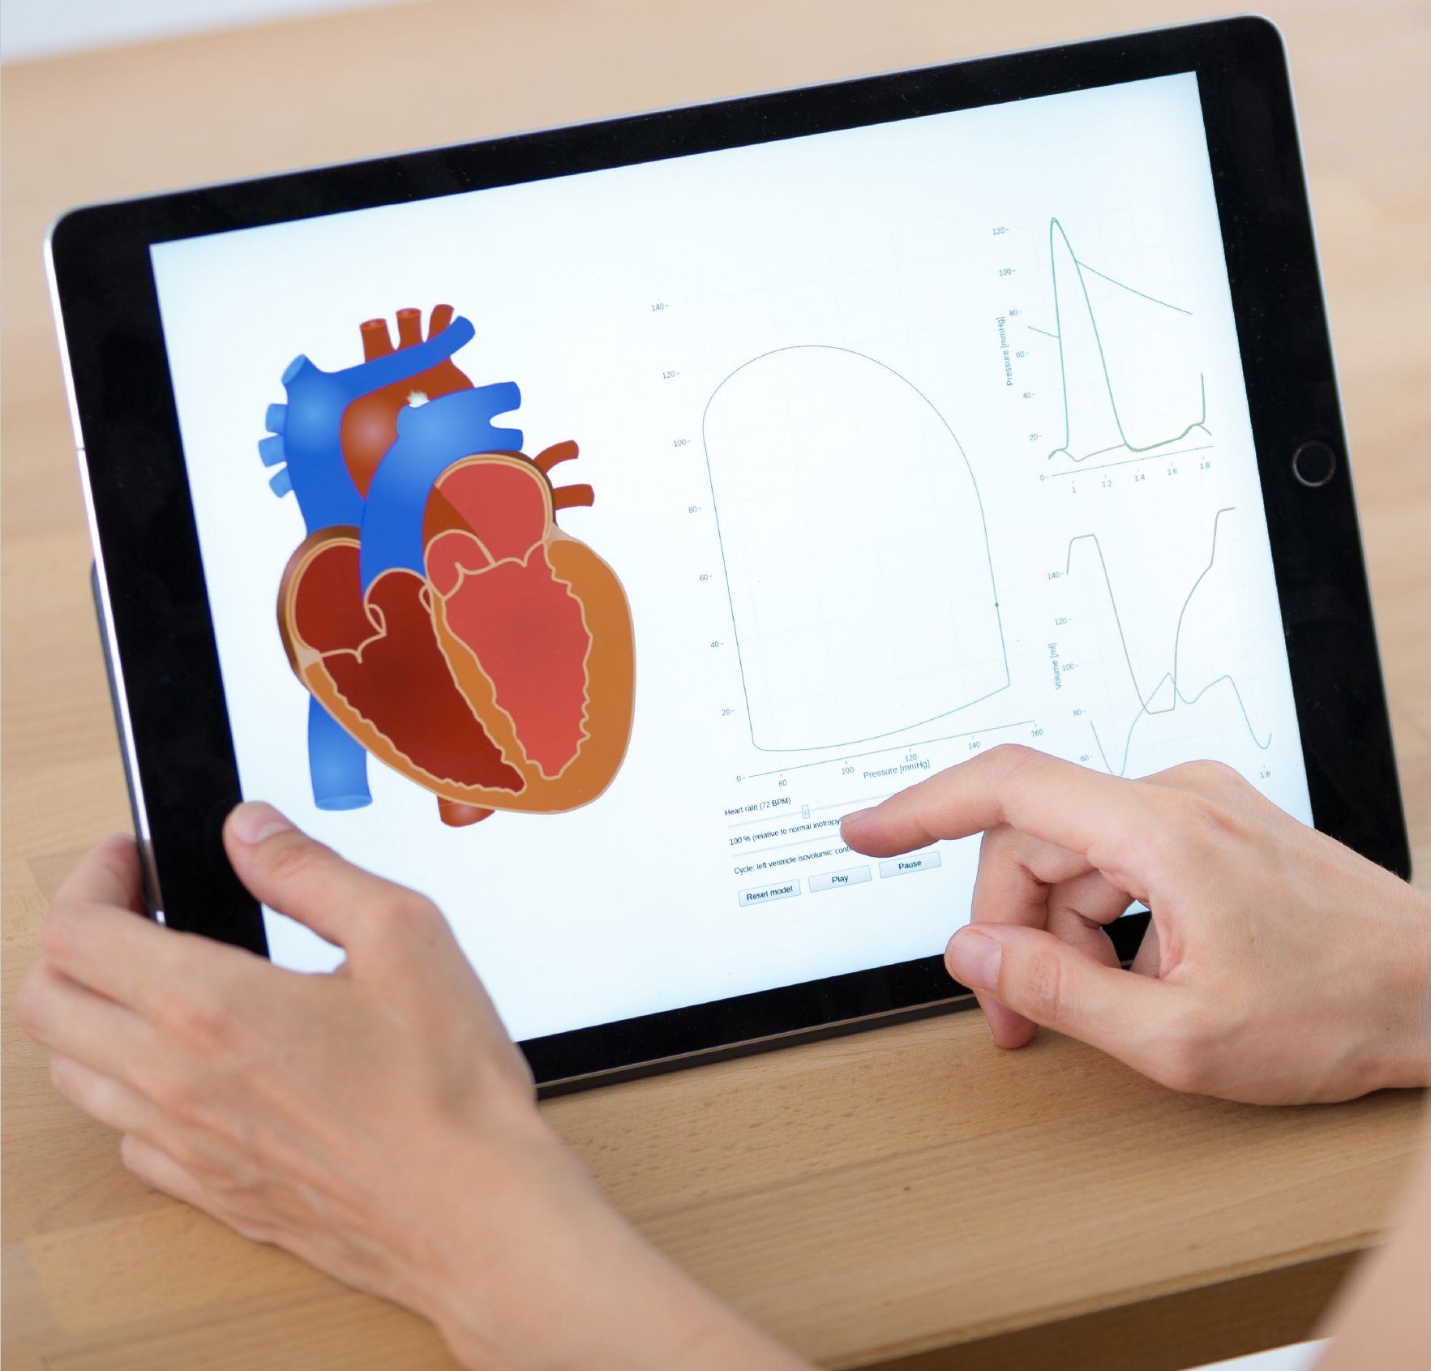
Graphics source code in HTML and JavaScript
CREATION OF INTERACTIVE GRAPHICS
BODYLIGHT
TOOL
The web component of graphics
Artist
CONCEPTUAL APPLICATION DESIGN
Web simulation application:
HTML 5
JavaScript
WebAssembly
BODYLIGHT
TOOL
APPLICATION CREATION
Educator
The web component of the model
CREATION OF APPLICATION SOFTWARE COMPONENTS
BODYLIGHT WebComponents library
Programmer
BODYLIGHT
TOOL
Model source code in C language
Model source code in WebAssembly and JavaScript
BODYLIGHT
TOOL
MODEL
Modeller
Notes:
The educator creates a conceptual application design.
The graphic artist creates interactive images and uses tools such as Adobe Animate to compile them into Javascript and HTML. Then we use our bodylight tools to create a standard web component.
The modeler creates a mathematical model in the Modelica language. The Modelica compiler generates C source code according to the FMI standard (as function muck-up units). Using our body-light tools, we recompile the model's source code into Web Assembly and JavaScript and then into the model's web component.
The programmer creates a library of interconnective web components and tools for developing applications.
We create learning applications from a library of web components as from Lego cubes.
The output is a generated web simulation application in HTML, JavaScript, and Web Assembly. We can run the developed application in any internet browser on any device.

Slide 15
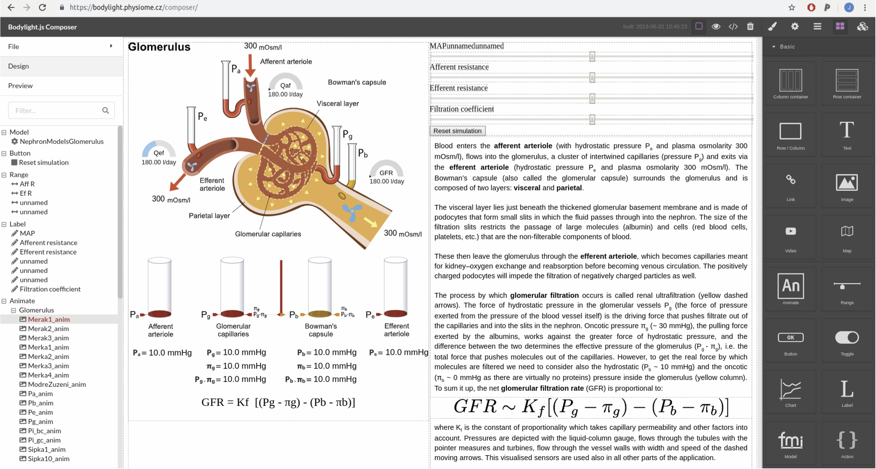
INTERACTIVE DESIGN TOOL
Artist
Educator
Programmer
BODYLIGHT
COMPOSER
Modeller
Notes:
Our interactive design tool supports the collaboration of educators, modelers, artists, and programmers in creating web-based learning simulators

Slide 16
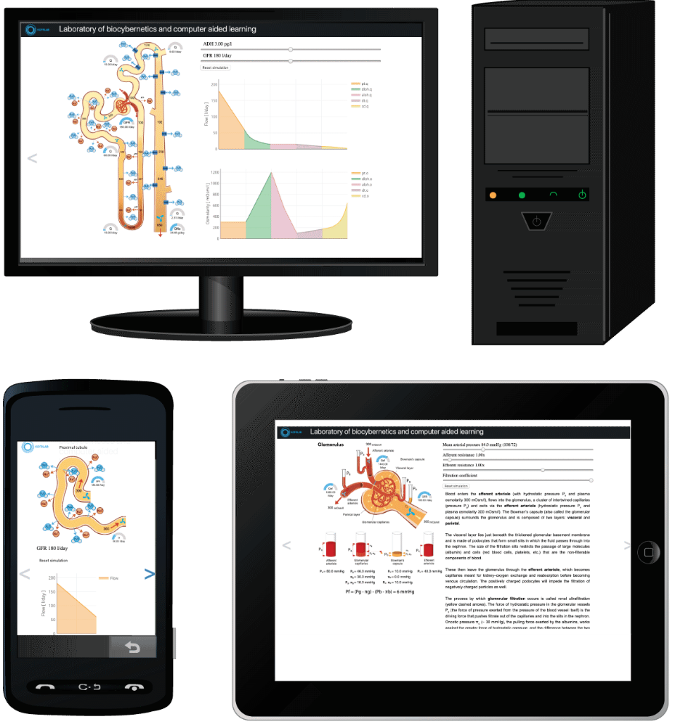
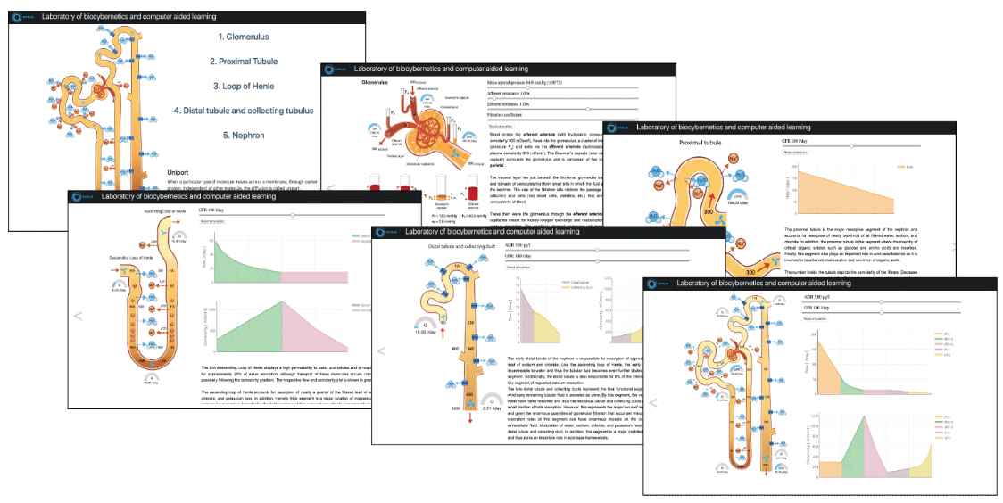

RESULTS
Notes:
The result is simulation tutorials that can be run in a web browser on any device - on a computer with different operating systems, on a tablet, or on a smartphone.

Slide 17
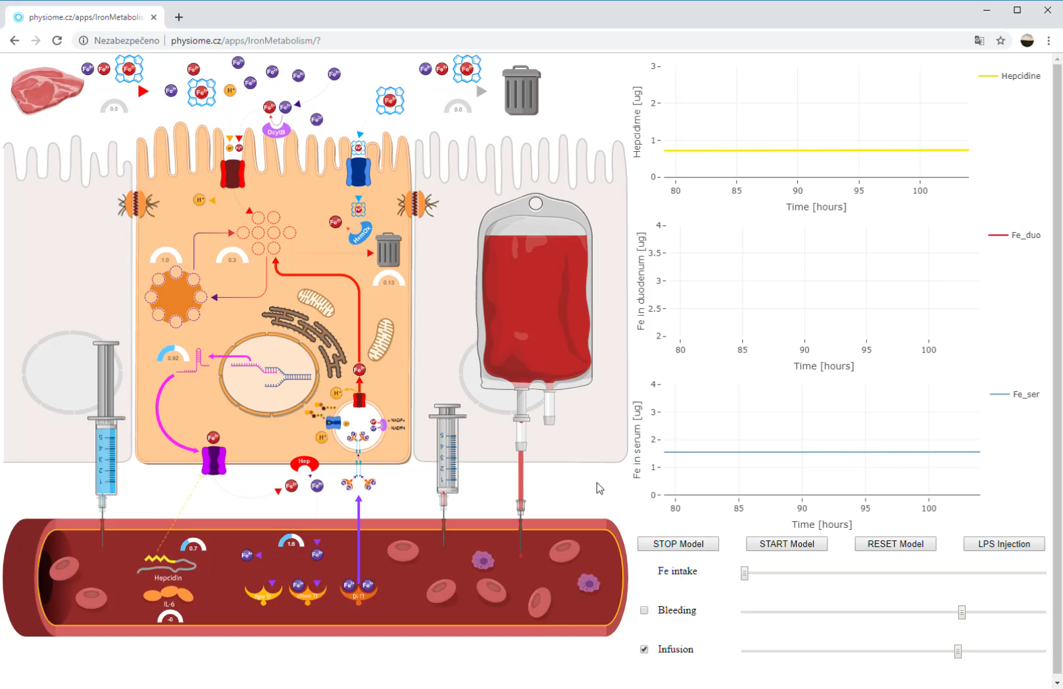
http://physiome.cz/apps/IronMetabolism/
Notes:
Finally, here are a few examples.
This is an example from a tutorial dedicated to iron metabolism. The animated image, controlled by a background model, represents a duodenum cell. The interactive model allows you to observe what happens during various iron intakes in the diet, bleeding or after a blood transfusion, or infection.

Slide 18
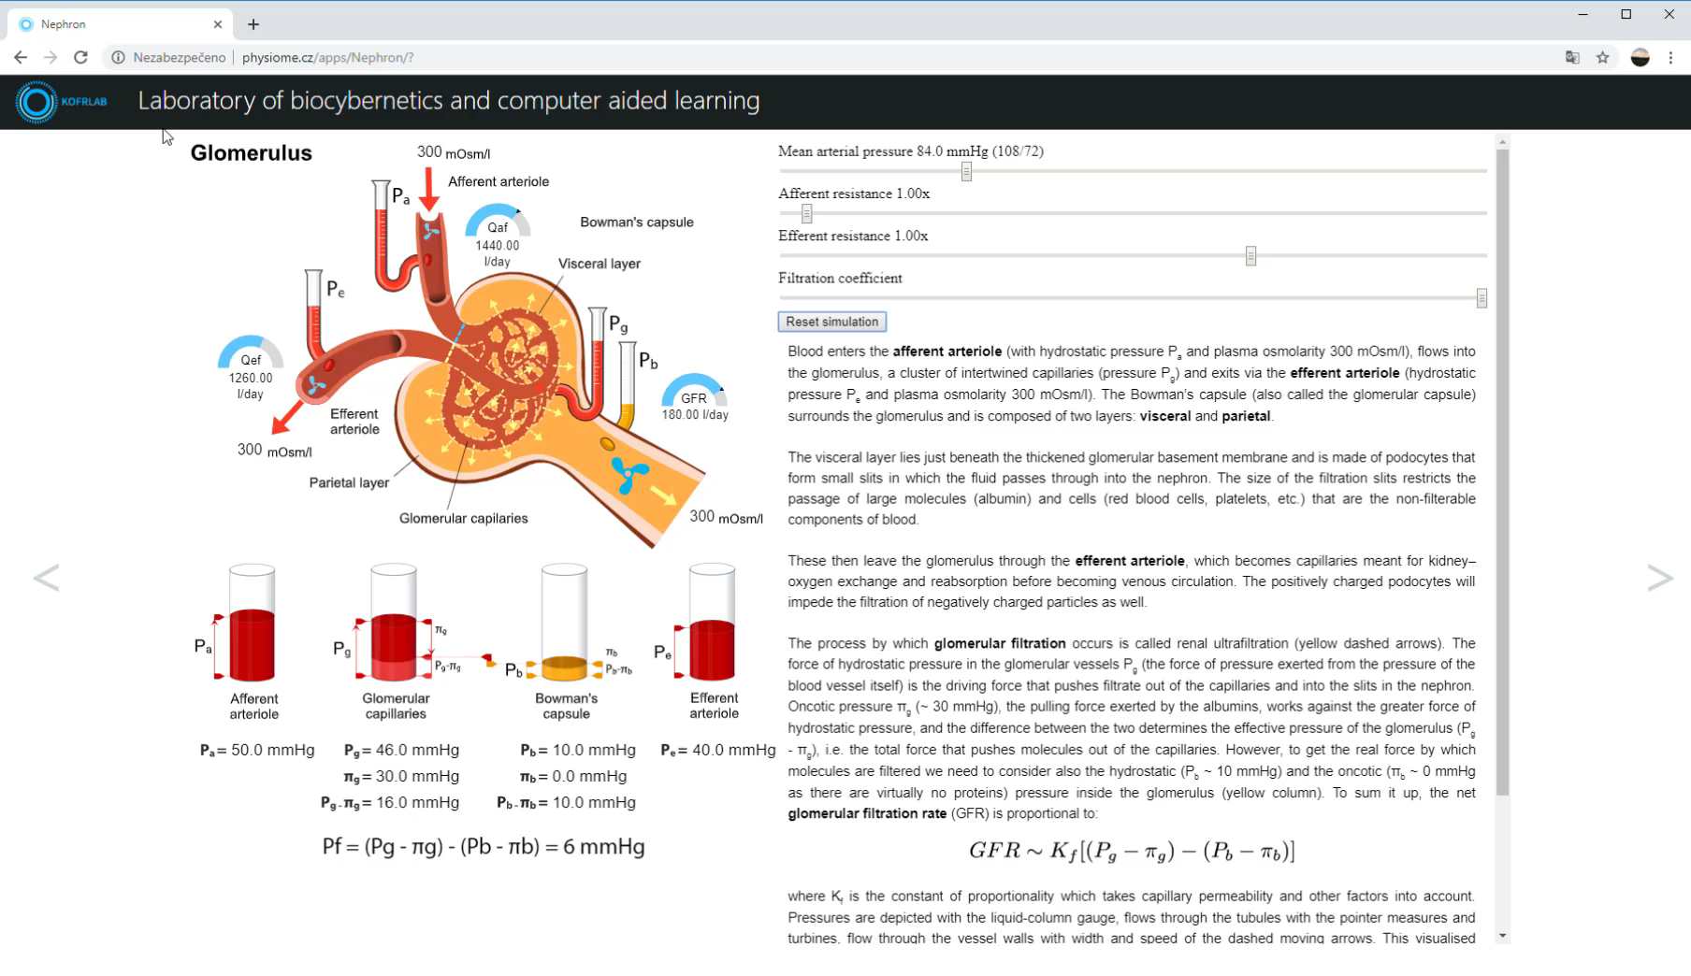
http://www.physiome.cz/apps/Nephron/
Notes:
Another example is a sample educational application explaining the function of the nephron.
An interactive model-driven picture of the glomerulus leads to a better understanding of the context in the accompanying text.
This picture shows how changes in arterial pressure, resistance in afferent and efferent arterioles, or changes in the filtration coefficient affect glomerular function.

Slide 19
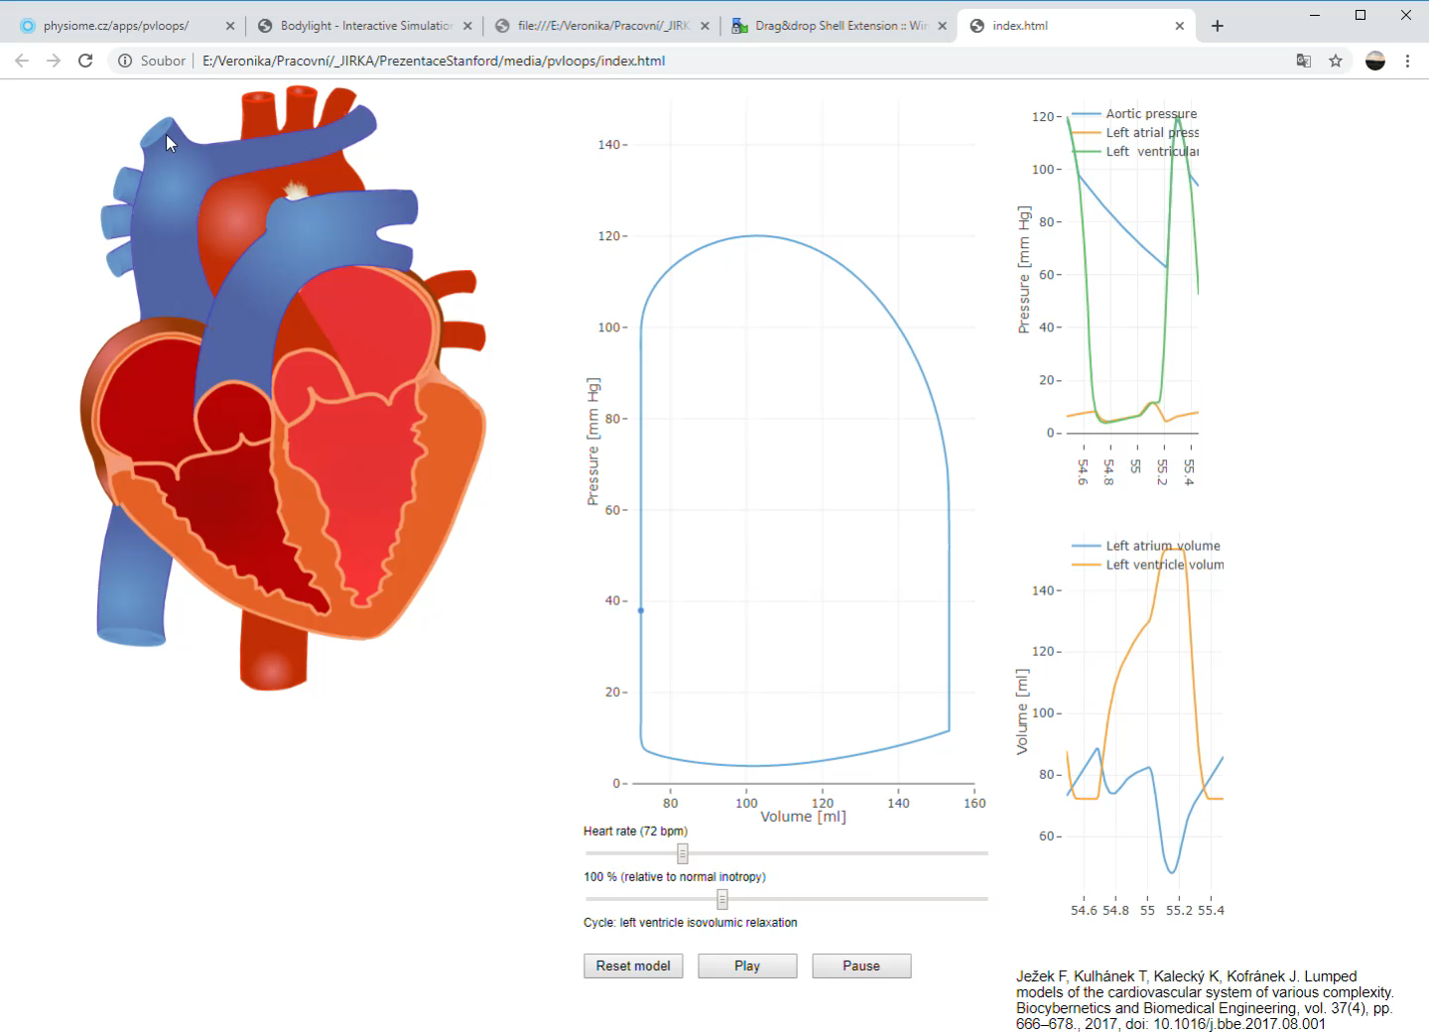
https://physiome.cz/apps/pvloops/
Notes:
The last example is an example from the hemodynamics tutorial. We can observe how to change left heart pressures and volumes and the PV diagram of the left ventricle with changes in frequency or inotropy.

Slide 20

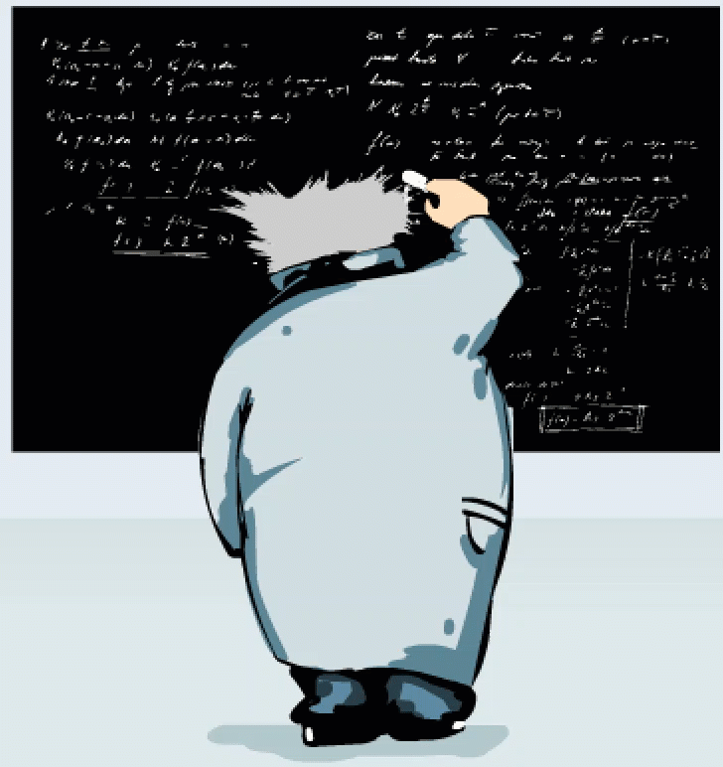
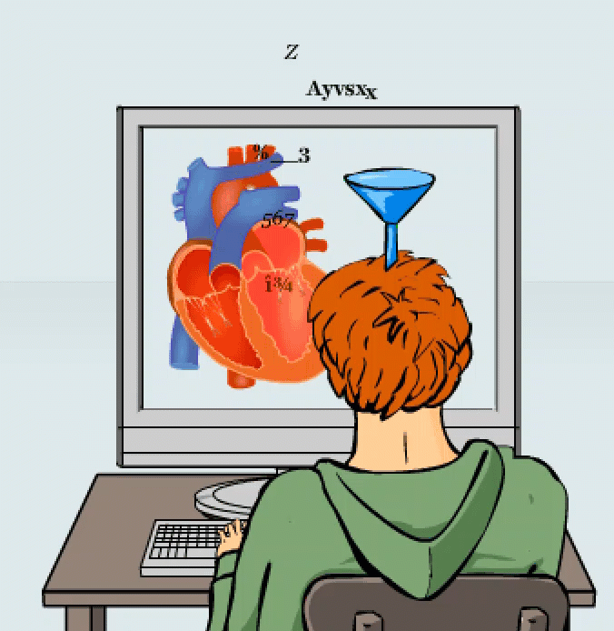
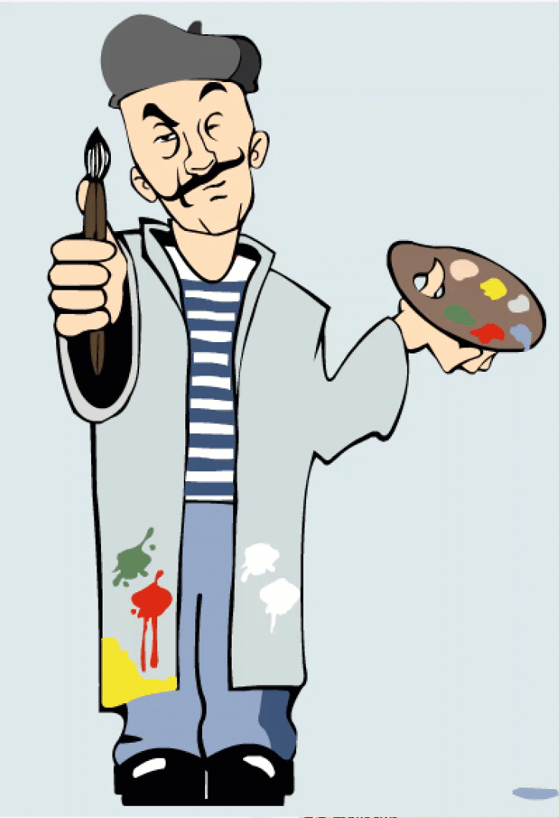
Key - Creative Connections of Professionals
MODELLER
Mathematical model creator
PROGRAMMER
Software designer
STUDENTS
User feedback
EDUCATOR
Creator of learning scenarios
ARTIST
Interactive graphics designer
Notes:
A critical prerequisite for developing educational simulators is a creative connection between professionals - an educator, an artist, a creator of mathematical models, and a programmer. But at the center of everything is the student, and student feedback is essential; therefore, students become full members of a multidisciplinary development team.

Slide 21
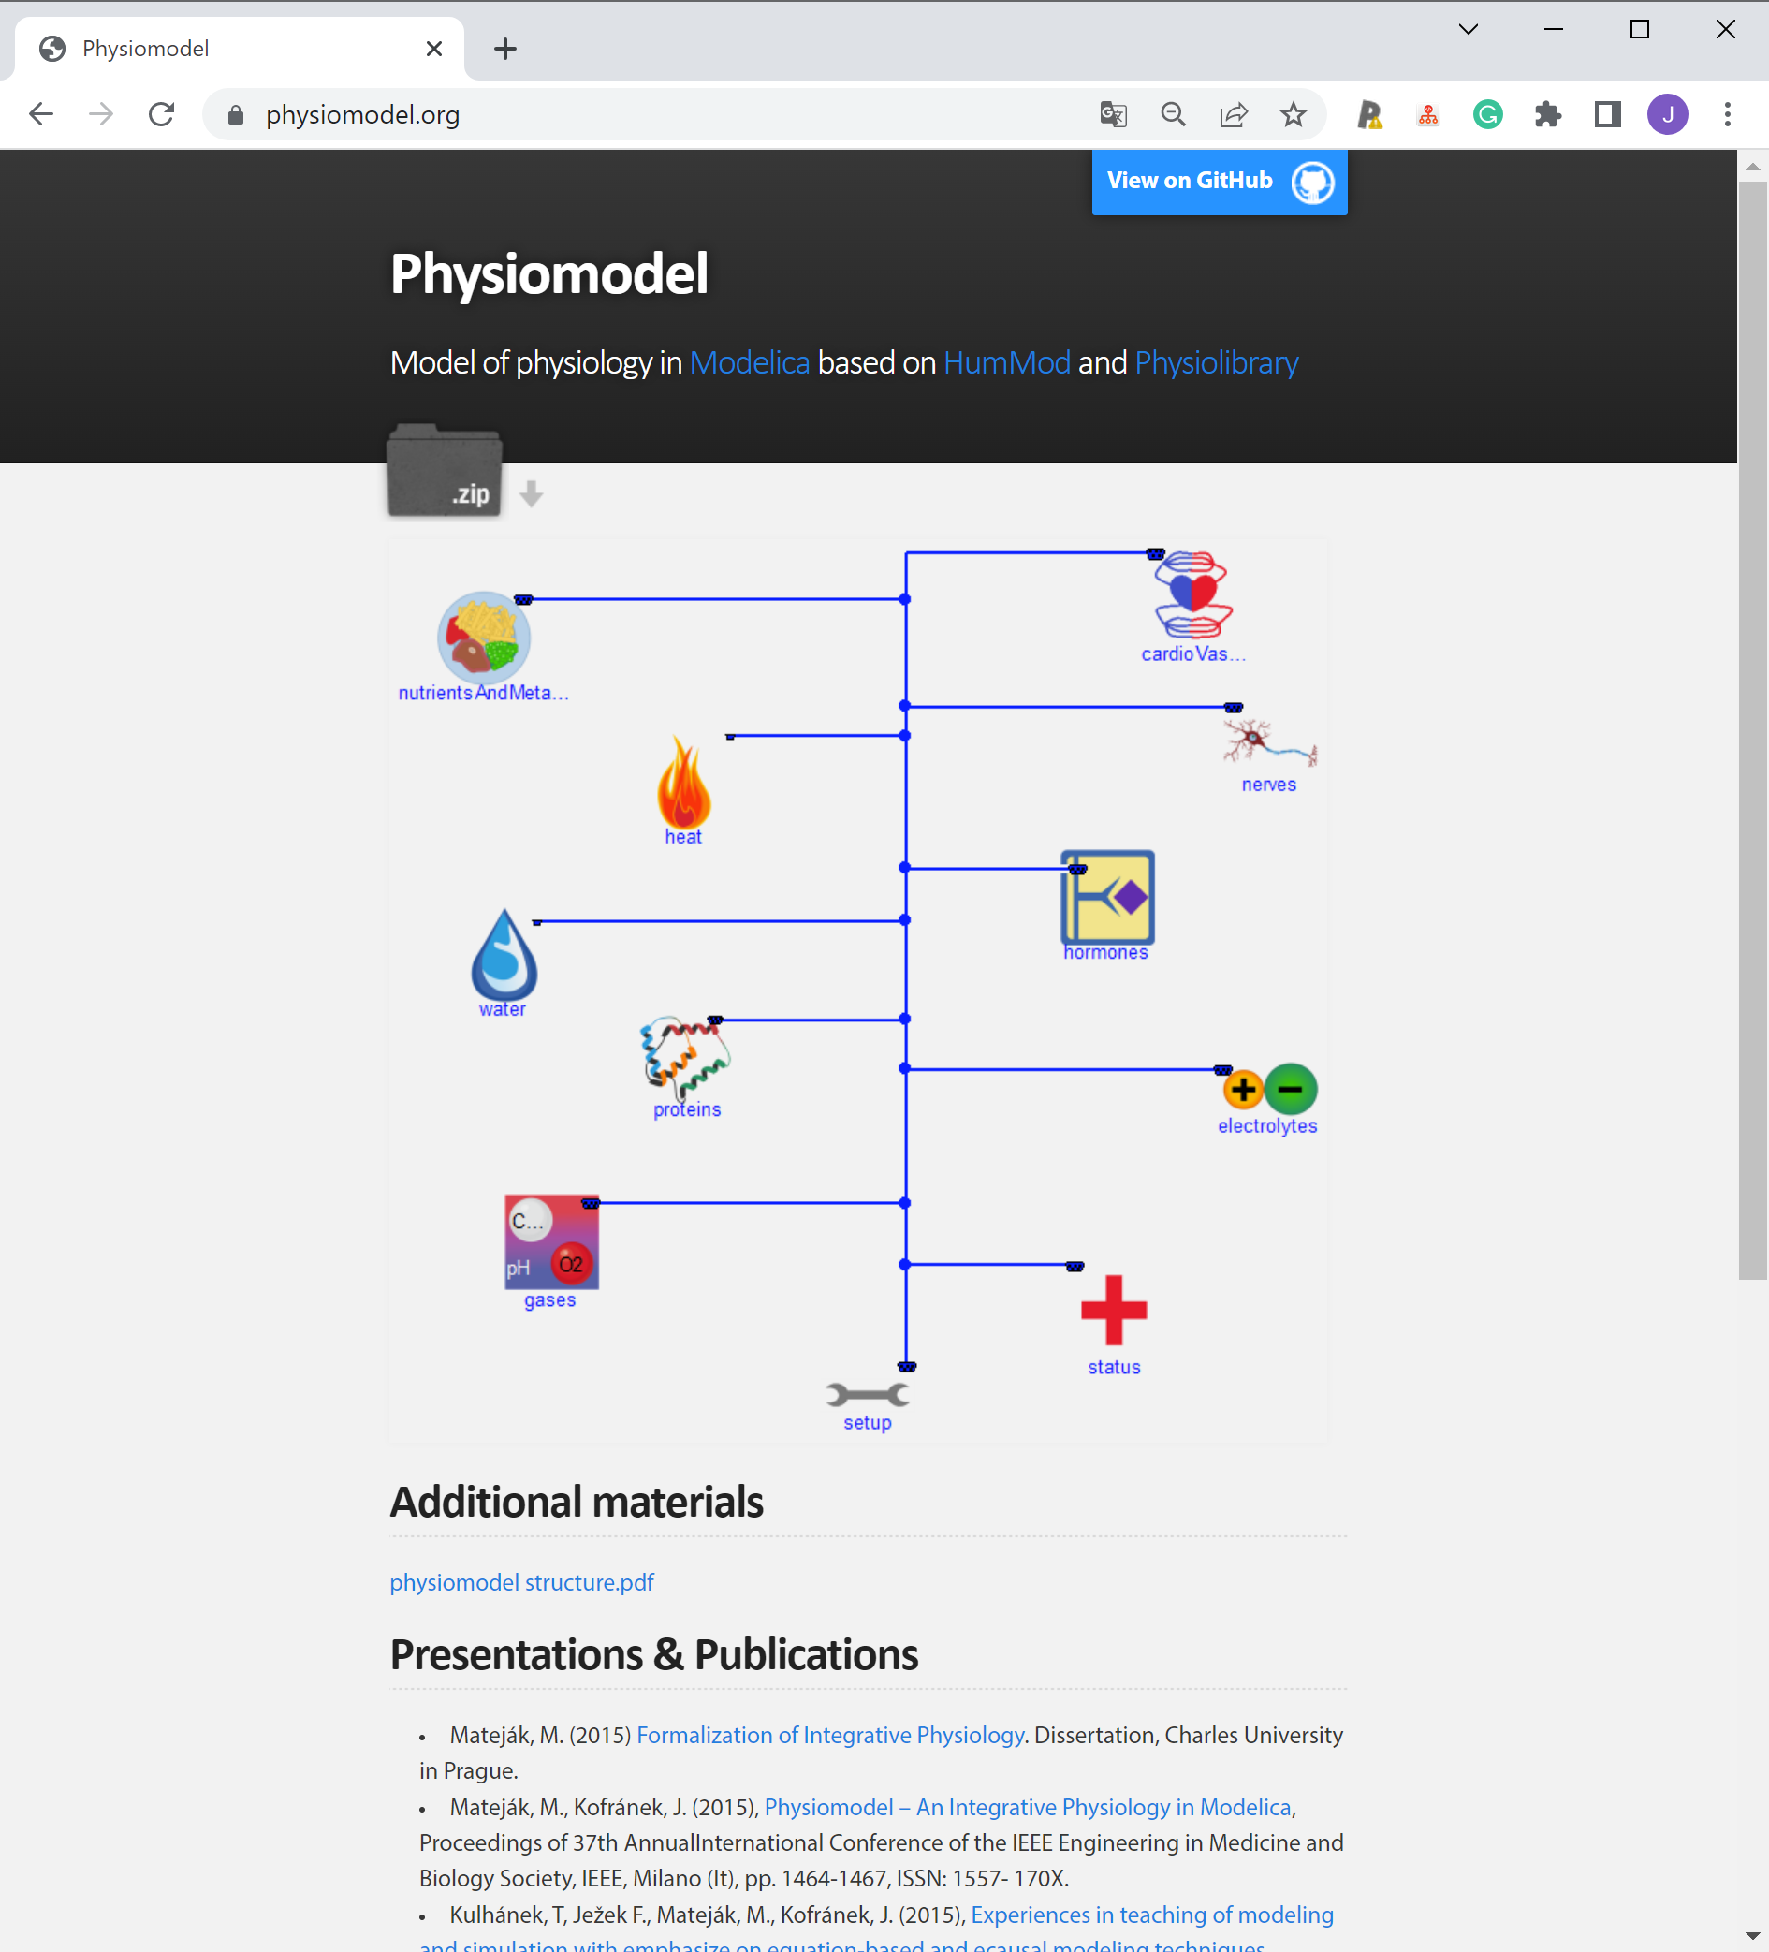
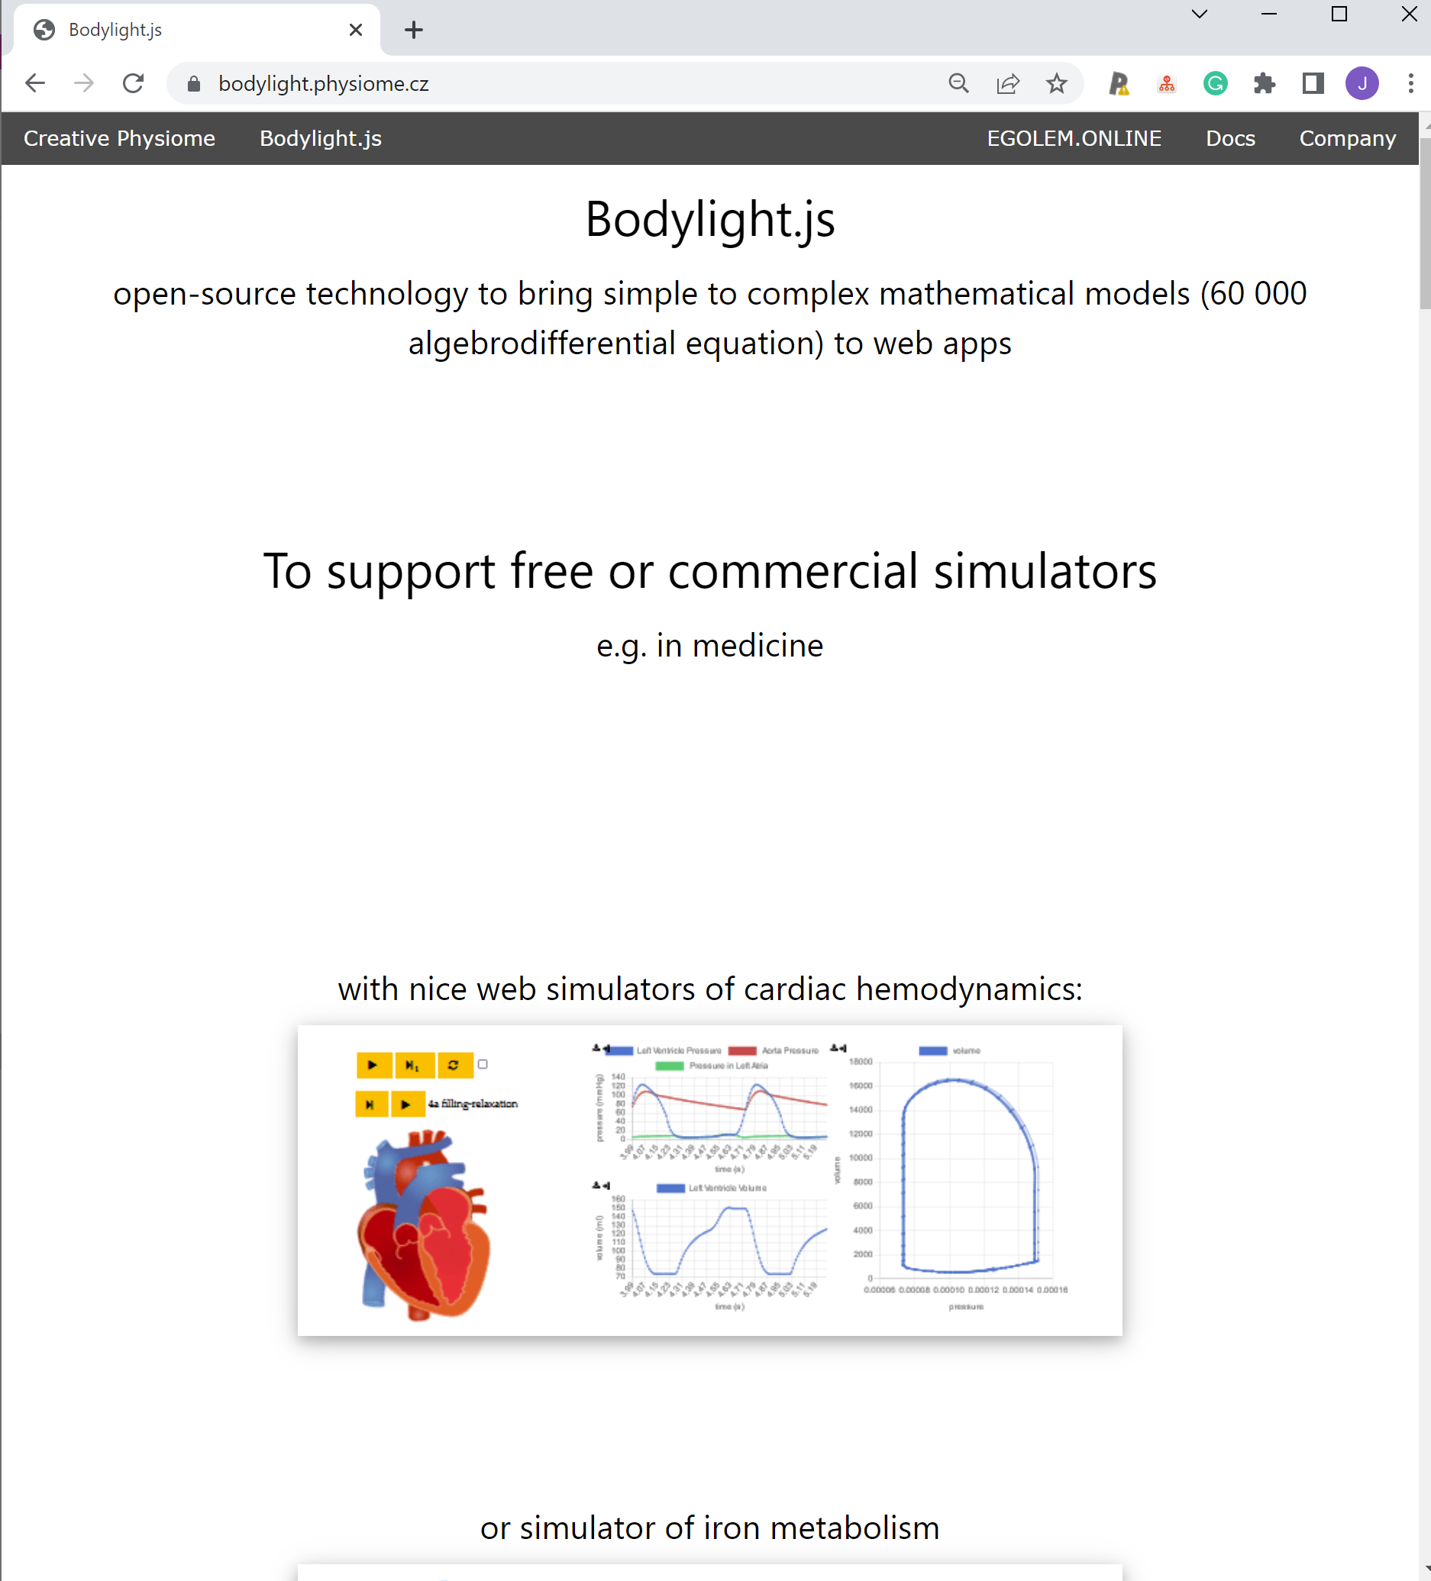
eGolem project based on:
https://bodylight.physiome.cz/
Shareable scientific results:
mathematical models of physiology
e.g. see: https://www.physiomodel.org/
Our open-source Bodylight technology for designing web simulation textbooks.
Notes:
The E-Golem project is based on shareable scientific results - mathematical models of physiology. We have been engaged in the mathematical modeling of physiological systems at our department for decades. The second pillar is our new open-source bodylight technology for creating web simulators.

Slide 22
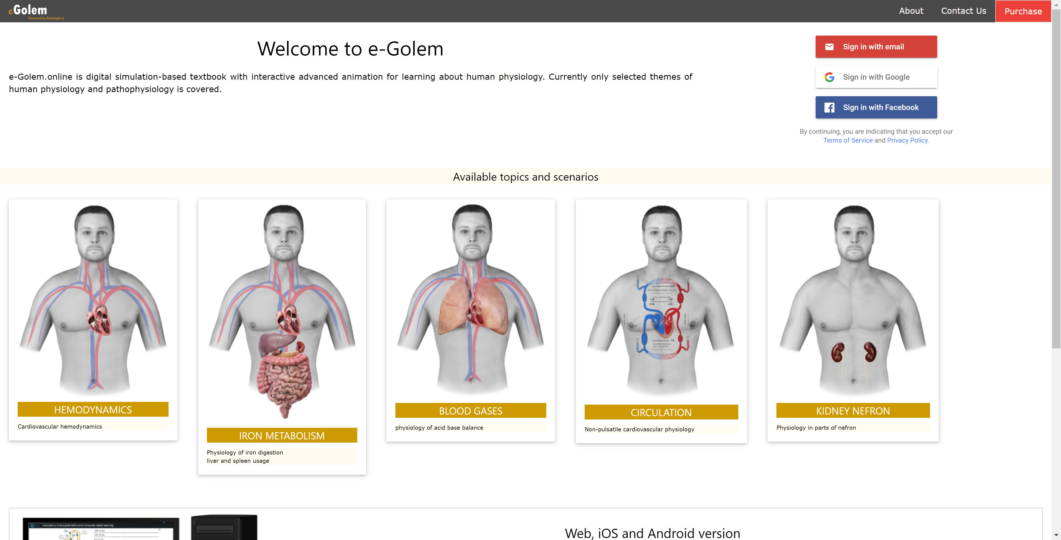
https://egolem.online/
The created web simulators are copyrighted work and have significant commercial potential.
Web-based simulators materialize interdisciplinary cooperation and the results of scientific research - the creation of mathematical models - into a commercially salable product.
Notes:
The created web simulators are copyrighted work and have significant commercial potential. They make it possible to materialize interdisciplinary cooperation and the results of scientific research - the creation of mathematical models of physiological systems - into a commercially salable product

Slide 23
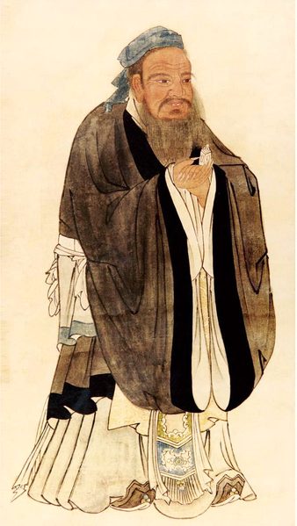
Schola Ludus for 21th century
„I hear and I forget. I see and I remember. I do and I understand.“ (Confucius)
5th century BC
17th century
Simulation model
Graphics
Schola ludus (School by playl
John Amos Comenius
Notes:
Interactive simulation textbooks are a modern realization of old Confucian wisdom and a implementation of Comenius‘ effort for playfully teaching.
Interactive simulation textbooks are real Schola Ludus for the 21st century.

Slide 24

We are looking for collaboration
to develop Bodylight technology
to exploit and create Interactive simulation textbooks in eGolem project
First Fakulty of Medicine, Charles University
Contact: Jiri Kofranek, email: kofranek@gmail.com
Notes:
We are looking for a collaboration to develop Bodylight technology.
We are looking for a collaboration to exploit and create interactive simulation textbooks in eGolem project.
Thank you for your attention,

